Slide 1
You Want to Ask Me What Question??
Collection of Social Determinants of Health in the Healthcare Setting
Megan Morris, PhD, MPH
Director of Qualitative and Mixed Methods Core, ACCORDS
Founder and Director of LEADERs
March 4th, 2020
Notes:
Question: How many have, currently or will be involved in a study that will collect SDOH?

Slide 2
Lecture Topics Today
Definitions of Social Determinants of Health (SDOH) and other demographic characteristics
Why collect the data
Patient attitudes towards data collection
Current status of data collection
Recommendations and lessons learned from data collection
Notes:
How this talk will be useful for clinicians and researchers

Slide 3
Lecture Topics
Will not discuss:
  Which questions to use
  How to use the information to inform interventions
*These topics will be discussed in future sessions!*

Slide 4
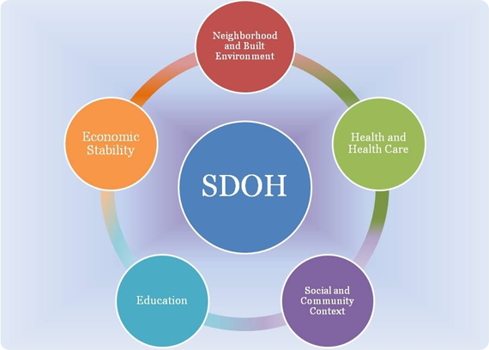
Social Determinants of Health
Healthy People 2020
Notes:
Healthy People 2020
the economic and social conditions that influence health

Slide 5
Social Determinants of Health
Economic Stability
  Employment
  Food Insecurity
  Housing Instability
  Poverty
Education
  Early Childhood Education and Development
  Enrollment in Higher Education
  High School Graduation
  Language and Literacy
Social and Community Context
  Civic Participation
  Discrimination
  Incarceration
  Social Cohesion
Health and Health Care
  Access to Health Care
  Access to Primary Care
  Health Literacy
Neighborhood and Built Environment
  Access to Foods that Support Healthy Eating Patterns
  Crime and Violence
  Environmental Conditions
  Quality of Housing
Notes:
Again, we won’t be going into the questions for each of these. There are other models out there that have other areas and other definitions.

Slide 6
Other Demographic Characteristics
Race, ethnicity, and primary language (REaL)
Sexual Orientation and Gender Identity (SOGI)
Disability status
Notes:
Sometimes people consider some of these as SDOH

Slide 7
Structural Inequality
By only focusing on SDOH, we are ignoring the role of racism, sexism, homophobia, transphobia, and ablism in SDOH
Important to not downplay or overlook the role of intersectionality
Important to realize how structural inequality can effects how patients will respond to SDOH and demographic questions
Notes:
https://www.ncbi.nlm.nih.gov/pmc/articles/PMC5588700/
Example: Cannot over look the role of redlining in forcing racial and ethnic minorities into certain neighborhoods
Embedded in our history and our institutions
Issues of discrimination and bias will be prominent throughout the rest of the presentation.

Slide 8
Why Collect SDOH in Healthcare Setting
Identify patients and families who could benefit from connection to community support services and other interventions
Track health and healthcare outcomes
Understand how SDOH can impact patients’ health and healthcare outcomes

Slide 9
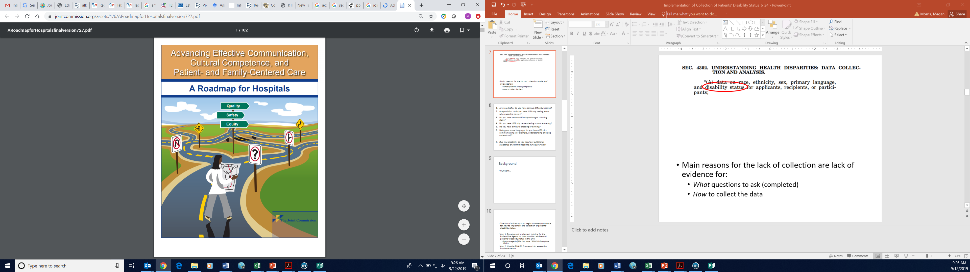


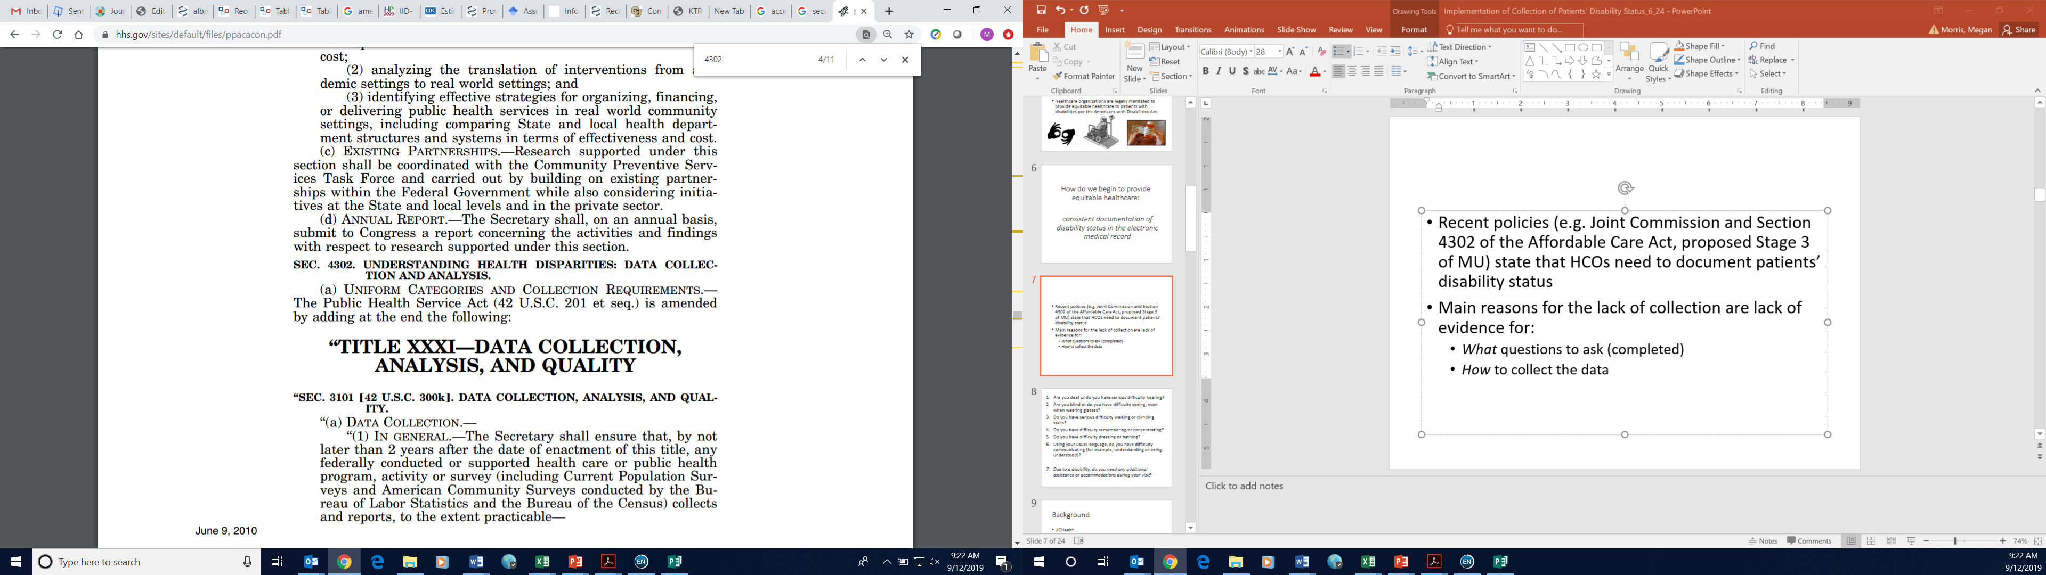
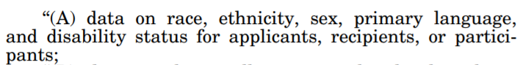
Calls for Collection
Notes:
Medicare Access and Children’s Health Information Program Reauthorization Act of 2015, the 2016 Centers for Medicare and Medicaid Services’ Quality Strategy
Institute of Medicine. Race, ethnicity, and language data: standardization for health care quality improvement. Washington, DC: National Academies Press, 2009.

Slide 10
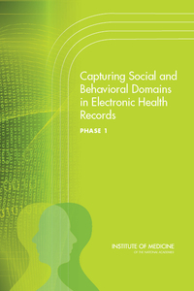
Recording SDOH in Electronic Health Records (EHR)
HITECH Act: Stage 2 and 3 of Meaningful Use
  Use EHRs that allow for collection of race, ethnicity, language and SOGI
CMS Listening Session
  December 2018
  Prioritize data elements
Notes:
We can’t talk about collecting SDOH and not talk about HER
Office of the National Coordinator for Health Information Technology

Slide 11
Patient Attitudes Towards Data Collection
Notes:
https://www.ncbi.nlm.nih.gov/pmc/articles/PMC6351414/

Slide 12
Patient Attitudes Towards Data Collection: REaL
Systematic review of 18 studies (2019)
  Majority of patients believe that it should be collected
  Concerns with who had access and where was it stored
Example:
  2007 Telephone study in California, (only 105 were white, non-Hispanic)
    88% agreed with healthcare providers collecting R/E
    17% were uncomfortable with reporting own R/E
    36% of Hispanics were uncomfortable reporting English proficiency
Petkovic J, Potential harms associated with routine collection of patient sociodemographic information (2019)
Baker DW, et al. Attitudes toward health care providers, collecting information about patients' race, ethnicity, and language (2007)
Notes:
https://www.ncbi.nlm.nih.gov/pmc/articles/PMC6351414/

Slide 13
Patient Attitudes Towards Collection: SOGI
Multiple studies have explored collection of SOGI in outpatient and emergency room settings (2014 – 2018)
  76-78% of patients who do and do not identify as LGBTQ are fine with SOGI data collection by HCOs and sharing with their provider
  90% of patients would share SO with provider
    Providers overestimate patient refusal (77%)
Haider, et al. Emergency Department Query for Patient-Centered Approaches to Sexual Orientation and Gender Identity : The EQUALITY Study. (2017)
Cahill, et al. Do ask, do tell: high levels of acceptability by patients of routine collection of sexual orientation and gender identity data in four diverse American community health centers. (2014)
Rullo, et al. Patient Acceptance of Sexual Orientation and Gender Identity Questions on Intake Forms in Outpatient Clinics: A Pragmatic Randomized Multisite Trial (2018)
Notes:
https://www.ncbi.nlm.nih.gov/pmc/articles/PMC6153164/
https://www.ncbi.nlm.nih.gov/pubmed/25198577
https://www.ncbi.nlm.nih.gov/pubmed/30646332

Slide 14
Patient Attitudes: SDOH
Growing number of studies documenting patients attitudes towards collection of SDOH
Recent survey (n=969)
  79% of participants believed that screening was appropriate
  65% reported comfort with social risks in EHR
DeMarchis E. et al. Part I: A Quantitative Study of Social Risk Screening Acceptability in Patients and Caregivers. (2019)
Notes:
https://www.ncbi.nlm.nih.gov/pubmed/31753277
https://www.ncbi.nlm.nih.gov/pubmed/31753278

Slide 15
Patient Attitudes: Disability
Patient Survey (n=303)
  Majority:
    Thought that it is important for healthcare organizations (HCOs) to collect information about disabilities (88%)
    Comfortable with HCOs collecting disability status (77%)
  Despite this:
    23% had concerns with front desk staff collecting disability status information
    13% had concerns about information being used to discriminate
Morris MA. et al. Collection of patients’ disability status by healthcare organizations: Patients’ perceptions and attitudes. (2017)

Slide 16
How well are we doing?
Hasnain-Wynia R, et al. Who, When and How: The Current State of Race, Ethnicity, and Primary Language Data Collection in Hospitals (2004)
Notes:
https://www.ncbi.nlm.nih.gov/pmc/articles/PMC1797091/#b14

Slide 17
How well are we doing? REaL
2004 Commonwealth Fund Report
  56% of hospitals in study reported R/E
  Half of these obtained R/E by staff observation
UCHealth
  Fall 2019 – 78% Completion in primary care patients
Hasnain-Wynia R, et al. Who, When and How: The Current State of Race, Ethnicity, and Primary Language Data Collection in Hospitals (2004)
Notes:
https://www.ncbi.nlm.nih.gov/pmc/articles/PMC1797091/#b14

Slide 18
How well are we doing? SOGI
Health Resources and Services Administration (HRSA) began requiring their Health Center Program grantees (HCs) to collect and report SOGI
1367 US health centers
  77% of records were missing SO
  63% of records were missing GI
Grasso C, et. al. (2019) Required Sexual Orientation and Gender Identity Reporting by US Health Centers: First Year Data. American Journal of Public Health .
Notes:
https://www.ncbi.nlm.nih.gov/pubmed/31219717

Slide 19
How are we doing? SDOH
Federally Qualified Health Centers were provided instructions on how to implement collection of SDOH
  Reviewed 2 years of EHR data using OCHIN
  2% of patients had a documented SDOH response
  55% of the screenings only included responses to 1 domain
  Most likely documented by a medical assistant
Cottrell EK, et al. Variation in Electronic Health Record Documentation of Social Determinants of Health Across a National Network of Community Health Centers (2019)
Notes:
https://www.sciencedirect.com/science/article/pii/S0749379719303228
100 clinics over 2 years
https://www.ncbi.nlm.nih.gov/pmc/articles/PMC6131002/

Slide 20
How are we doing? Disability
Fall 2018: 10% at UCHealth Primary care

Slide 21
Methods to Implement Data Collection
Case Study: Collection of Disability Status at primary care clinics at UCHealth

Slide 22
Case Study: Disability Status
Pilot study of implementing collection of patients’ disability status during new patient registration for UCHealth primary care clinics (n=63)
January – March 2019
  Trained PatientLine agents to collect disability status
    In-person training, materials, email reminders, paper tents
    How to ask the questions
    Reasons for data collection
    Responses to patient questions
EPIC Registration Wizard
  Already had fields for disability

Slide 23
Results
1,685 (45.9%) of 3,673 new patients had a recorded response* to the disability questions in 6 week trial
  9.52% at baseline
  38.7% in Phase 1
  52.9% in Phase 2
  (53.7% in “Phase 3” or maintenance for 8 weeks post trial)
*% of patients with “no disability”, “disability”, or “decline” recorded in EPIC versus being left blank
Notes:
at three time points: prior to collecting disability status, after the training, and after the prompts.

Slide 24
Notes:
(45.3% if you exclude week 1, still statistically significant @ p<0.001)
Race/ethnicity

Slide 25
 |  | Call Recordings
 |  | No response | No disability | Disability
EHR Data | No response | 23 | 10 | 7
 | No disability | 11 | 21 | 7
 | Disability | 14 | 9 | 10
48% agreement
58% of patients who reported a disability had either no disability or no response indicated in EHR
22% of patients who reported no disability, had a disability recorded
43% of the time nothing was recorded, the agent asked questions
52% of the time the agent did not ask the questions, patient had a recorded disability or no disability
Notes:
Reviewed 112 calls

Slide 26
Review of Recorded Calls
1/61 calls – patient asked why the questions were being collected
Median time discussing disability
  Phase 1: 62 seconds
  Phase 2: 18 seconds
When asking the questions, agents deviated from the script/prompt 56% of the time

Slide 27
Recommendations and Lessons Learned About Collection

Slide 28
Barriers to Collection
Concerns about privacy
  Where are you asking the questions
  Where are you recording the questions
Legality of collecting information
Staff concerns
  Comfort with asking
Notes:
https://www.ncbi.nlm.nih.gov/pmc/articles/PMC5588700/

Slide 29
Barriers to Collection
Patient concerns
  How is the data going to be used
How to record the data
  How often to collect
How to act upon the data
Notes:
https://www.ncbi.nlm.nih.gov/pmc/articles/PMC5588700/

Slide 30
Importance of Self Report
Early race and ethnicity data collection relied on staff observation and report
Marginalized population already, they should have the right to define their own identity
Allow for:
  No response
  Other
  I don’t know

Slide 31
Collection in Pediatrics
Consider who you will be collecting it from and for
  Child
  Parent
  Other
EHR challenges as to whether there are places to record multiple answers

Slide 32
Increasing Patients’ Comfort
2007 telephone study in California
  Statements explaining why the data were collected improved comfort
  Statement that the data would be used for staff training increased comfort the most
Baker DW, et al. Attitudes toward health care providers, collecting information about patients' race, ethnicity, and language (2007)

Slide 33
Increasing Patient Comfort
Explain why the data are being collected
Explain how the data will be used
Know who will have access to the data
If you don’t have an intervention yet…
  Still okay to collect!
  Let the patient know

Slide 34
Methods of Collection
Paper (intake forms)
Patient portal
In-person/phone
  Phone
    Registrar
  Waiting room
    Front desk staff or registrar
  Exam room
    Medical assistant
    Physician/Advanced practice provider
  Research staff (multiple potential locations)

Slide 35
Paper or Patient Portal
Benefits
  More anonymous
  Certain questions patients might be more comfortable disclosing
  Most efficient in terms of staff and provider time
Weaknesses
  Easy to skip over
  Requires level of literacy
  Patient not able to ask questions

Slide 36
Registration or front desk staff
Benefits
  Potentially more efficient
  Can connect to services or accommodations more efficiently
Weaknesses
  Less control with how the questions are asked
  Staff might not need to know the information

Slide 37
Providers
Benefits
  Can integrate the answers into clinical care
  Patients often feel more comfortable disclosing
Weaknesses
  Providers already have limited time with patient

Slide 38
Need to train staff!
Staff needs to buy in and be comfortable with collection
  Need to know what language to use
  Need to know how to answer questions patients might have
  Need to know the importance of why the data are collected – they are an important part of the team!
  Need to tell them that the patient has the right to self identify

Slide 39
EHR Challenges
Might not know when data entered
Might not know who entered the data
SDOH might change over time (might not have the record of all of the changes)
  Should allow patients to change/update their responses

Slide 40
EHR Considerations
Build it and they will NOT come
Quality of the data might be unclear
LOINC codes - codes for non-clinical data

Slide 41
Conclusions
Collection of SDOH and other demographic characteristics
  Is important and necessary
  Has patient buy in (if you provide explanation)
But…
  is not risk free
  Not consistently recorded
  Implementation challenges
Notes:
Consider ways to decrease risk and increase patients’ comfort with disclosing and recording in EHR

Slide 42
Resources
Recommended question sets:
NAM: http://www.nationalacademies.org/hmd/Activities/PublicHealth/SocialDeterminantsEHR.aspx
National Association of Community Health Centers:
http://www.nachc.org/research-and-data/prapare/
Accountable Health Communities Screening Tool (CMS)
Notes:
https://aspe.hhs.gov/system/files/pdf/259901/NORCSDH.pdf
https://innovation.cms.gov/initiatives/ahcm/

Slide 43
Questions
If You Are Not Counted, You Don't Count
- Source unknown
Email:
megan.a.morris@cuanschutz.edu

