Slide 1

ACCORDS Health Equity Seminar Series Part 2
A focus on social determinants of health
4/15/2020 8:00-9:00a |  | Clinician Experiences in Addressing the Social Determinants of Health | Andrea Nederveld, Heather Bleacher, Amy Huebschmann
4/27/2020 12:00-1:00p |  | Responding to Adverse Childhood Experiences (ACEs) in Nurse-Family Partnership: An Equity-Oriented Approach to Health Promotion Services | Susan Jack, RN, BScN, PhD
Recorded seminars can be found on our website https://goo.gl/1q9nUx
Request a Planning or Support Consultation with the Education Program

Slide 2
Advancing Implementation Science at the National Cancer Institute:
Directions and Opportunities
It has to be in your Qualtrics somewhere.
Gila Neta, PhD
Implementation Science
Division of Cancer Control and Population Science

Slide 3
Learning Objectives
Define key objectives and terminology in implementation science
Describe funding opportunities and other resources at NCI
Identify priority research areas for advancing implementation science

Slide 4
Definitions
Implementation practice: Using interventions in health care and public health settings (i.e., the act of implementing something)
Implementation science: Studying the use of interventions in health care and public health settings
  “scientific study of methods to promote the systematic uptake of research findings and other evidence-based practices into routine practice” (Eccles & Mittman 2006)
  “study of the use of strategies to adopt and integrate evidence-based interventions into clinical and community settings” (Glasgow 2012)

Slide 5







Evidence-based interventions

Slide 6
“PUBLICATION PATHWAY”
Balas & Boren, 2000
Original Research
18%
Dickersin, 1987
variable
Negative results
Submission
46%
It takes 17 years to turn 14 percent of original research to the benefit of patient care
Koren, 1989
0.5 year
Kumar, 1992
Acceptance
0.6 year
Kumar, 1992
Publication
Expert
opinion
Lack of numbers
35%
Balas, 1995
0.3 year
Poyer, 1982
Bibliographic databases
Inconsistent
indexing
50%
Poynard, 1985
6 - 13 years
Antman, 1992
Reviews, guidelines, textbook
9.3 years
Implementation

Slide 7
Beyond the evidence for efficacy/effectiveness…
Evidence is only as good as how and whether…
It is adopted?
Practitioners and communities are trained to use it?
Trained practitioners and communities choose to use it?
Eligible populations/patients benefit from it?
If we assume 50% threshold for each step…
(even w/perfect access/adherence/dosage/maintenance)
Impact: .5*.5*.5*.5 = 6% benefit

Slide 8
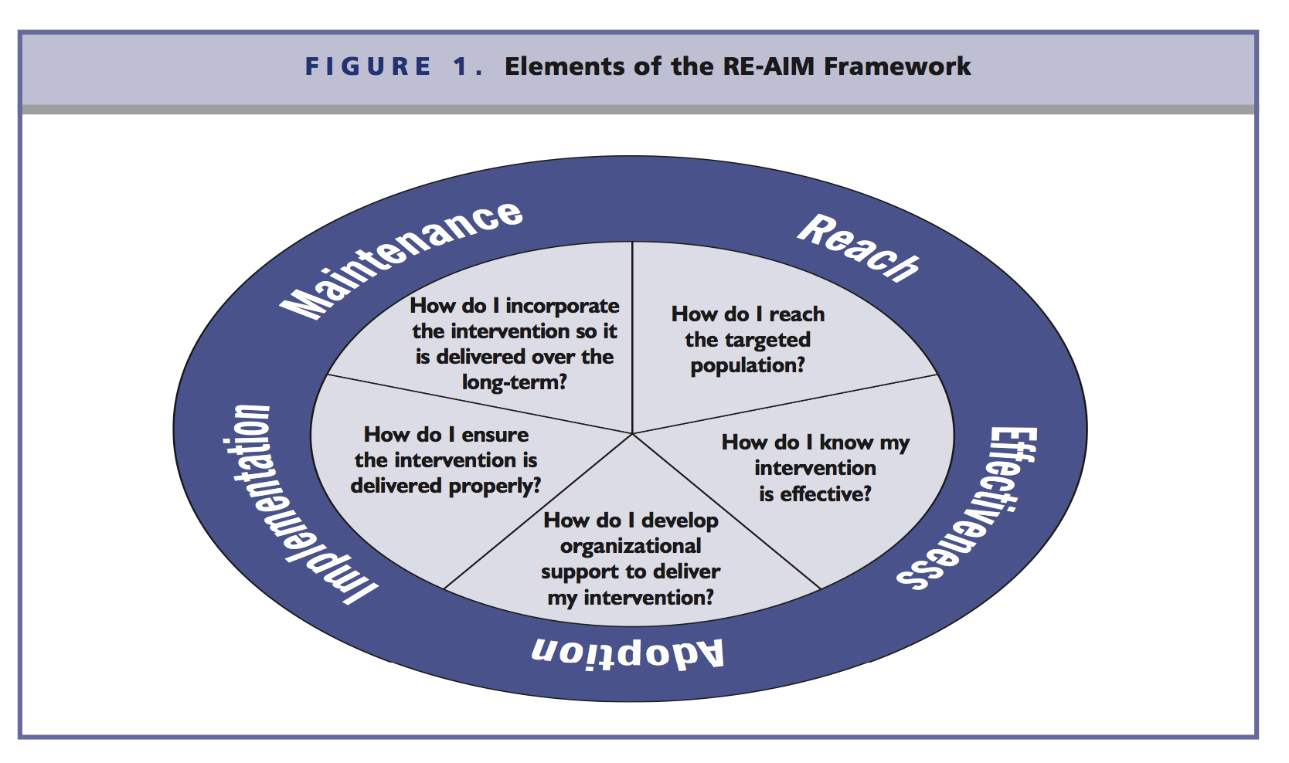
Beyond effectiveness
Glasgow, RE-AIM

Slide 9
Definitions (from NCI)
Implementation Science intends to bridge the gap between research, practice, and policy by building a knowledge base about how health information, effective interventions, and new clinical practices, guidelines and policies are communicated and integrated for public health and health care service use.
Dissemination research is the scientific study of targeted distribution of information and intervention materials to a specific public health or clinical practice audience. The intent is to understand how best to communicate and integrate knowledge and the associated evidence-based interventions.
Implementation research is the scientific study of the use of strategies to adopt and integrate evidence-based health interventions into clinical and community settings to improve individual outcomes and population health.
Source: PAR-19-274

Slide 10
Dissemination research
How, when, by whom, and under what circumstances evidence spreads
    Creation
    Packaging
    Transmission
    Reception
➔Turning information into action

Slide 11
Implementation research
THE IMPLEMENTATION PATHWAY
Implementation Outcomes
Feasibility
Fidelity
Penetration
Acceptability
Sustainability
Uptake
Costs
Service
Outcomes*
Efficiency
Safety
Effectiveness
Equity
Patient-
centeredness
Timeliness
Health Outcomes
Satisfaction
Function
Health status/
symptoms
THE USUAL
What?
How?
Evidence-based
Interventions
Implementation
Strategies
*IOM Standards of Care
Implementation Research Methods
Proctor et al 2009 Admin. & Pol. in Mental Health & Mental Health Services Research

Slide 12
Implementation strategies
Evaluative & iterative strategies
Interactive assistance
Adapt & tailor to context
Develop stakeholder relationships
Financial strategies
Train/educate stakeholders
Support clinicians
Engage consumers
Change infrastructure
What barriers are you trying to overcome?
What resources are you able to leverage?
Who are your stakeholders?
Powell, et al., 2015.

Slide 13
Context dependent & multi-level factors
STAKEHOLDERS AT ALL LEVELS!
Nation
State
Community
Organization
Service setting
Provider
Consumer
…As you scale up decision-making from practice to program to policy, does evidence exist to guide implementation?

Slide 14
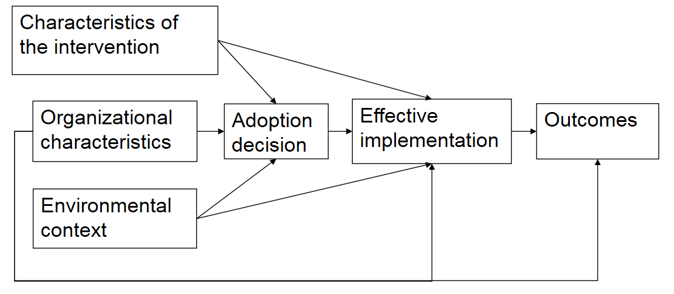
Rogers’ Diffusion of Innovations theory
Characteristics of the intervention
Organizational characteristics
Adoption decision
Effective implementation
Outcomes
Environmental context
CIPRS: Stetler & Damschroder Theoretical Frameworks
Krein SL, Olmsted RN, Hofer TP, et al. Am. J. Infect. Control 2006;34(8):507-12.

Slide 15


Consolidated Framework for Implementation Research (CFIR)
Intervention
(adapted)
Intervention
(unadapted)
Outer Setting
Inner Setting
Core Components
Adaptable Periphery
Adaptable Periphery
Core Components
Individuals
Involved
Damschroder & Damush, 2009
Process

Slide 16
Learning Objectives
Define key objectives and terminology in implementation science
Describe funding opportunities and other resources at NCI
Identify priority research areas for advancing implementation science

Slide 17
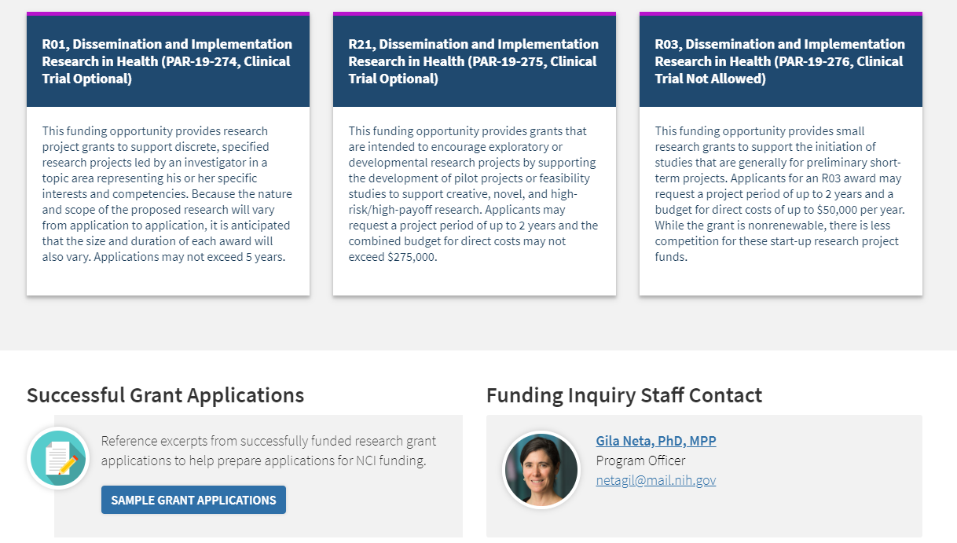
Funding opportunities

Slide 18
NIH Participation
R01: NCI, NCCIH, NHGRI, NHLBI, NIA, NIAAA, NIAID, NIAMS, NICHD, NIDA, NIDCD, NIDCR, NIEHS, NIMH, NIMHD, NINDS, NINR, ODP*, OBSSR*, ORWH*
R21: NCI, NCCIH, NHGRI, NIA, NIAAA, NIAID, NIAMS, NIDA, NIDCD, NIEHS, NIMH, NINDS, NINR, Fogarty (FIC), ODP*, OBSSR*, ORWH*
R03: NCI, NHGRI, NIA, NIAAA, NICHD, NIDA, NIDCR, NIEHS, NIMH, NINDS, FIC, ODP*, OBSSR*, ORWH*
*Not typically grant-holding offices

Slide 19
The Purpose
to support innovative approaches to identifying, understanding, and developing strategies for overcoming barriers to the adoption, adaptation, integration, scale-up and sustainability of evidence-based interventions, tools, policies, and guidelines. Conversely, there is a benefit in understanding circumstances that create a need to stop or reduce (“de-implement”) the use of interventions that are ineffective, unproven, low-value, or harmful. In addition, studies to advance dissemination and implementation research methods and measures are encouraged.

Slide 20
Selected research questions
How can an evidence-based practice be adapted to fit within specific contexts or settings?
Which strategies best support uptake and sustainability, and how do these strategies work?
How do you scale up and sustain effective interventions across systems, states and communities
How do you de-implement practices that are not evidence-based, or are harmful or wasteful?

Slide 21

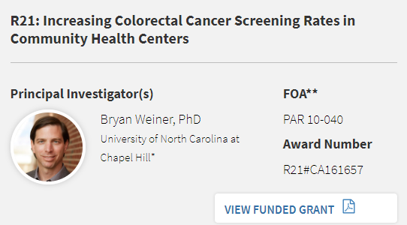
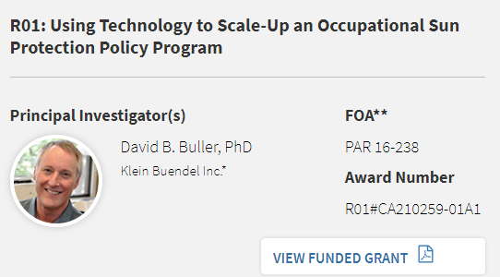
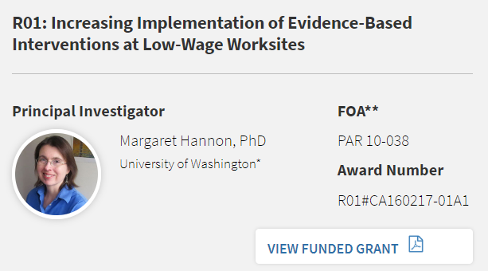
Examples of funded studies
https://cancercontrol.cancer.gov/IS/sample-grant-applications.html

Slide 22
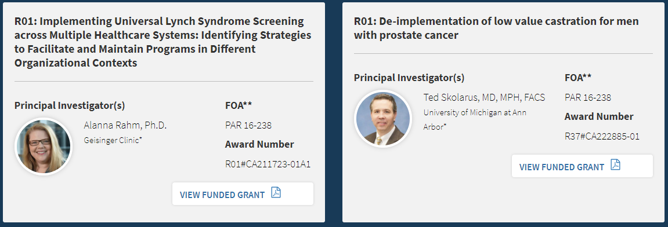
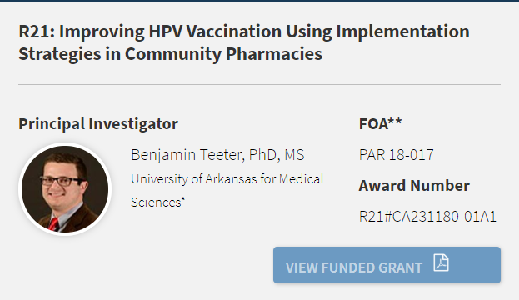
Examples of funded studies

Slide 23
Specific Aims – Lynch Syndrome Screening (R01)
Describe variation in LS screening implementation across multiple healthcare systems
Explain practice variation and determine factors associated with optimal implementation
Determine the relative effectiveness, efficiency, and costs of different LS screening protocols by healthcare system
Develop and test in a natural environment an organizational toolkit for LS screening.

Slide 24
Specific Aims – Prostate cancer treatment (R01)
Assess preferences and barriers for de-implementation of chemical castration in prostate cancer
Use a discrete choice experiment, a novel barrier prioritization approach, for de-implementation strategy tailoring
Pilot two tailored de-implementation strategies to reduce castration as localized prostate cancer treatment

Slide 25
Specific Aims – HPV Vaccination in Pharmacies (R21)
Identify barriers and facilitators to community pharmacies’ provision of HPV vaccine through a mixed methods design with pharmacy staff members and local physicians
Select a pharmacist-physician collaborative model and identify implementation strategies through an Evidence Based Quality Improvement (EBQI) process with key stakeholders
Pilot the selected pharmacist-physician collaborative model and implementation strategies in two Harps pharmacies (1 rural, 1 urban) on relevant implementation outcomes

Slide 26
Review Criteria
Overall Impact derived from five criteria
  Significance
  Investigator
  Innovation
  Approach
  Environment
Specific language in the FOA for each criterion
Review Committee: DIRH
https://public.csr.nih.gov/StudySections/DABP/HDM/DIRH

Slide 27
NIH Clinical Trials
NIH Office of Extramural Research (OER), Clinical Trial Requirements for Grants and Contracts
  https://grants.nih.gov/policy/clinical-trials.htm
Resources:
    Clinical trial definition
    Does my human subjects research study meet the NIH definition of a clinical trial? Decision Tool (4 questions)
    Clinical trial-specific funding opportunities
    Clinical-trial specific review criteria
    Clinical trials protocol template
    Registration and reporting

Slide 28
Things to Remember
Start early
Need prior approval to exceed $500K for R01
Do not skimp on methods/approach
Demonstrate your partnership(s) and understanding of context
TALK WITH PROGRAM OFFICERS – A listing of Institute contacts available at the end of the PARs.

Slide 29
Guidance on Reaching out to Program Officers
Identify Program Officer from PARs lists
Send them one-pager (Specific Aims page)
Highlight questions
Ask for 30-minute call?
Don’t be shy to email reminders (weekly, not daily)

Slide 30
Resources Available
NIH Grants: http://grants.nih.gov/
NCI Implementation Science website: http://cancercontrol.cancer.gov/IS
Prior D&I Grants and Topics Funded: http://cancercontrol.cancer.gov/IS/funding.html
Link to PAR announcements and FAQs: http://cancercontrol.cancer.gov/funding_apply.html#is
NIH Foreign Grants Info: http://grants.nih.gov/grants/foreign/index.htm
Email NCIdccpsISteam@mail.nih.gov for more information.

Slide 31
Cancer MoonshotSM Initiatives

Slide 32
Implementation of Evidence-Based Cancer Prevention and Screening
Cancer Center Cessation Initiative
ACCSIS 1/2
Implementation Science Centers
Cervical Cancer Control
AI/AN CRC Project
Symptom Management
Hereditary Cancers
IMPACT
Tolerability RFA
Hereditary Cancer Testing & Follow-Up
cGVHD Project
PRO Translation Project
Communication and Decision-Making
Survivorship RFAs

Slide 33
Selected Cancer MoonshotSM Initiatives
The Cancer MoonshotSM has enabled the NCI to concentrate on important opportunities in implementation science including several areas of focus:
  Accelerating delivery of colorectal cancer screening, follow-up, and referrals to care in underserved areas of the U.S.
  Enhancing delivery of tobacco cessation treatments
  Developing approaches to identify and care for individuals with inherited cancer syndromes
  Developing implementation science centers

Slide 34
Accelerating Colorectal Cancer Screening and follow-up through Implementation Science (ACCSIS)
NCI Leads: Sarah Kobrin, Wynne Norton, Michael Halpern, Robin Vanderpool, Genevieve Grimes
RFAs to fund research grants (UG3/UH3 mechanism) and coordinating center.
Goal: Generate implementation strategies that substantially improve CRC screening and follow-up rates in populations where baseline rates remain low.
Emphasis on addressing disparities, including:
    Underserved racial and ethnic minority populations;
    Rural and hard-to-reach populations;
    High-risk subgroups
Testing implementation strategies to improve rates of CRC screening and follow-up within a range of community and health care settings
Adding research to local efforts to improve CRC screening and follow-up (e.g., 80 by ‘18 initiative)

Slide 35
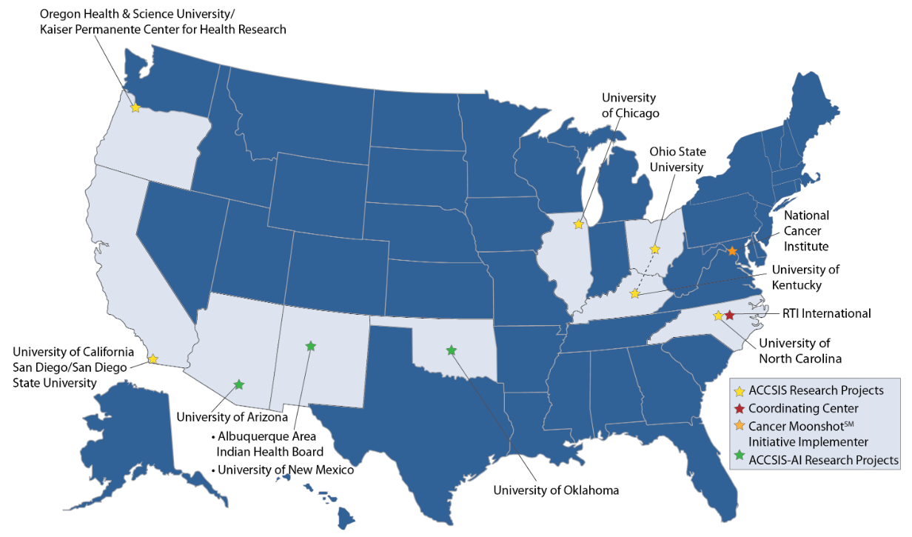
ACCSIS Consortium

Slide 36
Cancer Center Cessation Initiative (2017- )
NCI Lead: Stephanie Land
Goal: Administrative supplements to develop tobacco cessation treatment capacity and infrastructure for cancer patients that should lead to the implementation and dissemination of a sustainable tobacco cessation treatment program within the cancer center.
Natural laboratory for understanding implementation of tobacco cessation within cancer center care delivery
Capturing data on Implementation strategies to integrate cessation services
Coordinating Center: University of Wisconsin Madison (Lead: Michael Fiore)

Slide 37
Approaches to Identify and Care for Individuals with Inherited Cancer Syndromes (U01)
NCI Leads: Erica Breslau, Nonniekaye Shelburne
Goal: Promote research that identifies and tests methods to increase case ascertainment, and optimize the delivery of evidence-based follow-up healthcare for individuals at high risk of cancer due to an inherited genetic susceptibility
Grant | PI | Institution | Title
1U01CA232829-01A1 | Wiesner, Georgia | Vanderbilt University Medical Center | Improving identification and healthcare for patients with Inherited Cancer Syndromes: Evidence-based EMR implementation using a web-based computer platform
1U01CA232836-01A1 | Nathanson, Katherine L | University of Pennsylvania | Randomized trial of universal vs. guideline-directed germline testing among young adults with cancer
1U01CA232795-01A1 | Bowen, Deborah | University of Washington | Implementing the moon: Getting genomic testing to the public
1U01CA232826-01 | Buys, Saundra | University of Utah | Levering an electronic medical record infrastructure to identify primary care patients eligible for genetic testing for hereditary cancer and evaluate novel cancer genetics service delivery models

Slide 38
Communication and Decision Making for Individuals with Inherited Cancer Syndromes (U01 Clinical Trial Optional)
NCI Lead: Wendy Nelson
Goal: Develop, test, and evaluate interventions and implementation approaches, or adapt existing approaches, to improve patient/provider/family risk communication and decision making for individuals and families with an inherited susceptibility to cancer.
RFA Reissued October 30th as RFA-CA-20-006
Submissions closed
Grant | PI | Institution | Title
1U01CA243688-01 | Mack, Jennifer | Dana Farber Cancer Institute | The AYA-RISE intervention: Risk information and screening education for adolescents and young adults with cancer predisposition syndromes

Slide 39
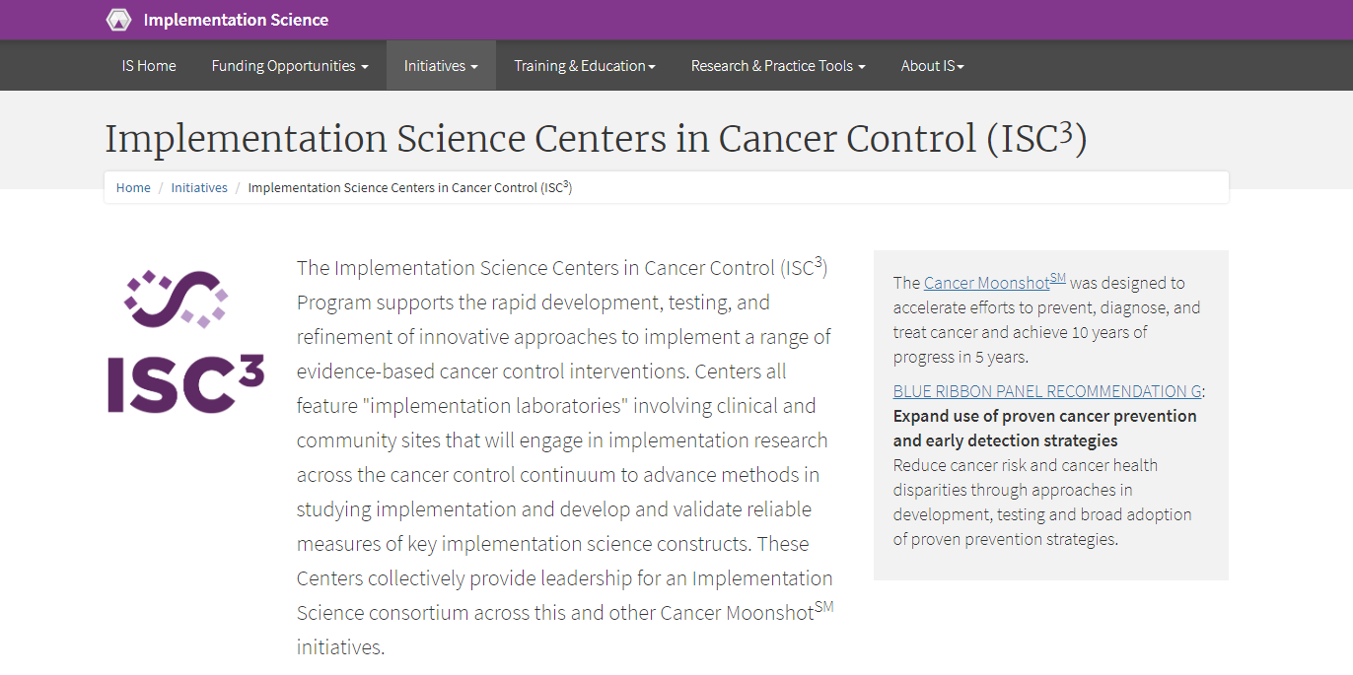
NCI Leads: Cynthia Vinson, April Oh https://cancercontrol.cancer.gov/IS/initiatives/ISC3.html

Slide 40
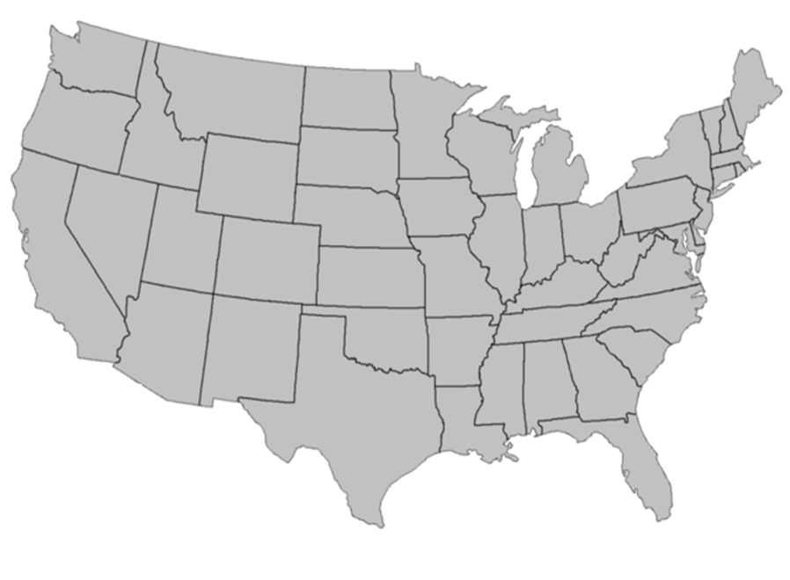

ISC³ Funded Sites
University of Washington
Harvard School of Public Health
Oregon Health &
Science University
University of Colorado, Denver
Wake Forest University
Health Sciences
Washington University in St. Louis

Slide 41
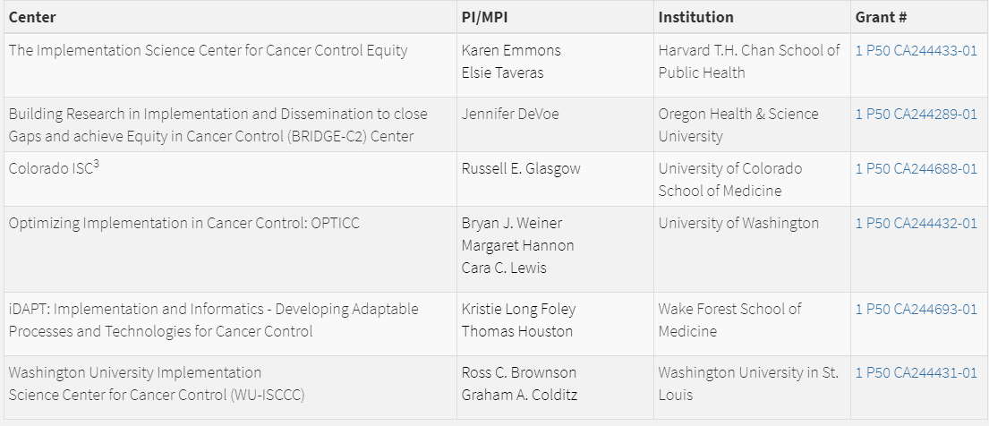
Implementation Science Centers in Cancer Control (ISC³)

Slide 42

NCI Annual Plan

Slide 43
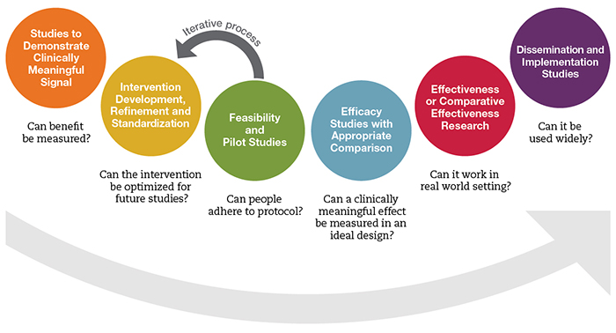
Considering implementation science earlier
https://nccih.nih.gov/grants/mindbody/framework

Slide 44
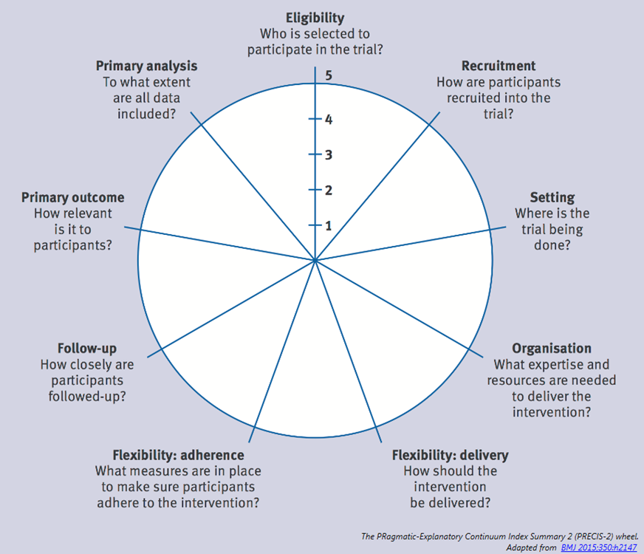
PRECIS-2
PRagmatic Explanatory Continuum Indicator Summary: A tool to design pragmatic trials
1 = Very explanatory, 5 = Very pragmatic; Loudon et al., 2015.

Slide 45
Considering implementation science earlier
Designing for Implementation
Who’s going to deliver it?
Fit with ultimate patient population
Building in tests of training, support, adherence, mediators and moderators to high quality delivery
Hybrid designs
https://nccih.nih.gov/grants/mindbody/framework

Slide 46
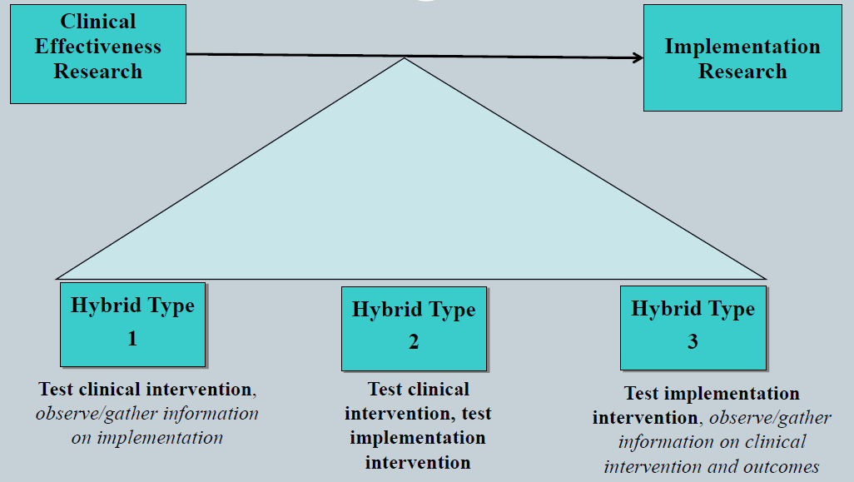
Hybrid designs: 1, 2, 3
Curran et al. (2012). Effectiveness-implementation hybrid. Med Care.

Slide 47



Slide 48
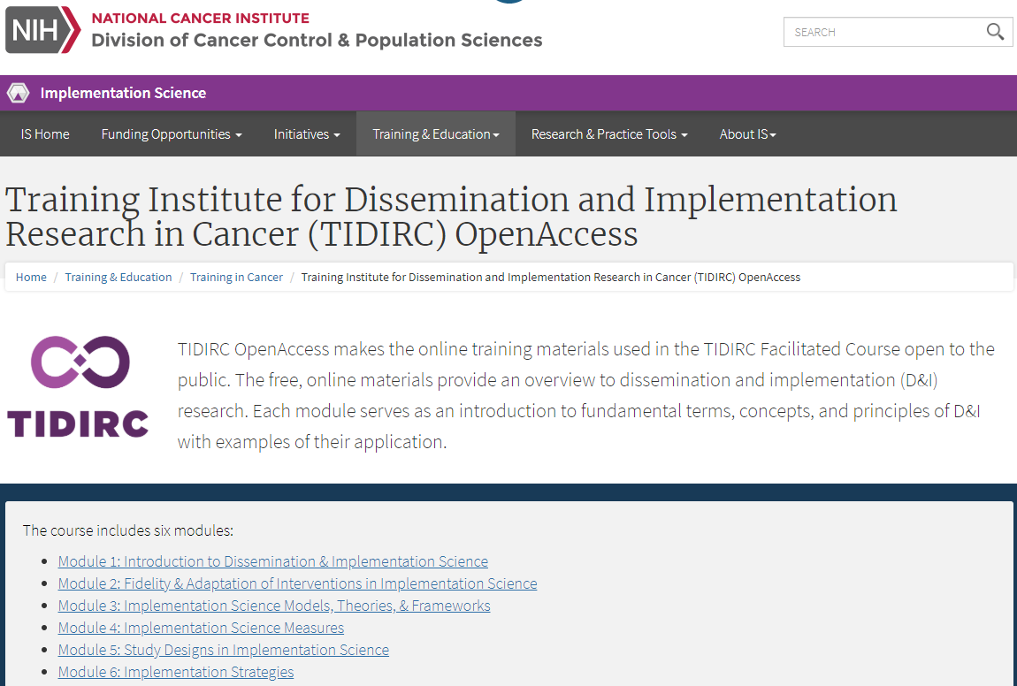



Slide 49


Textbooks
December 2017
October 2018

Slide 50
Learning Objectives
Define key objectives and terminology in implementation science
Describe funding opportunities and other resources at NCI
Identify priority research areas for advancing implementation science

Slide 51
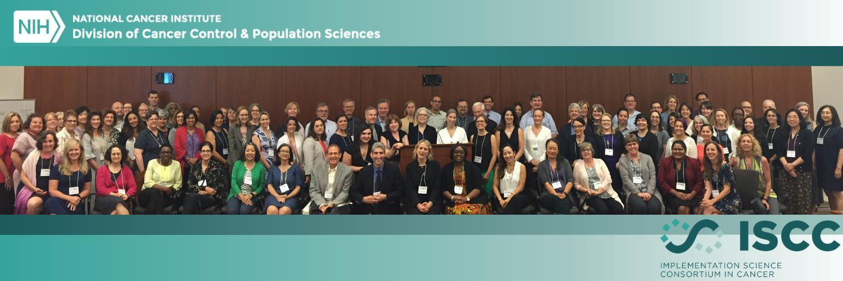
Implementation Science Consortium in Cancer (ISCC; July 10-12, 2019)
  107 in-person attendees (72 institutions)
  136 online attendees (102 institutions)
Goals identified by participants:
  Advance implementation science (IS); build capacity; collaboration; articulate and create a vision for IS across Moonshot Initiatives and beyond
Future meetings hosted by Implementation Science Centers:
  Wake Forest (2020); Colorado (2021); Seattle (2022)
https://cancercontrol.cancer.gov/IS/initiatives/iscc.html

Slide 52

Working Groups
20 projects generated across 7 working groups
Working groups:
  Implementation laboratories
  Rapid cycle designs
  Economics & costs
  Technology
  Equity
  Policy
  Precision medicine

Slide 53

ECON: Standardized measures for cost analyses
ECON: Tools to engage stakeholders in cost collection
EQUITY: Equity constructs for IS models, frameworks, strategies
EQUITY: Assess methods for contextual inquiry for health equity
EQUITY: Building health equity into IS: definition, checklist, PA req.
LABS: Environmental Scan of Implementation Labs
LABS: Common (Pragmatic) Measures, Methods needed from labs
LABS: Develop sustainable IS collaboratories
LABS: Support center across Implementation Labs
POLICY: Policy Implementation Landscape Review (PILR)
POLICY: Strategic Expansion of IS Stakeholders
POLICY: Data Warehouse/Mapping Tool for Local Policies
RAPID CYCLE: Define what is known about Rapid Cycle Design
RAPID CYCLE: Develop guidance for rapid cycle design use
RAPID CYCLE: Multi-stakeholder initiative: promote adoption of rapid cycle research
PRECISION: Contextual Phenome for Precision Health Implementation (via GMIR Framework)
TECH: Brightspots: scan of IT challenges opportunities
TECH: National Technology Infrastructure
TECH: Technology to Transform Health Care to Health Improvement
TECH: Increasing IS and IT Team Science Capacity
5
1 14
3 8
11
Potential Impact
13
6 10
4
20 9 ₇
15 ₁₉
₁₈ 12
2
17
16
Priority
Total Dots Weighted
Scale of In-Person Meeting Dots Data
 | 67.61-115.55
 | 46.98-65.61
 | 32.65-46.97
 | 17.66-31.31

Slide 54
Question?
Gila.Neta@nih.gov

