Slide 1
Using Qualitative methods in LARGE SCALE PROJECTS
LESLIE CURRY, PHD, MPH
SENIOR RESEARCH SCIENTIST, YALE SCHOOL OF PUBLIC HEALTH
LECTURER, YALE COLLEGE
April 2018

Slide 2
Overview of our session
Qualitative methods in large scale research projects
Challenges in implementation
Strategies: Illustrations from Leadership Saves Lives
Application to your current work/discussion

Slide 3
Funders
Collaborators
Mayo Clinic Care Network
AHRQ
Robert Wood Johnson Foundation
The Commonwealth Fund
The Donaghue Foundation
The Medicines Company
A diverse team at Yale and nationally
Mayo Clinic Knowledge & Evaluation Unit
Emily Cherlin, PhD, MSW

Slide 4
Qualitative methods in large scale research projects

Slide 5
Qualitative methods are becoming increasingly common in large scale projects
Complex interventions
Program and policy evaluations
Randomized controlled trials
Implementation science approaches
Curry LA, Krumholz HM, O’Cathain A, Plano Clark VL, Cherlin E, Bradley EH. Mixed methods in biomedical and health services research. Circulation: Cardiovascular Quality and Outcomes. 2013; 6:119-123
Notes:
Examine a wide range of phenomenon (e.g., clinical or quality issues, healthcare organizational performance, behavioral interventions, implementation of innovations, intervention fidelity, healthcare decision making, measurement development for complex constructs
Assess whether an intervention works but also why it worked or failed to work
Determine why a program worked, for whom, and under what circumstances
Provide timely insights before, during or after a trial

Slide 6
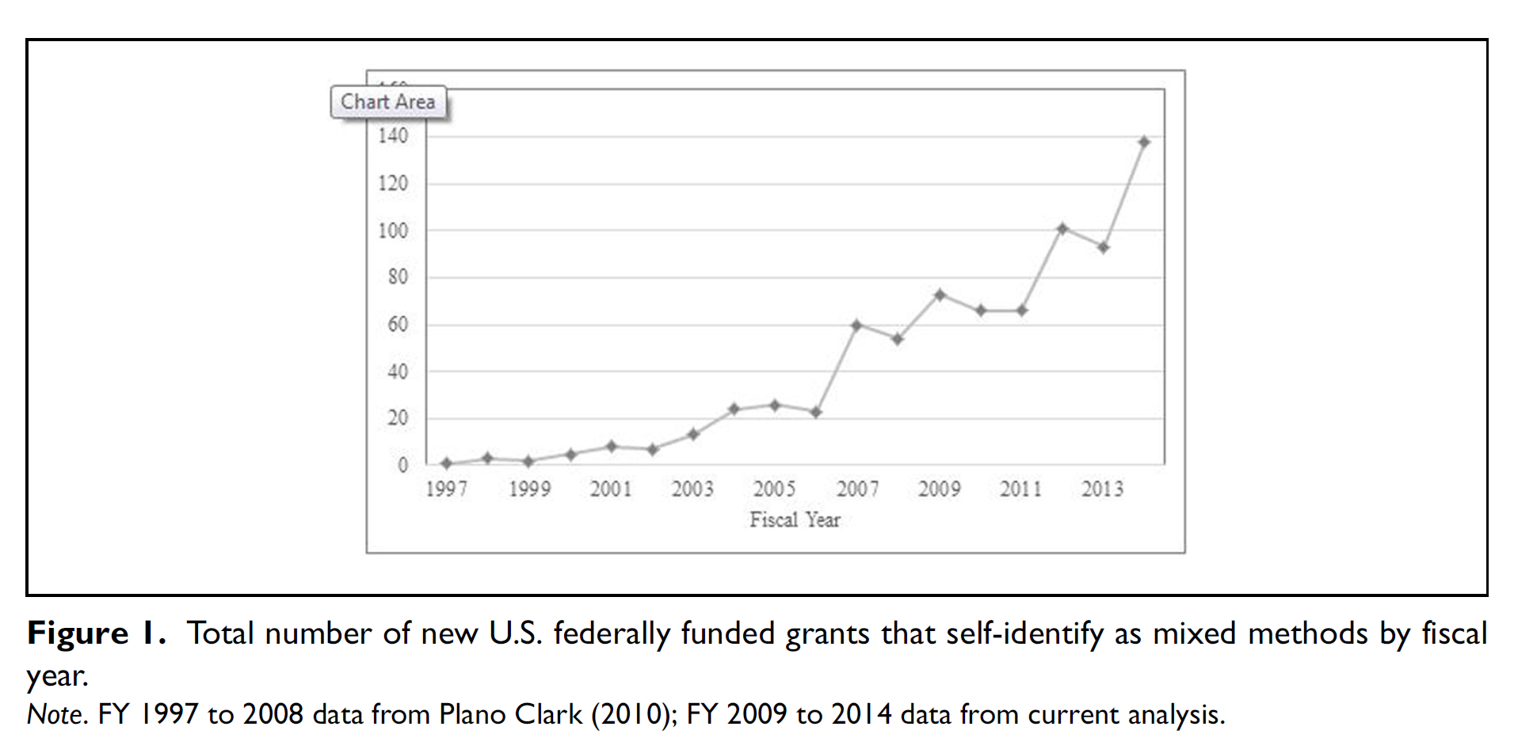
Coyle C, Schulman-Green D, Feder S, Toramin S, Prust ML, Plano Clark VL, Curry L. Federal funding for mixed methods research in the health sciences in the United States: Recent trends. Journal of Mixed Methods Research 2016; DOI: 10.1177/1558689816662578

Slide 7
Challenges

Slide 8
Common implementation challenges
Managing large and diverse teams
Inadequate resources, time and/or expertise
Complexities in sampling designs
Unwieldly volume of qualitative data
IRB lack of familiarity with qualitative methods
Notes:
Inadequate resources and/or expertise
Multiple rounds of IRB approval if protocol changes
Complexities in sampling designs
Unwieldly volume of qualitative data
Integrating at multiple levels: over time, over settings, with quantitative measures
Logistics of managing large teams (training, travel, communication)
IRB constraints

Slide 9
Strategies: Illustrations from Leadership Saves Lives

Slide 10
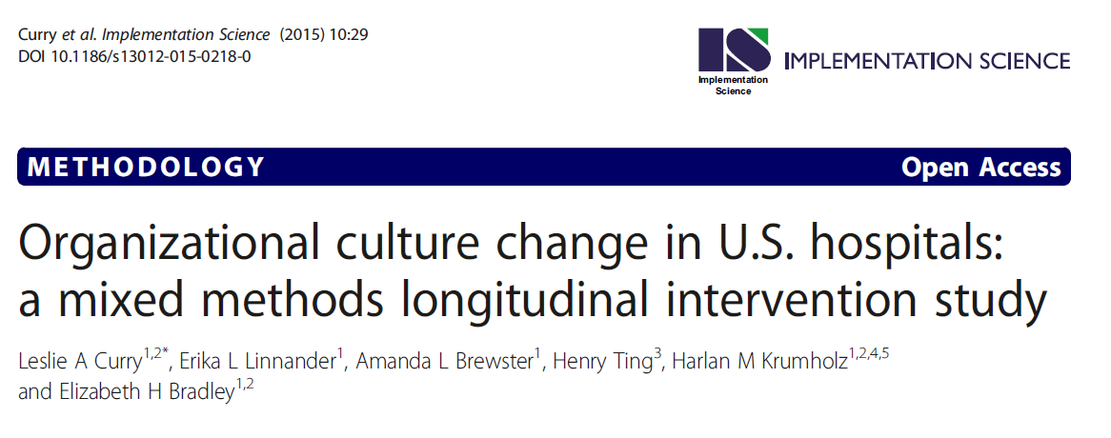
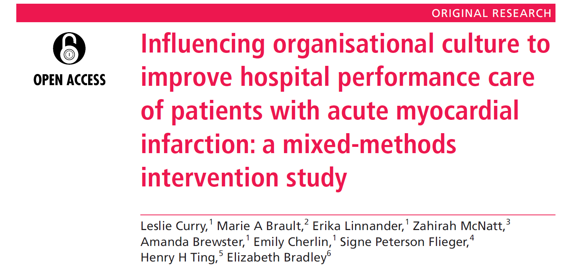
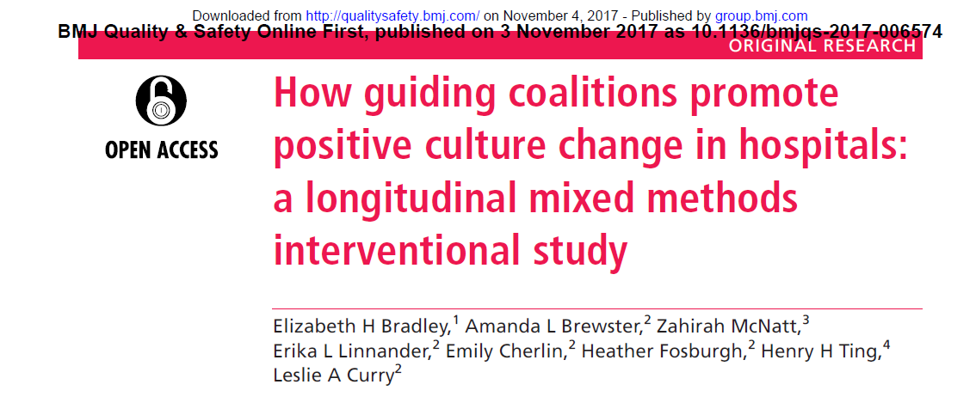

Slide 11

Each year, over 800,000 people in the US have a heart attack
About 200,000 die
Risk-standardized mortality rates vary substantially

Slide 12
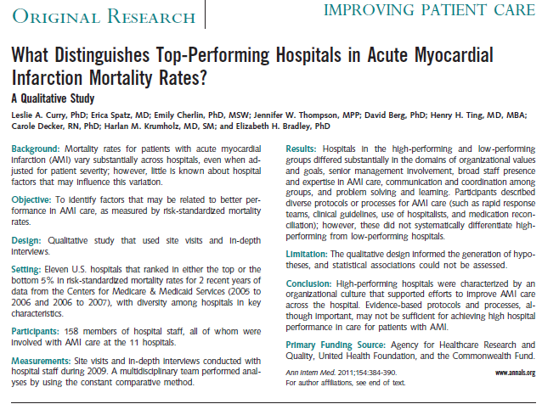
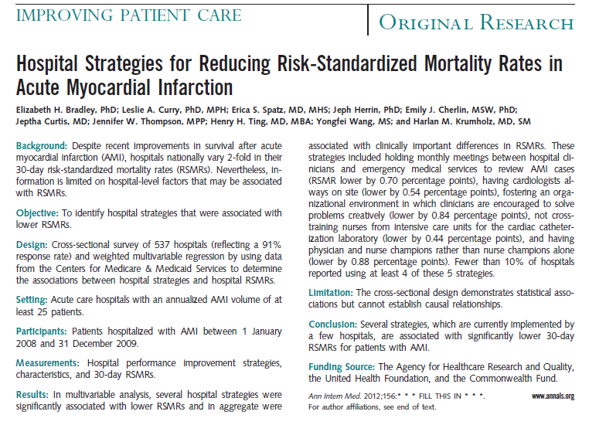
Hospital organizational culture is associated with lower RSMR for AMI

Slide 13
Leadership Saves Lives
Intervention to promote organizational culture change in US hospitals & improve outcomes for patients with AMI
Outcomes:
  Uptake of 5 evidence-based strategies
  Changes in key dimensions of culture
  RSMR for AMI
Mixed methods evaluation to measure change AND describe the process of change

Slide 14
Sample
KEY
MCCN Hospital
Intervention Hospital
Creative Commons Attribution-NoDerivs 3.0 ppt-toolkit.com

Slide 15
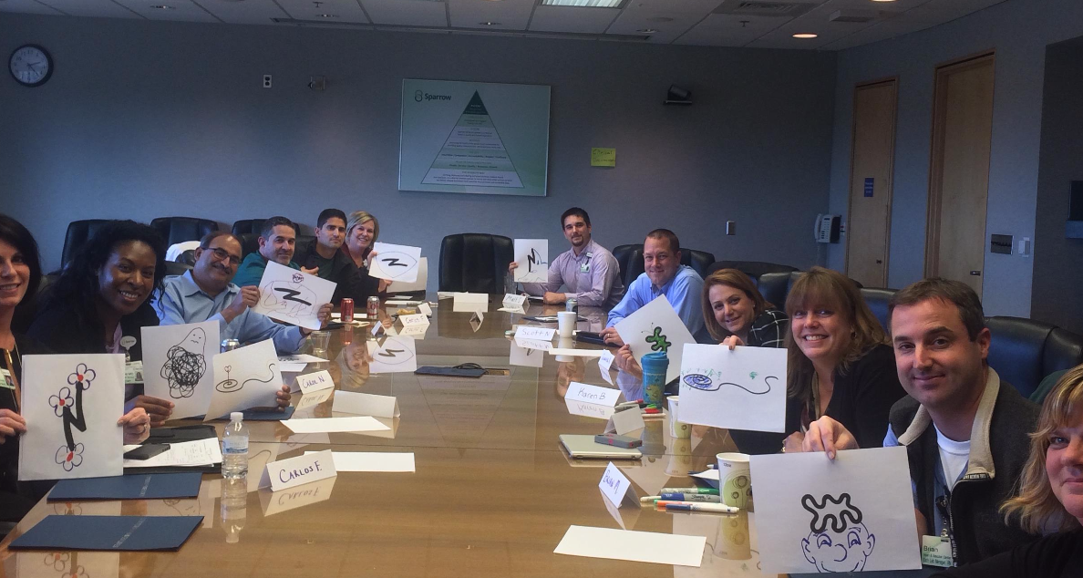
Guiding Coalitions
MULTIDISCIPLINARY
ACROSS DEPARTMENTS WITHIN AND OUTSIDE HOSPITAL
ACROSS ALL LEVELS OF THE ORGANIZATION
Notes:
Each hospital was asked to appoint a guiding coalition that included approximately 15 key staff involved in care of patients with AMI. Coalition members included staff from multiple departments (i.e., cardiology, emergency medicine, pharmacy, quality improvement, cardiac rehabilitation), professions (i.e., physicians, nurses, technologists, administrators, physician assistants), and levels of the organization (from senior executives to front-line staff

Slide 16
Convene
Convene
Convene
Workshop
Workshop
Workshop
Workshop
Workshop
Workshop
Workshop
Workshop
Month 0
Remote Support
Month
24
Interviews and Observations
Interviews and Observations
Interviews and Observations
Survey
Survey
Survey

Slide 17
Key informant interviews
wave 1 (n=162)
wave 2 (n=118)
wave 3 (n=113)
Observations (56 hours)
Qualitative
Merge
Describe what changed and how
Surveys
  Wave 1: n=146 (87%)
  Wave 2: n=153 (83%)
  Wave 3: n=162 (96%)
Quantitative

Slide 18
Building and managing the team
Include essential and complementary expertise
Explicitly define roles
Tend to group dynamics
Be mindful throughout the project
Curry LA, O’Cathain A, Plano Clark VL, Aroni R, Fetters M, Berg D. The Role of group dynamics in mixed methods health sciences research teams. Journal of Mixed Methods Research, Epub 2011 Aug 29. DOI:10.1177/1558689811416941

Slide 19
Example: Role definitions
Data analysis role | Person and time needed
Management and first coder: Prepare research team with interview and observation guides, recorders Manage transcripts & Atlas files File/track the observation notes Enter and reconcile input from other coders Code every transcript | Emily, with backup as needed on Atlas from Sohini Management role: 20% effort weekly Coding: 10 hospitals (150 hours per round, 1 hour per tx)
Second coder: | Heather – 5 hospitals (50 hours per round, 1 hour per tx) Amanda – 5 hospitals (50 hours per round, hour per tx) Note: we will mix up assignments so Betsy and Signe are reading both Heather and Amanda’s codes
First expert read: | Leslie – all hospitals (75 hours per round at 45min per tx)
Second expert read: | Betsy – 4 hospitals (30 hours at 45 min per tx) Signe – 6 hospitals (45 hours at 45 min per tx)
Additional reads: | LSL faculty as needed for breadth, especially those that conducted the specific visit being coded

Slide 20
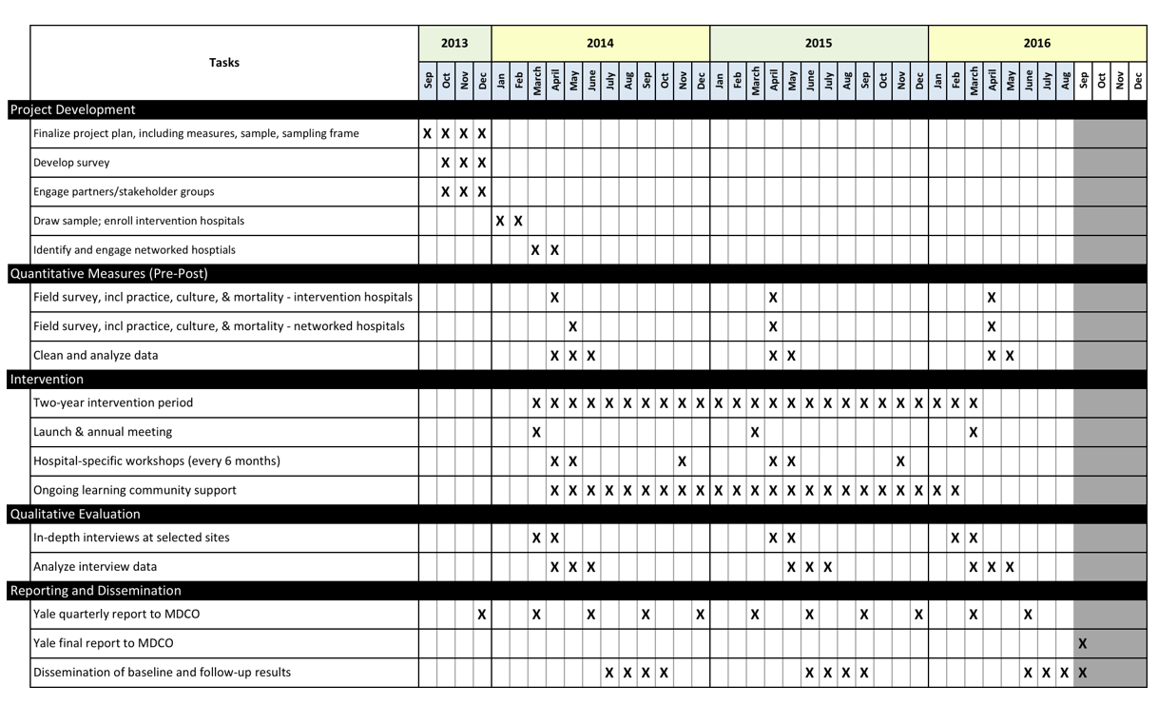
Example: Gantt Chart

Slide 21
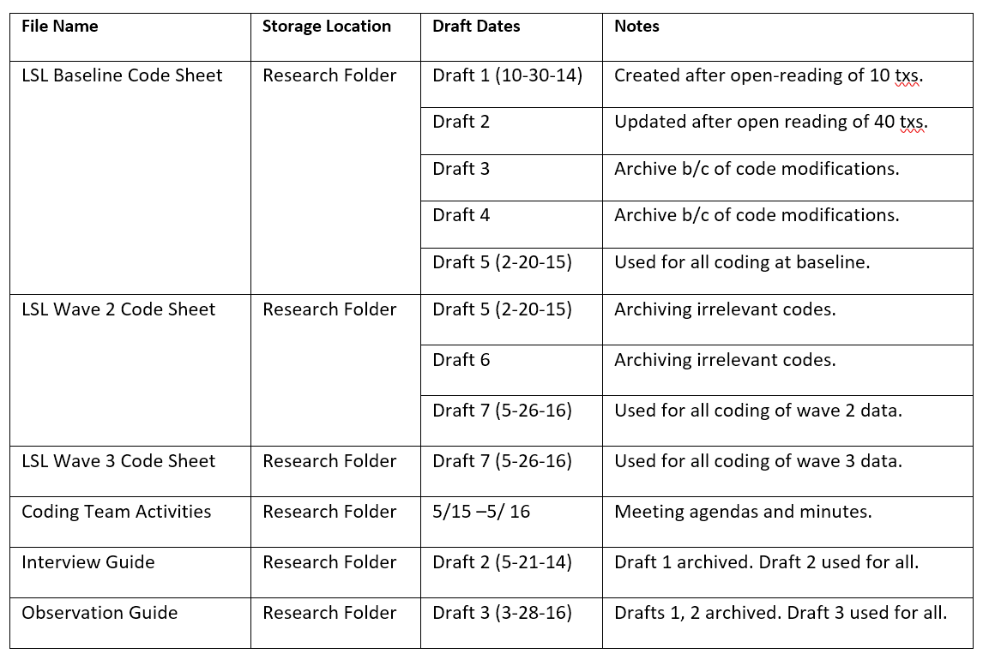
Example: Audit Trail

Slide 22
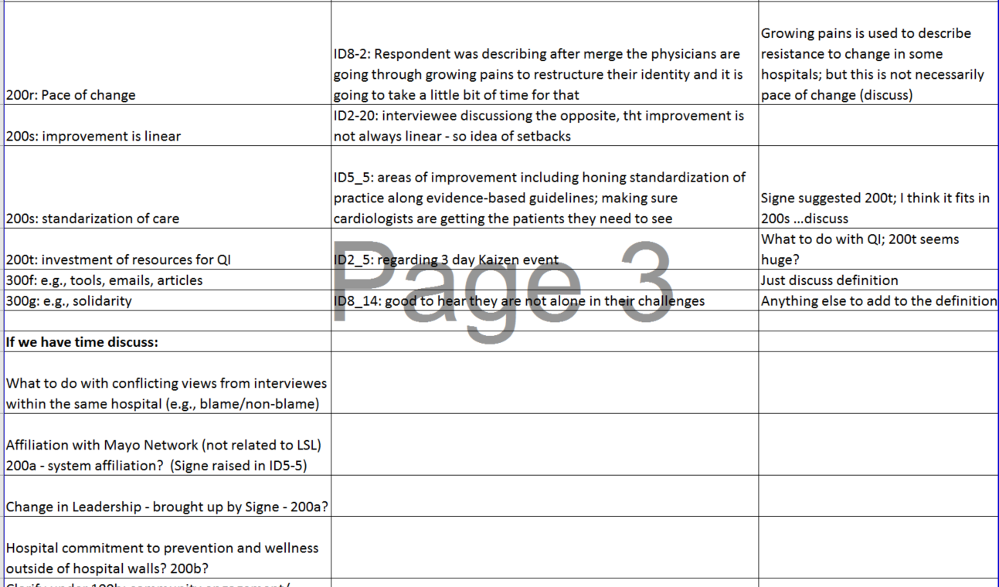
Example: Code structure tracker

Slide 23
Sampling and data collection
Random purposeful approach EACH WAVE
Saturation per unit of analysis (LSL = hospital)
Retention not always a goal
Matching expertise interviewer to respondent, consistent across waves
Refine data collection strategy in each wave based on prior findings
Notes:
Some suggest that ideally unit of analysis is the individual (Vallance, 2005).
Individual is easiest, but also least generalizable (Holland et al., 2006).
Other units of analysis possible (Holland et al., 2006):
Communities
Organizations
Physical settings (e.g., shopping center, playground)
Events (e.g., retirement, birth of a child)
Time periods
Groups (e.g., families, households, classes, age cohorts).

Slide 24
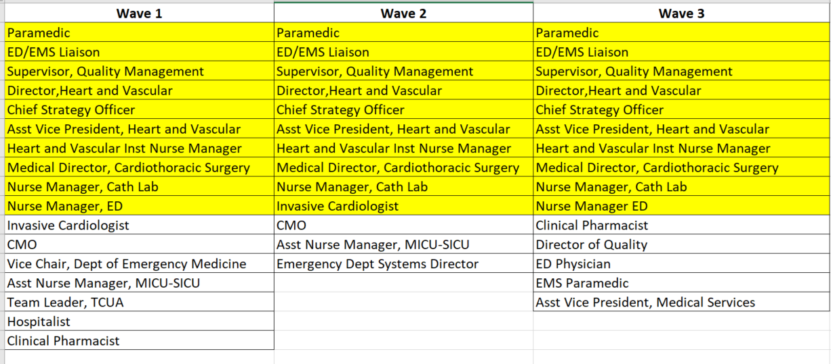
Example: Respondent Wave, Hospital A

Slide 25
Analysis: Coding
Establish efficient coding processes
Elicit expert input
Use integrated approach to coding
Create timetable to allow for iterative input into subsequent round
Bradley EH, Curry LA, Devers KJ. Qualitative data analysis for health services research: developing taxonomy, themes, and theory. Health Services Research, 2007; 42(4):1758-1772. PMCID: PMC1955280

Slide 26
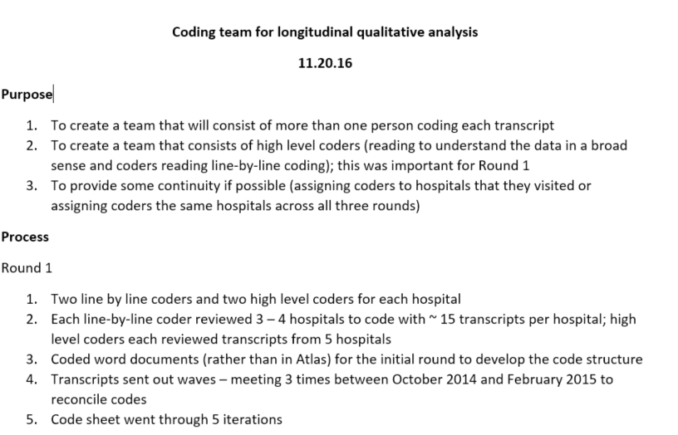
Example: Coding team process

Slide 27
Integrating content and methods expertise
Core team methods experts
conduct
all coding/
analysis
Content experts inform initial codes
Content experts refine coded transcripts for their sites
Content experts refine
final codes

Slide 28
Analysis: Assessing change
  Use change code and matrices to compare across time
We do not always know what to look for in advance
Sometimes changes are so subtle, hard to see
Allow for the possibility that change will not occur
Pay attention to what you expect is most likely to change

Slide 29
Example: Matrices for change over time
Creative problem solving (code/theme)
 | 2014 Visit | 2015 Visit | 2016 Visit
Site 1
Site 2
Site 3
Site 1 | 2014 Visit | 2015 Visit | 2016 Visit
Patient-centeredness
Problem solving
Psychological safety

Slide 30
Example: Code Report Assessing Change
Quotation-Filter: All
500c and Change and Good Quote [("500a and Change" & "99a. Concise great quotes for any code)]
P432: ID9_13_2-Year_VP Quality and Performance Mgt - 432:5 [Okay. Pharmacists are on the t..] (57:59) (Super)
Codes: [99a. Concise great quotes for any code (for papers)] [200k. Silo thinking] [200l. Teamwork] [400a. Change] [500c. Pharmacists engagement] [600a. Learning and problem solving]
I think we really became cohesive more into the latter part of LSL. I think it was getting everyone in the mode of "We're all here together to do the same thing." It was a silo initially. I think now we are all able to be open and honest. We've gone to the next level in regards to physician peer review, looking at cases. Are there opportunities?”

Slide 31
Publication strategy
Create a plan at the outset of the project
Revisit periodically and at key junctures
Publish the methods protocol as early as possible
Invest heavily in response letters
Curry L and Nunez-Smith M. 2014. Mixed Methods in Health Sciences Research, Sage Publications, Thousand Oaks, CA

Slide 32
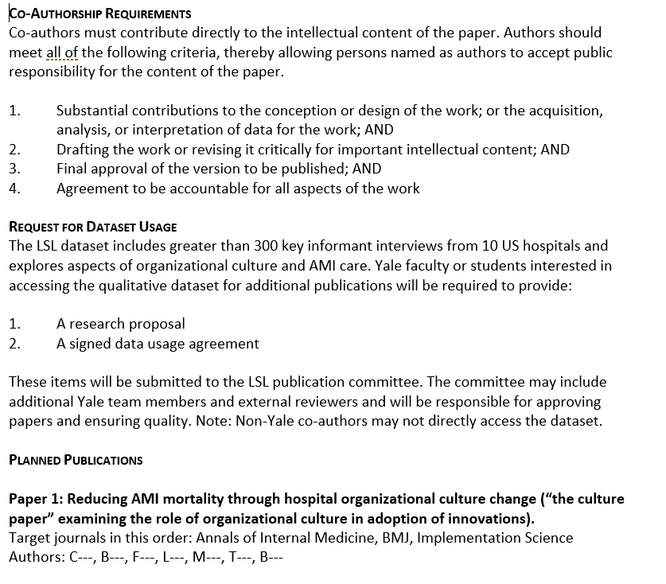
Example: Publication Plan

Slide 33
Thank you! conversation

Slide 34


Contact Information
Leslie Curry, PhD, MPH
Senior Research Scientist
Yale Global Health Leadership Institute
Yale University
leslie.curry@yale.edu
http://ghli.yale.edu
@lesliecyale, @YaleGH
YaleGlobalHealth

