Slide 1


Social Needs Screening
in Family Medicine
Heather Bleacher, MD MPH
AF Williams Family Medicine Center

Slide 2
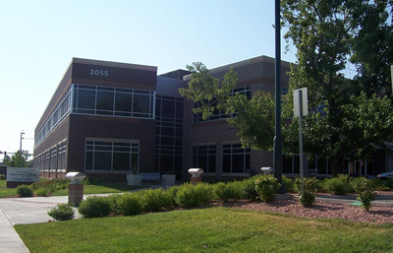

AF Williams Family Medicine Clinic
Academic family medicine residency
24 faculty (part-time clinicians); 20 residents
16,500 empaneled patients
Over 39,000 visits annually
Early adopters of APEX model of care = enhanced medical assistant support
Integrated care team
  Behavioral health
  Clinical pharmacy
  Care manager
  ½ social worker
    Volunteer patient navigators
AF Williams Clinic

Slide 3
Screening pilot at a glance
Decided to screen for social needs in December 2015
Screening pilot November 2017 - July 2018
  Screened 2018 patients
  541 patients with > 1 social need
  146 patients requested assistance
Process evaluation:
  Rates of patients receiving screening
  Demographics of screened and eligible population
  Staff and provider surveys (pre-pilot, midpoint, post-pilot)
  Prevalence of needs reported
Outcome evaluation
  Rates of social work referrals placed (couldn’t get the report)
  Rates at which needs were met (miserable response rate to post-screening patient survey)
Notes:
Had a small grant from the CEPS program here at CU so we were able to pay for a research assistance and some statistical support

Slide 4
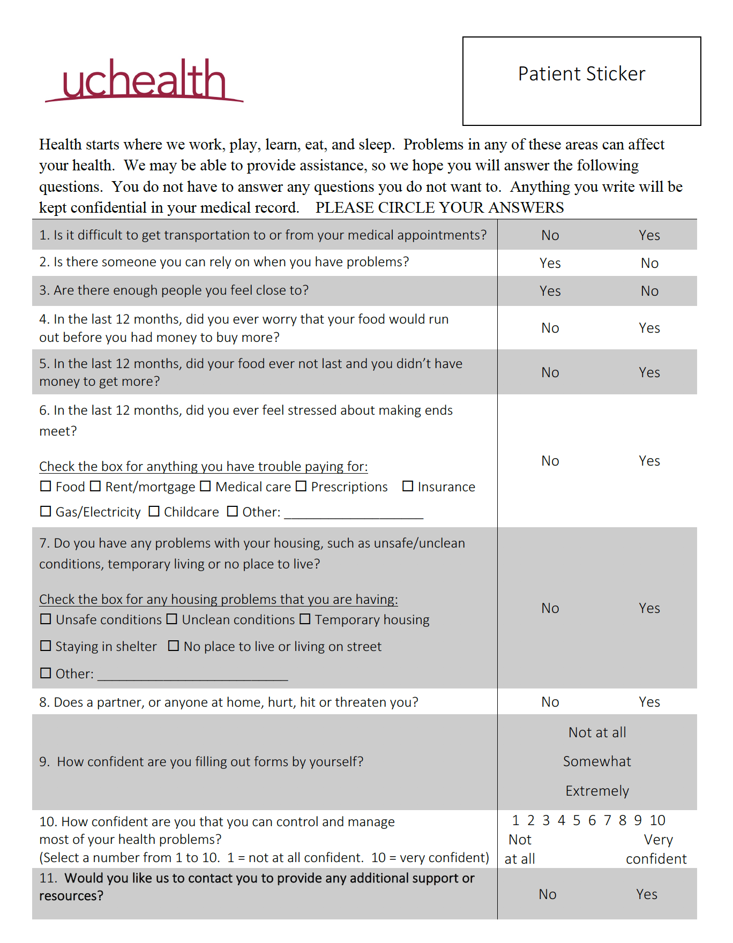
Transportation
Social
Isolation
Food
Insecurity
Financial Strain
Housing Problems
Household
Violence
Health Literacy
Health Confidence
Request for help
Notes:
We selected these items based on importance to clinical care, ability to intervene, and brevity of the question. We wanted to keep the questionnaire on a single page. The screener overall was modeled after the one being used by Children’s Hospital and individual items had all been previously published except for the housing question, which we created ourselves.
Prior to developing this screener, we had performed a needs assessment using two different approaches – CSPH students, waiting room survey
It is important to note that we were developing this screening tool at the same time that UCH was looking into adding social needs modules into epic. We were in the right place at the right time and were able to have this screening tool built into a flowsheet for recording data and creating reports.
Question 1
Manchanda R. Upstream Risks Screening Tool and Guide V2.5. Los Angeles, CA: HealthBegins; 2015.
￼
Questions 2 and 3
de Jong Gierveld J, Tilburg T. A six-item scale for overall, emotional and social loneliness: confirmative tests on new survey data. Research on Aging. 2006;28(5):582–598.
￼
Questions 5 and 6
Hager ER, Quigg AM, Black MM, et al. Development and validity of a 2-item screen to identify families at risk for food insecurity. Pediatrics. 2010;126(1):e26-32.
￼
Question 6
Brcic V, Eberdt C, Kaczorowski J. Development of a tool to identify poverty in a family practice setting: a pilot study. International Journal of Family Medicine. 2011.
￼
Question 7
Created de novo
￼
Question 8
Stanford School of Medicine. How to Ask. Stanford Medicine: Domestic Abuse 2017; http://domesticabuse.stanford.edu/screening/how.html. Accessed Jan 28, 2017.
￼
Question 9
Chew LD, Griffin JM, Partin MR, et al. Validation of screening questions for limited health literacy in a large VA outpatient population. J Gen Intern Med. 2008;23(5):561-566.
￼
Question 10
Wasson JH, Benjamin R, Johnson D, Moore LG, Mackenzie T. Patients use the internet to enter the medical home. The Journal of ambulatory care management. 2011;34(1):38-46.
Wasson JH, Johnson DJ, Mackenzie T. The impact of primary care patients' pain and emotional problems on their confidence with self-management. The Journal of ambulatory care management. 2008;31(2):120-127.

Slide 5
Screening and Referral Workflow

Slide 6



Community Partnerships
Electronic referral system
SNAP enrollment
Monthly data reports
Client intake completed by our staff
Extended hours
Connections to community service providers
Notes:
Early on, we learned that the nearby children’s hospital had a partnership with Hunger Free Colorado, an organization that operates a “Hunger Hotline” which includes a database of every food resource in the state. We were able to arrange an electronic referral system so they could then reach out to our patients, inform them of nearby food resources, and initiate enrollment in SNAP (food stamps) if the patient was eligible. They also sent us monthy reports detailing the outcomes of all of the referrals we made to them each month.
We also developed a relationship with a local emergency resource center that resulted in a streamlined intake process for our patients seeking their services, as well as extended hours for our patients to access their services
We recently started communications with the Colorado Regional health connectors. RHCs are a statewide network of regionally based lay workers whose job it is to make connections between community organizations, clinical services, and public health entities.

Slide 7
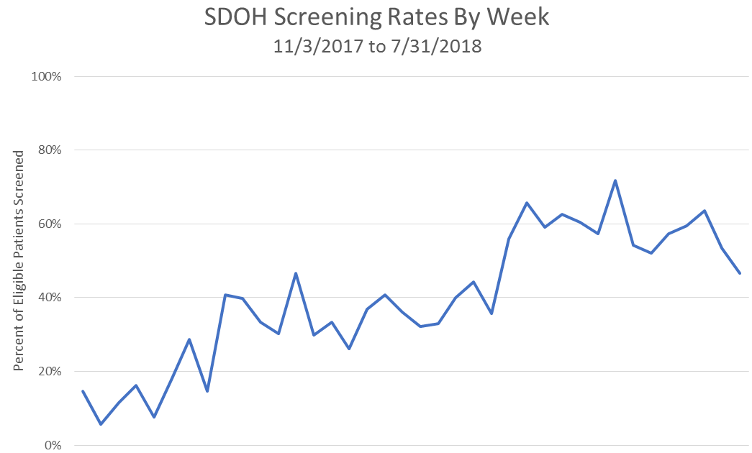
Data reviewed by staff during morning huddle
Staple screener to other pediatric paperwork
Labeling eligible patients on provider schedule
Screeners in exam rooms
Emphasize handing off screening results to providers
Screening data report created
Project update presentation to providers
Staff reminders in weekly email
Weekly email with provider-level data on screening rates
Screeners available for MAs to hand out
MA in-service
Nov
Dec
Jan
Feb
Mar
Apr
May
June
July
Notes:
Throughout the process, the steering committee met on a monthly basis to review data, gather feedback, and make modifications as needed. Additional ad hoc meetings of clinic leadership were also convened if higher-level decisions were needed or if larger barriers were encountered.

Slide 8
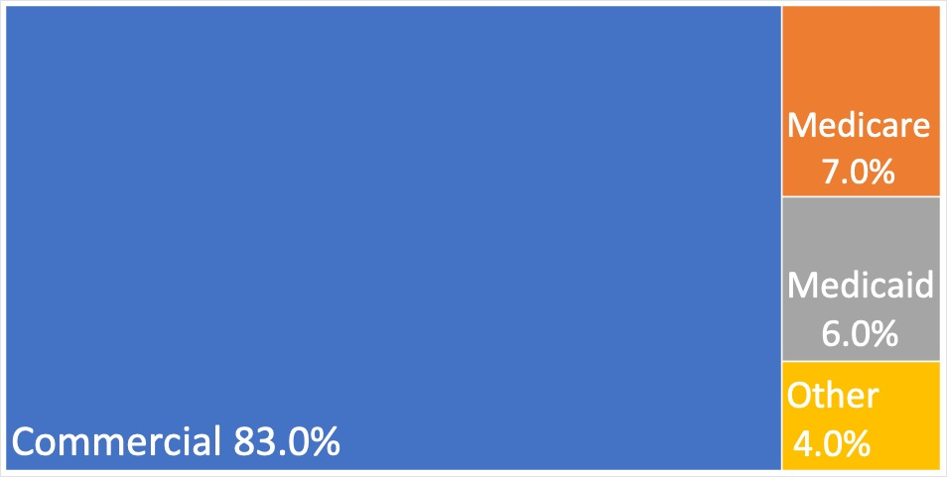
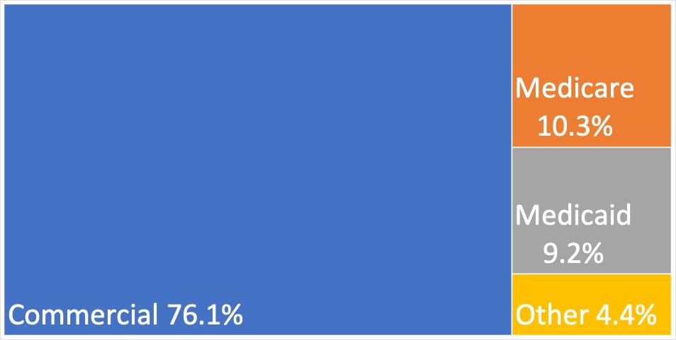
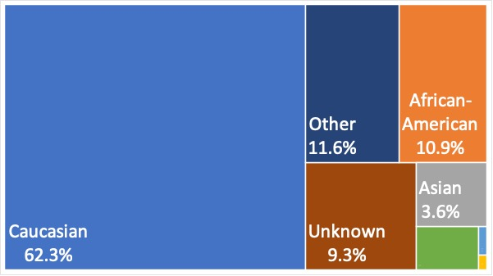
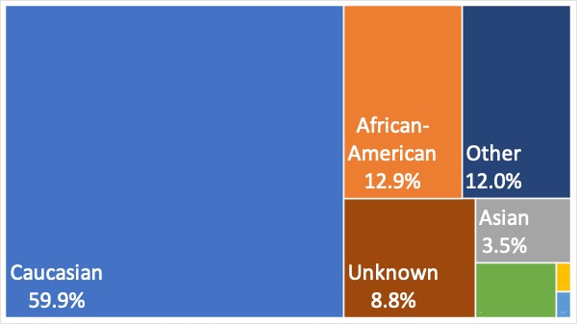
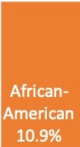
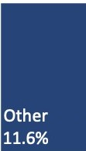
Screening Data: Population Characteristics
Screened
n=2018
Eligible for Screening
n=5083
Insurance
Race
2%
3%
>1 Race
American Indian
Native Hawaiian/ Pacific Islander
Notes:
Our screening process under-sampled patients with public insurance and African Americans. There were no differences by age or ethnicity

Slide 9





Social Needs Among Patients
Reporting >1 Need (n=541)
56%
37%
26%
25%
19%
Notes:
Rates at which help was requested:
Among patients with >1 need – 24%
Transportation – 22%
Social Isolation – 21%
Food insecurity – 38%
Financial Strain – 32%
Housing problems – 22%

Slide 10
“The social needs screening is an extra burden on
AF Williams staff & providers.”
Staff
Provider
Most staff and providers did not find social needs screening to be an extra burden.
Notes:
We were also pleased to find that most staff and providers did not find the screening to be an extra burden.

Slide 11
“Even though it takes some extra work, we should
continue using the social needs screening questionnaire. ”
Staff
Provider
Most staff and providers thought we should continue screening.
Notes:
They also felt that we should continue performing the social needs screening.
Responses do not add up to 100% because we had a “don’t know/not enough experience” option.

Slide 12
Staff & Provider Input on Screening Process
They liked….
Helps our patients
Identifies needs that would otherwise go undiscovered
Uses a systematic and comprehensive approach
Could be better…
Rephrase questions
Complete screening in the exam room
Easy to forget when things get busy
Communication of results
Screen more patients
Notes:
When asked how we could make the screening better, participants discussed some questions that needed rephrasing, and they they thought it might be better if the screening happened in the exam room, instead of the waiting room.
Providers felt that more staff ownership of the process would allow more patients to be screened.
Staff an providers both commented on the need for better communication of results.

Slide 13
Key Lessons Learned
It takes time to implement social needs screening!
Screening strategy missed key groups
Needs were prevalent, but patients frequently declined assistance
Screening was acceptable to patients, staff and providers
Room to improve teamwork and communication
  Anyone who has any role in screening needed to be represented during planning
Needed to improve messaging to patients about the initiative

Slide 14
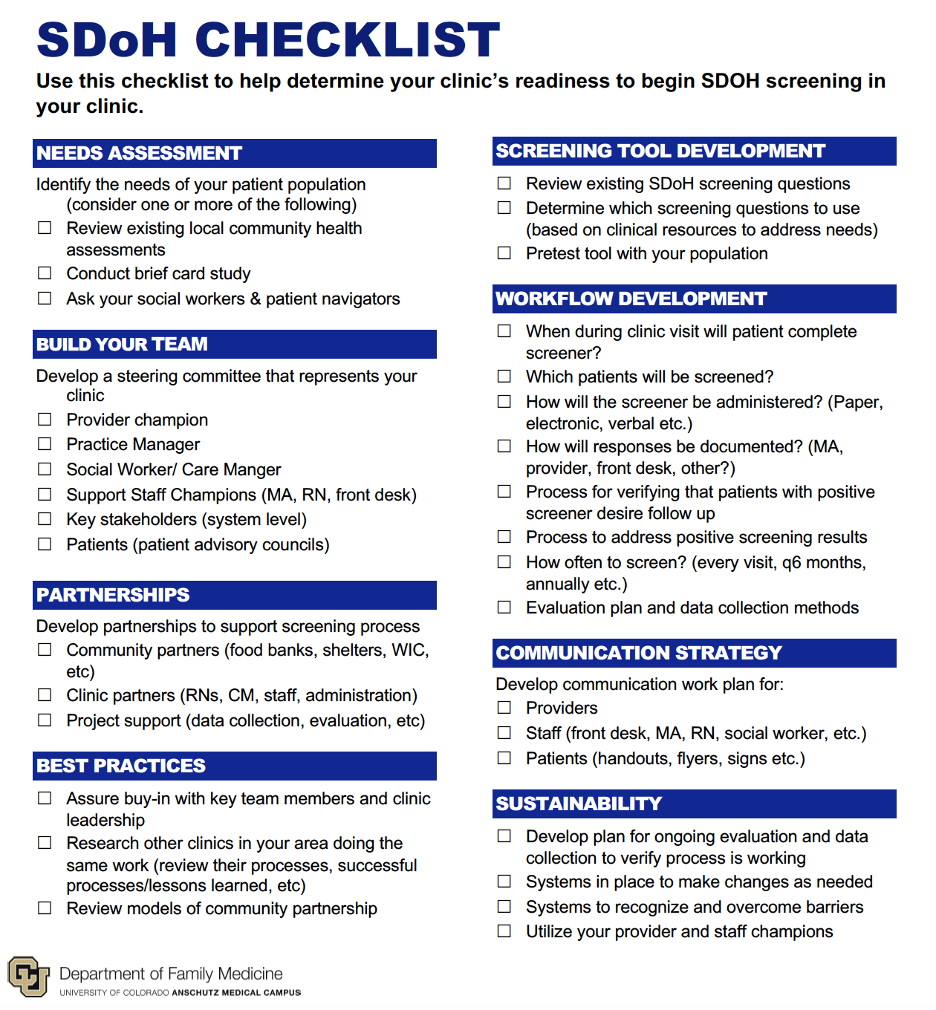

Slide 15


Moving Beyond Screening and Referral
That’s a lot of “A” words…
Focused on Individuals
Adjustment
Assistance
Modifying clinical care to accommodate social barriers
Connecting patients to community resources
Awareness
Identifying social needs and assets of patients
Alignment
Advocacy
Investing in and
deploying community resources for the wellbeing of patients
Promoting policies
that create or improve community resources or social conditions
Focused on Community
National Academies of Medicine, 2019

Slide 16
Acknowledgements
Many thanks to:
  Staff and providers at AFW
  CU Department of Family Medicine
  CU School of Medicine Clinical Effectiveness and Patient Safety Small Grants Program

