Slide 1
Clinical Education
Student Contributions to the Clinic

Slide 2
Objectives
Describe the purpose of student projects
Identify how clinical sites might determine an appropriate project idea

Slide 3
Value to the Student and the Clinic
Provides the student with opportunities to:
demonstrate initiative and accountability
understand the role of PT as a team member
develop an understanding of administrative quality improvement
Allows the student to share their knowledge with the staff and develop presentation skills in some instances
Adds value to the department or organization

Slide 4
Choosing the Project
Collaborative discussion between CI/SCCE/Supervisor
Could include a department project in process
Could be from a list of ideas generated by the rehab team
Could be a spontaneous idea from a student

Slide 5
In-services
Traditional way of students contributing to clinic
Appropriate for EBP knowledge dissemination, literature search strategies, etc.
Only one of many options for student projects

Slide 6
Topic Areas
Coding billing procedures
Policies/Procedures revisions
Staff recruitment/retention
Patient satisfaction assessment
Job descriptions
Annual competencies
Facility accreditation
Budgeting/finance
Risk management
Supervision/delegation of support staff
Quality improvement/control
Medicare compliance
Marketing
Documentation reviews
Inventory tracking
Reimbursement tracking
Program development
Productivity assessment
Documentation auditing
Outcomes assessment
Student orientation booklet
Clinic forms

Slide 7
Project Examples
Development of a customer service satisfaction survey
Start a journal club
Review of apps and technology uses in clinic
Program development and or promotional materials
HEP form development
Quick reference forms for equipment
Psychometric properties for common tests and measures
CSIF form completion
Form or Content development
Skills competencies
Equipment competencies
Prognostic indicators in various practice settings
In-services (EBP on areas of practice, eg)
Skills fairs for other disciplines
(transfer/gait training for CNAs/RNs
Development of patient education materials

Slide 8
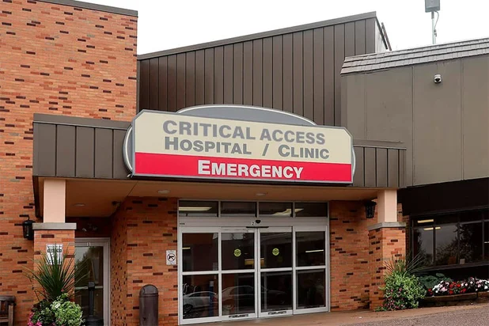
Rural Clinical Site Video
Strongly recommended as the project idea for student at rural clinical sites
Highlights aspects of the clinical site, people, layout, and activities
Showcases the community – events, restaurants/coffee shops, activities…and spirit
Example:
SW Memorial Hospital

Slide 9
The Win-Win
Project must be interesting & relevant to student
Adequate time (weeks) should be provided to complete the finished product
Expectations should be clear
The project liaison should be available for consultation & feedback

