Slide 1
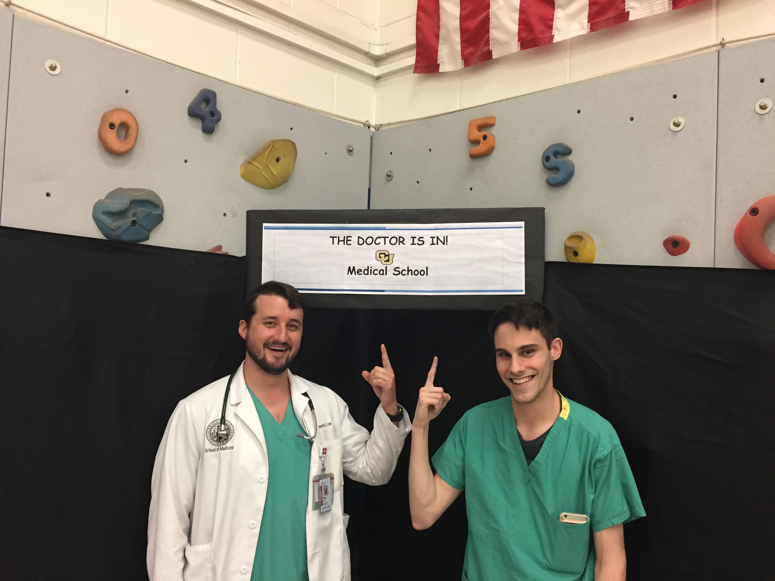
Lead the Way

Slide 2
What is the need?
Project Lead the Way
  STEM focused problem based learning
  Gap in pipeline
Our data
  More on this later

Slide 3
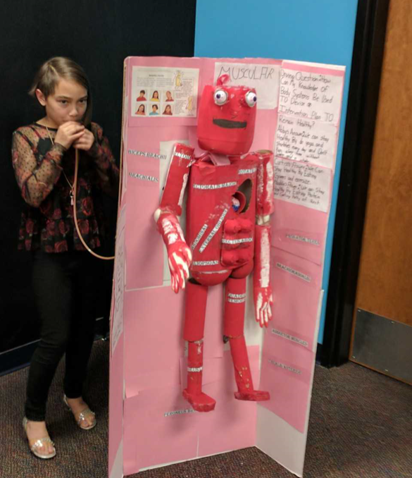
Our Mission & Our Direction
To interact with the children of Penrose Elementary and incite interest in the sciences.
To gather data
To build a partnership

Slide 4
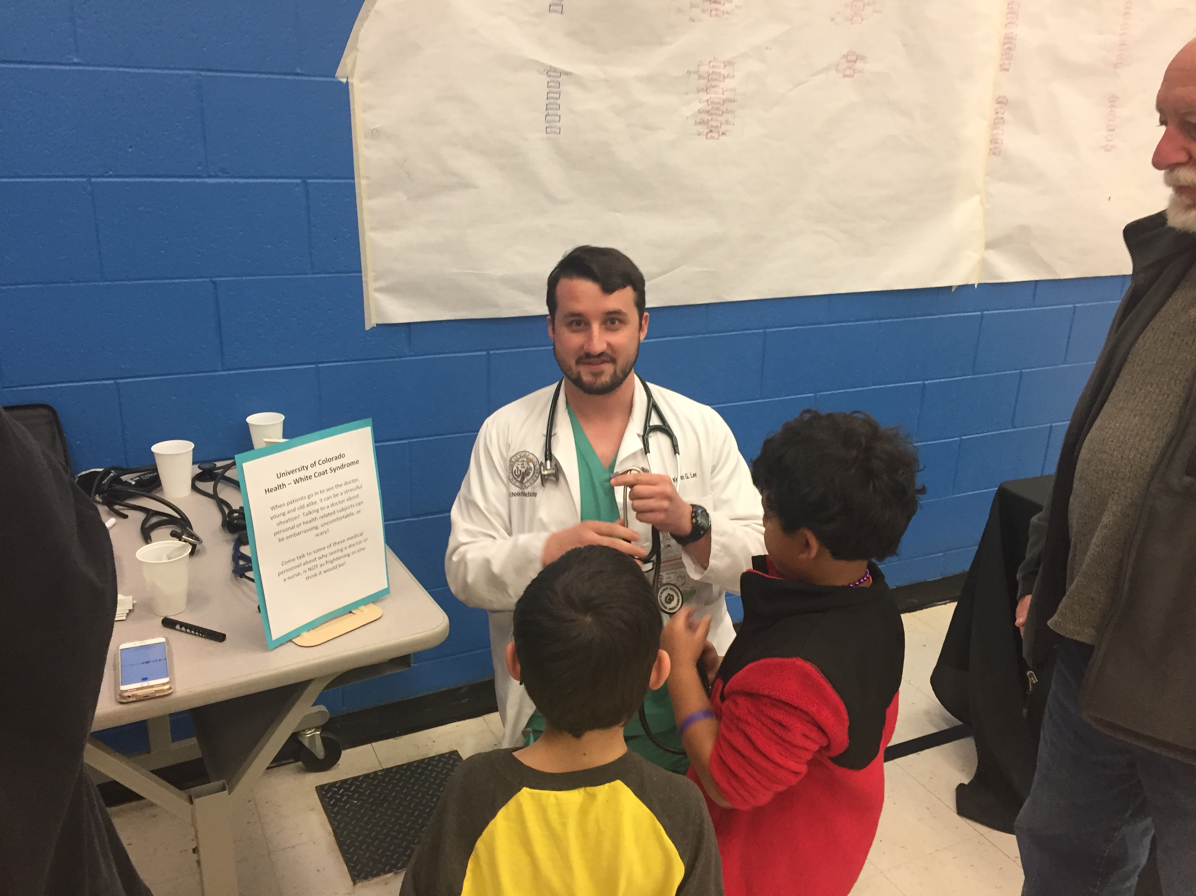
Our Approach
STEM Night – White Coat Station
  Exposed children to the “gadgets” of medicine.
    Everything from otoscopes to carefully observed suture kit station for older students
1-on-1 with 5th Grade Students
  Worked with students on Human Body Project
  Early exposure to physiology and pathology.

Slide 5
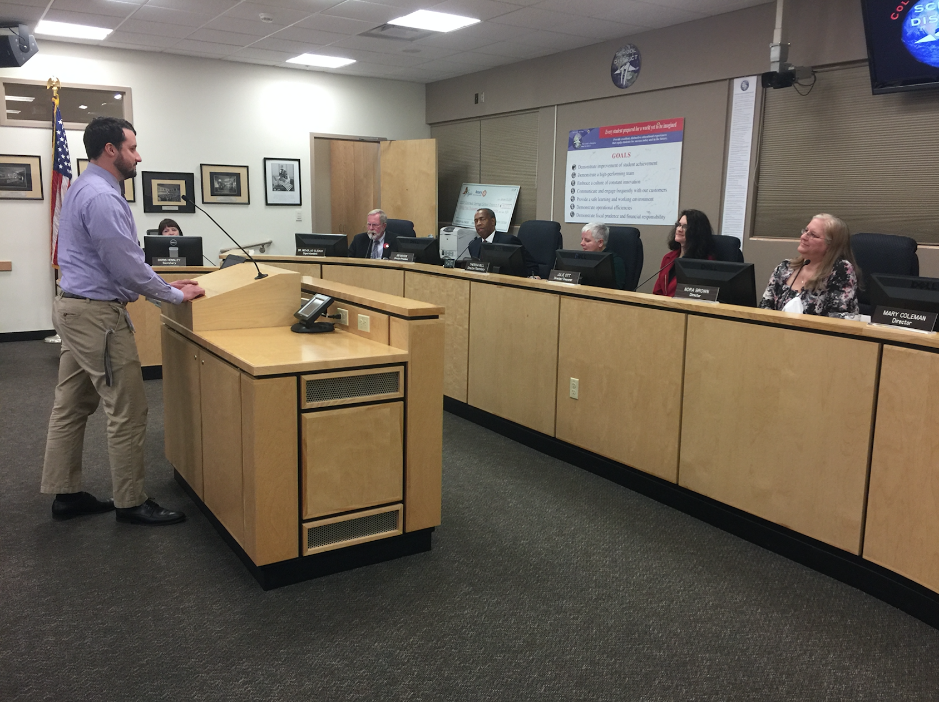
Our Approach
Advocate to School board
Survey development
  Evaluate student interest across grades
  Guide future directions
  May be useful to PLTW

Slide 6
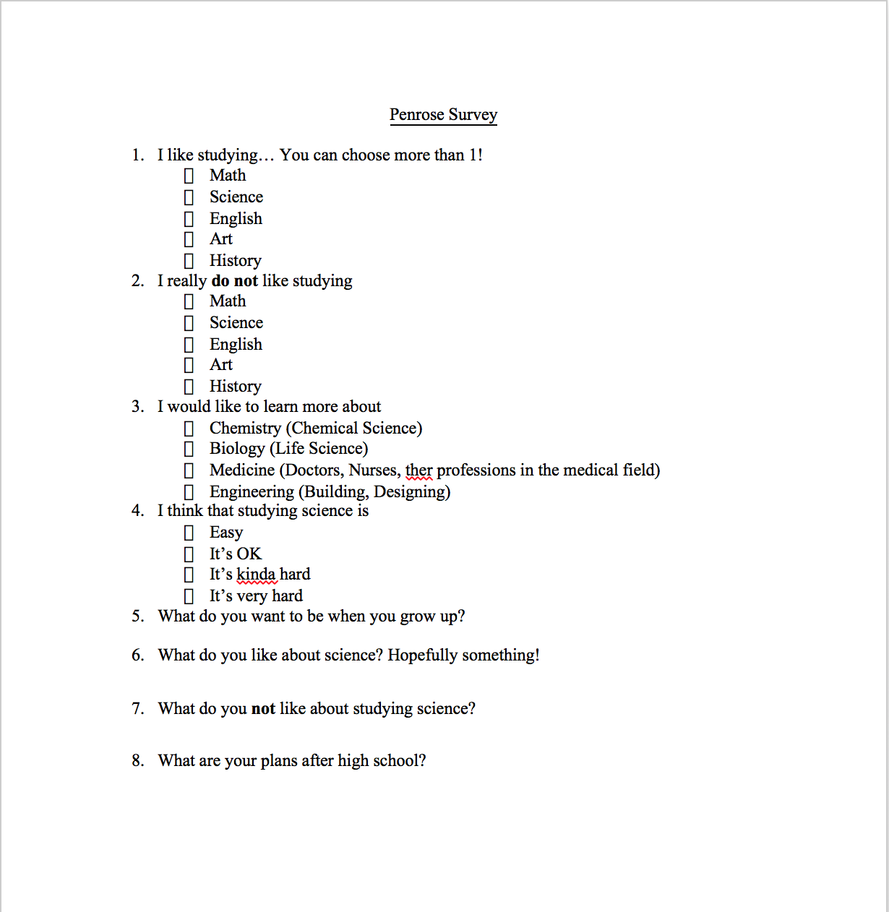

Slide 7
I Like Studying…

Slide 8
I Don’t Like Studying…

Slide 9
I Want to Learn More About…

Slide 10
I Think Studying Science is…

Slide 11
What do you want to be when you grow up?
Successes
  “A singer, or a doctor”-Grade 3
  “Be in nursing”-Grade 5
  “Got to collage to be a doctor”-Grade 5
  “Cryptozoologist”-Grade 2
  "I want to be an art teacher and the first woman president. I want to join the miltary.”-Grade 3
  “Professional saxaphone player, singer, doctor, or lawyer.” –Grade 3
Less Impressed
  “Drive cars”-Grade 3
  “Make Youtube videos”-Grade 5
  “Fun”-Grade 2
  “To buy a house and food”
  “Pipe fitter”-Grade 2
  “Making $”-Grade 3
  A Taekwondo master-Grade 2
  “Parent”-Grade 2

Slide 12
What do you like about science?
Successes
  “Owls and Owl Pellets”-Grade 5
  “Making potions”-Grade 2
  “Cryptozoology”-Grade 2
  “Explosions”-Grade 2
  “It is messy”-Grade 2

Slide 13
What do you not like studying about science?
Successes
  You don't get to take it home and you might get hurt" –Grade 3
Less Impressed
  “It does not seem important”-Grade 2
  “It is boring”-Grade 3
  “Challages”-Grade 2
  “Worms”-Grade 3
  “I don’t like wearing suits”-Grade 3
  “I do not like how you could die”-Grade 3
  “Everything”-Grade 2

Slide 14
What are your plans after high school?
Successes
  “Goto colig”-Grade 3
  “Go to collage”-Grade 5
  “Collag”-Grade 2
  “Get into UCCS”-Grade 2
  "I'm going to do computer science and have a boyfriend!”-Grade 2
  “Cryptozoology”-Grade 2
Less Impressed
  “Having fun”-Grade 2 (could go in Successes)
  “To get a dog”-Grade 2
  “Going home”-Grade 2

Slide 15
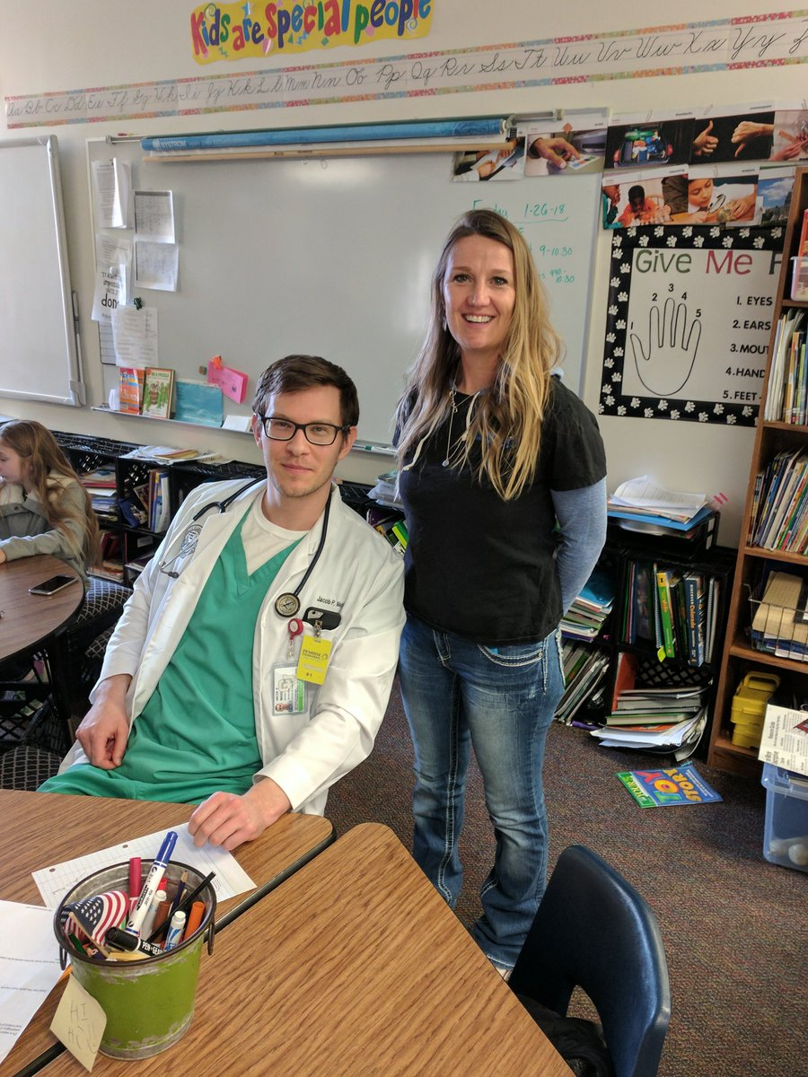
Challenges
Finding mutual time to meet
Defining our role in a brand new project
Good ideas, difficult implementation

Slide 16
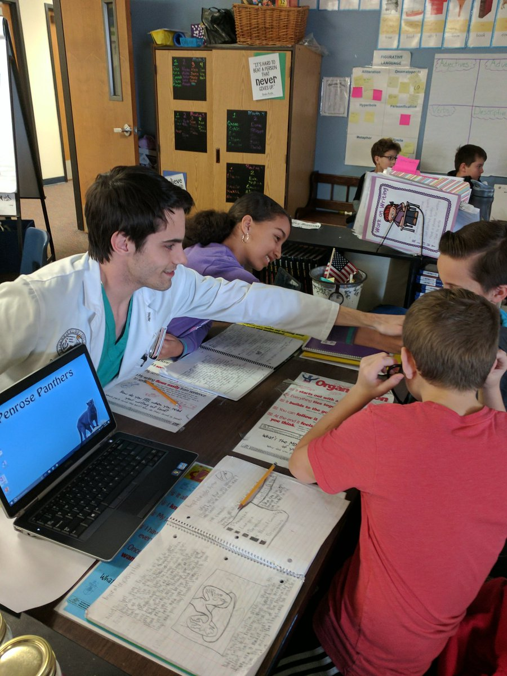
Take Aways
Students are generally excited about science and medicine
Students had awesome projects and seemed genuinely interested
Based on the surveys something happens between 3rd and 5th grades

Slide 17
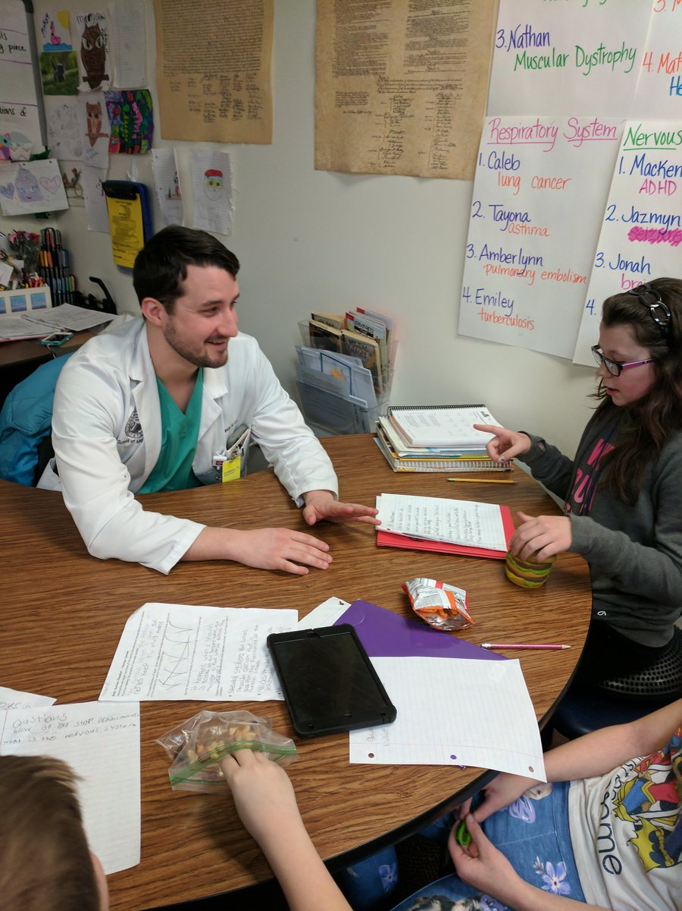
Next Steps
CU SOM class of 2020
Share ideas early
Continue the surveys
Dig into the 3rd to 5th grade discrepency
Continue advocacy

Slide 18
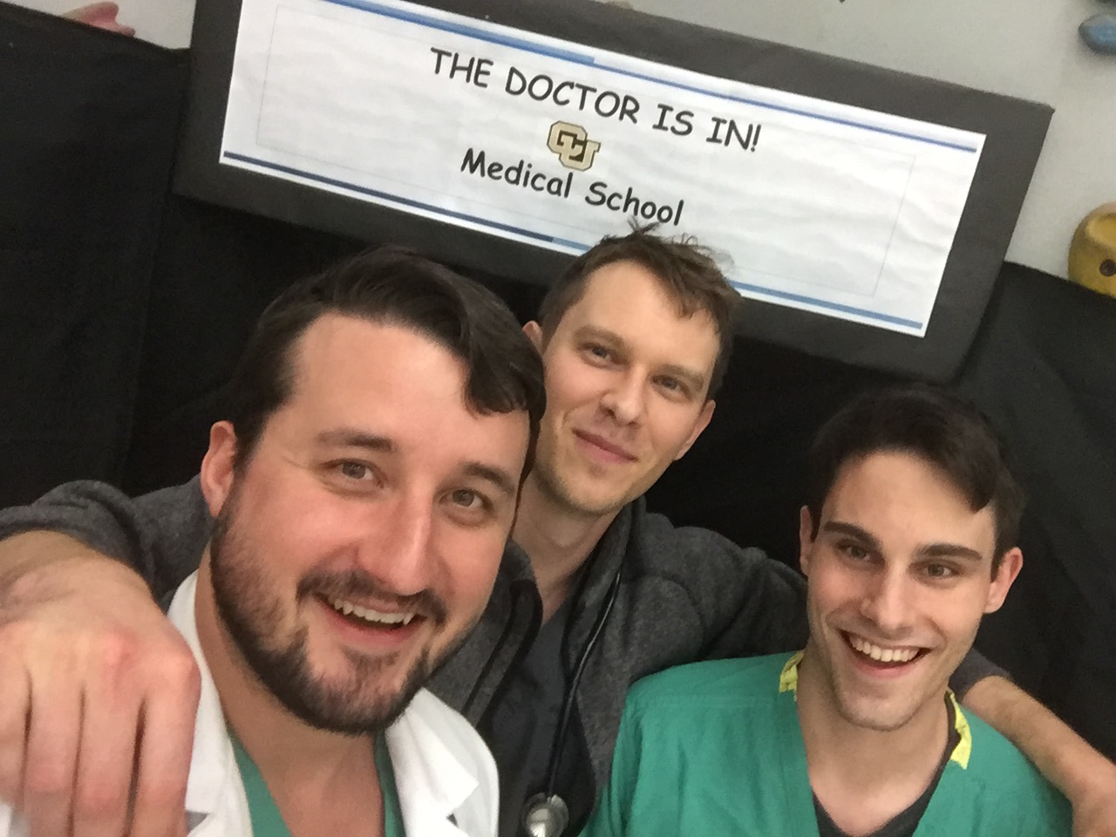
Questions?

