Slide 1
Partnership Education Action Project: Mitchell High School
Nick Anderson, Aya Angstadt, Carl Dernell
University of Colorado School of Medicine
Colorado Springs Branch | March 16, 2018

Slide 2
Who We Are

Slide 3
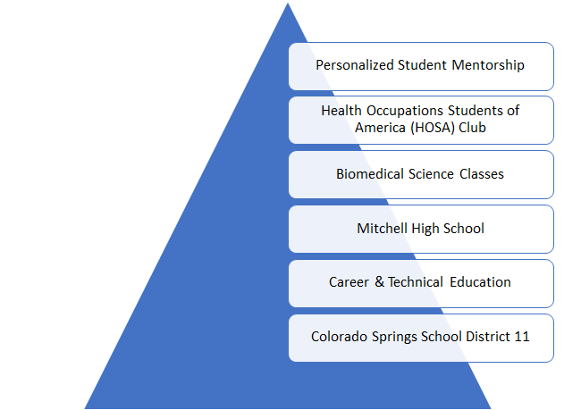
All About the Partnership
Notes:
It's called Project Lead the Way | use the word assets
– add in pictures of teachers, students, us...
TALK ABOUT ASSETS
A team of 3 very supportive teachers at Mitchell who are passionate about the Biomed program, the HOSA club, and their students.
Students in HOSA (specifically student leadership) and Biomedical programs
Support of District 11
Biomedical classes during the school day and biomedical club/HOSA in the evenings

Slide 4
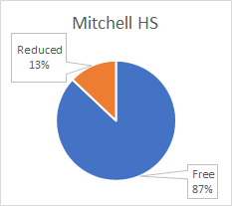
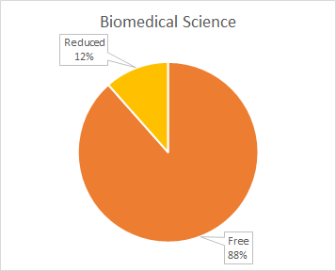
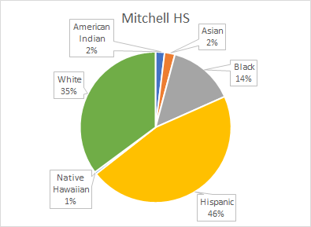
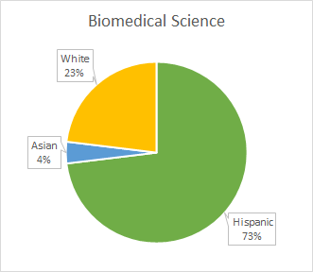
MORE ABOUT OUR PARTNERS
The students at Mitchell High School come from a disadvantaged demographic that is underrepresented in healthcare. As a result, there is a need to spark interest in health professions that might not otherwise exist.

Slide 5
MISSION AND INNOVATION
Increase awareness of the healthcare profession
Inspire academic achievement in the Colorado Springs community
How?
Providing personalized mentorship
Preparing engaging activities
Providing opportunities to gain exposure to the medical field
Notes:
Talk about meetings with teachers

Slide 6
GOALS OF THE PROJECT
Short-term
Bimonthly large group event with smaller events with mentees
Help students prepare for state HOSA competition in February
Develop personal relationship with mentees
Professionalism!!!
Long-term
Increase retention in the Biomedical Science Program
Increase the college matriculation rate of students from the Biomedical Science Program
Inspire students to pursue healthcare careers
Fully-connected D11 – UCCS – CSB pipeline

Slide 7
CSB-Led Events

Slide 8
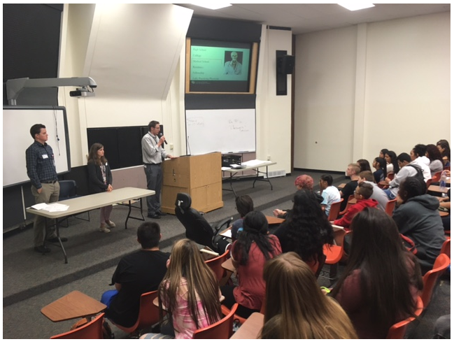
MEDICAL STUDENT PANEL
Question and Answer Assembly!
181 freshman-senior students enrolled in biomedical sciences classes
Life of a medical student
What is medical school?
“…again, it’s 4 years college, 4 years med school, then 3-7 years residency”
...and the hand shaking begins

Slide 9
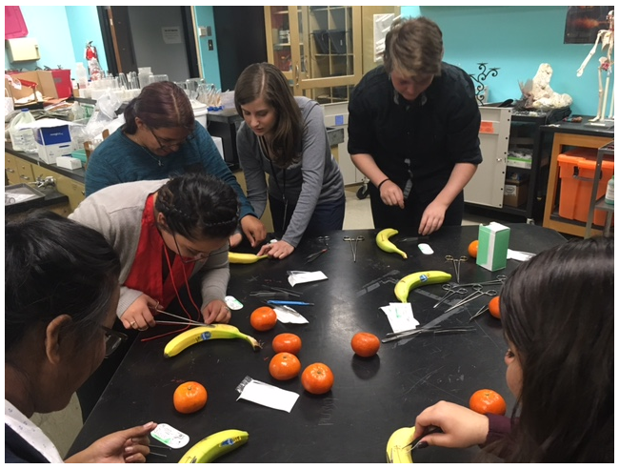
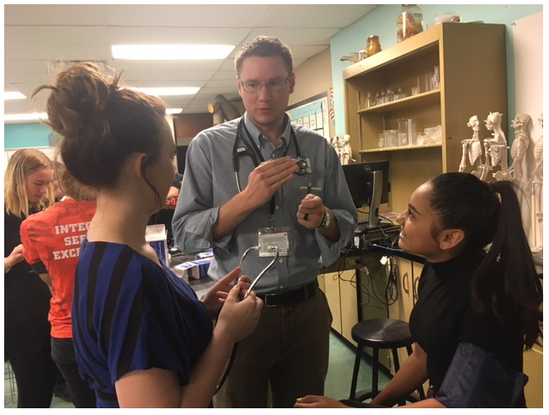
SUTURE CLINIC (...AND HOW TO USE A STETHOSCOPE CLINIC)

Slide 10
PROFESSIONAL LETTER WRITING WORKSHOP
GOAL: Teach a practical application of professionalism
Students wrote mock professional letters to a physician in the community to inquire about shadowing opportunities

Slide 11
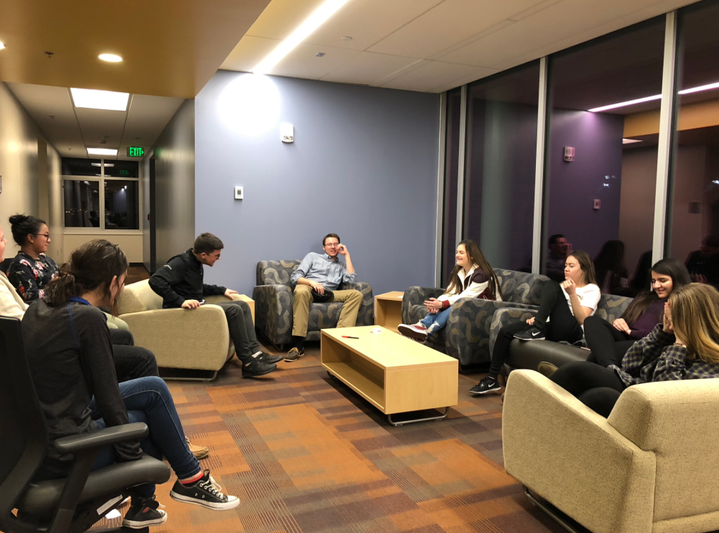
MENTOR GAME NIGHT
GOAL: Give platform for mentees to ask more personal questions
Opportunity to interact ONE-ON-ONE with mentees
Learn about mentees' life goals
Ask questions about college!
Have fun!

Slide 12
OTHER EVENTS
Guests at Friday Afternoon Didactics
They brought our energy WAY up!
How to think like your doctor
Starring Nick AKA Justin Bieber suffering from appendicitis
"It taught me what diagnosing a patient is like and let me connect more personally with the mentors"
Splinting Clinic with the one-and-only Dr. Lam!

Slide 13
SUCCESS!

Slide 14
RECEPTION – FROM THE STUDENT’S VIEW
SELECT RESPONSES
Are you considering a career in health care? If so, which one?
Yes, pediatric doctor or surgeon
yes, undecided
Yes; undecided
Yes, im not sure yet
Yes, genetic counseling
forensic pathologist – CARL IS PROUD
Yes, an orthopedic surgeon.
Yes, physician
Yes, doctor

Slide 15
RECEPTION – FROM THE STUDENT’S VIEW
SELECT RESPONSES
What was the most meaningful event for you this year? Why?
Suture, and blood pressure clinic
Suture & blood pressure clinic, and game night. Lots of personal time with mentors.
The most meaningful event was the game night because we had the chance to learn more about the mentors and the steps to take to follow our careers.

Slide 16
RECEPTION – FROM THE STUDENT’S VIEW
SELECT RESPONSES
How has the medical student mentorship program influenced your desire to pursue a medical profession?
It just made me more motivated to actually go for it
It has provided with more information on what medical school and different fields are like to help me in my decision.
Very much; it gave me insight on what it’s like to be a medical student.
It has definitely provided more information on what to expect in medical school and has brought my interest into great consideration
It has greatly influenced me because it has shown me it is not impossible like so many people make it out to be.

Slide 17
RECEPTION – FROM THE STUDENT’S VIEW
SELECT RESPONSES
What has been your favorite aspect of the medical student mentorship program?
Everything it was a real great experience
Being able to see what medical school/the medical field is really like and has let me have a personal relationship with medical students.
Having a connection with the medical students was important to me because we got to know them.
My favorite aspect is having the personal relationship to somebody who is where i want to be.
Getting to know the mentor better

Slide 18
RECEPTION – FROM THE STUDENT’S VIEW
SELECT RESPONSES
Do you think that medical student involvement with high school students improves the community of Colorado Springs? If so, how?
I think it does because they teach us things we usually don’t have courage to ask or want someone who actually knows about it. Also the medical students are just students like us so we both have similarities just on different levels
Yes, i believe it does because it connects the higher education students with the lower education
It improves the community of Colorado springs because you wouldn't normally have medical students interacting with high school students.
Yes, it grows the community because the involvement is growing
It does. This means we have more medical professionals
Yes it could get more people involved in medical careers
Yes i believe so because it helps high school students pursue medical careers and have stronger connections than they would usually have.

Slide 19
Outcomes by the Numbers
Opportunity to share success at D11 Board Meeting
HOSA State Competition
3 students qualified for International HOSA competition in Dallas
Epidemiology, Public Speaking, Medical Terminology
1st in state in Medical Terminology
Top 5 placement in Clinical Nursing, Biomedical Laboratory Techniques, and Medical Career Display
Future outcomes to track: Graduation rates, retention in biomedical classes during high school career, college attendance, healthcare careers

Slide 20
Lessons Learned & Future Work

Slide 21
LESSONS LEARNED
Unexpected obstacles
Needs assessment for one-on-one personalized mentorship with students
Leadership lessons
Teachers were amazing assets
Planning debrief meeting
Utilize HOSA student leadership (focus groups, meetings, etc.)
Bureaucracy barriers
Difficulties getting access for students to shadow physicians in the community
Take more pictures next year!

Slide 22
NEXT STEPS
Future event ideas
Ultrasound workshop
Participate in classroom dissections
Sustainability
This project is best served by having permanent medical student involvement
Establish a sustainable shadowing program for the high school students
Establish a system that allows for meaningful one-on-one mentorship
Establish continuity between Penrose Elementary School and Mitchell High School via a middle school

Slide 23
OUR CLOSING THOUGHTS
Impact of teacher support
Impact of partnership on high school students
Impact of high school students on us!

Slide 24
Thank You!
Questions?

