Slide 1
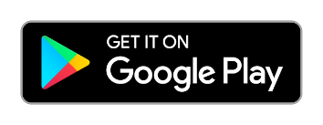
EAB Navigate360 Student Quick Start Guide
Navigate360
Guidance for Setting Up Your App.
Follow these steps to start using the Navigate360 app today!
Download Navigate360 from the App Store
1
Download the Navigate Student app from your device’s app store.
Search for your institution’s name in the dropdown menu. Use your institution’s login credentials to log in.
2
Access your institutions Navigate360 Student Experience on the Desktop at: or through the Mobile Application. Use Chrome or Firefox browser for best results. Use your institution’s login credentials to log in Desktop Experience: https://ucdenver.navigate.eab.com
3
If you have any trouble logging in, please reach out to Student.Success@ucdenver.edu

Slide 2
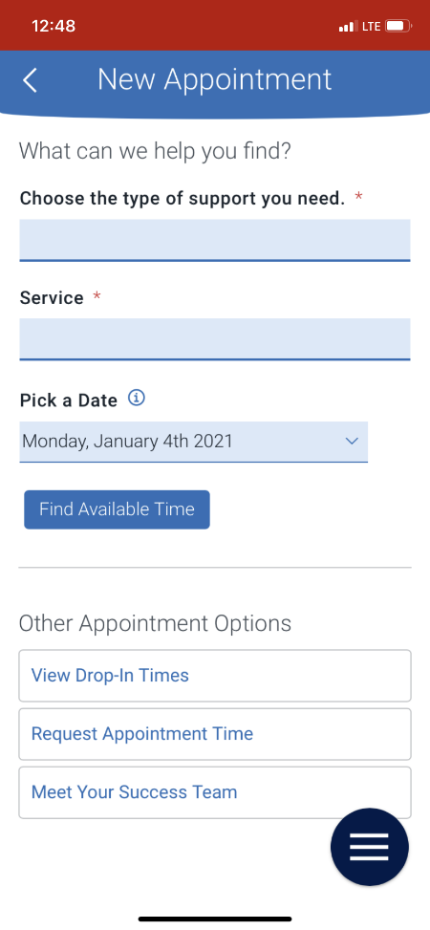
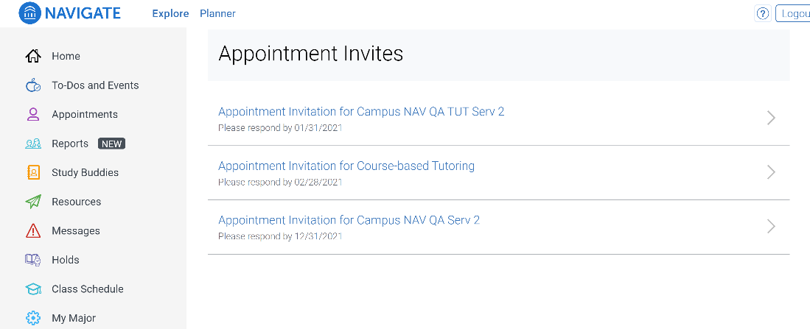
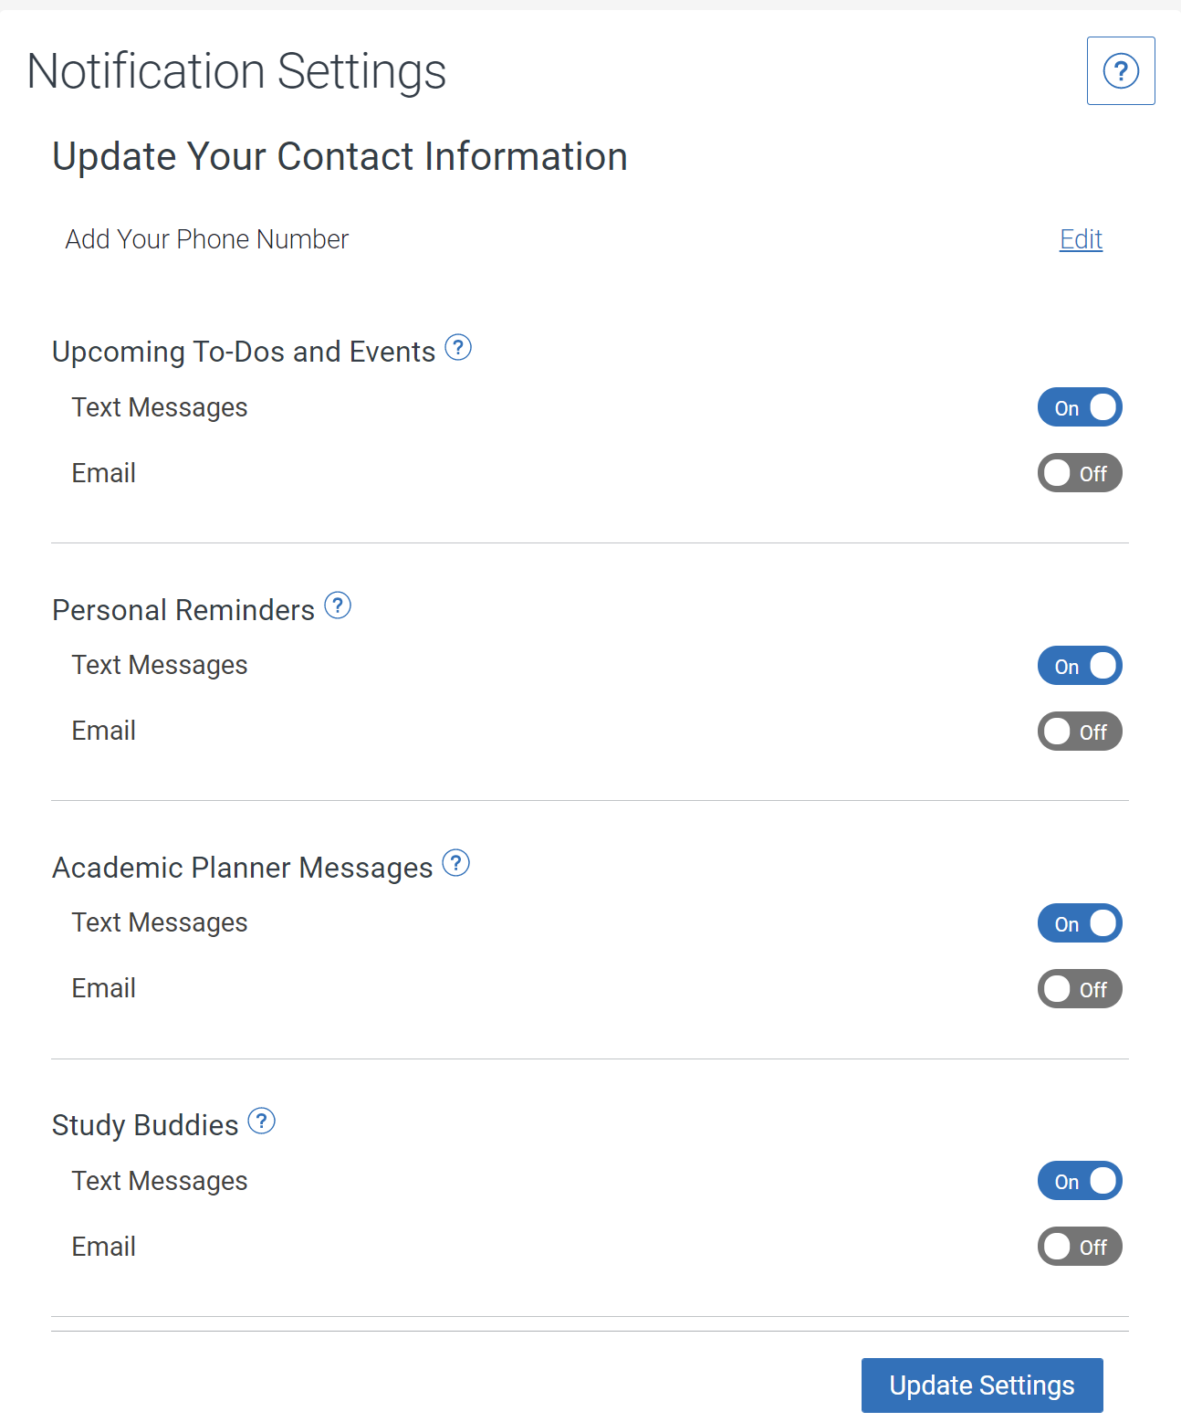
Make an Appointment
To schedule appointments, click the purple Appointments icon on the left navigation menu and answer questions about your preferred service, date, time, and location.
Other Appointment Options
You can also view available drop-in times or request appointment times for your preferred service.
Appointment Invitations
Your Success Team (e.g., assigned advisors, instructors) may also request you meet with them. When this happens, you receive an appointment invitation where you only need to choose a time that works for you!
Set Up Notifications
1
Choose the Account button on your app or on the desktop site.
Select Notification Settings. Scroll to find content categories such as Study Buddies
Select your preferred method of notification. Note: You can select as many notification methods as desired, but you receive multiple notifications if you choose more than one.
If you select the Text option, ensure that your cell phone number is accurate in Navigate360. You can do this by choosing Edit next to Add Your Phone Number.
2
3
4

Slide 3
Hand Raise
Let your campus know that you are looking for more information or need additional assistance by “raising your hand”. This can be accessed either by clicking the “+” sign on the top right of your screen or by clicking the Hand Raise icon on your home page.
My Docs
Here you can see Appointment Summaries, Notes and/or Progress Reports that have been shared with you by your Success Team. You can see reports that were created after your school enabled this feature that you have permission to see. Reports are hidden 180 days after they are created.
Resources
See a list of important services and locations on campus. The People tab shows a list of your assigned staff, e.g., advisors and instructors. Click the heart icon to favorite a resource. You can find your favorites in Settings > Favorites.
View Your Class Schedule
See your course schedule at a glance or get additional details such as meeting time, location or instructor.

