Slide 1
Student Success Collaborative
Navigate360
Quick Start Guide for Navigate360
GETTING STARTED
1. Log in to Navigate360 using your SSO credentials! Once logged in, links below will take you directly to the Help Center with How-to steps, videos, and best practices.
Training site URL: https://cudenver.campus-training3.eab.com/ - available for training/practice only
PRODUCTION SITE URL: https://cudenver.campus.eab.com/ –
2. Configure Availability and Calendar for Appointment Scheduling
Set Up Your Availability - This is an important first step that will allow you to then create appointments with students by selecting the ‘Add Time’ from your Staff home screen - see Appendix A for detailed instructions on setting up your Availability.
Sync Your Calendar - This initiates the two-way sync between Navigate360 and your calendar. See Appendix B for detailed instructions.
KEY PLATFORM FEATURES
Perform These Key Actions to Identify, Communicate With, and Support Students (Please note these features are permission-based at your institution)
For assistance please email Student.Success@ucdenver.edu
Reference the Student Profile – After clicking on a student’s name through the search results, your Staff Home, or the Quick Search, note their Academic progress and any areas of concern with the various tabs on a student’s profile
Mass Email and Text a Group of Students – Use ‘Send a Message’ from the ‘Actions’ drop-down to contact your advisees or other lists you’ve created in the platform – see Appendix C
Add Appointment Summary Reports or Notes– Record your interactions and follow-ups from student meetings by adding an Appointment Summary Report (record associated with an appointment) or a Note (general record not associated with a specific meeting) – see Appendix D
Create a Progress Report or Issue an Alert to initiate Alert interventions. Staff will intervene based on level of interventions – see Appendix E
Create an Appointment Campaign - Use this to invite students set up an appointment during times you have designated – see Appendix F
Build an Advanced Search - Use Saved Searches and Lists to create your own caseload of students through student population filters – see Appendix G

Slide 2
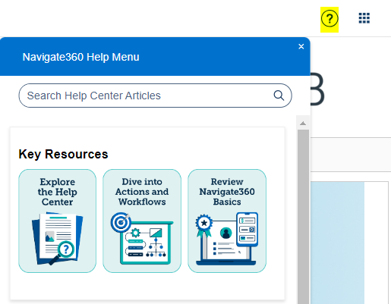
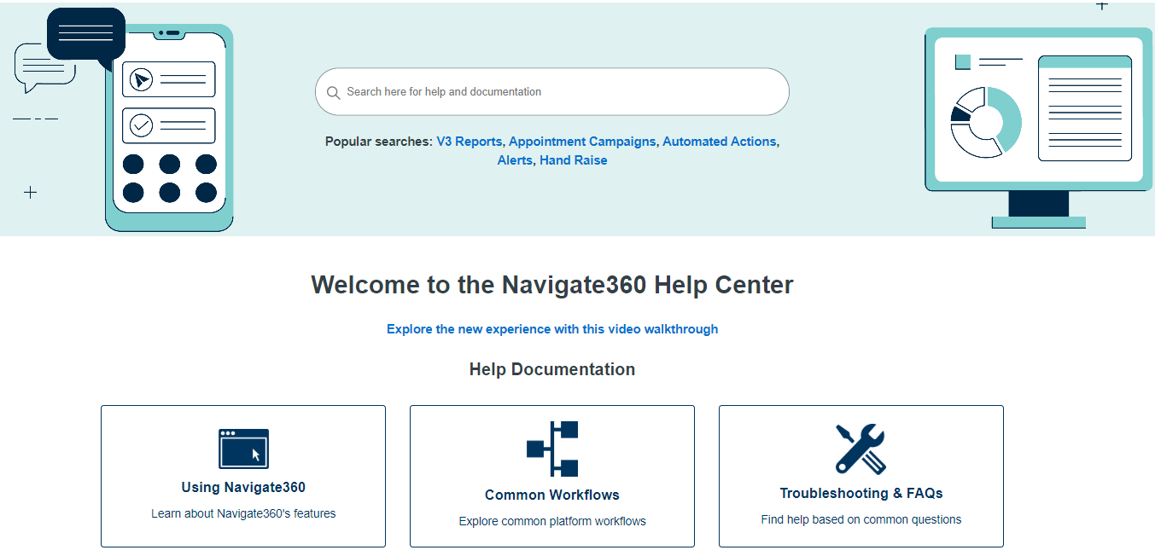

Need Help? Access EAB’s Help Center
Visit the Navigate360 Help Center for articles and how-to instructions on all Navigate360 Features and Workflows.
Accessing the Help Center -
Step 1: Log in to Navigate360
Step 2: Click on the question mark icon in the top right hand corner.
Step 3:Click Explore the Help Center to be taken to articles and step by step instructions for Navigate360 features and workflows. View the Help Center Overview Video to get the most from its resources!
Tip:
Links to feature-specific articles in the Help Center are found at the bottom of each page of this document (look for this icon)
For more detailed guidance, check out the Help Center!
Additional Questions? Email xxx for support!

Slide 3
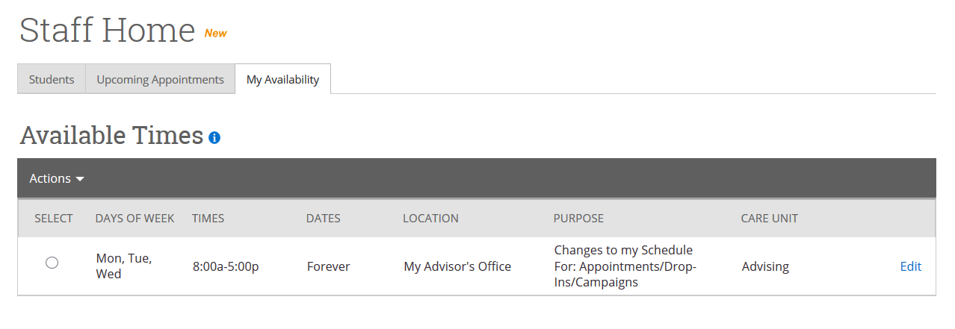
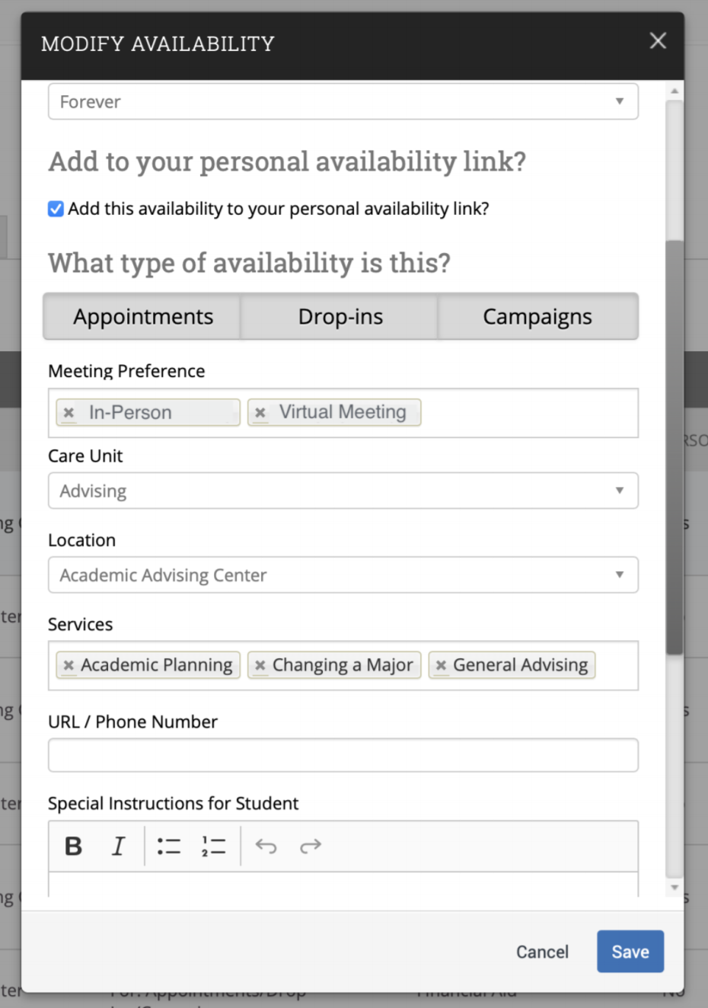
Appendix A: Setting Up Your Availability
Availability
As a new user, the first thing you need to do is set up availability so that students can schedule appointments to see you. It is important to note that locations and services are created by institution administrators.
Add Time -
Step 1: Click the Add Time button in the Actions Menu
Step 2: Select the days as well as start and end time in the From and To fields.
Step 3: Set the length of the availability with the How Long Is this Availability Active? field.
Step 4: If you want this availability added to your personal availability link, select Add This Availability to Your Personal Availability Link? You can put the personal availability link in an email or text or on a website. Students are taken to a scheduling workflow that has the staff/faculty’s chosen availabilities pre-filled. (Note: Personality Availability Link only works for regular Appointments, not for Drop-in’s and Campaigns)
Step 5: Select your Availability types. You can choose more than one at a time. For example, an availability can be for both Drop-In and Appointments.
Step 6: For Meeting Preference, select the applicable meeting modality.
Step 7: For Care Unit, select appropriate functional area.
Step 8: Choose the location where you will be available.
Step 9: Select services you can provide students during this availability. You must choose at least one service but can pick more.
Steps 10-14 continued on next page…

Slide 4
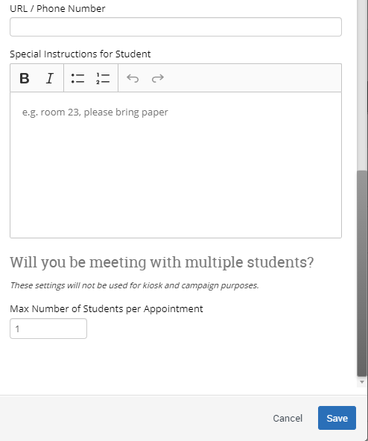
Appendix A: Setting Up Your Availability
Step 10: In the URL / Phone Number field, add your meeting link for your appointments.
Step 11: Use the Special Instructions box to include additional details for students. (Example: We will use Zoom for our meeting, which you can access by using the link provided. Virtual meeting spaces allow us the flexibility to connect from various spaces. Please ensure the space you are in is conducive for such a meeting. I very much look forward to meeting with you!)
Step 12: If you want to hold group appointments, you can specify the number under Max Number of Students per Appointment. Otherwise, you can leave is as 1 for one-on-one appointments.
Step 13: Click the Save button.
Step 14: Repeat this process until all your availabilities have been defined.
You can have as much availability as needed.
Creating multiple availabilities will enable you to set aside specific blocks for specific services (registration advising for example) or meeting types (drop ins vs. scheduled appointments)
Editing Availability:
Copy Time - to copy a time, select the time you would like to copy and then click the Copy Time button. The availabilities will be copied, and a dialog will open allowing you to make edits or to save your newly created availability.
Delete Time- to delete your time, simply select the time and click the Delete Time button.
Group Appointments - You can create availability for group appointments by indicating how many students are able to schedule into the same appointment (indicate specific number under “Max Number of Students per Appointment”)
Inactive availabilities are highlighted in red in the Times Available grid.
For more detailed guidance, check out the Help Center!

Slide 5
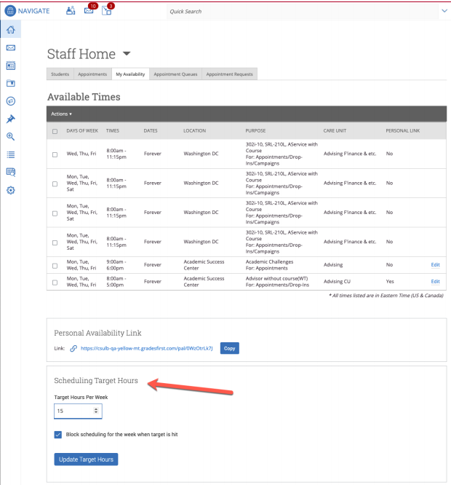
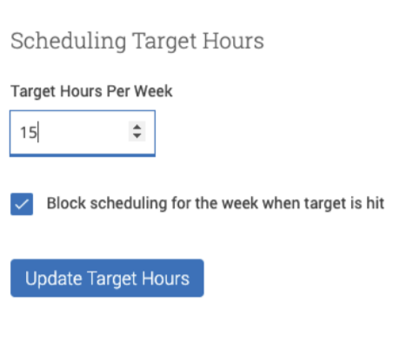
Appendix A: Setting Up Your Availability & Target Hours
Target Hours allow staff to restrict the number of hours in which they can be scheduled for appointments via Student Scheduler.
Staff set their Target Hours in the Scheduling Target Hours section.
Target Hours have two aspects:
  Target Hours Per Week: This is the maximum number of hours per week in which they can be scheduled for an appointment. (You can set this between 1-168 hours.)
  Block scheduling for the week when target is hit: If selected (and hours have been reached), the staff member will no longer be available to students for appointments for the remainder of the week.
Note: Target Hours are calculated against all Services, Locations, and Care Units. Your Leadership Team will provide clarification on how this feature should be used.

Slide 6
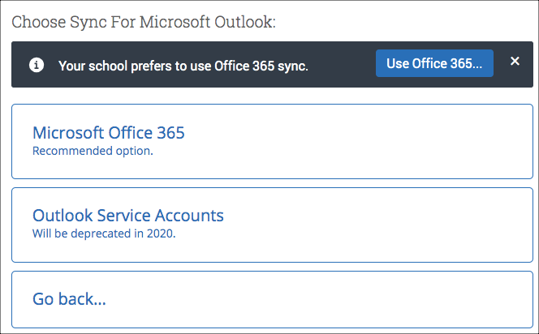
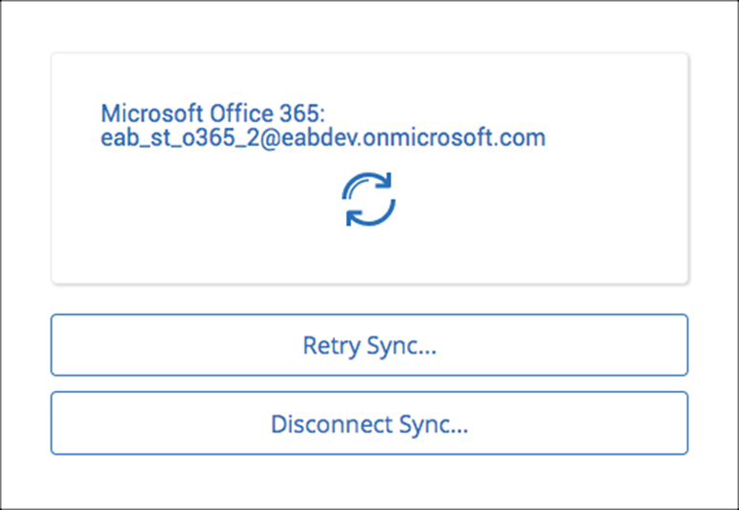
Appendix B: Sync Your Outlook Calendar
Integrating Your Calendar
The availability you set up within Navigate360 dictates students’ ability to schedule appointments with you. You have the added option to integrate your calendar with the Navigate360 platform to pull in Free/Busy times from your personal calendar and push appointments scheduled in Navigate360 to your personal calendar.
Toggle to the calendar page within Navigate360 using the calendar icon on the left side toolbar.
Select Settings and Sync on the top right side of the page
Click Setup Sync. You will see a “Your school prefers to use Office 365 sync” banner on Calendar with a “Use Office 365…” button to begin the setup.
Upon clicking the button, you will be routed to login.microsoftonline.com. If the you are not already signed into Office 365, you will be prompted to sign in.
After signing in, Office 365 will ask you to grant permission for the application to access your calendar. Pressing “Accept” will authorize and begin the syncing.
The browser will return to the Calendar Integrations page. The “Exchange Integration” tab will no longer appear. The “Office365 Integration” tab will now show the timestamp for the last successful sync (or any applicable error message) and will include options for you to Retry or Disconnect the sync as needed.
The Two-Way Sync will enable that any agenda item created from Navigate360 will sync back to your Outlook Calendar. All existing events and events that are created from your Outlook Calendar will be shown as ‘Busy’ in Navigate360
For more detailed guidance, check out the Help Center!

Slide 7
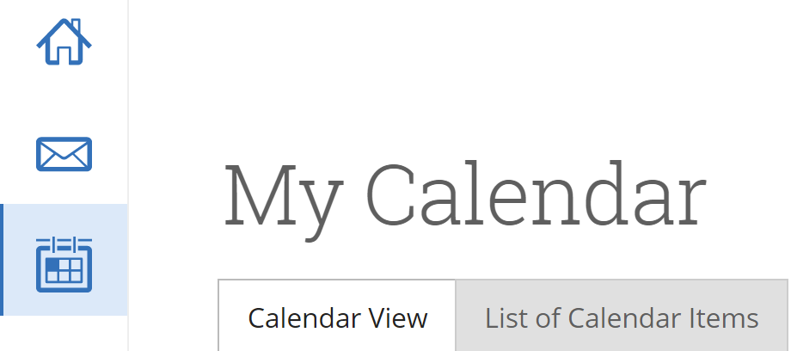
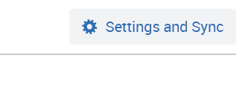
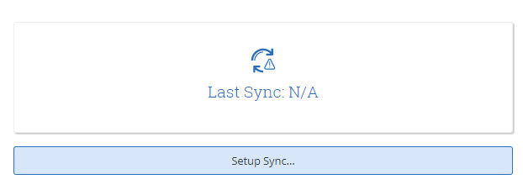
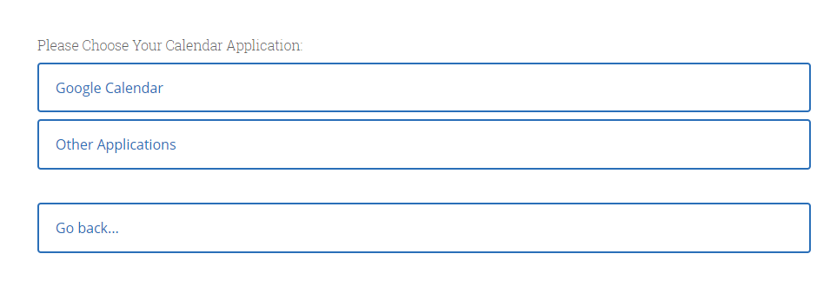
Appendix B: Sync Your Google Calendar
Integrating Your Calendar
PLEASE ONLY SYNC YOUR CALENDAR IN THE PRODUCTION SITE
The availability you set up within Navigate360 dictates students’ ability to schedule appointments with you. You have the added option to integrate your calendar with the Navigate360 platform to pull in Free/Busy times from your personal calendar and push appointments scheduled in Navigate360 to your personal calendar.
Step 1: Click on the Calendar Icon on the left side toolbar (third icon from the top).
Step 2: Click “Settings and Sync” in the upper right-hand corner
Step 3: Click “Setup Sync…”
You can now sync your calendar by clicking the “Google Calendar” button. You will be prompted to complete the sync from your Gmail account confirming your request to sync. Click “Allow”. You will then be relocated back to Navigate360. Click on the drop down for “calendar for two-way sync” and select your Gmail address. Finally, click the “Save and Update” button. This should complete your calendar sync. Please log into Gmail to view your calendar and compare it against the calendar within Navigate360. You can reach out to your Business Analyst for any technical questions. You can also reach out to your Dedicated Consultant for management and use of the calendar from a functional aspect.
The Two-Way Sync will enable that any agenda item created from the platform will sync back to your Google Calendar. All existing events and events that are created from Google Calendar will be shown as ‘Busy.’

Slide 8
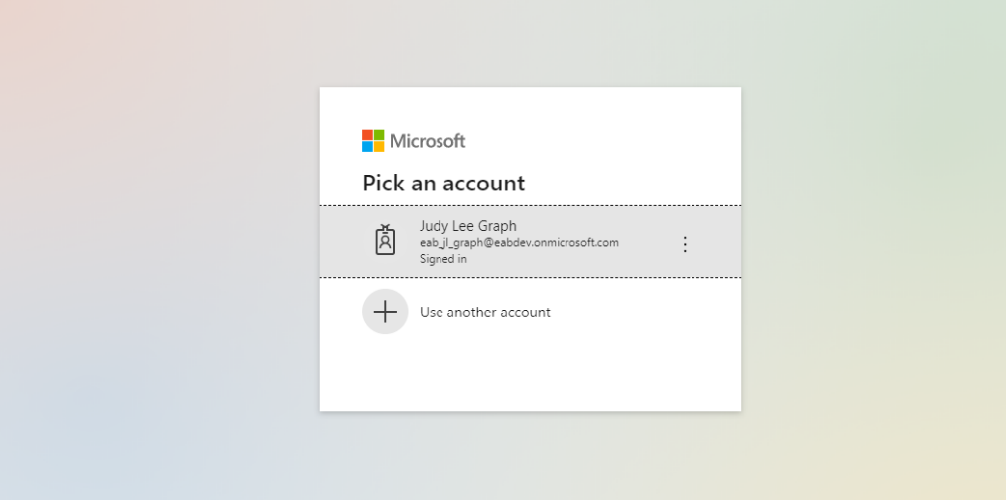
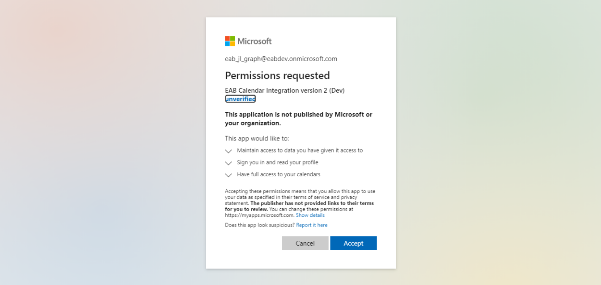
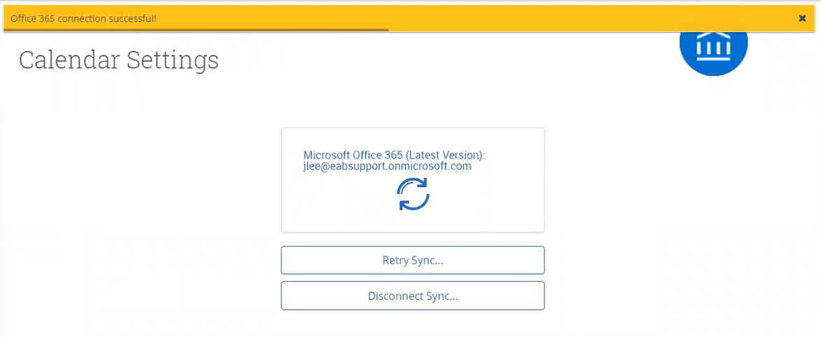
Appendix B: Sync Your Outlook Calendar
Integrating Your Calendar
If you log in successfully, you see a page requesting permissions.
Select Accept. The page redirects to the Navigate360 Calendar Settings page, with a success message and information about the sync on display.

Slide 9
Appendix C: Mass Email and Text a Group of Students
Communicating with Students
Navigate360 provides both email and text messaging for faculty and staff to communicate with students, either individually or en masse. Communicating with students through the platform creates records of those communication which can be accessible by other staff or faculty on your campus. In addition, it allows for a quick and easy way to communicate with more than one student at once.
Any faculty or staff member will only be able to view communications in which they have the proper permissions. Permissions allow users to either view only their own communications with students, or to view all communications with students. If you are unsure who can view your communications, contact your Application Administrator.
How do I send the emails or texts?
You can send emails or texts to one or more students from your staff homepage, the student profile, or the advanced search. Most “Actions” menus throughout the platform allow for sending emails or texts. See below for screenshots of each of these locations.
Send a message from the Staff home page (fig. 1)
Send a message from the Student home page (fig. 2)
Send a message from the Advanced Search (fig. 3)
Important Note: If you do not see the option to Email or Text students, then your role does not have the proper permission for this action, or your institution decided not to allow texting. Please contact your Application Administrator with questions.
For more detailed guidance, check out the Help Center!

Slide 10
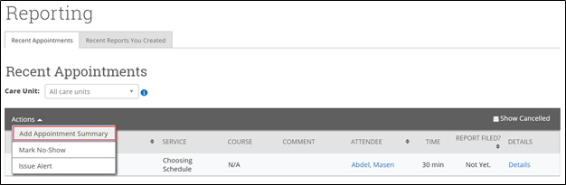
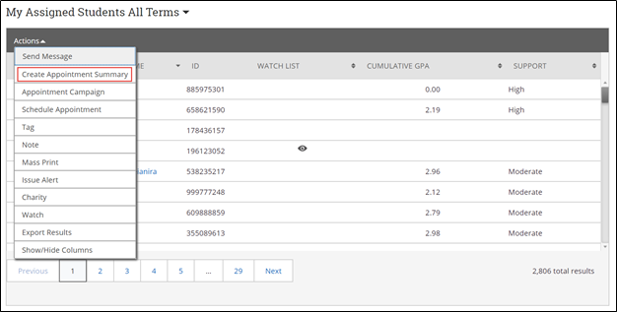
Appendix D: Add Appointment Summary Reports
Documenting a Student Interaction
Summary Reports can be created during or after meeting with students. You can add a summary report to an appointment scheduled in advance, create a summary report for a walk-in appointment, mark a student as a no show, or edit existing summary reports.
For Scheduled Appointments: There are several different ways to create an Appointment Summary Report for scheduled appointments. Add Appointment Summary is an option in the Actions drop-down menu throughout the platform. The easiest way to access your appointments is from your Staff Home page. Under the Students tab on Staff Home, scroll down and find your Recent Appointments. From this section, you can click on a student and select Add Appointment Summary from the Actions drop-down menu. You can also access this section from the Upcoming Appointments tab of Staff Home.
Note: It is important to always create Appointment Summary Reports from the scheduled appointment itself, rather than ad-hoc, to ensure the Summary Report is tied to that specific appointment.
For Drop-in Appointments: There are several different ways to create an ad-hoc Appointment Summary Report for walk-in appointments. Create Appointment Summary is an option in the Actions drop-down menu throughout the platform. The easiest way to create an ad-hoc Appointment Summary Report for a walk-in appointment is from Staff Home or a student profile. Under the Students tab of Staff Home, find the specific student in your My Assigned Students section, or click the drop-down to find the student from one of your saved lists. From this section, you can click on a student and select Create Appointment Summary from the Actions drop down. This will create an Appointment Summary and add that appointment to your calendar in the past.
For more detailed guidance, check out the Help Center!

Slide 11
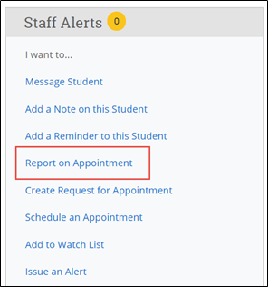
Appendix D: Add Ad Hoc Appointment Summary Reports
Documenting an Advising Interaction
You can also create an ad hoc Appointment Summary Report from a student’s profile page. Navigate360 to that specific student’s profile and click Report on Appointment from the Actions menu on the right. This will create an Appointment Summary and add that appointment to your calendar in the past.
Reminder: When creating an ad-hoc Appointment Summary Report to track drop-in appointments, the Navigate360 platform will create the relevant appointment on your calendar for the date and time you selected in the past. Creating that appointment helps our system keep track of all appointments happening with students, regardless of whether they were scheduled or walk-ins. If you sync your professional calendar to the Navigate360 platform, this appointment created in the past will also sync to that calendar.
For No-Show Appointments: The primary way to mark a student as a no-show for a scheduled appointment is from Staff Home. On the Students tab, scroll down and find your Recent Appointments. From this section, you can click on a student and select Mark No-Show from the Actions drop down. You can also access this section from the Upcoming Appointments tab of your homepage. Marking a student as a no-show still adds a Summary Report to the appointment. The only difference is that the box next to the student’s name called Attended will not be checked. See the screenshot below.
Important Note: Any information you enter into Navigate360 pertaining to a student becomes a part of their official student record and may be subpoenaed by that student, as outlined in the Family Educational Rights and Privacy Act (FERPA).
For more detailed guidance, check out the Help Center!

Slide 12
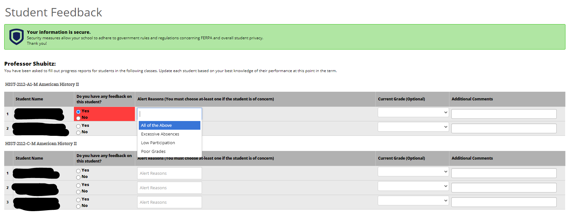
Appendix E: Create a Progress Report or Issue an Alert
Submitting a Progress Report
Navigate360’s Progress Report feature is used by faculty to share critical academic information on students enrolled in their courses. Use the instructions below to submit a Progress Report and mobilize support for a student.
Step 1: Access the Progress Reports either directly from the request email or by logging in to the Navigate360 platform and toggling to the Professor home page.
Step 2: Click “Fill out Progress Report” from email or home page.
Step 3: In the feedback screen, you will see a list of course sections and students that feedback is being requested for. This may or may not include all the students enrolled in your courses this semester. Begin filling out feedback according to the instructions provided in the Progress Report request email.
Step 4: If you have feedback about a student, select “Yes” and choose an “Alert Reason” that indicates why you are submitting feedback on this student. You may choose more than one alert reason. Please fill out the remaining columns, including the comments section with additional detail that will help an advisor follow up with this student.
Step 5: When submitting your Progress Reports, you have the option to submit only the students you have filled out feedback for or to submit all students. If you choose to submit all students, the students who you have not filled out feedback for will be marked as “I do not have feedback about this student.”
TIP: Use the glossary of Alert Reasons on the next page to understand what follow up action will be associated with each Alert Reason.
For more detailed guidance, check out the Help Center!

Slide 13
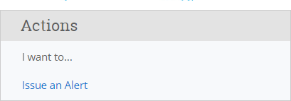
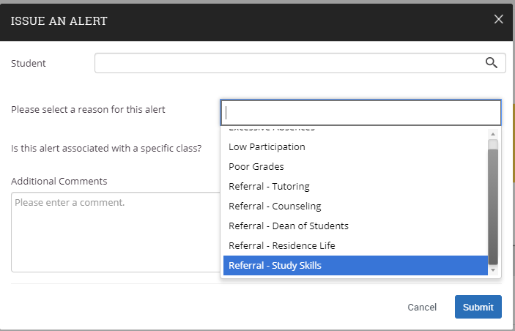
Appendix E: Create a Progress Report or Issue an Alert
Submitting an Ad-Hoc Alert
Navigate360’s ad hoc alerts are used by faculty and staff to share critical information and to create referrals for student between support offices. Use the instructions below to submit an early alert and mobilize support for a student.
Step 1: Click the “Issue an Alert” link in the upper right-hand corner of your home page.
Step 2: Search for the student for whom you’d like to issue an
alert (using name or ID).
Step 3: Select the reason(s) you believe the student needs assistance. The reason(s) you choose will connect the student with the appropriate office. See more details
on the specific alert reasons below.
Step 4: If the alert is associated with a particular class, fill out that field.
Step 5: Lastly, please provide any relevant context around your reason for submitting the alert in the comments section. Comments will help the team reviewing alerts to connect the student with the right resources in a timely fashion.
Step 6: Issuing an alert may open a case. You will receive an email notification when the case has been resolved.
TIP: Use the glossary of Alert Reasons on the next page to understand what follow up action will be associated with each Alert Reason.
For more detailed guidance, check out the Help Center!

Slide 14
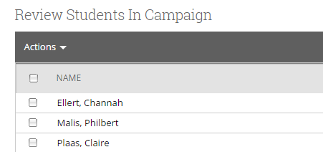
Appendix F: Creating an Appointment Campaign
Building your Campaign
Navigating to Campaigns: While on the staff home screen, select “Appointment Campaigns” from the left-hand side Quick Links section. This will take you to the Campaigns tab. From there, select Appointment Campaign from the right-hand side, under Actions.
Define Campaign:
  Name your campaign (Students will not see the name of the campaign)
  Select “Advising” as the Care Unit (or the applicable Care Unit for your campaign)
  Location- Choose your location. NOTE: Ensure that for the campaign availability you have created under “My Availability” you have selected that you will be available in the same location (Advisor’s office).
  Under “Service”, choose the services for which you are available. NOTE: This must match the availability you have set up on your staff home page, under “My Availability”.
  Begin Date and End Date- choose the date range for which you want the campaign to run. If a student tries to schedule outside of that time period, they will receive a message stating that the campaign has expired. NOTE: This must match the availability you have set up on your staff home page, under “My Availability”.
  Appointment Limit- how many appointments can the student schedule for the campaign? (default is 1)
  Appointment Length- how long do you want the appointment to last?
  Select 1 slot per time (select more if you’d like more than 1 student to select the same time slot)
Adding Students: Use the advanced search feature to search for students you would like to participate in the campaign. Or choose one of your saved searches by clicking the drop-down arrow beside “Saved Searches”.
Adding Staff: If you have correctly set up your availability for Campaigns then you should see your name on the next page under “Add Advisors to Campaign”. If applicable, select other advisors to join your campaign.
Compose Your Message:
  Create a Subject Line for your email
  In the next box, edit the text for the email. Default is “Please schedule your advising appointment”. NOTE: Always be sure to keep the Schedule Link in your email body, if that is removed students will be unable to schedule appointments.
Confirm & Send: Review the details of your campaign. When you are ready, click send to issue the email to students on the list.
For more detailed guidance, check out the Help Center!

Slide 15
Appendix F: Creating an Appointment Campaign
Drafting your Campaign Message
Adding Staff: If you have correctly set up your availability for Campaigns then you should see your name on the next page under “Add Advisors to Campaign”. If applicable, select other advisors to join your campaign.
Add Welcome Message, Nudges, and Success Message:
Nudges replace the Compose a Message functionality and allows for more communication from your school to students during an Appointment Campaign. Each nudge is an email or SMS message sent to your campaign list.
  Click Add Welcome Message to create your first nudge. You have a choice to create either an Email nudge or an SMS nudge. You must create at least one nudge per campaign. The nudge can be either an email or an SMS. Only one nudge type (email or SMS) can be sent per day. There are no limits to the amount of nudges you choose to send during the campaign.
  Enter a subject line and customize the message.
  Choose a Send Date. This is the date the nudge is to be sent. Nudges are sent in the morning of the date chosen when you create the nudge.
  After creating a nudge, click Save Nudge to add it to your campaign.
  You can also create a Success Message on the Nudges step of an Appointment Campaign. This is an email or SMS message sent the day after the recipient schedules all appointments for the campaign. It is for communication purposes only. Click Add Success Message to start creating a Success Message.
    The Add Success Message page is like the Add Nudge page; however, there is no Send Date because the Success Message only sends after the student schedules an appointment.
Verify & Start: Review your campaign details, nudges, invitees, and advisors on this page. Click Start Campaign when you are ready to email the invites to the selected students.
For more detailed guidance, check out the Help Center!

Slide 16
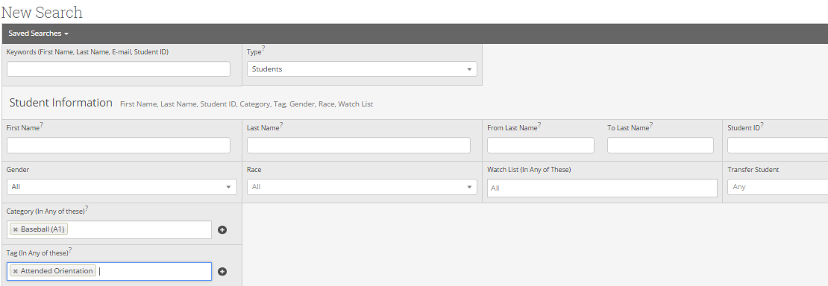
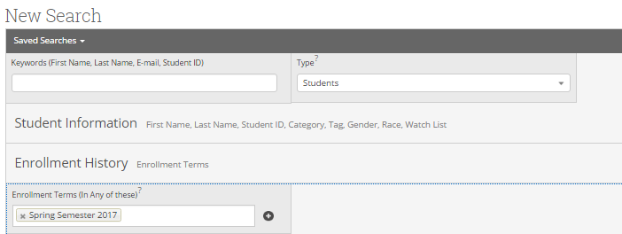
Appendix G: Creating Advanced Searches
Filtering Student Data
Advanced Search lets you create unique cohorts of students based on the layering of search parameters. The search results are used as the foundation for building appointment campaigns or tracking student progress. Queries pull lists of current students that fit the search parameters. Information in the results reflect current student data.
Advanced Search uses different logic statements to build queries. Most search filters create AND statements. As you build a search, the query identifies students that satisfy all the listed requirements.
Step 1: Click on the magnifying glass on the lefthand side of your home screen to open Advanced Search
Step 2: Each filter drawer has a collection of filters. They can be used alone or in conjunction with other filters - both within and across drawers - to build your customized search. Some filter fields need you to enter text; others provide options in a menu. There are three more options at the bottom of the search page to further restrict your search.
Advanced Search uses different logic statements to build queries. Most search filters create AND statements. As you build a search, the query identifies students that satisfy all the listed requirements.
Step 3: Select the current term in Enrollment History to yield the most accurate student data results.
Combine elements of other filters to search for students based on areas of study, including college affiliation, degree, concentration, and/or major.
NOTE: While Advanced Search does not display historical data for students in the resulting list, you can create parameters based on historical conditions.

Slide 17
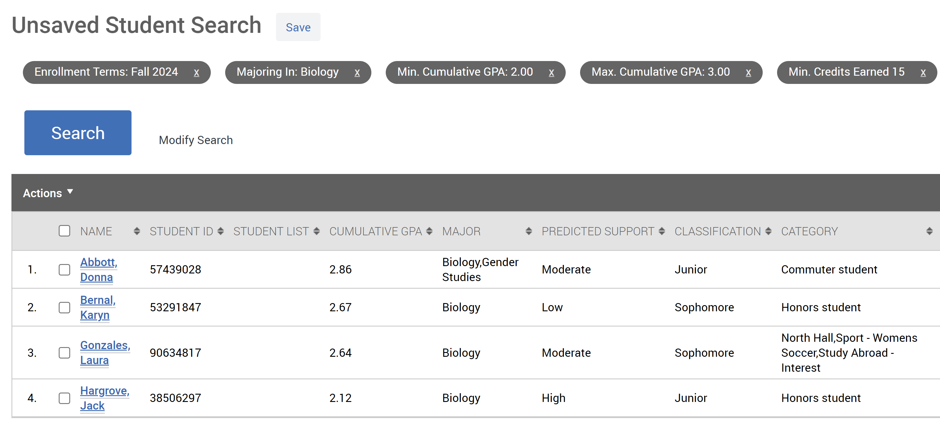
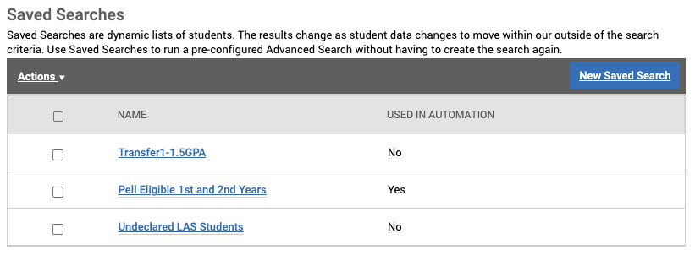
Appendix G: Saving Student Searches and Lists
Building Dynamic and Static Student Caseloads
Step 4: Once you have selected your specified search fields, click Search. The results display the current information for the students that fit the parameters of your search, which are displayed across the top.
Step 5: From here, you can take a variety of actions:
Perform a task via the Actions menu with one, several, or all the students on this list, such as sending a Message, adding to an Appointment Campaign, or creating a Student List. You must select ‘All Students’ if there are more than 100 results in your search.
Create a Saved Search by clicking the Save button next to the Unsaved Student Search title. You can also access previous saved searches from this page.
  Saved searches lets users run a pre-configured Advanced Search without having to create the search again. Unlike Student Lists, which save a static list of the same students, a saved search dynamically regenerates a list of students or users based on the search criteria. This feature can be especially helpful for users who frequently run the same search at different points in the term, as it allows you to maintain consistency with your search parameters
Modify the search. If you want to add to the original parameters selected, you can select Modify Search to return to the filter drawer view. You can also remove an existing parameter by clicking on the X icon to the right of each of your filter selections.
NOTE: Because some tools in the platform display all Student Lists in filters, please use a standard naming convention for your Student Lists that explains the purpose of the list (e.g., F23 Senior His Maj, F24 Transfer 1st Gen). Talk to your Application Administrator if you have questions about the naming conventions for Student Lists at your institution.

