Slide 1
CCTSI Translational Methods
Pilot Program
Natalie Julie Serkova, Ph.D.
Translational Methods Pilot Program Director

Slide 2
CCTSI Pilot Programs
CCTSI awards $3 million/year in pilot grants, microgrants, and pre-doctoral and post-doctoral research scholar awards
Funding Sources
National Center for Advancing Translational Science (NCATS)
University of Colorado School of Medicine Dean’s Office
Children’s Hospital Colorado Research Institute

Slide 3
Translational Methods Pilot Program
Speed the development and application of novel technologies, methods, or analytical assays for clinical and translational research that are presently lacking or not available to CCTSI members
Major goals
Facilitate developing functioning and validated methodologies, which are not yet available in Colorado
Foster new collaborations
Disseminate new technologies across the CCTSI
Notes:
Translational Methods (TM) Pilots were previously known as Novel Methods Development (NMD). The term “novel technologies” includes the development of innovative assays, devices, software, models, protocols or technologies which will readily enhance clinical and translational research of CCTSI members.
The validation/ new application of an existing technology will not be supported under this funding mechanism.

Slide 4
TM-Pilot Program Awards
Multiple TM-Pilot awards of up to $20,000 each
Categories
Translational Methods (TM) Pilot Awards (3 and up)
Biostatistics/Bioinformatics TM-Pilot Award
Colorado State University TM-Pilot Award (CSU PI)
Notes:
This includes the development of innovative assays, devices, software, protocols or technologies which will readily enhance clinical and translational research of CCTSI members.

Slide 5
TM-Pilot Program Eligibility
CCTSI Members
Faculty at CCTSI Affiliated Institutions (Instructor level and above)
CU Anschutz Medical Campus
CU Boulder
CU Denver
Colorado State University
University of Colorado Hospital
Children’s Hospital Colorado
National Jewish Hospital
VA Eastern CO Health Care System
Kaiser Permanente Colorado
Notes:
• Underrepresented, female, and minority researchers are particularly urged to apply, as the CCTSI intends to contribute to the creation of a research workforce that is representative of the U.S. population.
Investigators from non-CCTSI Affiliate Institutions may participate in Non-Key Roles only. They must collaborate with a faculty (Instructor level and above) from a CCTSI Affiliated Institution who would be
eligible to serve as PI on an application.
• Graduate, undergraduate, postdoctoral students, fellows and PRAs are encouraged to participate in Non-Key Roles.

Slide 6
Pilot Awards: 2019 cohort
 | CO-Pilot | CMH-Pilot | TM-Pilot | CE-Pilot
RFA | 7/2018 | 7/2018 | 10/18/18 | 8/10/18
Mandatory intent form | 8/13/18 | 8/13/18 | 12/3/18 | 9/21/18
Application due | 10/1/18 | 10/1/18 | 1/7/19 | 10/26/19
NOA sent | 2/2019 | 2/2019 | 2/2019 | 2/1/19
Start date | 3/19-6/19 | 3/19-6/19 | 5/2019 | 5/1/19
#LOI | 144 | 74 | 64
#Applications | 94 | 28 | 51 | 12
#Funded | 19 (20%) | 5 (18%) | 5 (10%) | 4 (33%)
#Intent-to-Submit
Notes:
These are retrospective data from the previous year application cycle

Slide 7
Application Guidelines
Abstract (limit 250 words)
Research Plan (4 page limit)
Specific Aims (l½ page limit)
Background and Significance (1 page limit)
Approach (suggested 1-2 pages)
Education Mission (suggested ¼ to ½ page)
References
Budget and Justification (2 page limit)
Biosketches (current NIH format and page limit)
Letters of Support (no page limit)
Institutional Prior Approval LOS: For CSU Investigators
Institutional Prior Approval LOS: For Investigators Outside CU Denver and AMC
Highlight Innovation!
Highlight Dissemination!

Slide 8
TM-Pilot Program Review Criteria
Innovation: Is the proposal innovative and novel in developing new technologies/assays/models?
Approach/Scientific Merit: Will the proposed study design develop a new method or technology?
Significance (especially to the CCTSI mission): Can the new method or technology be generalized and translated to other scientific settings/ applications?
Investigators
Environment
Educational Mission: Include student/ postdocs/ how technology will be disseminated

Slide 9
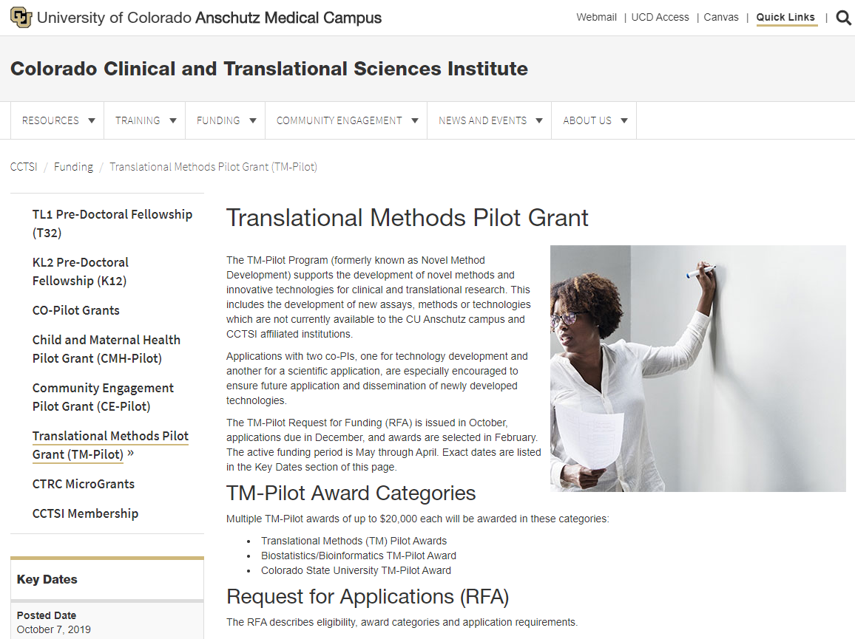
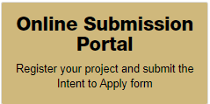
Online Submission Portal
Notes:
This year, for the first time, all LOI and final applications will be submitted on-line

Slide 10
Notes:
CCTSI Resources
The Colorado Clinical and Translational Sciences Institute offers a variety of resources and starting points to help you prepare for your clinical research studies.
The CU Cancer Center supports a variety of state-of-the-art technological shared resources – their incorporation into TM proposals is encouraged

Slide 11
Grant Cycle Dates
12/02/2019 Intent-to-Submit Form (LOI) Deadline
01/08/2020 Application Form Deadline
February 2020 Review Panel
April 2020 Announce Awards
May 1, 2020 Active Funding Period Begins

Slide 13
Questions?
Dr. Natalie Serkova
TM-Pilot Director
Natalie.Serkova@cuanschutz.edu
(303) 724-1084
Debra Szuster
CCTSI Pilot Program Coordinator
debra.szuster@cuanschutz.edu
(720) 848-4327
CCTSI TM-Pilot Program Webpage
https://www.cuanschutz.edu/cctsi/funding/tm

