Slide 1
Neurodiversity in the classroom
Kate Miller Office of Information Technology

Slide 2
Our time together today
Defining Neurodiversity
Exploring why Neurodiversity is important
What Neurodiversity can look like in the classroom
Ideas to consider to support learning
Classroom suggestions to support Neurodiversity
Questions

Slide 3
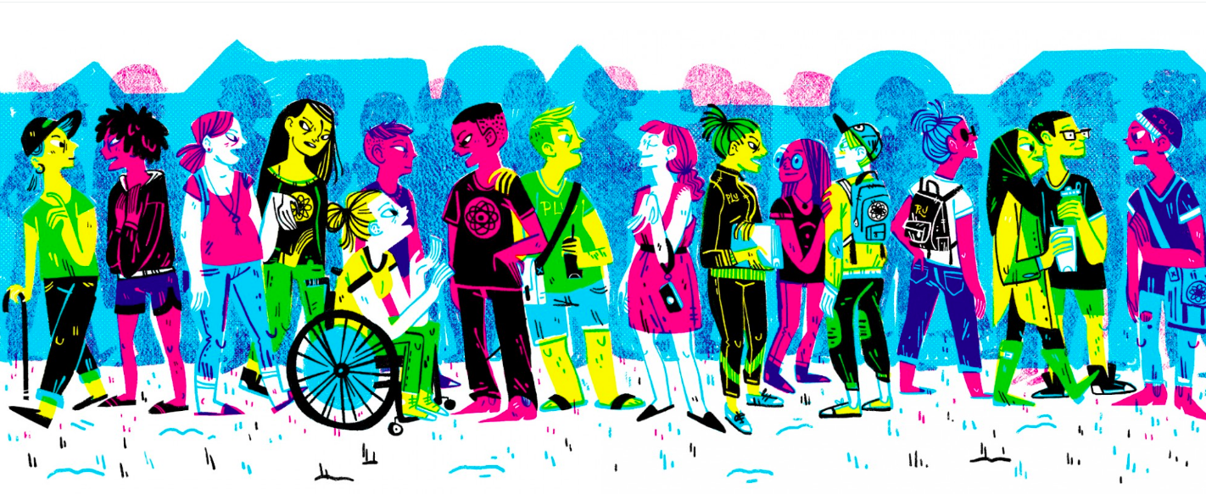
Neurodiversity
(Short for “neurological diversity”)
The diversity of human brains and minds, and the idea that this is a natural, valuable form of diversity.

Slide 4
What is Neurodiversity, cont.?
• Neurodiversity is a philosophy that emphasizes differences in human neurologies
• Neurodiversity emphasizes that Autism, ADHD, dyslexia, mental health disorders for example, represent difference rather than deficits
• Neurodiversity invokes an emerging disability rights/ civil rights movement

Slide 5
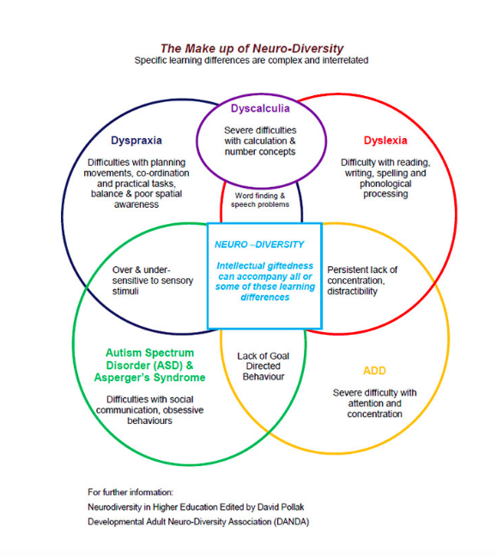

Slide 6
Why Neurodiversity?
• More students in college with learning differences, including autism
• More CU Denver students needing support • It’s the right, good, and universal thing to do (human rights perspective)
• Our community is enriched by diversity (maximizing human
capital perspective)

Slide 7
What can Neurodiversity look like in the classroom?
• Student may appear inattentive or bored
• May see repetitive behaviors
• Intense focus on topics of interest
• May display unexpected emotion when stressed
• Difficulty with organization
• Difficulty with group work
• Poor awareness of body space

Slide 8
Ideas to consider to support learning?
• Transparent and inclusive pedagogy
• What does success in this class typically entail?
• Executive Functioning challenges
• Provide specific, explicit instructions for organizing information and completing assignments
• Give clear, written plan of assignments
• Provide detailed schedule
• Have a clear, predictable class routine

Slide 9
Classroom suggestions?
Universal design for learning
- Clear expectations
- Structured opportunities to interact
- A constructive class culture
- And consistent feedback

Slide 10
Classroom suggestions?
Fine motor challenges
Provide printed or online accessible notes
Allow use of laptop or other voice-activated technology to take notes
Sensitivity to Environment
Provide quieter testing environment
Allow use of headphones to block out sounds during exam
Easing Transitions
Begin class with discussion of diversity
Allow for extra transition time
• Allow for sensory or comfort items (e.g., a fidget)

Slide 11
Where to go from here?
Reflect
Ask yourself – is there anything I can change within my course today?
One change is a difference and it matters
Truly benefits everyone!

Slide 12
Questions?

