Slide 1
LYNX Camps Went Viral… I mean Virtual for 2020
Highlights from the 2020 Virtual LYNX Camps.
Pandemic hit but creativity, connection, and learning thrived!

Slide 2
June 8-12, 2020 | One Week | $400 (vs. $500)
2D Animation/Illustration
Ableton Live/Audio Production
Comic Book Character Design
Photography
June 22-26, 2020 | One Week | $500 (vs Two Week @ $1100, $1700, $2200)
Music Industry: Songwriting, Performance, Music Business, Recording Arts
July 6-10, 2020 | One Week | $400 (Don’t normally have)
Mural Creation
2D Animation/Illustration
July 13-17, 2020 | One Week | $400 (vs Two Week @ $1100, $1700, $2200)
Design & 3D Animation
July 13-24, 2020 | Two Weeks | $800 (vs $1100, $1700, $2200)
Filmmaking Camp

Slide 3
Fast Facts
223 Campers Served
25 Double Campers
8 Triple Campers
Total of 181 Different Campers Trusted Us to Offer a Fun & Engaging Arts Camp Online!
11 Different States (26 kids) other than CO + 1 kid from Turkey!!
74 students received a scholarship to attend camp
$29,000 (almost) in scholarship money awarded!
Employed 31 Faculty & Staff members
100% of campers have still have a good impression or have a better impression now ☺

Slide 8
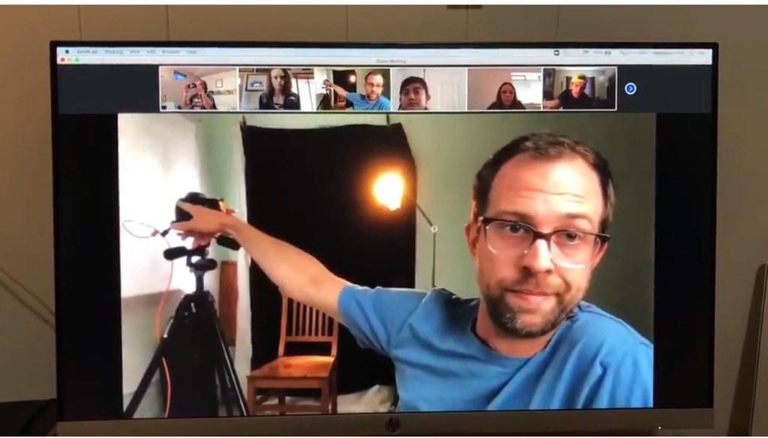

Slide 9
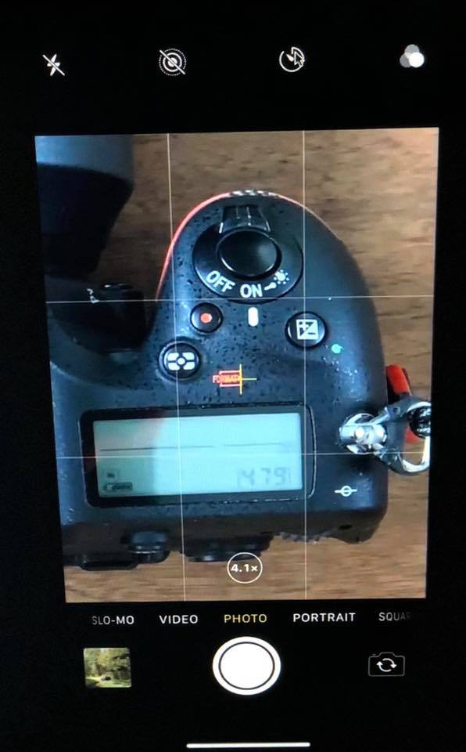

Slide 10
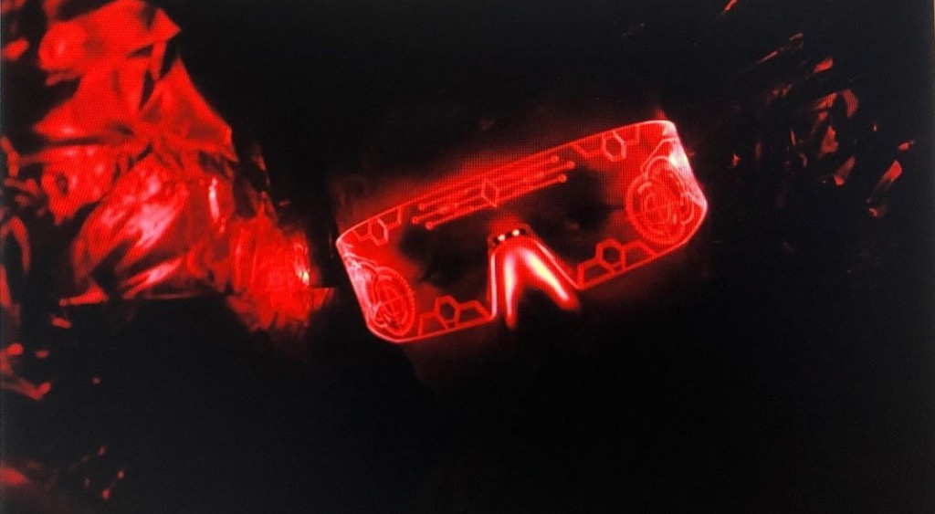

Slide 12
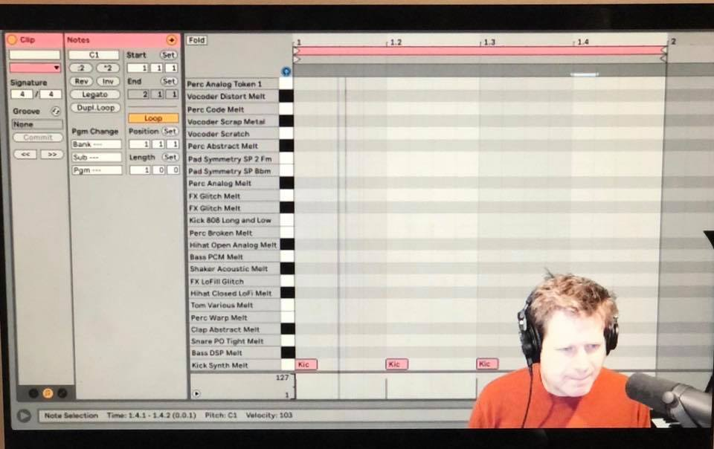

Slide 13
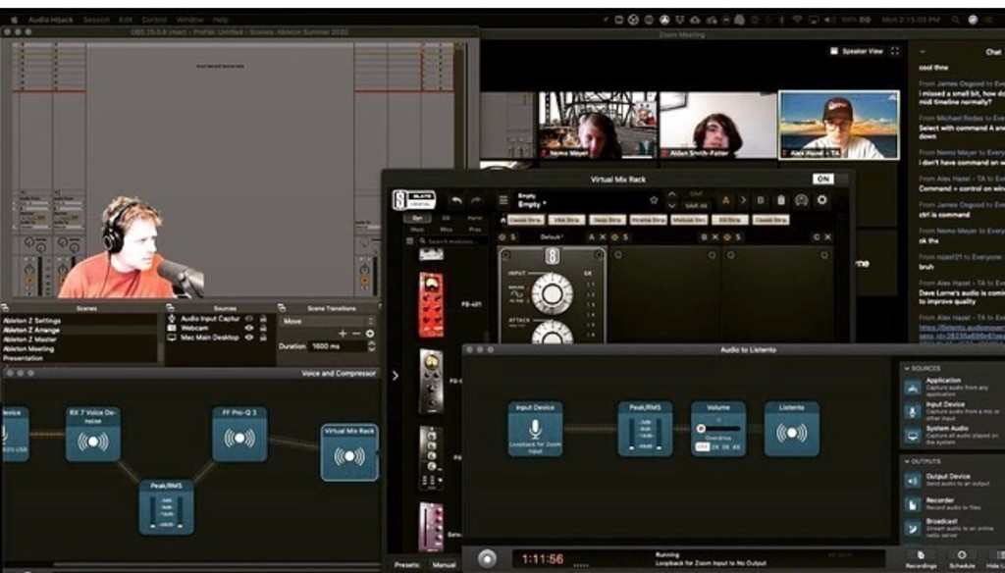

Slide 15
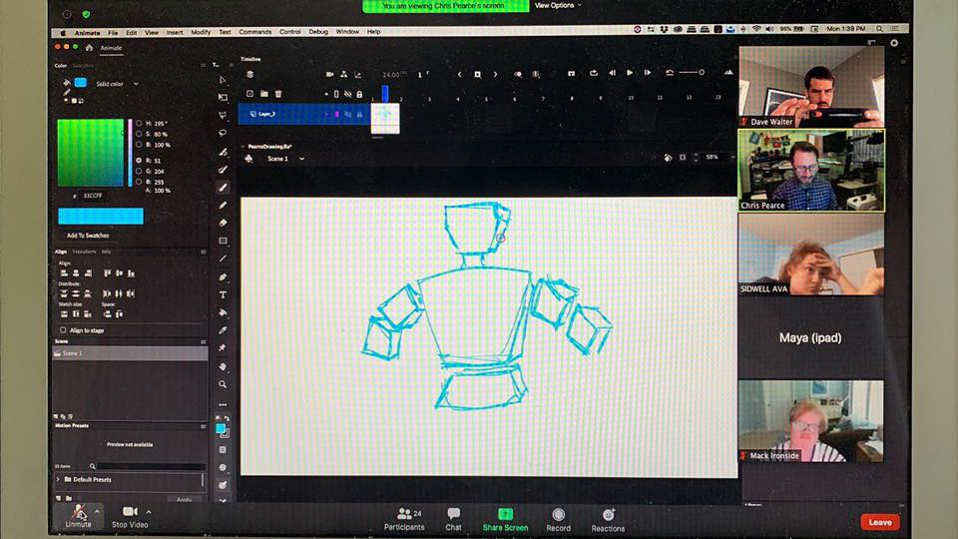

Slide 16
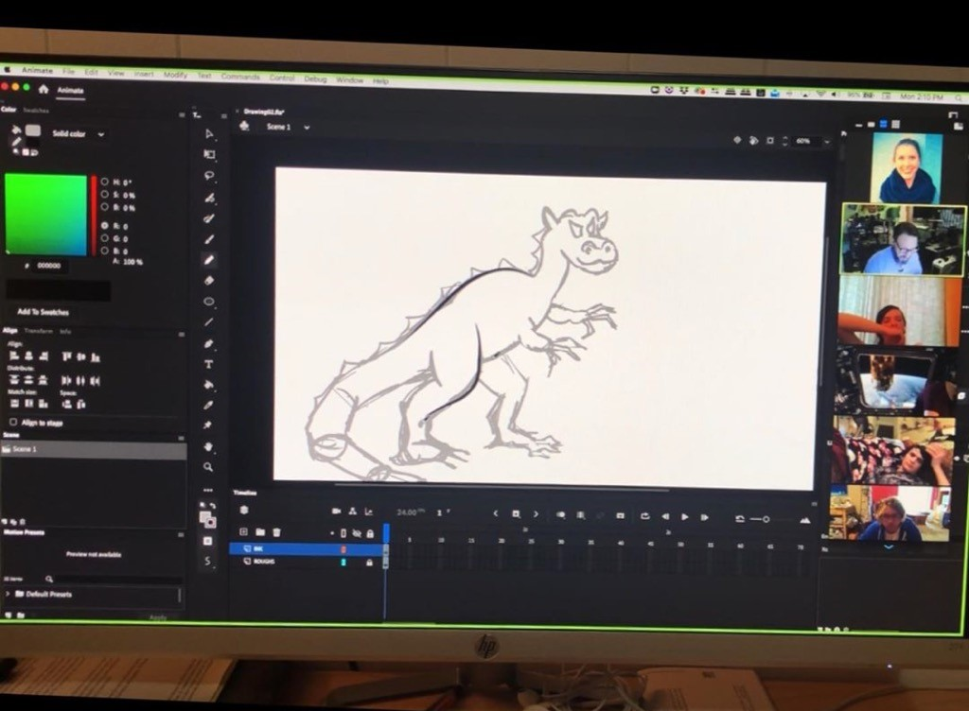

Slide 18
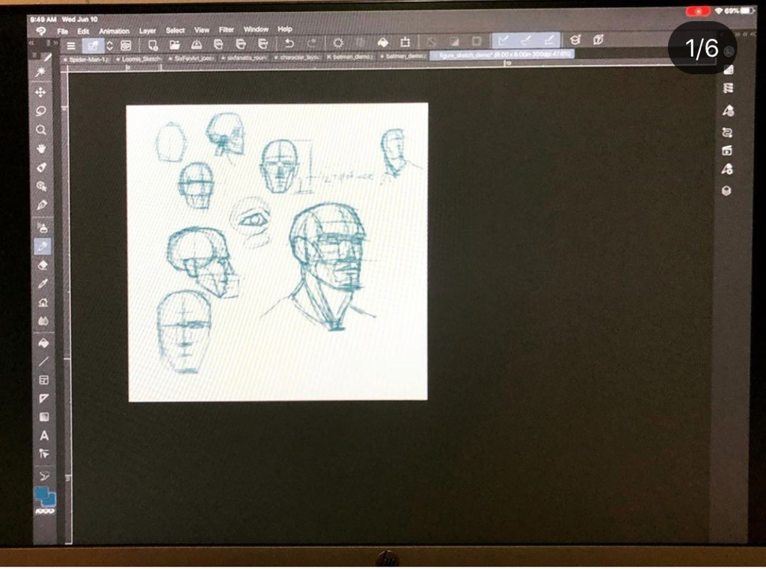

Slide 19
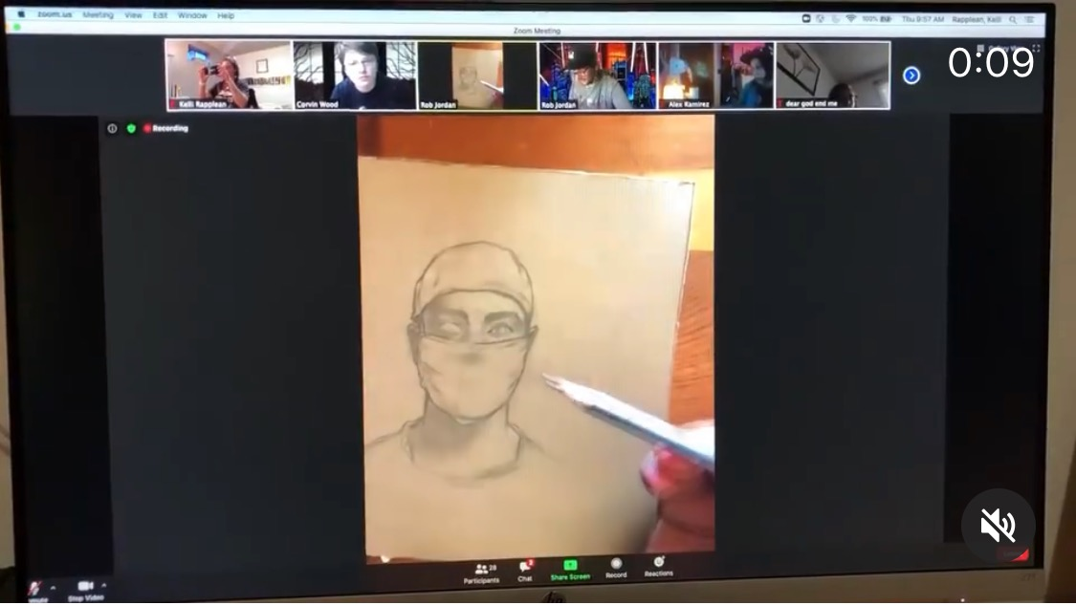

Slide 21
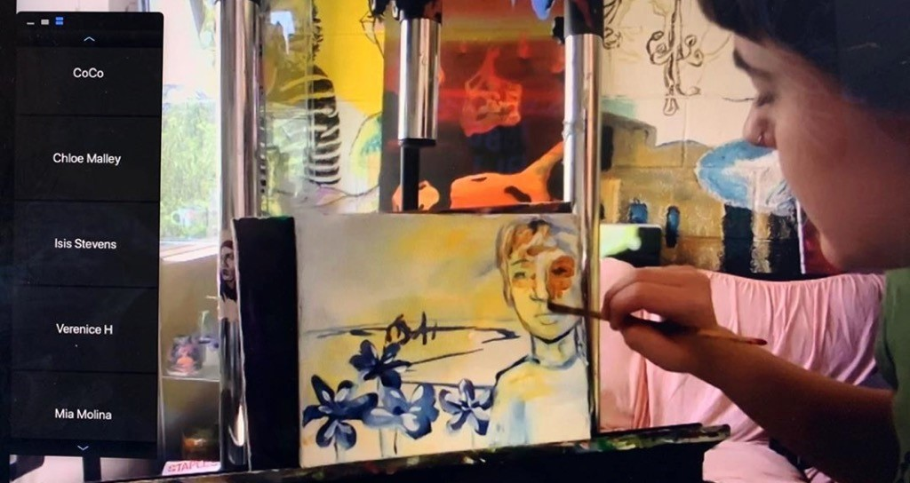

Slide 22
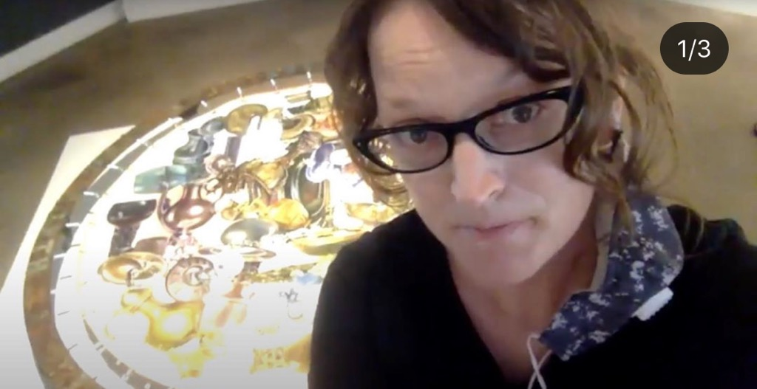
Melissa Furness as Guest Artist … Collaborative piece with Rian Kerrane

Slide 23
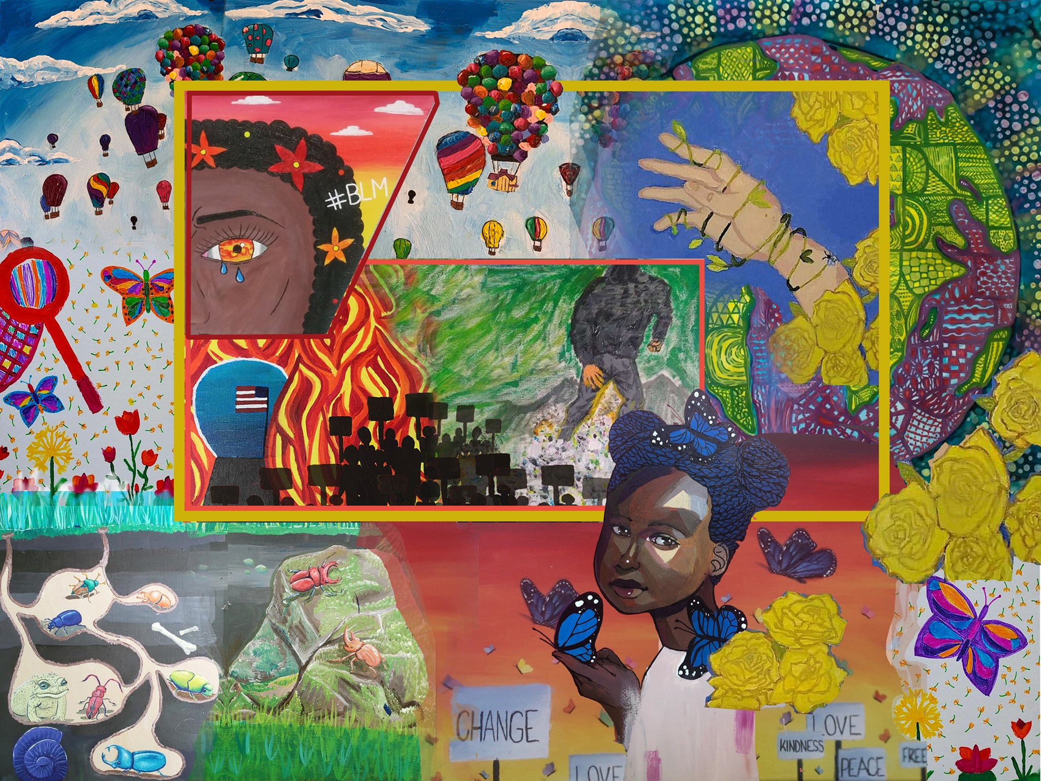
The Final Mural Creations piece- made virtually!! 😲

Slide 24
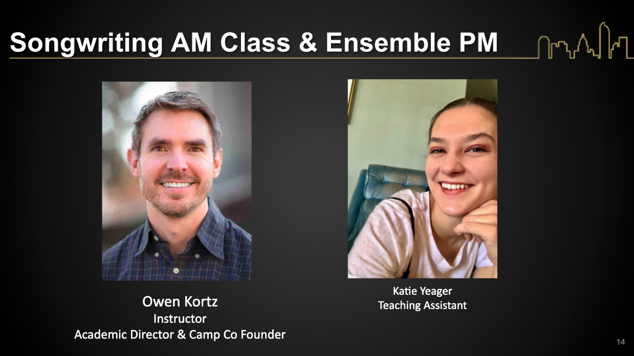

Slide 25
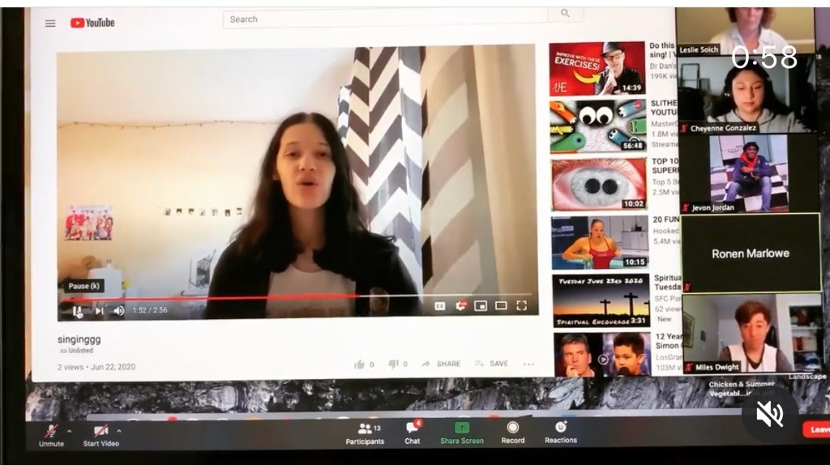

Slide 27
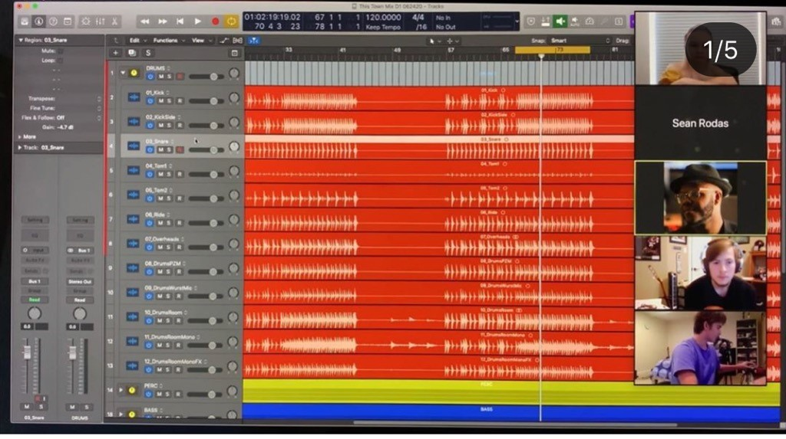

Slide 29
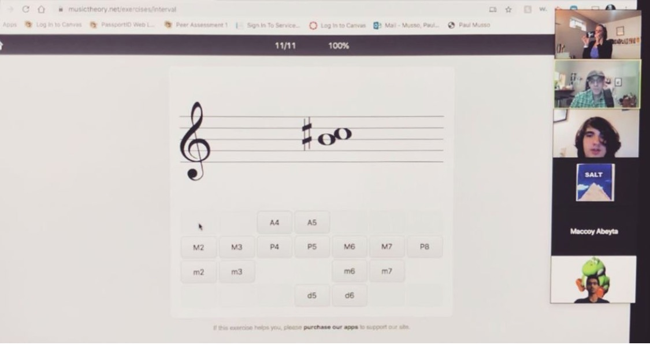

Slide 31
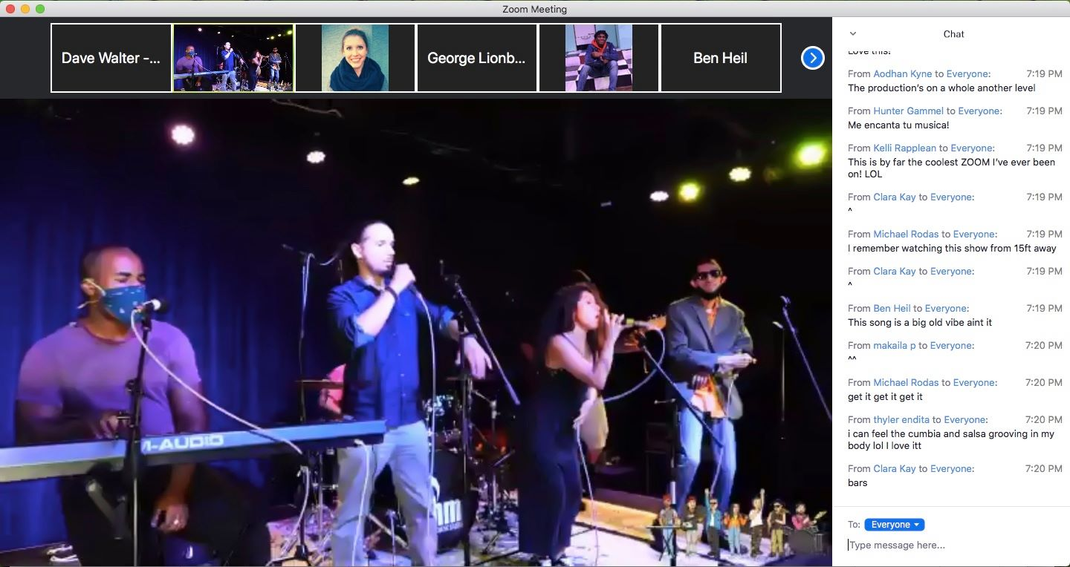
Guest Artist 2mx2 (Owen Trulillo normally teaches our Hip Hop Ensemble)

Slide 33
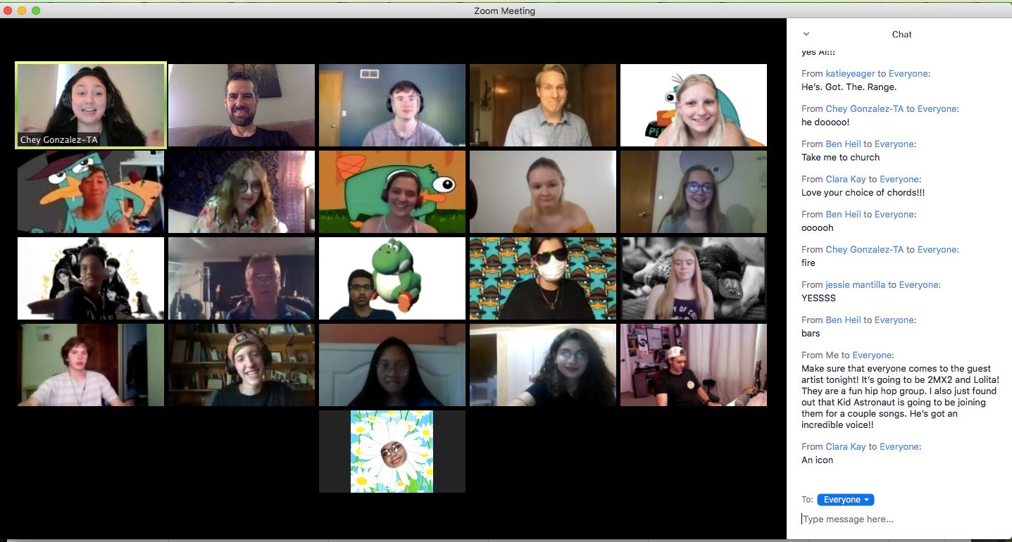

Slide 35
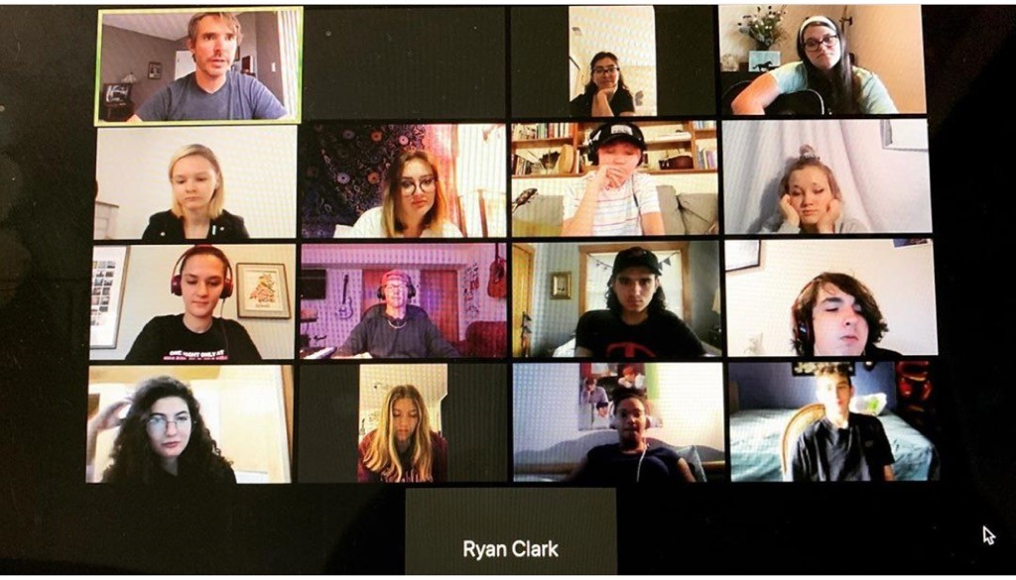

Slide 37
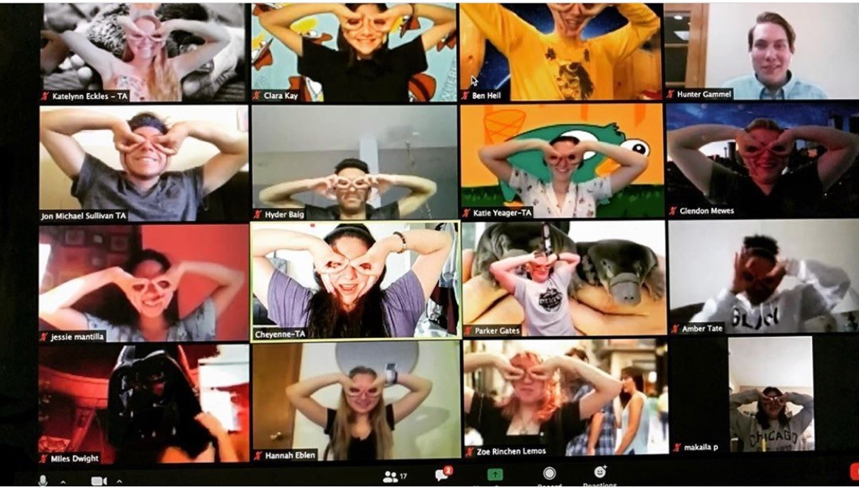

Slide 38
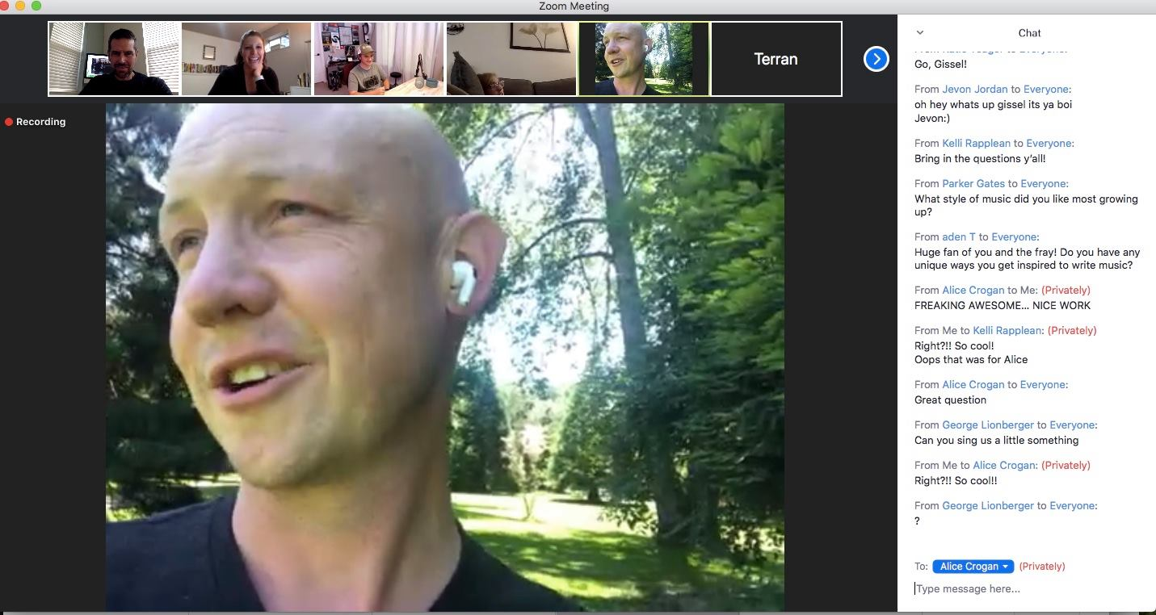
Isaac Slade- Lead Singer of The Fray ZOOM Bombed as a Guest Artist!

Slide 39
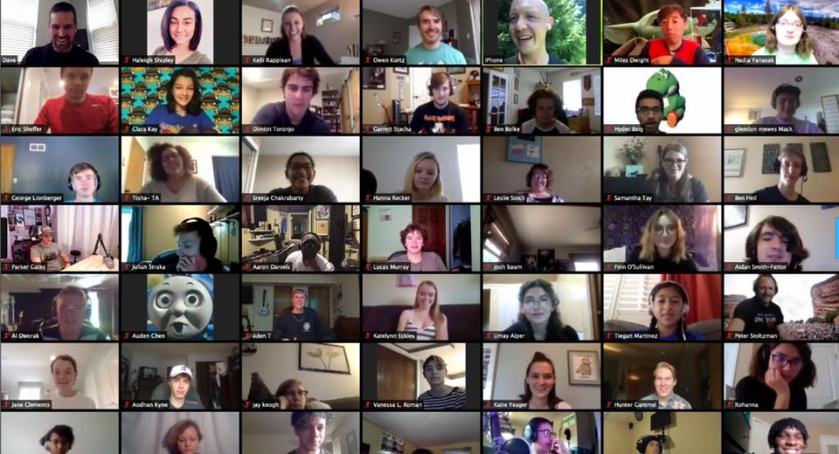

Slide 43
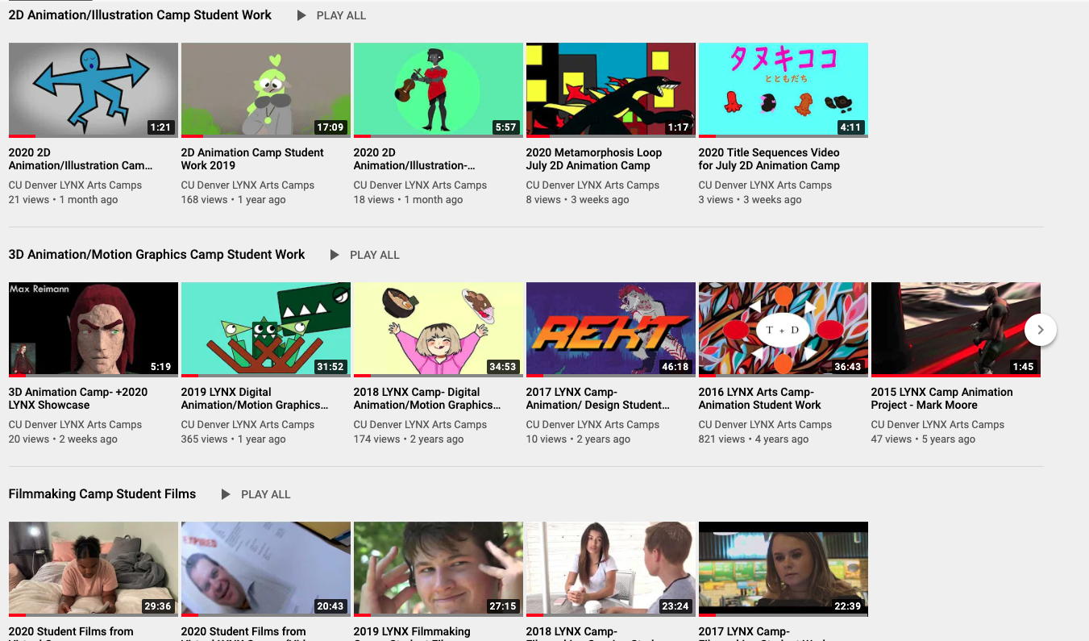

Slide 44
LYNX Campers Now in CAM!
Fall 2017 | Fall 2018 | Fall 2019 | Fall 2020
35 | 55 | 84 | 100?

