Slide 1
WELCOME!
Partnering for Impact:
Advancement 101 + Partnering in Our Public Campaign
Presenter:
Melisa Baldwin
Vice Chancellor, Office of Advancement

Slide 2
Today’s Agenda
Welcome & Introductions
Advancement 101
Building Donor Relationships
Telling Your Story
Our Campaign: Where We Are + Your Role
Resources & Next Steps

Slide 3
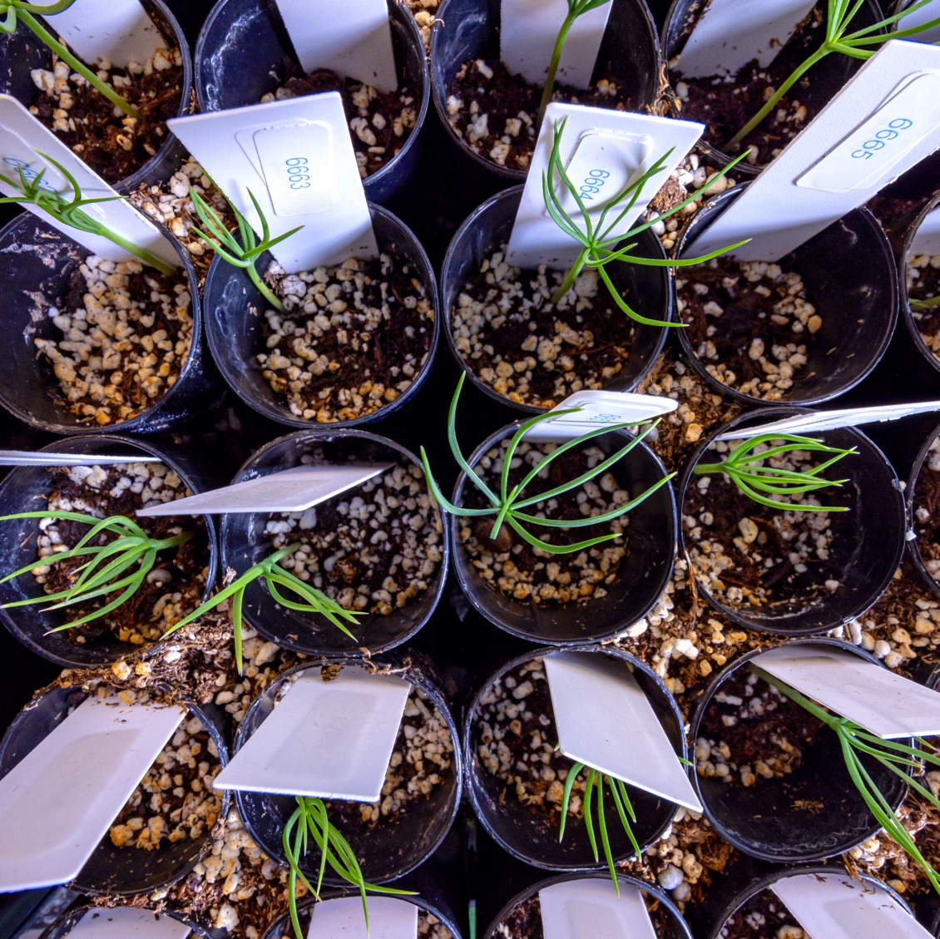
ADVANCEMENT 101

Slide 4

Advancement’s Functional Areas
Major Gifts Fundraising
Alumni
Engagement
Annual Giving
Crowdfunding
Event Planning
and Execution
Industry and
Foundation
Relations
Planned
Giving
Prospect
Research
Donor
Stewardship
Strategic
Communications

Slide 5
Advancement Resources
ucdenver.edu/partneringwithadvancement
ucdenver.edu/campaigninfo
DASupport@UCDenver.edu

Slide 6

DONOR CONTINUUM
Relationship Development

Slide 7
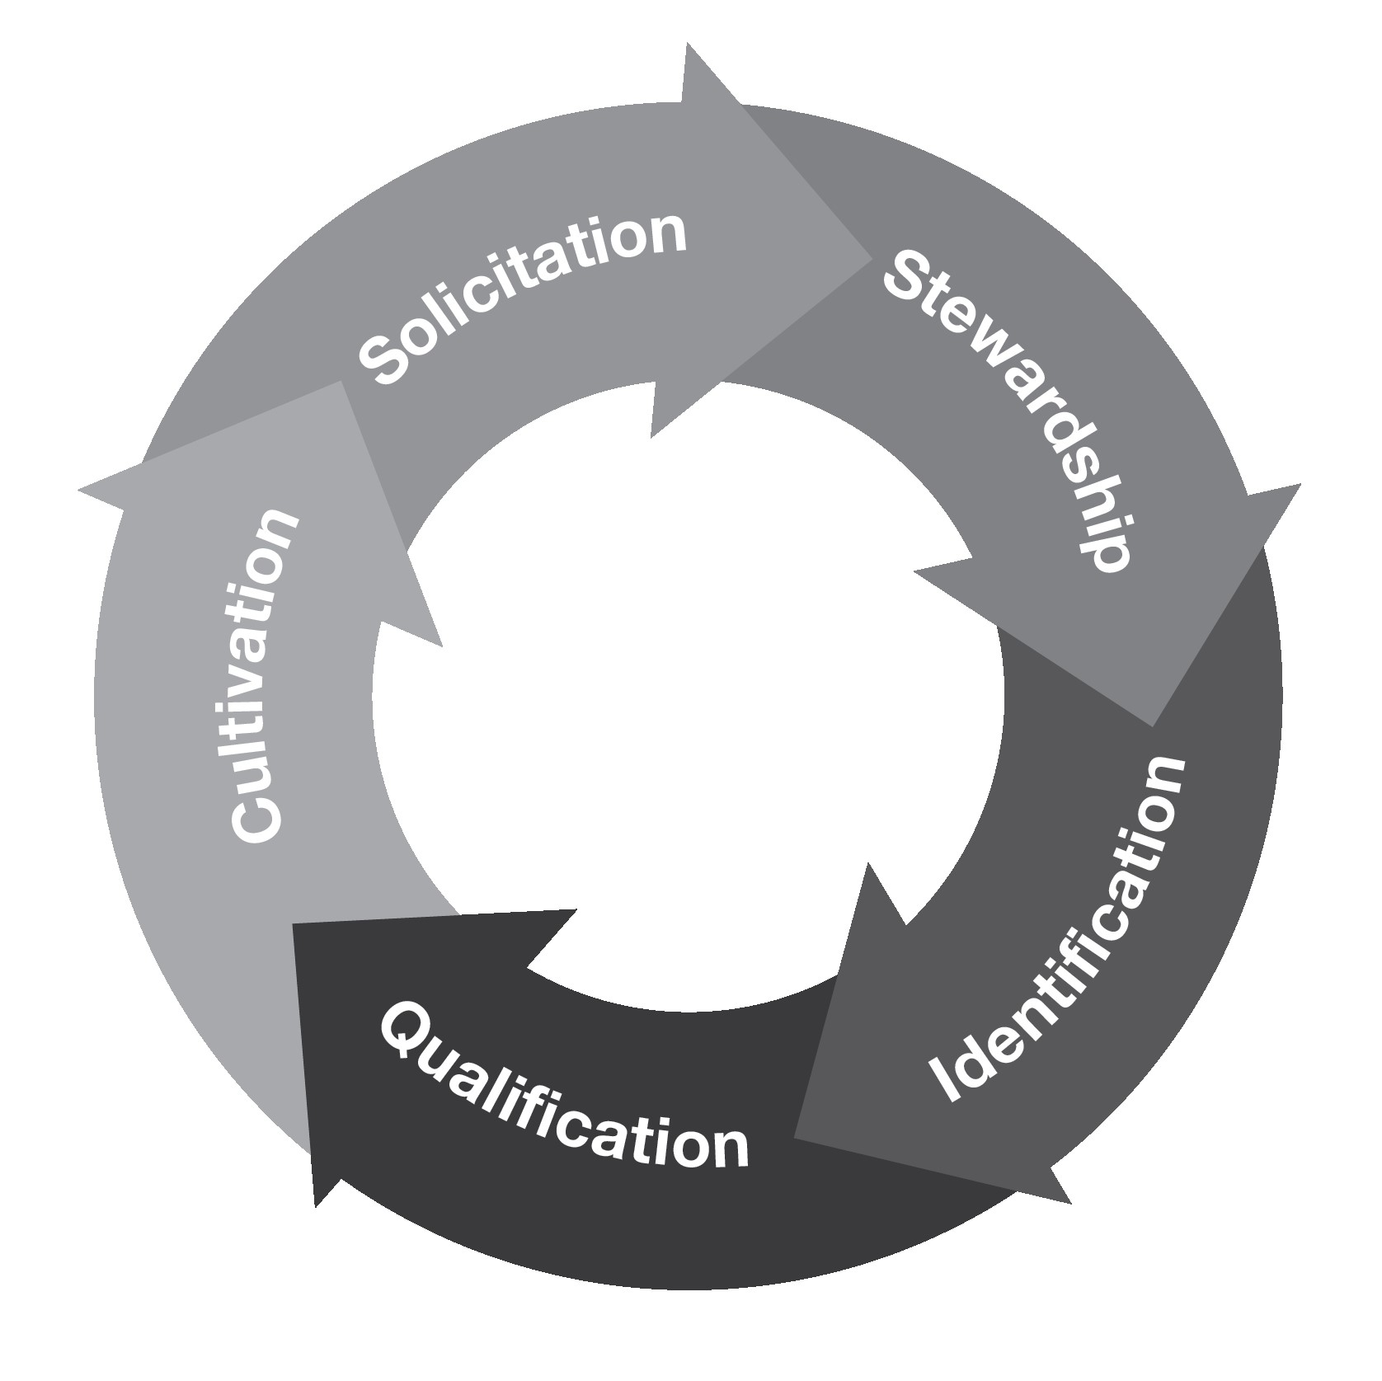
Donor Continuum – Relationships, not Transactions
Identification: Recognize potential
Qualification: Assess
Cultivation: Build and deepen
Solicitation: Strategically ask
Stewardship: Maintain and nurture

Slide 8
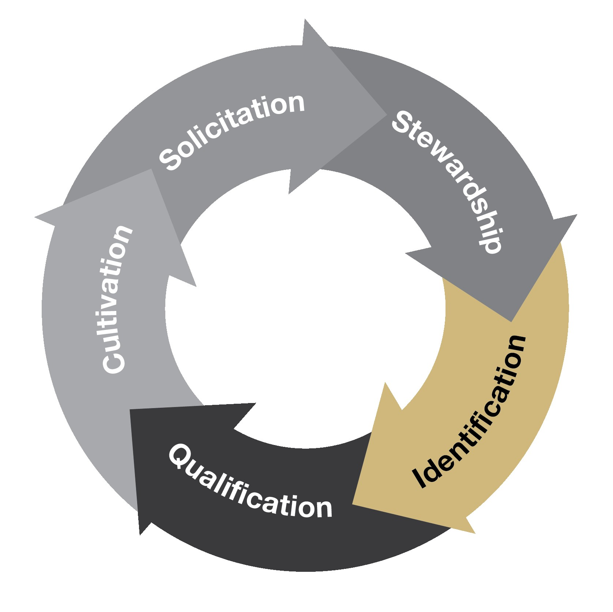
Identification
Identification: Recognize potential
    What makes a great prospect:
        Affinity
        Propensity
        Connections
        Capacity

Slide 9
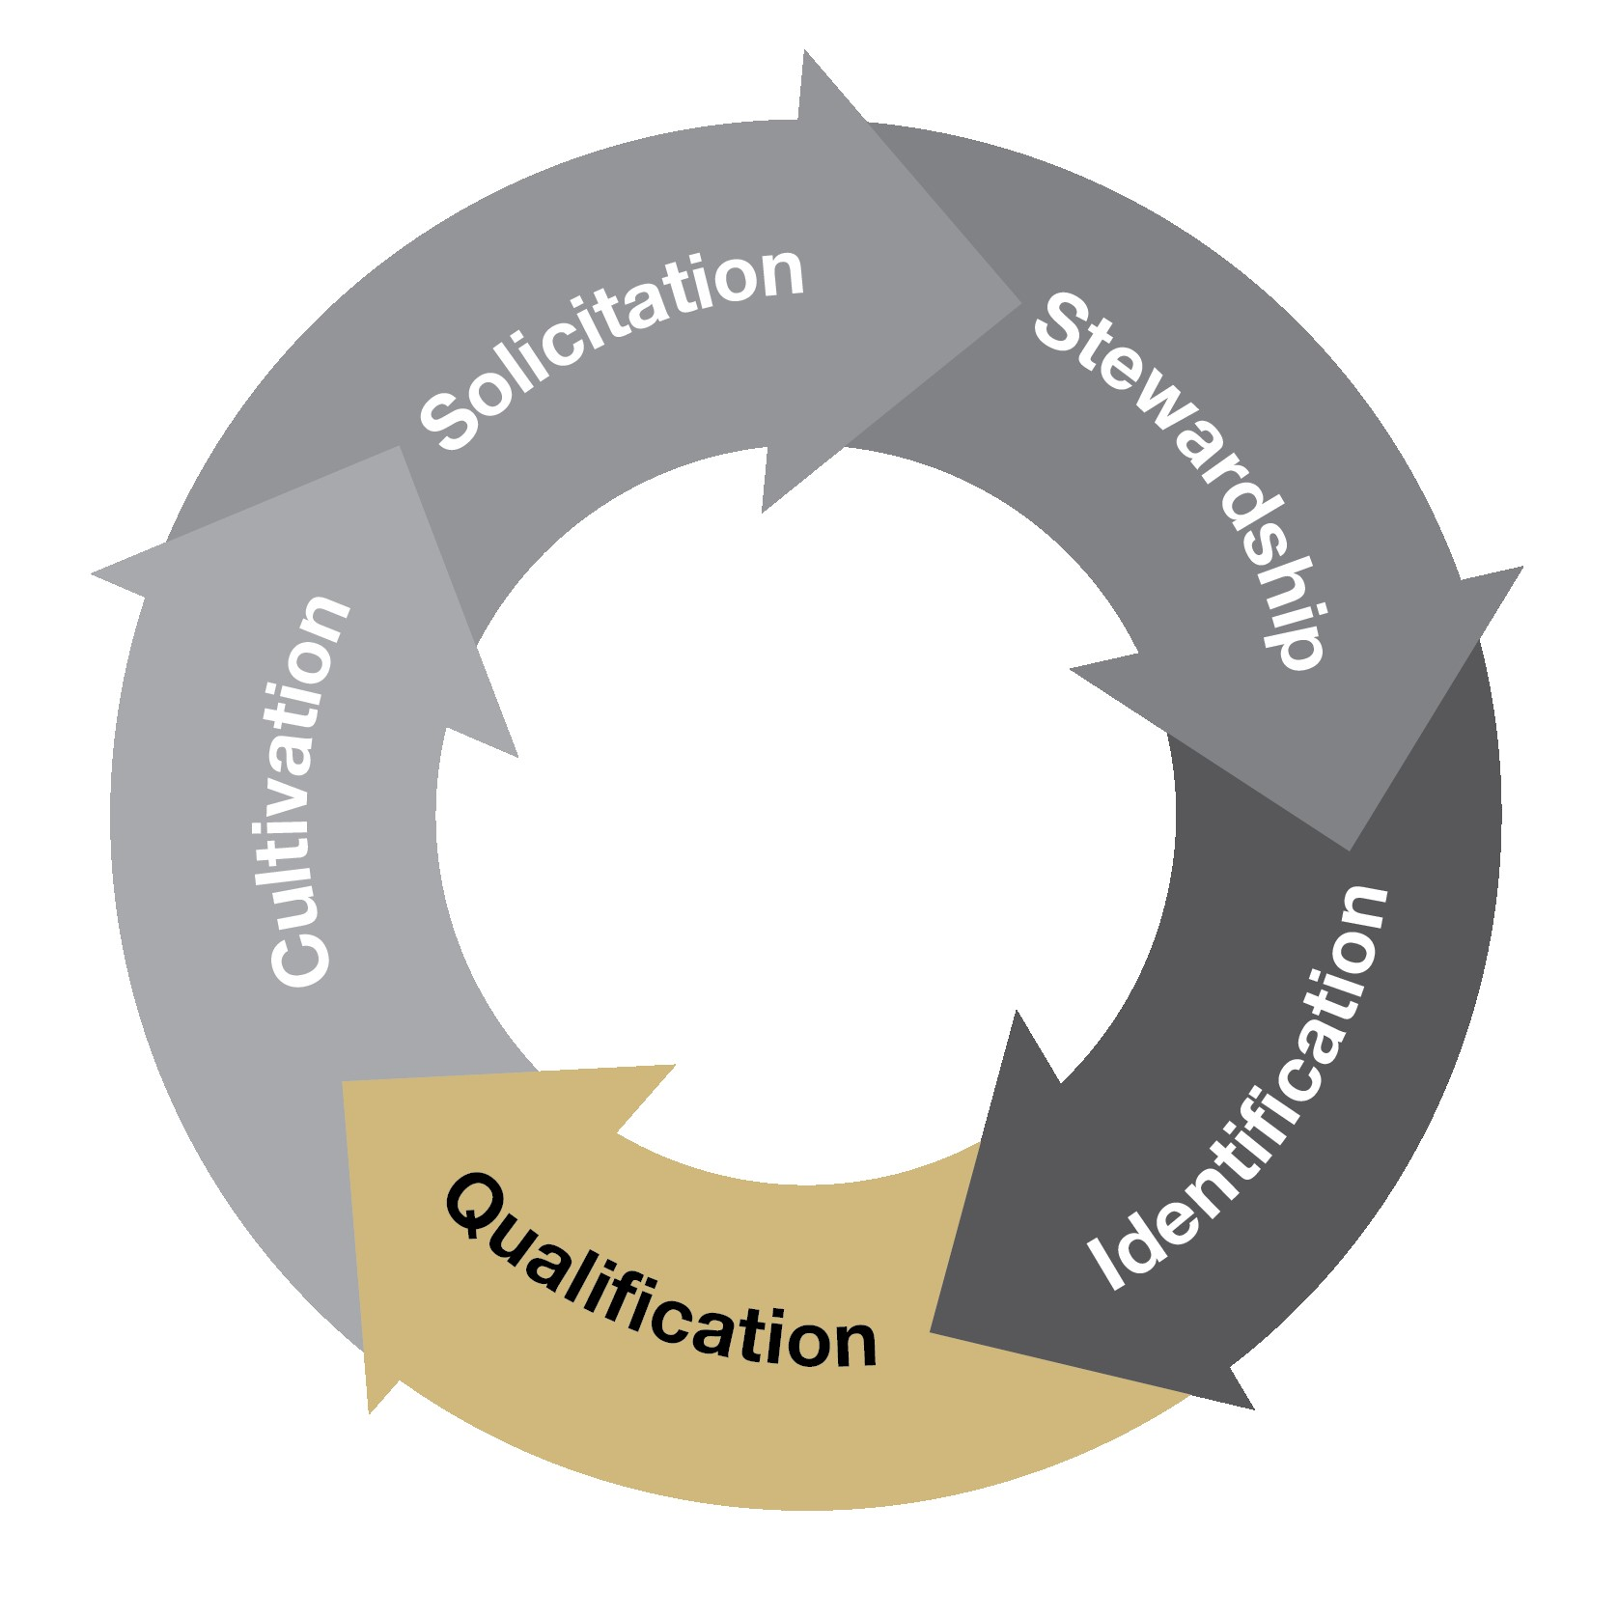
Qualification
Qualification: Assess
  CU Denver’s Major Gift Level:
        $25,000
  The only true way to qualify a prospect is to have a conversation.

Slide 10
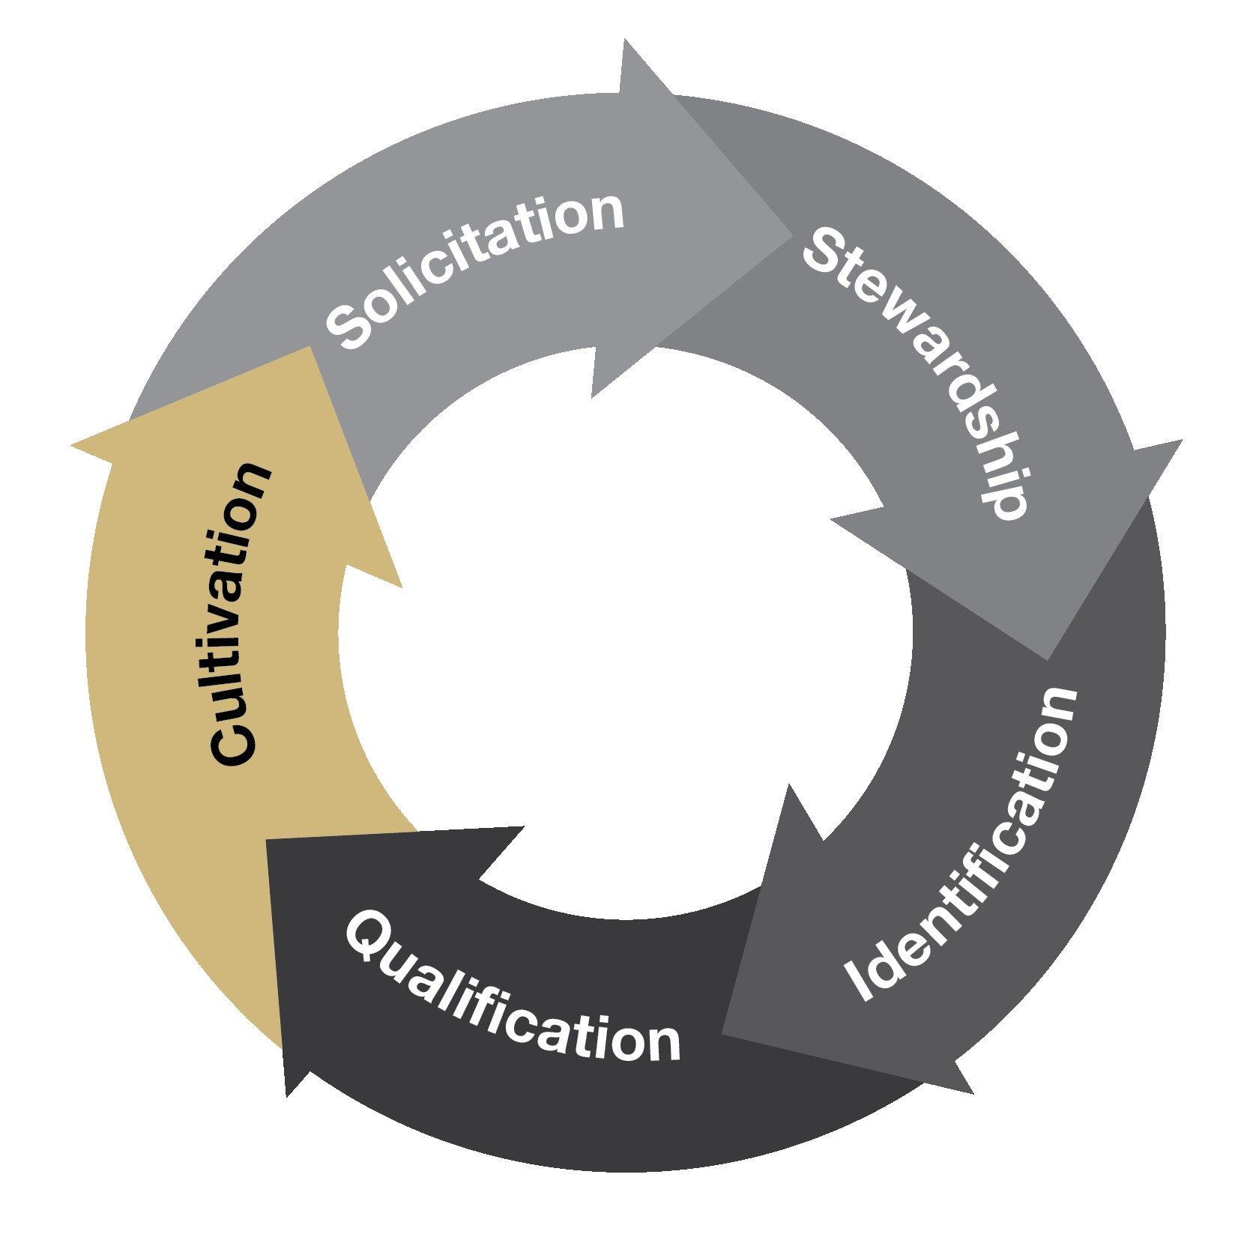
Cultivation
Cultivation: Meaningful Engagement
  Connect
  Invite
  Share
  Listen

Slide 11
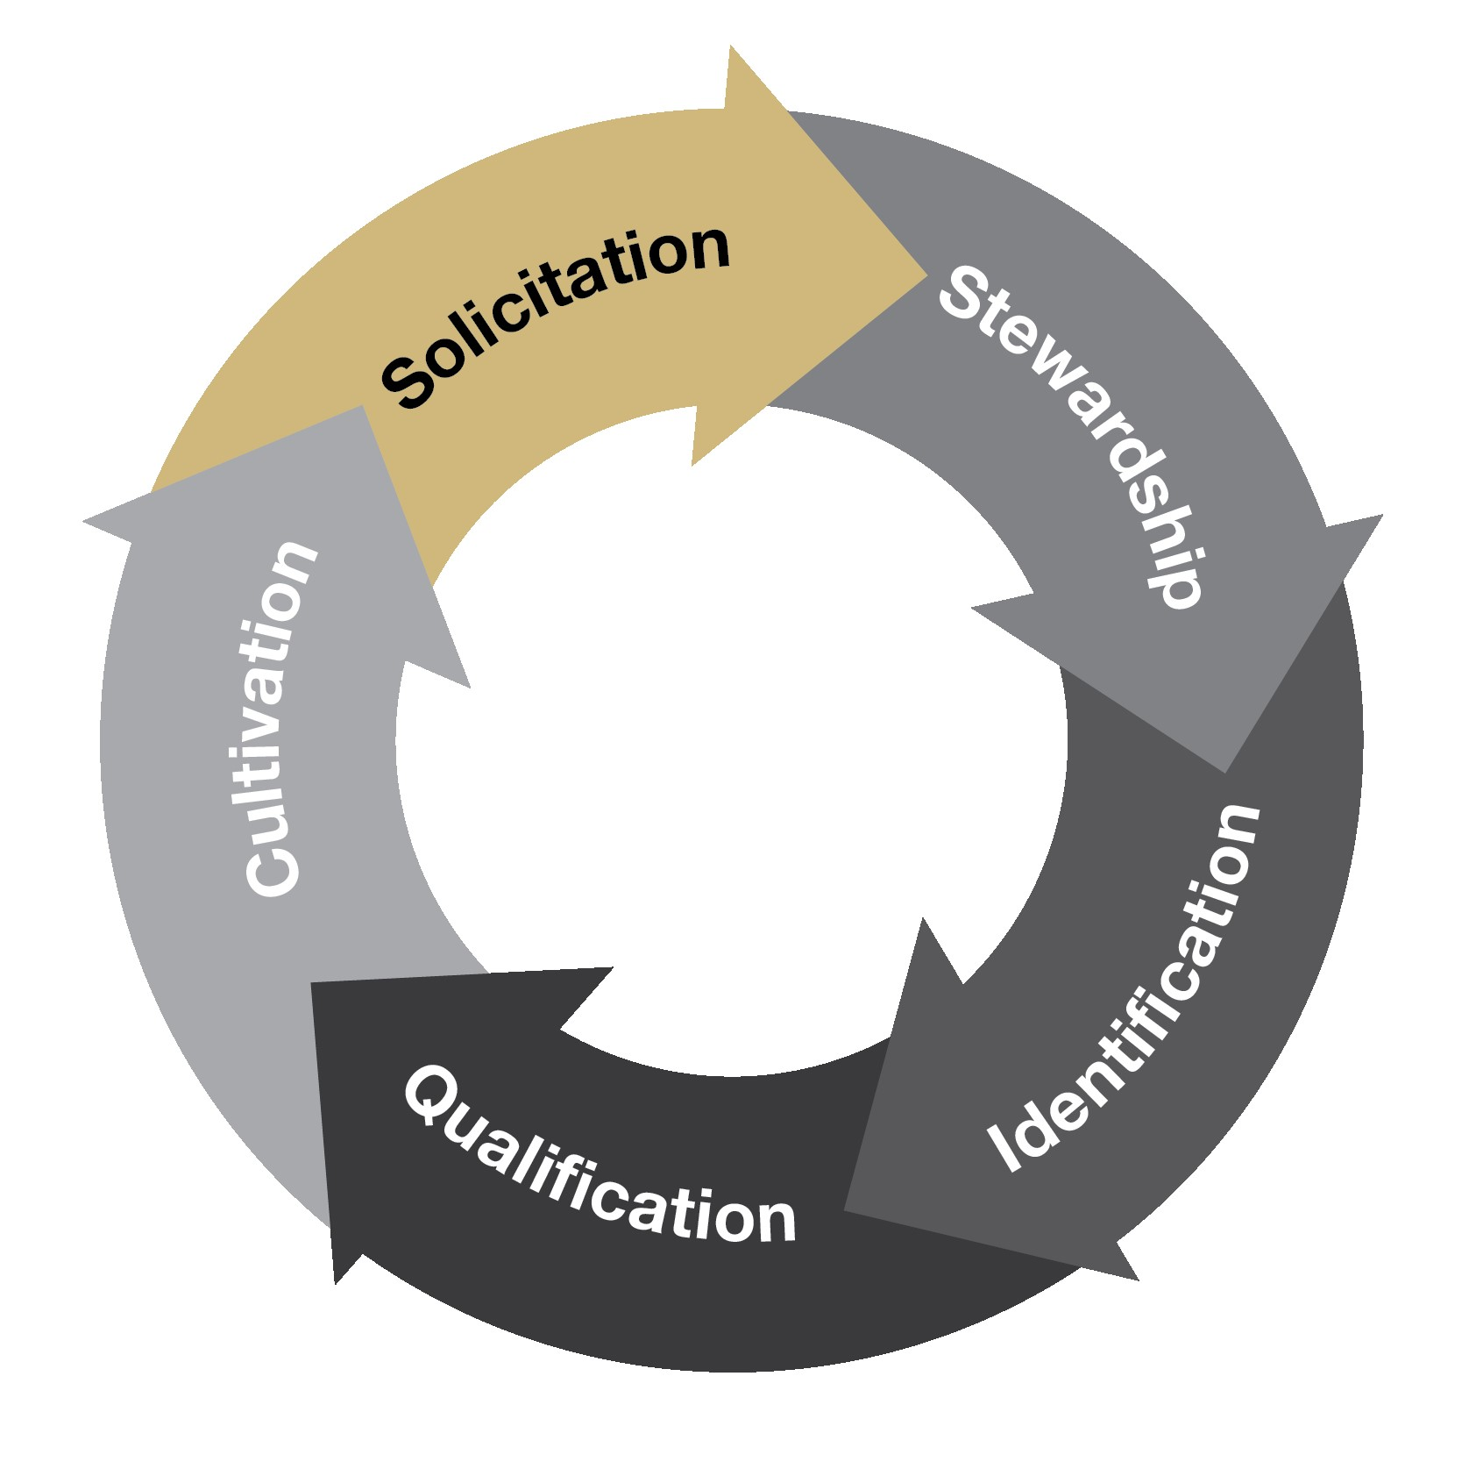
Solicitation
Solicitation: Strategically ask
  Share the Vision
  Explain the Impact
  Answer questions
  Bring the work to life

Slide 12
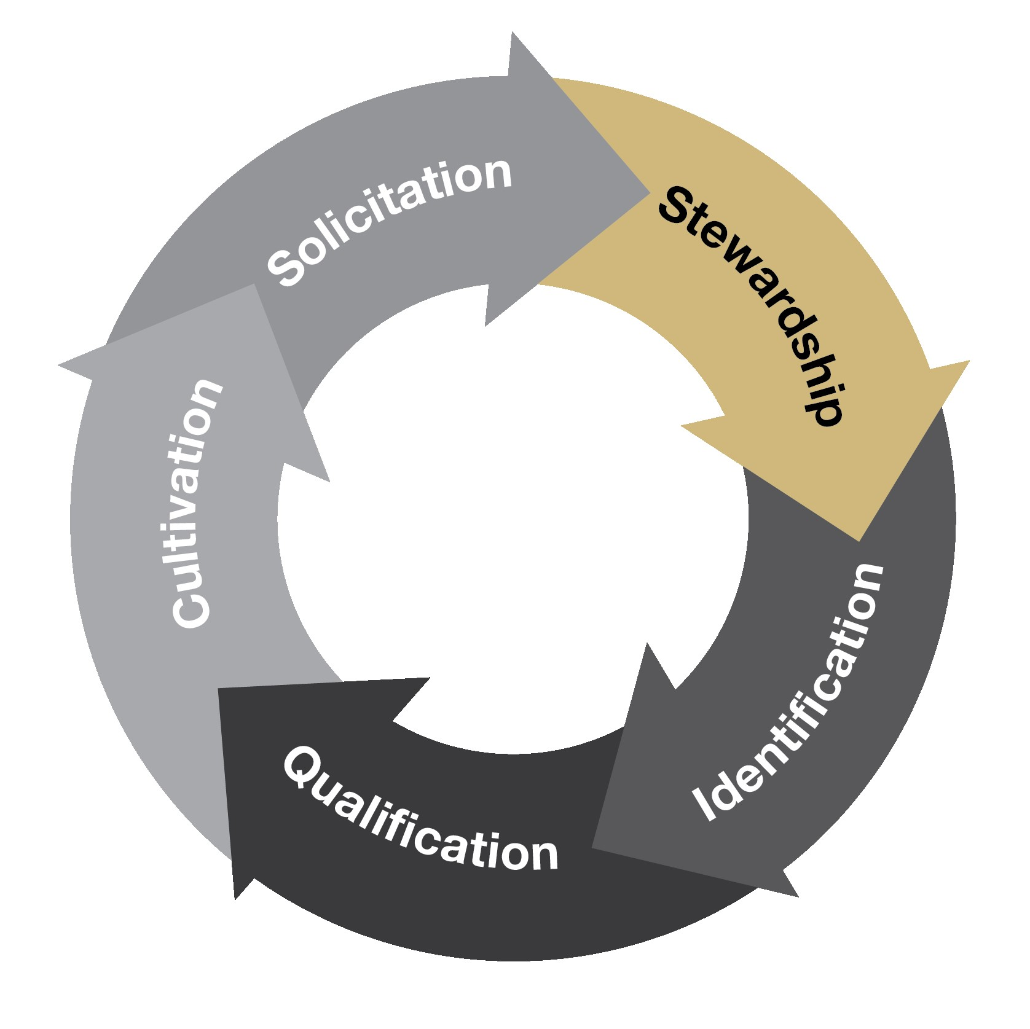
Stewardship
Stewardship: Maintain and Nurture
  A Handwritten Thank you
  A Student Story
  A quick video from a lab
  An invitation back to campus

Slide 13
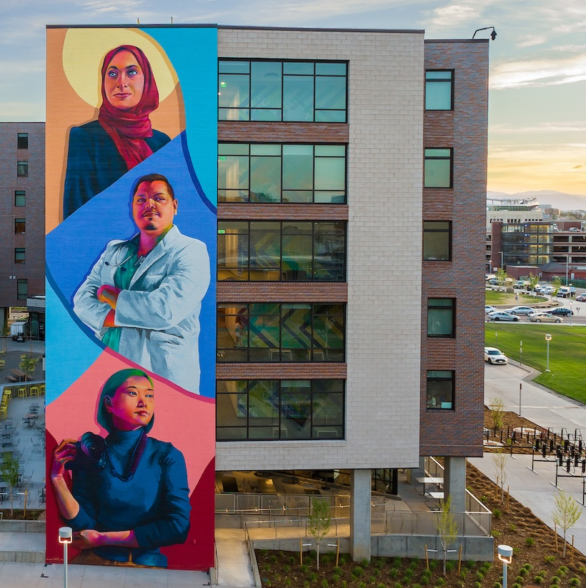
TELLING YOUR STORY
Connecting People to Impact

Slide 14
Crafting Your Story – 5 Finger Messaging
What is our plan?
Why are we the right ones to do it?
Why does it matter?
How can the listener help?
Where are we going?
Hunt, P.C. (2012) Development for academic leaders: A practical guide for fundraising success. New York: John Wiley & Sons.
14

Slide 15
Crafting Your Story – An Example
CU Denver provides scholarship support to eligible students through a variety of institutional, donor-funded, and program-specific awards. Scholarship funds are allocated based on established criteria, including financial need, academic achievement, and program eligibility. These resources help reduce students’ unmet financial need, support persistence and retention, and increase access to degree completion.
15

Slide 16
Crafting Your Story – 5 Finger Messaging
Where are we going?
More students are focused on learning, growing, and graduating—not whether they can afford to stay enrolled.
CU Denver serves ambitious students who are building better futures for themselves, their families, and our communities.
We understand that without these financial pressures, students are likely to succeed.
Why does it matter?
What is our plan?
We want to offer more scholarships to help close financial gaps and give students greater freedom to persist toward their degrees.
Why are we the right ones to do it?
CU Denver has the expertise and processes to effectively award scholarships, that lead to successful outcomes.
How can the listener help?
Your scholarship support can put a CU Denver degree—and everything that comes after it—within reach for more students.
16

Slide 17
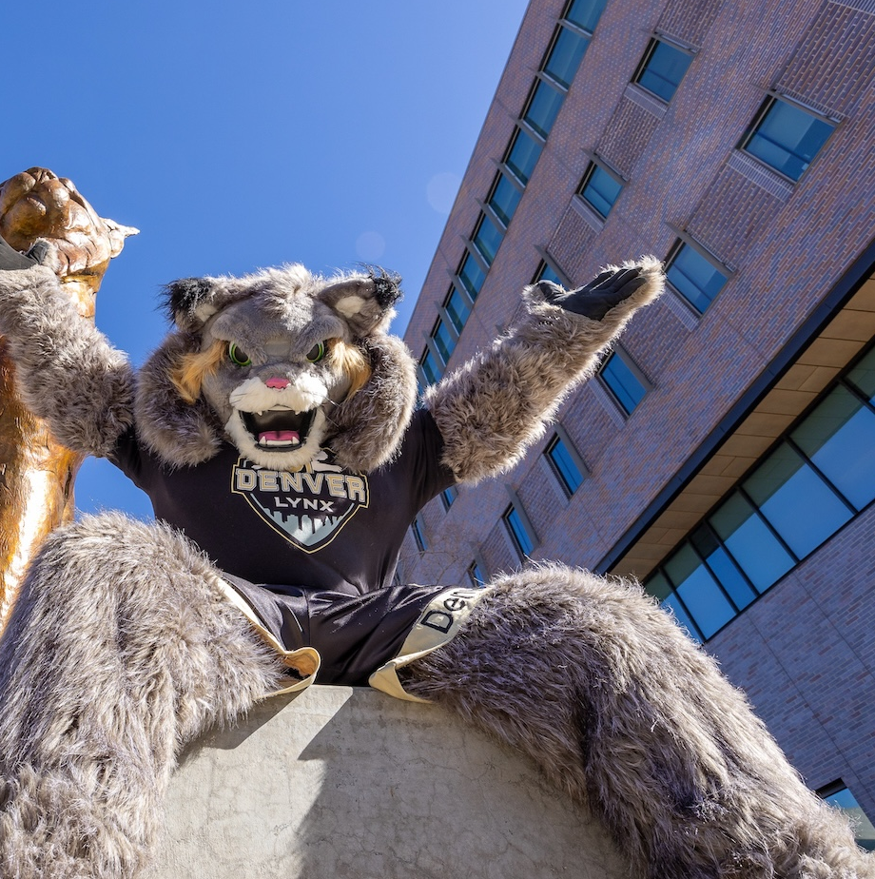
OUR COMPREHENSIVE CAMPAIGN
From preparation to public momentum

Slide 18
A comprehensive campaign:
Brings people together around shared priorities
Invites philanthropy to accelerate impact
Builds relationships + engagement
Creates momentum beyond fundraising

Slide 19
Our Campaign Journey
PLAN → SILENT PHASE → PUBLIC PHASE → CELEBRATE + SUSTAIN
Listen
Assess
Prioritize
Steward
Build
Cultivate
Secure early investment
Share
Engage
Invite
WE ARE HERE

Slide 20
What Changes in the Public Phase?
Silent Phase | Public Phase
Build relationships | Deepen relationships
Test + refine the story | Tell the story widely
Secure early investments | Invite broader participation
Prepare internally | Mobilize our community
Build momentum | Show momentum

Slide 21
Our Three Campaign Focus Areas
Expanding Access Students benefit from an affordable path to a degree, which provides greater value and more opportunity throughout their lifetimes. Our communities benefit from greater social mobility and civic engagement | Enhancing Student Success Students benefit from enhanced advising, first-year experiences, early intervention when hurdles arise, career connectivity, and a university for life. Our communities benefit from an exceptional, career-ready talent pipeline that fuels our region’s workforce. | Cultivating Human Talent Students benefit from instructional excellence, innovative pedagogy, and research and creative opportunities with real-world impact. Our communities benefit from a thriving innovation ecosystem and practical research examining pressing complex issues.

Slide 22
SHARE
Tell us what's happening.
CONNECT
Help us recognize relationships and opportunities.
ENGAGE
Participate in experiences and conversations.
TELL THE STORY
Help people understand why the work matters.
STEWARD
Help show the impact philanthropy makes possible.
YOU ARE PART OF THE CAMPAIGN

Slide 23
What did we accomplish today:
Learned how Advancement partners with campus
Explored how donor relationships develop
Practiced telling your story through impact
Connected your work to our campaign
Identified ways to participate in the public phase

Slide 24
KEEP THE CONVERSATION GOING
Have an idea?
Talk to your Advancement partner.
Know someone we should connect with?
Let us know.
Have a great story?
We want to hear it.
Want to learn more?
Campaign site • Advancement resources • Spring workshop

Slide 25
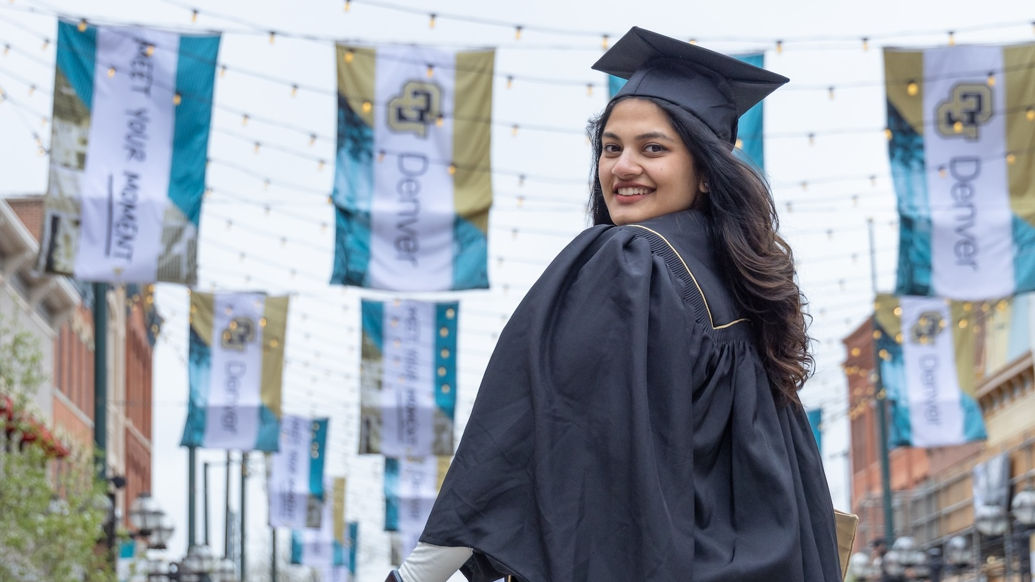
Together, we tell the story of what's possible at CU Denver. Thank you for being part of it.

