Slide 1
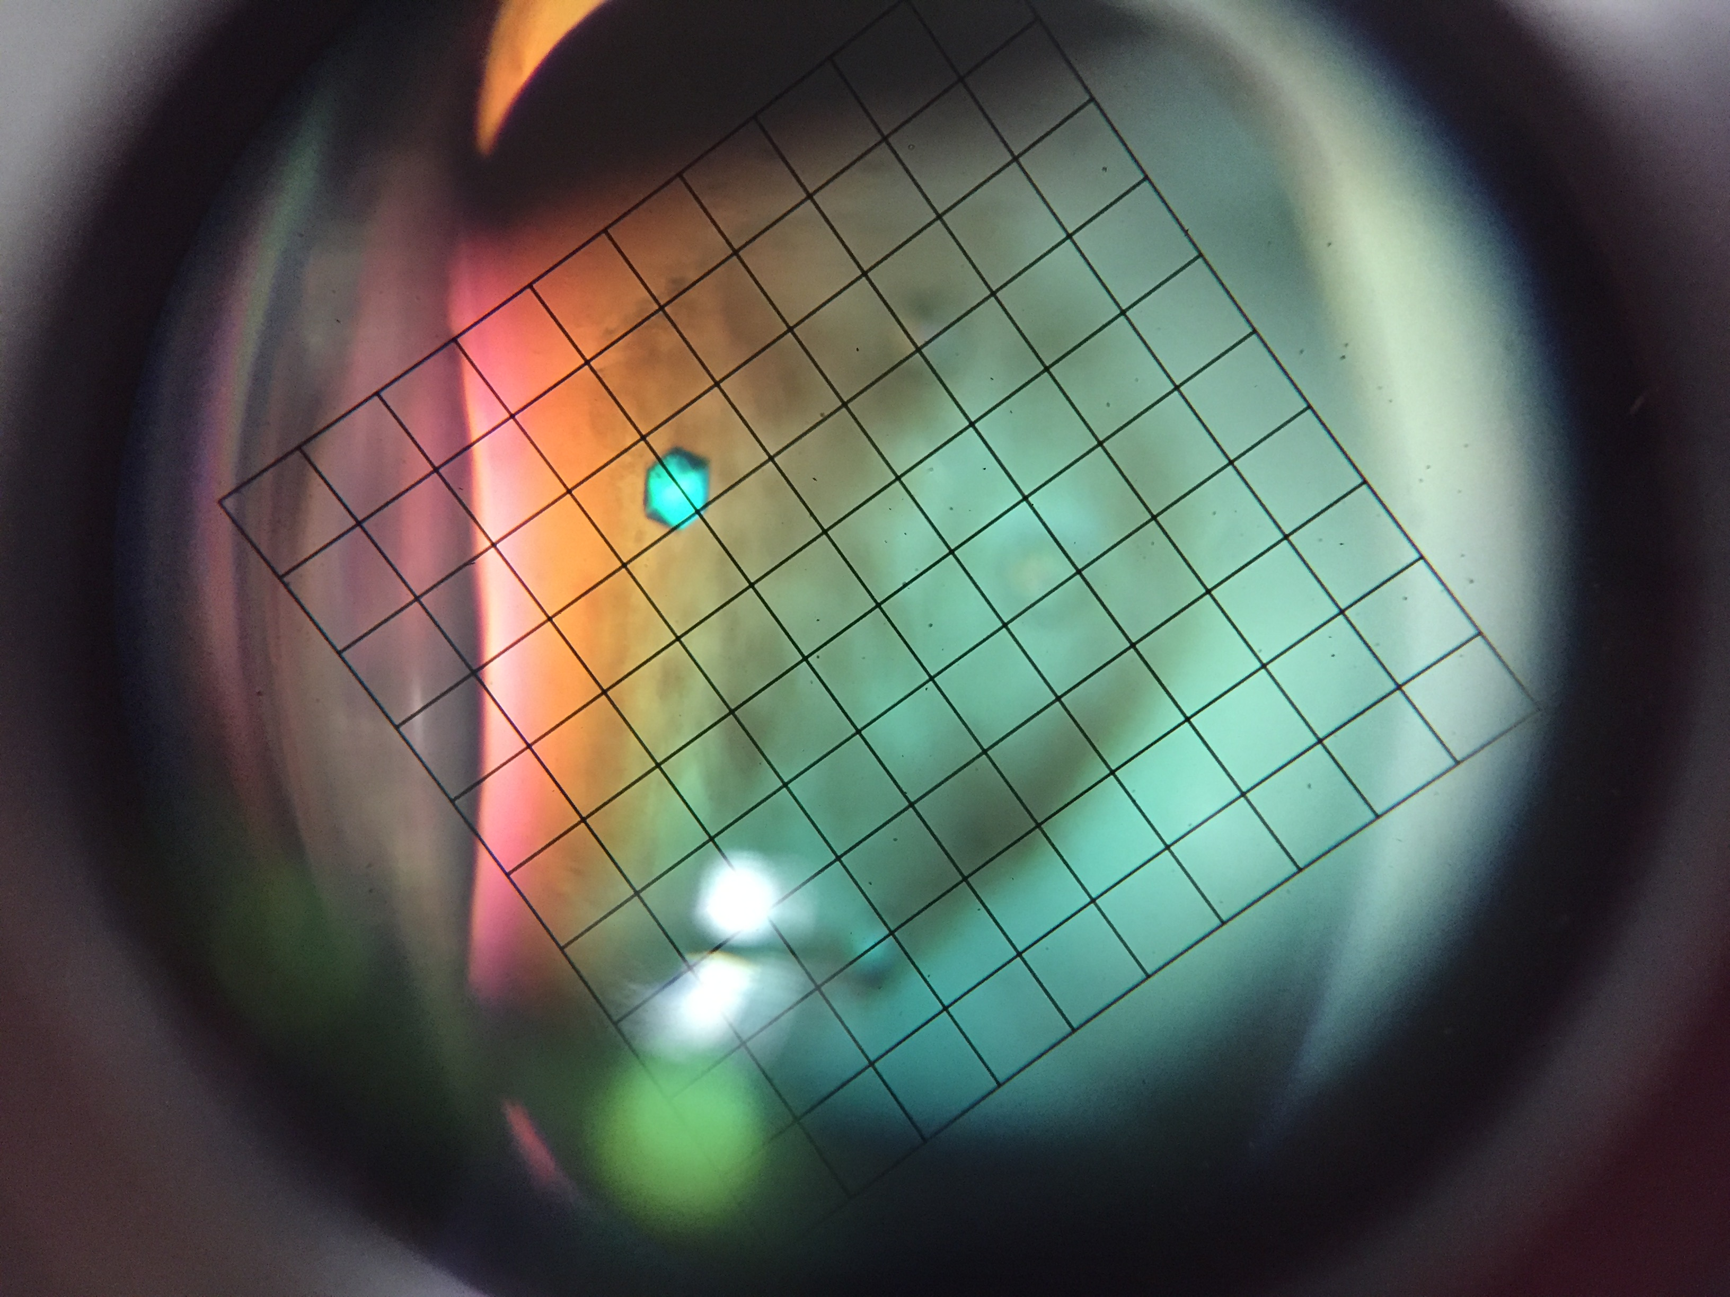
Structural Biology
Mentee: Spencer Shaffstall
Sophomore Undergraduate Student
Mentor: Dr. Karthik Selvam
Post-Doctoral Fellow

Slide 2
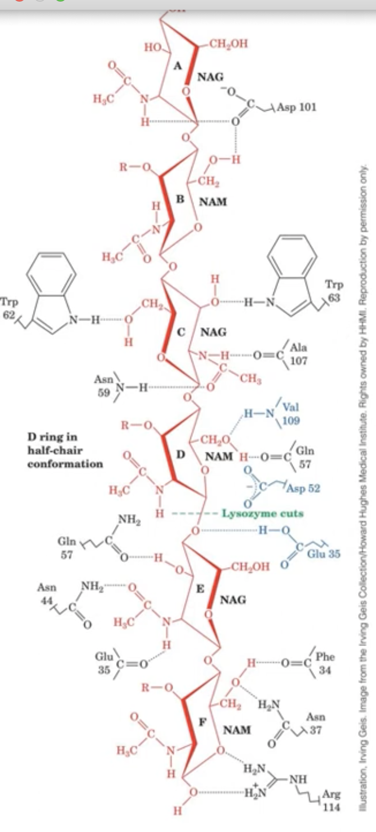
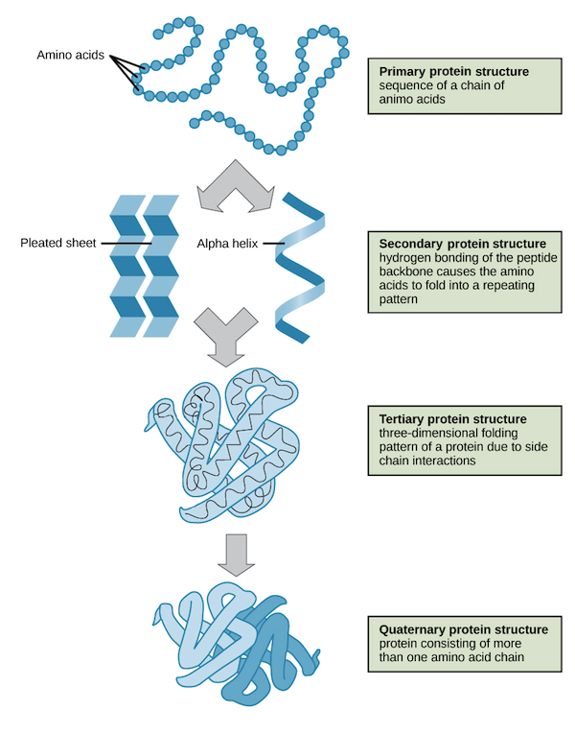
Structural Biology Breakdown
Lysozyme
What is Structural Biology?
Structural biology is how we determine the structure of biological molecules such as proteins and nucleic acids.
The form of the structure determines its function.
Location: Tk Lab Department of Pharmacology

Slide 3
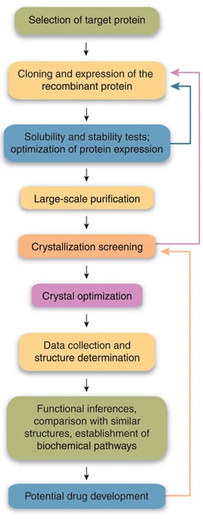
Process of Determining Protein Structure
General steps for determining protein structure
  Clone gene for target protein into bacteria to make enough to study
  Purify and isolate the soluble protein
  Concentrate the protein
  Check purity with gel
  Crystalize protein and study with X-ray Crystallography
  Fit and model the protein into electron density map

Slide 4
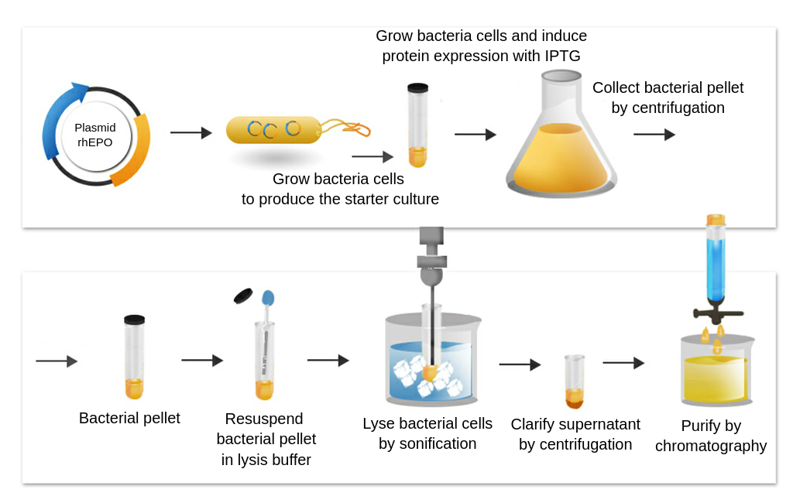
Purifying Protein From E. Coli
Large amounts of protein needed for analysis
To make this, overexpress the protein into E. coli
E. coli are grown, up to 8 liters at a time
Protein is collected by lysing bacterial cells.
Collect the lysate by centrifugation and purify by chromatography

Slide 5
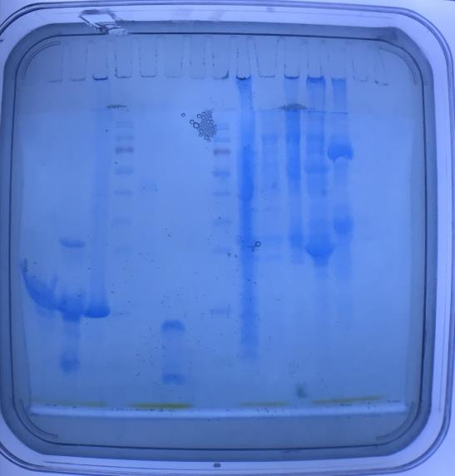
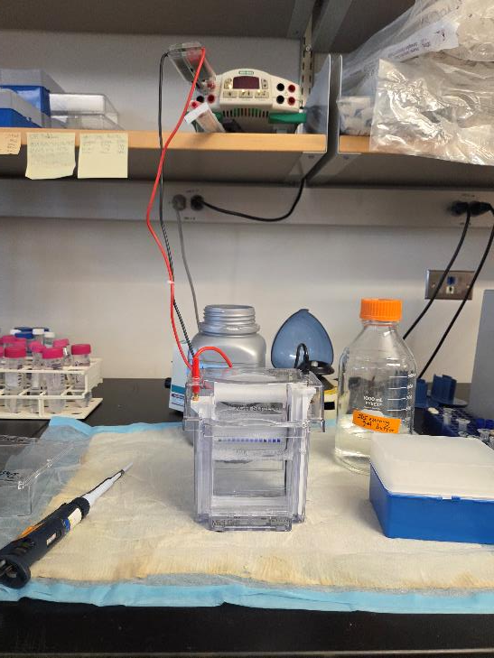
Checking Purity and Concentration With Gel Electrophoresis
SDS Gel electrophoresis uses current to pull proteins through a gel
An electric field is applied across the gel, creating a potential difference (voltage) that drives the negatively charged proteins through the gel.
proteins and other components shown as bands based on size

Slide 6
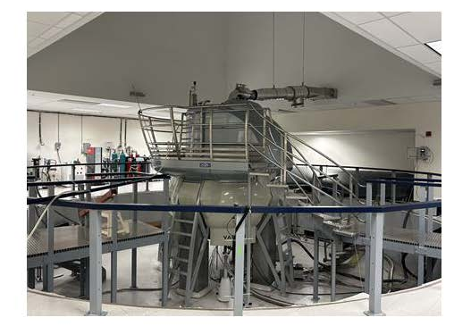
Characterization by NMR
NMR Spectrometer – 900 MHz
2D NMR-HSQC spectra

Slide 7

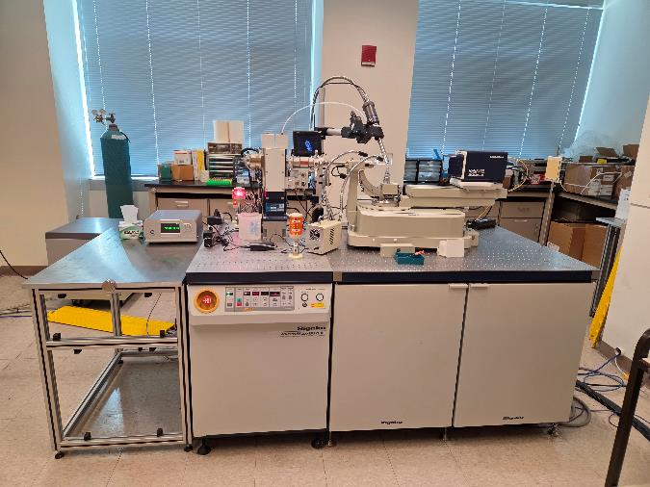
X-ray Crystallography
Purified protein is crystallized gradually into crystals under appropriate conditions (left)
Crystals are mounted onto X-ray diffractometer.
Crystal is bombarded with X-rays that scatter the atoms.

Slide 8
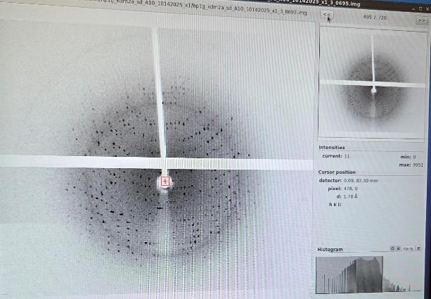
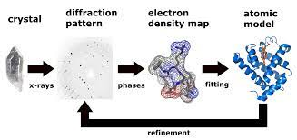
Determining Protein Structure
Diffraction pattern generated from X-rays
Software used to generate electron density map from the set of diffraction patterns.
Electron density map is used to fit and refine the protein model.

Slide 9
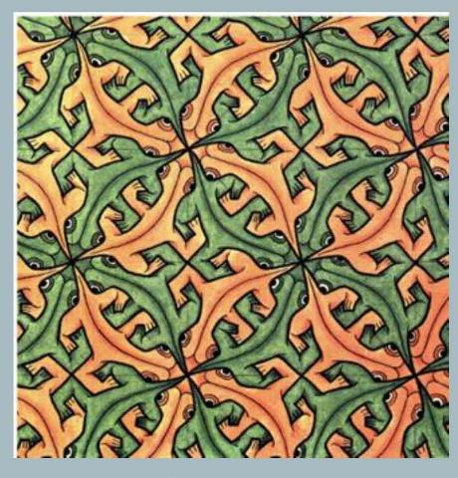
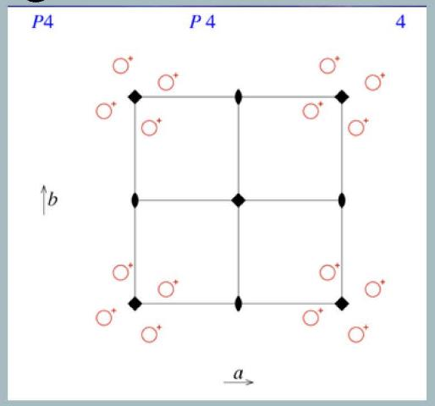
Symmetry and patterns - M.C. Escher
Head, shoulder and tail
International Tables for Crystallography, Vol A – Space group number 75

Slide 10
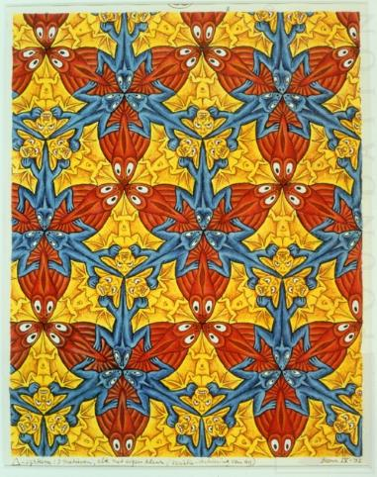
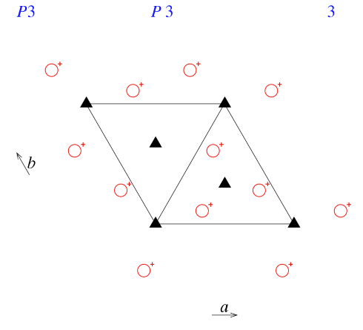
Symmetry and patterns
International Tables for Crystallography, Vol A – Space group number 143

Slide 11

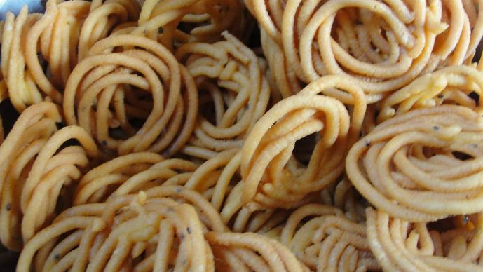
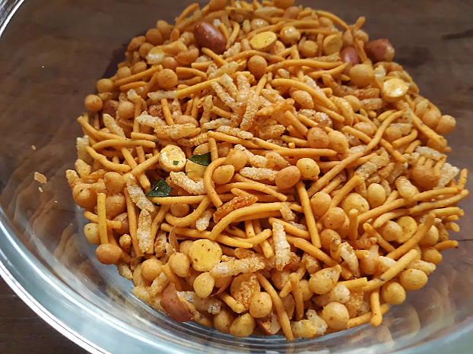
Cultural Exchange
Snacks and movie culture were among the many conversations had!
Murukku
Highly recommended show!
Madras Mixture

Slide 12
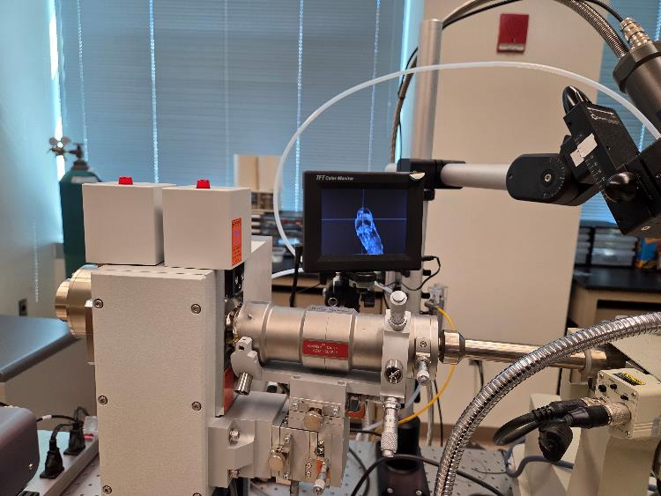
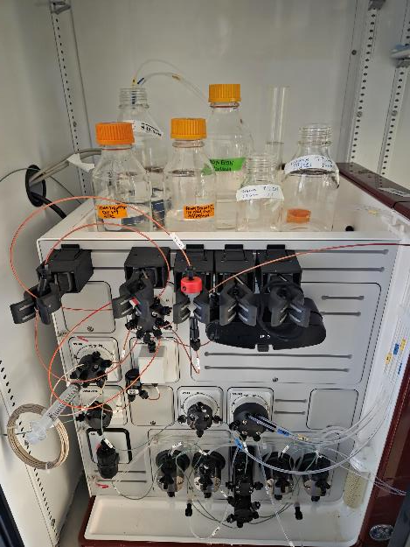
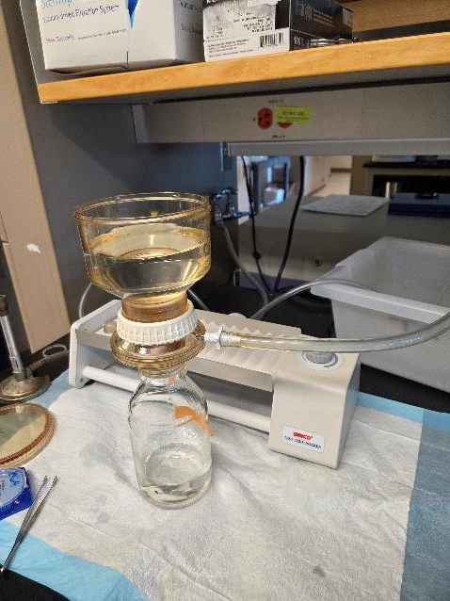
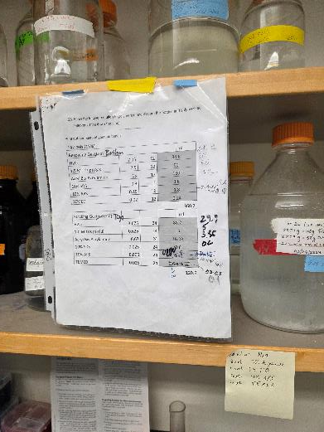
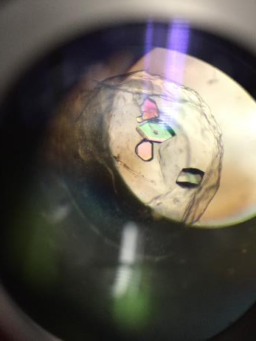
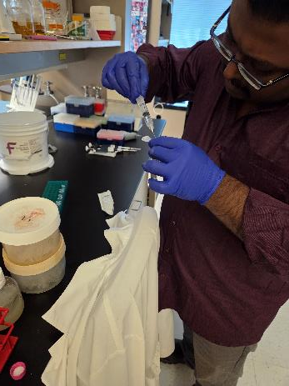

Slide 13
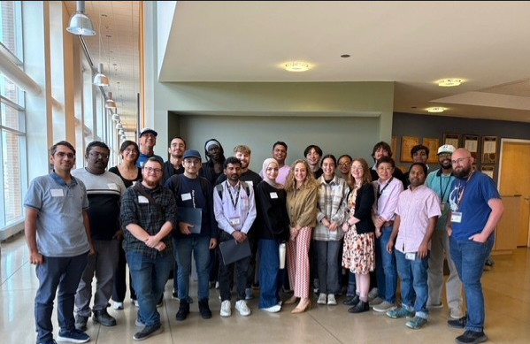
Thank you!
Dr. Karthik Selvam and the TK lab
ISCORE Program
Dr. Cristina Cenciarelli
Elizabeth Evans

