Slide 1







Sex Differences in Cognitive Decline in Parkinson's Disease
Paulina Guzman Tinoco → Undergraduate Student
Ece Bayram → Assistant Professor, Neurology

Slide 2







Culture
My mentor, Ece, is from Turkey
What I learned
  Both Mexican and Turkish cultures are very family oriented.
  Healthcare is universal and publicly funded in Turkey.
  Public university is either free or extremely low cost.
  Medical school starts right after high school.
  As someone who is Mexican but was born and raised in America, learning these differences and similarities made me reflect on how culture can majorly shape education.
  It also helped me appreciate the background my mentor comes from and how our cultures overlap in very meaningful ways

Slide 3




WHAT IS PARKINSON’S DISEASE?
PARKINSON’S DISEASE IS A PROGRESSIVE NEURODEGENERATIVE DISORDER CAUSED BY THE GRADUAL LOSS OF DOPAMINE-PRODUCING NEURONS IN THE BRAIN.

Slide 4







Those With Parkinsons May Experience
  Cognitive changes
  Trouble with memory
  Trouble with attention
  Trouble with problem solving
Tracking these changes helps us understand how thinking abilities decline as the disease progresses.

Slide 5

Objectives
  EXAMINE HOW COGNITIVE SCORES CHANGE OVER TIME IN PEOPLE WITH PARKINSON’S DISEASE
  ASSESS WHETHER MALES AND FEMALES SHOW DIFFERENT RATES OF COGNITIVE DECLINE

Slide 6


METHODS
METHODS
  DATA FROM THE FOX INSIGHT DATABASE (SELF REPORT)
  OUR ANALYSIS INCLUDED 2178 FEMALES AND 2526 MALES WITH PARKINSON’S DISEASE
  Cognitive scores were from Penn ParkinsON’S DAILY ACTIVITIES QUESTIONNAIRE, HIGHER SCORE INDICATING BETTER COGNITION
  LINEAR MODEL IN R TESTED WHETHER SCORES DECLINED DIFFERENTLY BY SEX OVER TIME ADJUSTING FOR AGE; COGNITIVE SCORE AS OUTCOME, SEX*TIME INTERACTION AS PREDICTOR, AGE AT BASELINE AS COVARIATE
  PREDICTED VALUES AND 95% CONFIDENCE INTERVALS WERE USED TO CREATE A GRAPH OF COGNITIVE SCORES OVER TIME BY SEX ADJUSTING FOR BASELINE AGE

Slide 7
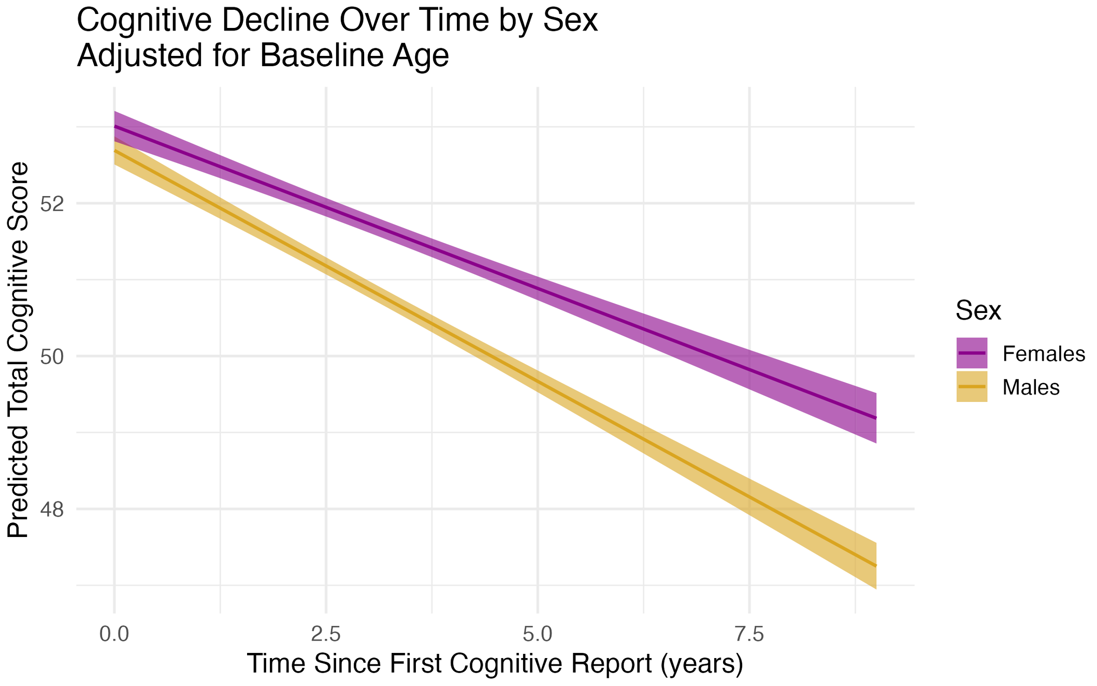

Slide 8
  RESULTS
  4.
Sex difference in decline (sex and time interaction): B = 0.18, p = 7.07e–07
  1.
Baseline cognitive score: 56.02 (score range on scale is 0–60; higher score = better cognition)
Sex effect overall: +0.32 points for females
(p = 0.0215)
  5.
  2.
Male decline: –0.784 points per year
  6.
Time effect overall: –0.784 points each year (p < 2e–16)
  3.
Female decline: –0.604 points per year
  7.
Effect of baseline age: –0.0566 points per year older (p < 2e–16)

Slide 9
  Cognitive scores went down over time for both males and females, but males showed a faster decline.
  Older participants had lower cognitive scores, meaning age was linked to worse cognition.
  These results suggest that cognitive decline in Parkinson’s disease may differ by sex, and that other factors (like age and possibly education or health) also play a role in these changes.
  I am still wondering
  Why do females decline faster? Biological reasons? Hormones?
  How do sleep, stress, and physical activity influence cognitive decline rate?
  Do symptoms change/differ between race/ethnicity?

Slide 10


Thank You!!!
  Thank you to my mentor, Ece, who guided me throughout this project with nothing but kindness, patience, and understanding. For taking me under her wing and for providing me a safe learning space.
  Thank you Christina and Liz for this amazing opportunity!

