Slide 1
Protein Folding in Respiratory Illnesses
ISCORE 2025
Laila Solorzano Bravo, undergraduate student
Dr. Rahul Ahuja, postdoctoral fellow

Slide 2
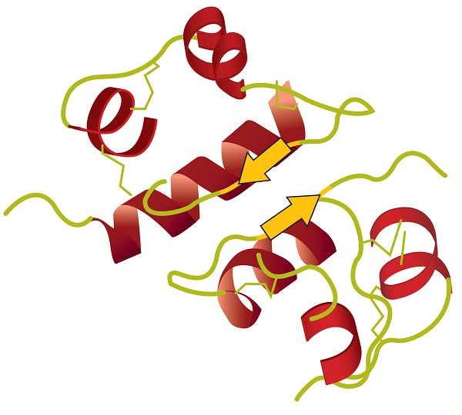
Introduction to Proteins
Proteins are macromolecules made up of amino acids that aid in different functions in the body like transporting substances, catalyzing chemical reactions, and repairing tissues. The protein depends on its 20 different types of amino acid chain sequence, shape, and structure.
This Photo by Unknown Author is licensed under CC BY-SA-NC

Slide 3
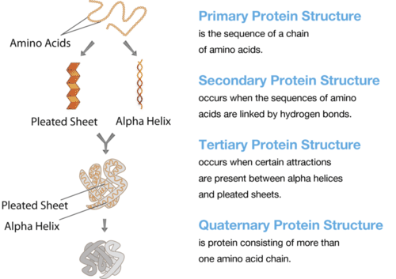
Protein Structures
The shape of the proteins is determined by their amino acid sequence and its interaction.
The primary structure is the linear sequence of the amino acid protein chain.
The secondary structure is the folding pattern within the protein chain like the Alpha helix (a coiled spring like structure) and a Beta sheet (a flattened structure).
The tertiary structure is the overall three-dimensional shape of the protein.
The quaternary structure which is the combination of multiple polypeptide chains to form a functional protein. These chains are held together by either hydrogen or ionic bonds.
This Photo by Unknown Author is licensed under CC BY-SA-NC

Slide 4
Techniques and Experiments I Learned

Slide 5
Micropipetting
Throughout the eight weeks, I learned proper micropipetting technique through multiple trials in which I pipetted set volumes of water onto a scale, recorded the weight, and repeated the process several times to calculate the standard deviation.

Slide 6
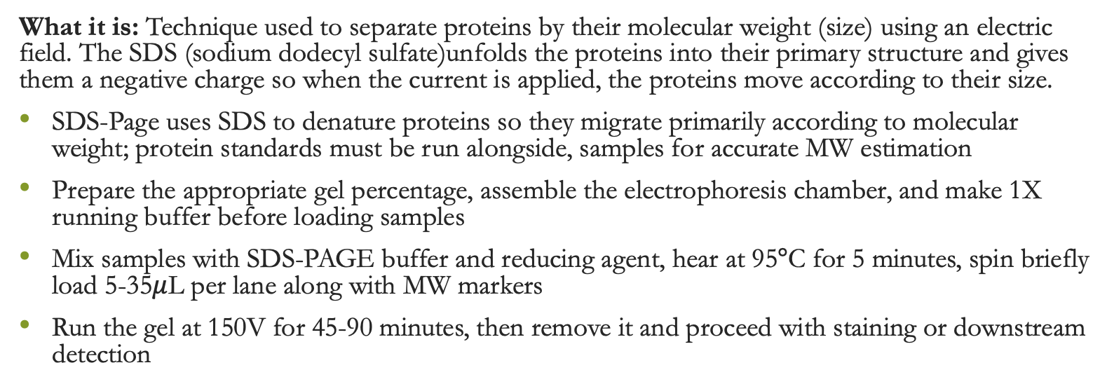
SDS Page
What it is: Technique used to separate proteins by their molecular weight (size) using an electric field. The SDS (sodium dodecyl sulfate)unfolds the proteins into their primary structure and gives them a negative charge so when the current is applied, the proteins move according to their size.
SDS-Page uses SDS to denature proteins so they migrate primarily according to molecular weight; protein standards must be run alongside, samples for accurate MW estimation
Prepare the appropriate gel percentage, assemble the electrophoresis chamber, and make 1X running buffer before loading samples
Mix samples with SDS-PAGE buffer and reducing agent, hear at 95$°$C for 5 minutes, spin briefly load 5-35$μ$L per lane along with MW markers
Run the gel at 150V for 45-90 minutes, then remove it and proceed with staining or downstream detection

Slide 7
HEK Cell Culture
What it is: A widely used mammalian cell culture system derived from human embryonic kidney cells. HEK cells grow robustly, are easy to maintain, and are commonly used for protein expression and viral production.
HEK cells are anchorage-dependent mammalian cells that thrive in nutrient-rich media and controlled environmental conditions
They are highly transactable which makes them ideal for studying gene expression, protein function, and recombinant protein production
Proper culture conditions support healthy cell morphology and consistent growth
HEK cells are often chosen thanks to their ability to produce recombinant proteins

Slide 8
DNA Plasmid Purification
What it is: A technique used to isolate plasmid DNA from bacterial cells, separating it from genomic DNA, proteins, RNA, and other cellular components. Purified plasmids are essential for cloning, sequencing, transfection, and other molecular biology applications.
Plasmid purification relies on selectively isolating circular plasmid DNA while removing chromosomal DNA and cellular debris
Chemical and physical separation methods ensure that plasmid DNA remains intact and enriched throughout the process
High-quality purified plasmids enable reliable downstream workflows, including gene expression studies, recombinant protein production, and genetic engineering
Different purification formats (mini-, midi-, and maxi-preps) allow scaling depending on DNA yield requirements
The final plasmid DNA is typically assessed for concentration and purity before being used in downstream molecular assays

Slide 9
Ni-NTA Based Protein Purification
What it is: A method used to isolate His-tagged proteins. The His-tag sticks to nickel ions on the Ni-NTA resin, allowing the tagged protein to be separated from everything else in the sample.
The Ni-NTA resin has nickel ions that specifically attract proteins with a His-tag
This makes it easier to pull out the protein of interest from all the other cellular material
The conditions are adjusted so the tagged protein binds well while unwanted proteins wash away
A molecule like imidazole is used to gently release the His-tagged protein from the resin
After this, the purified protein can be checked or used for later experiments

Slide 10
Cultural Comparison

Slide 11
Similar Cultures
Diwali Festival
  This festival celebrates the phases of the moon with the use of light. It celebrates the victory of Dharma over Adharma and is the day that he returned to his kingdom after the victory.
Danza de los Viejitos
  Celebrates phases of life. The dance honors life, death, and the overall passing of time on Earth which is how older people gain wisdom.
Our Lady of Guadalupe
  The Virgin of Guadalupe, a big part of Mexican culture, is seen standing over a crescent moon. The crescent moon symbolizes triumph over darkness and evil.

Slide 12
Common Interests
Cars
During breaks and between procedures, we would discuss different types of cars and how good they are in the snow
Food (Rice)
We shared some of our cultural food and noticed the similarity between rice and the importance of it in our meals
Family
We discussed the similarities and differences between our parents
Home country similarities
We discussed the similarities between the governments in both of our home countries including the political corruption

Slide 13
Thank You!

Slide 14
A Special Thanks…a
Thank you so much to Dr. Rahul Ahuja for allowing me to enter his lab space and mentoring me!
Liz Evans
Dr. Cristina Cenciarelli
Dr. Kushal Kandhari

