Slide 1
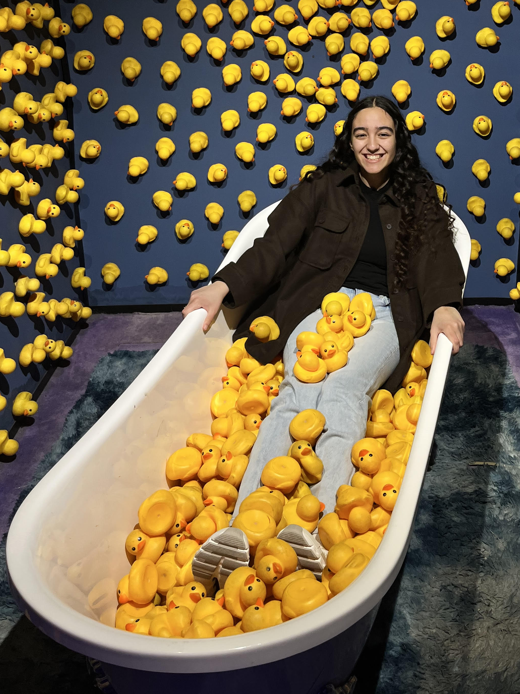
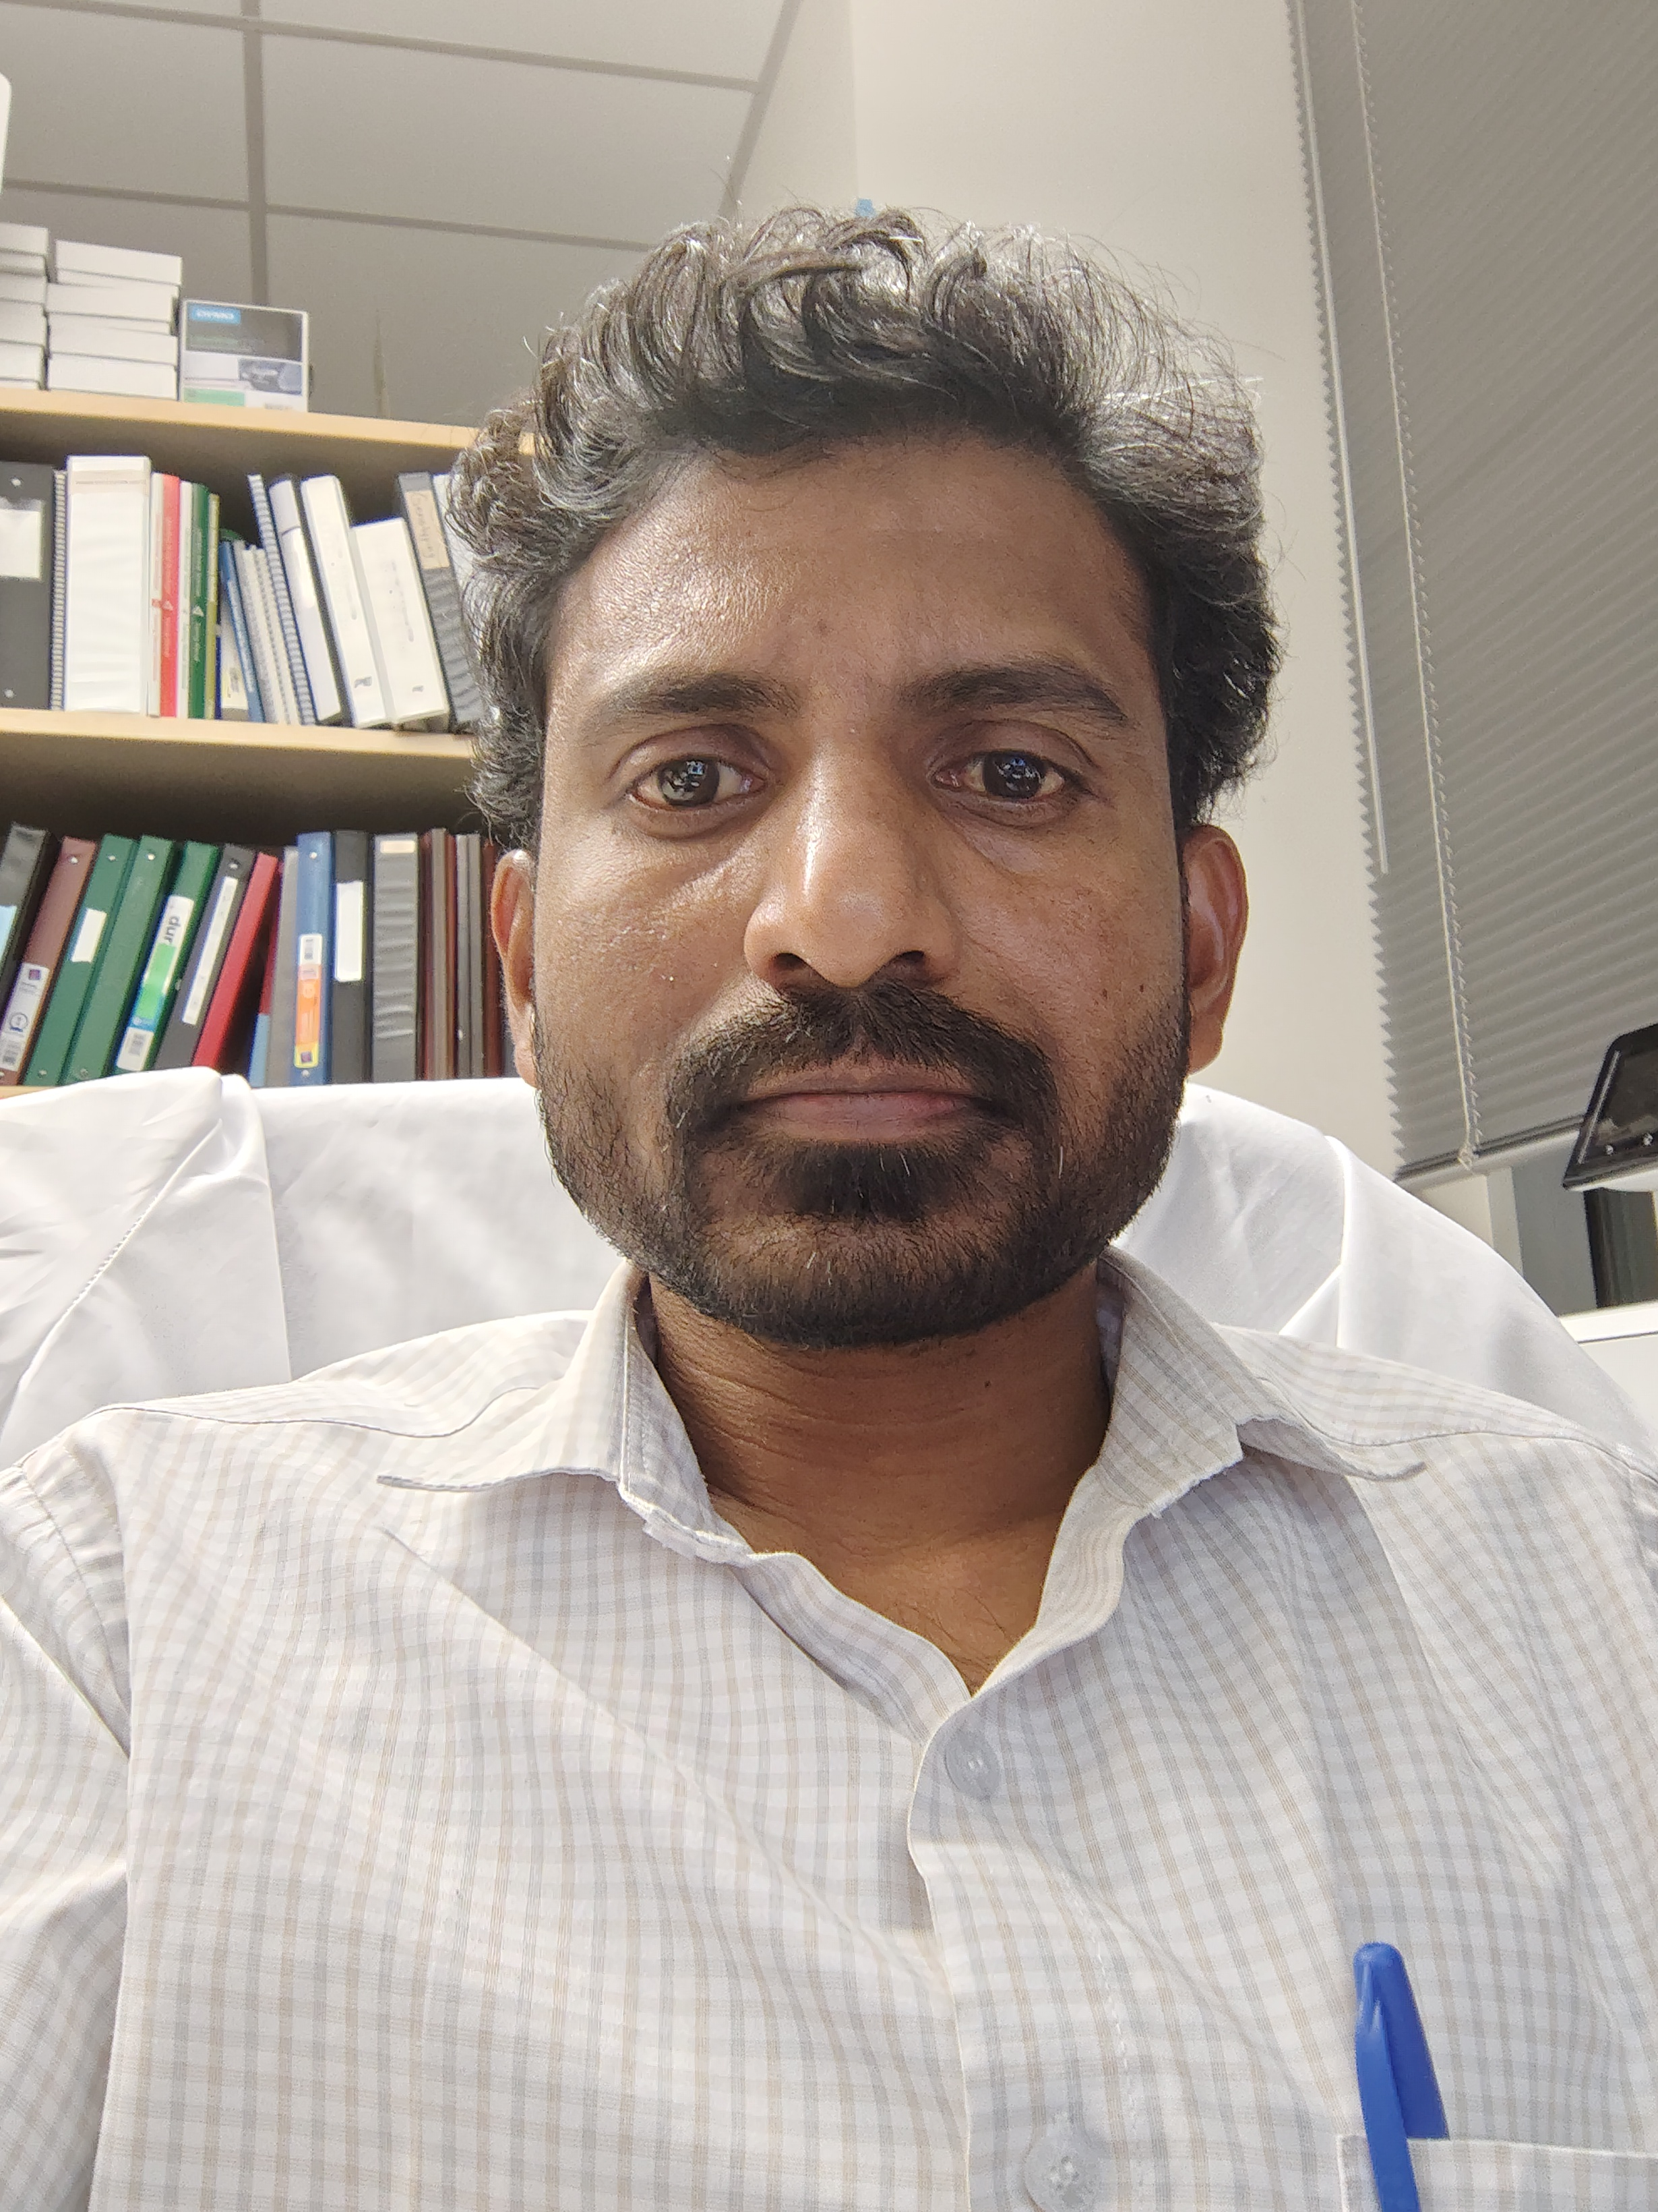
Expression of RUNX2 and SP7 in Osteoblasts
Nour Goucem
Undergraduate Student
Dr. Rajashekar Donaka
Postdoctoral Scholar

Slide 2
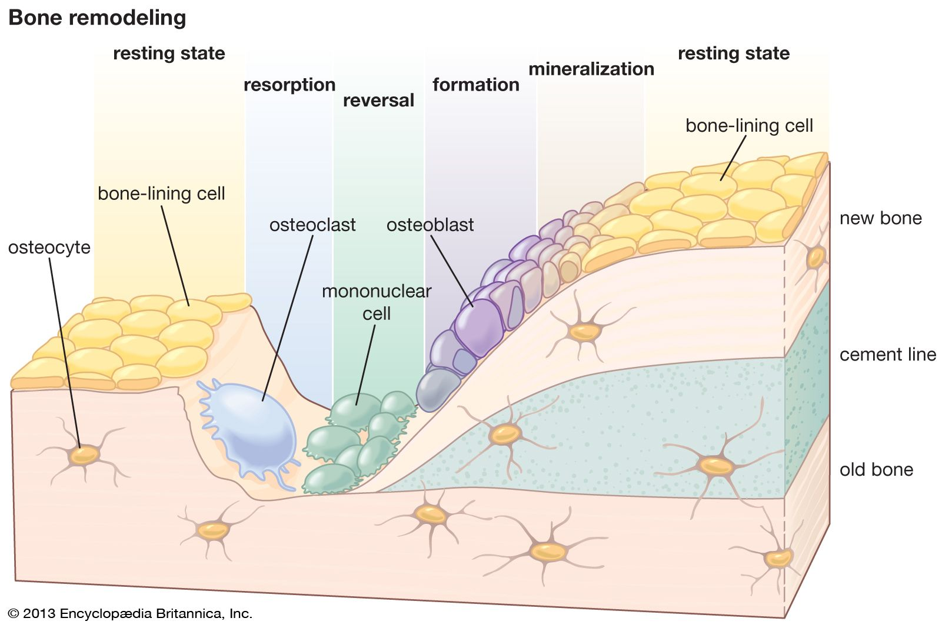
Bone
Bone makes up 15% of the human body weight
Functions:
Structure
Support
Movement
Blood, Hormone, Calcium
Cell Types:
      - Osteoblasts
      - Osteoclasts
      - Osteocytes
Homeostasis between the osteoblasts and osteoclasts is essential for bone formation

Slide 3
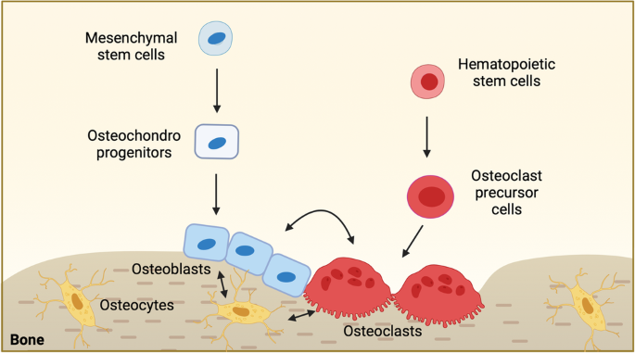
Osteoblasts
They have a mesenchymal stem cell lineage
They build new bone
They make matrix that becomes mineralized
Process:
      Proliferation
      Maturation
      Mineralization
Notes:
This lab is focused on exploring in fish, mice, and human, maintaining the fuctional

Slide 4
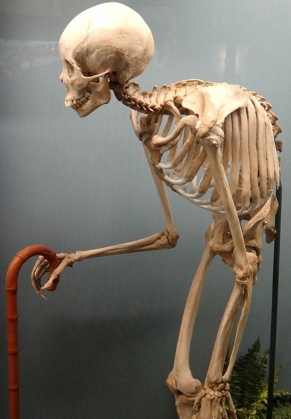
Osteoporosis
Most common bone disease that leads to weak and brittle bones
Affects 10.2% of adult 50 and over in the US, with 13.6% increase by 2030 (Harris 2023)
Risk Factors:
- Age
- Genetics (80%)
- Diet (15%)
Understanding these bone diseases and underlying mechanisms allows us to promote bone growth
Notes:
Blending the modifiable and non modifiable

Slide 5


Goal
To study the role of Omega 3 fatty acids on the osteoblast differentiation using a Human Fetal Osteoblast Cell (hFOB; immortalized cell line established in the 1970s)
Alpha Linolenic Acid (ALA)
RUNX2 and SP7
An essential and required dietary nutrient that the body can’t synthesize
Reduces inflammation, inhibits bone resorption
Transcription factors important for bone development
RUNX2: Initiates osteoblast differentiation
SP7: Ensures maturation of osteoblasts
Notes:
Testing how osteoblasts respond to fatty acid treatment in diet

Slide 6
Procedure
Seeded/grow for 24 hours
Added CGM (growth media)
Differentiated for 10 days
Added Differentiated media every other day (Control and ALA Treatment)
Quantified and Measured Protein
Used BCA Protein Assay and Western Blot

Slide 7
Cell Growth and Differentiation
Growth Media:
MEM media w/ 1X L-glutamine ( - Ascorbic Acid)
10% FBS
1% Pen/Strep
Differentiation Media:
MEM-ɑ w/ 1X L-glutamine ( + Ascorbic Acid)
50 µg / mL ascorbic acid
10 mM betaglycerophosphate
10 nM dexamethasone
Control
10 uM ALA
Seeded 750K cells / per well
Notes:
Human fetal osteoblasts

Slide 8
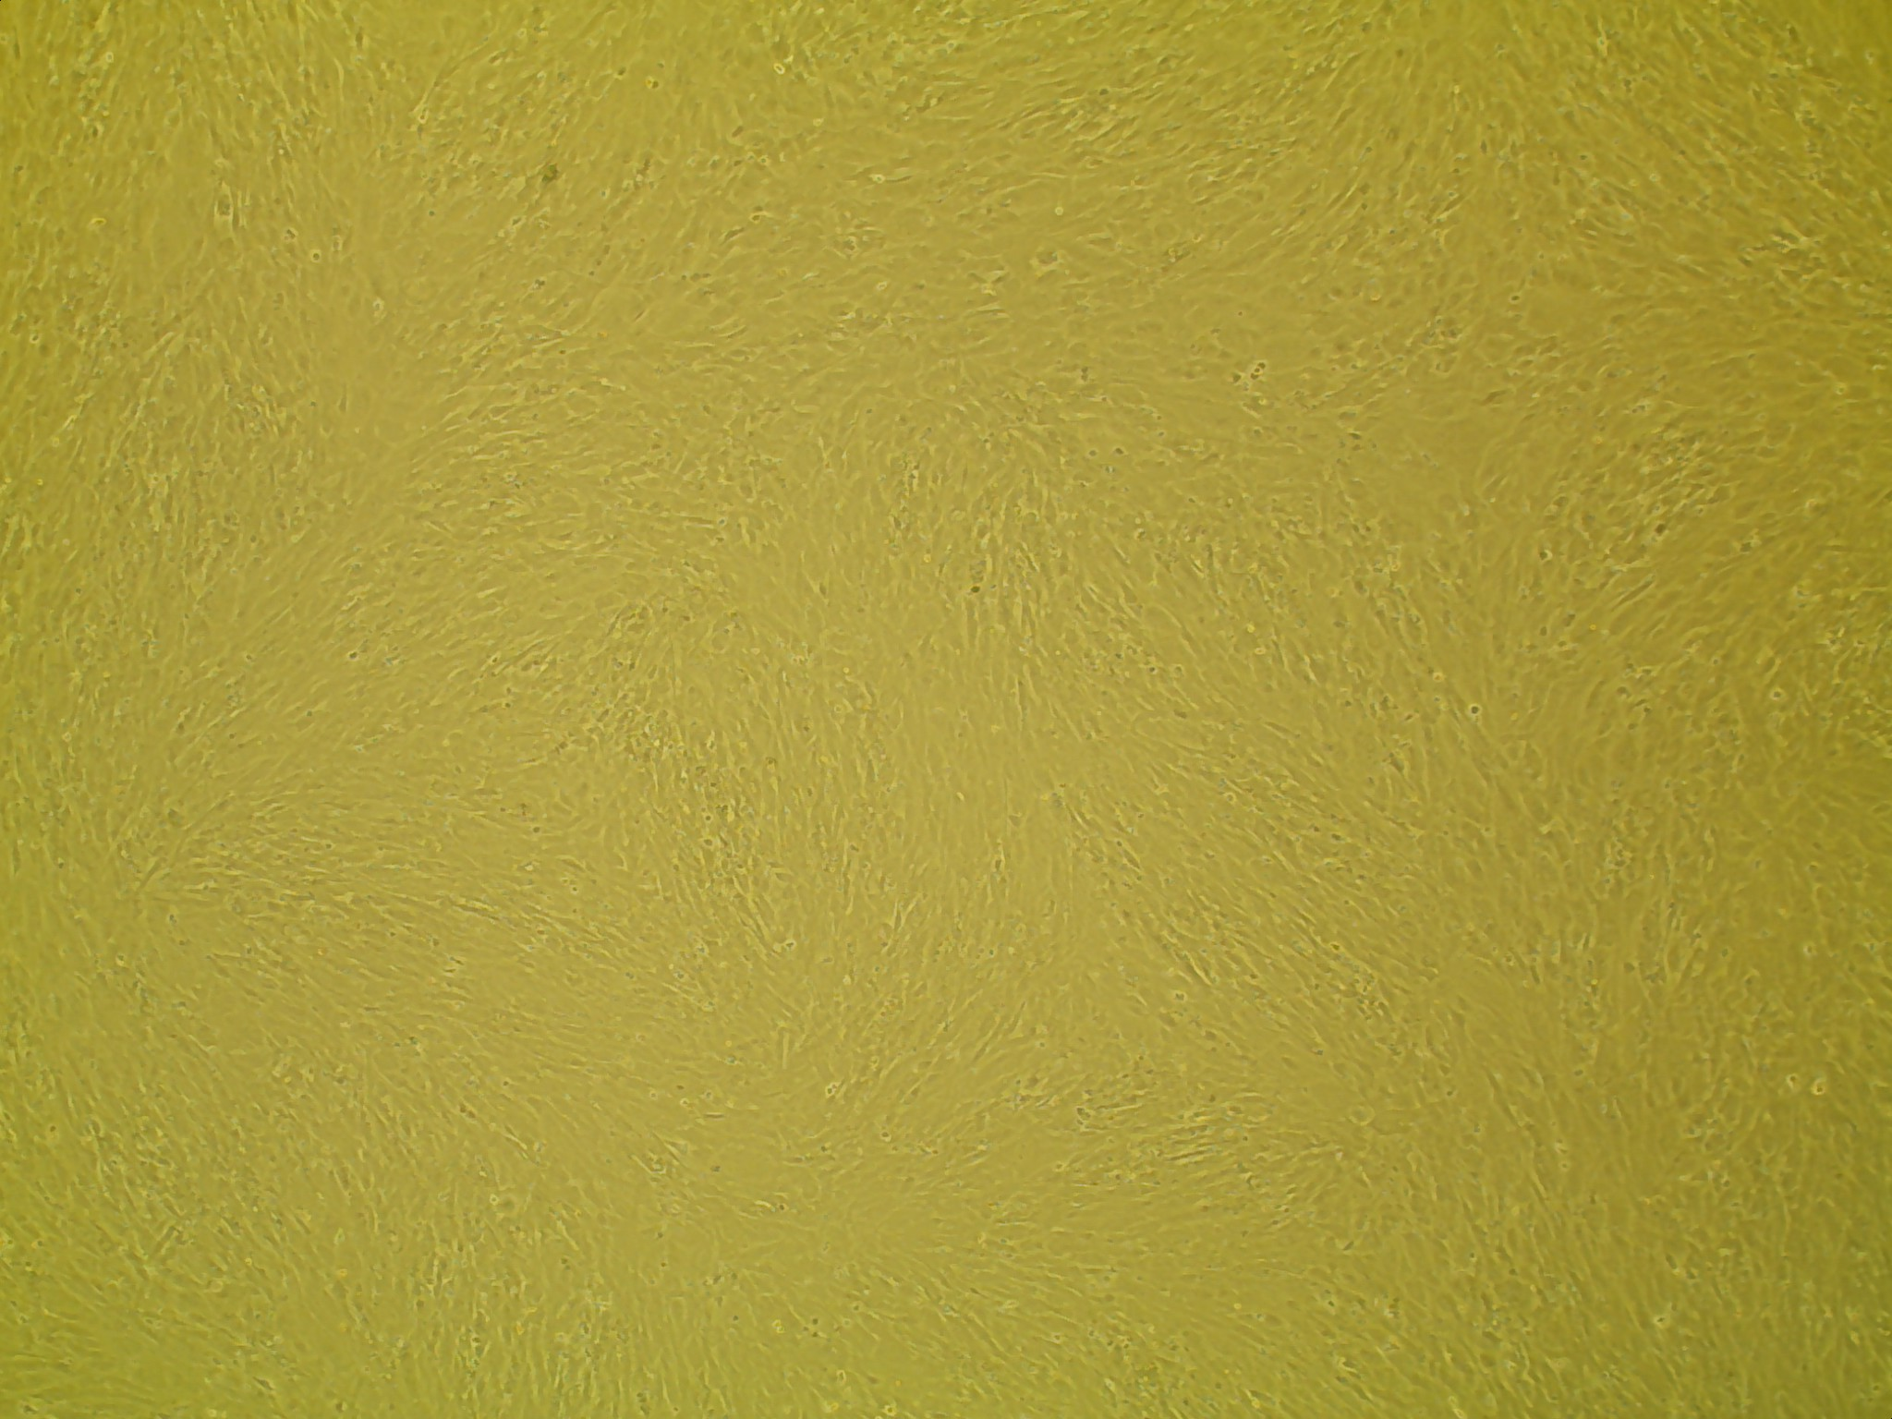
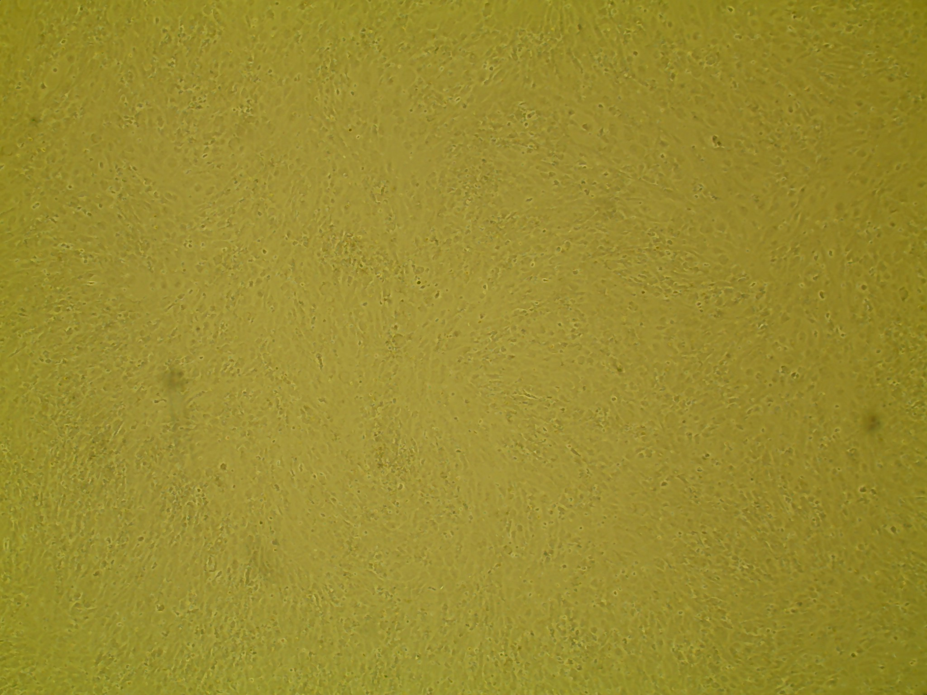
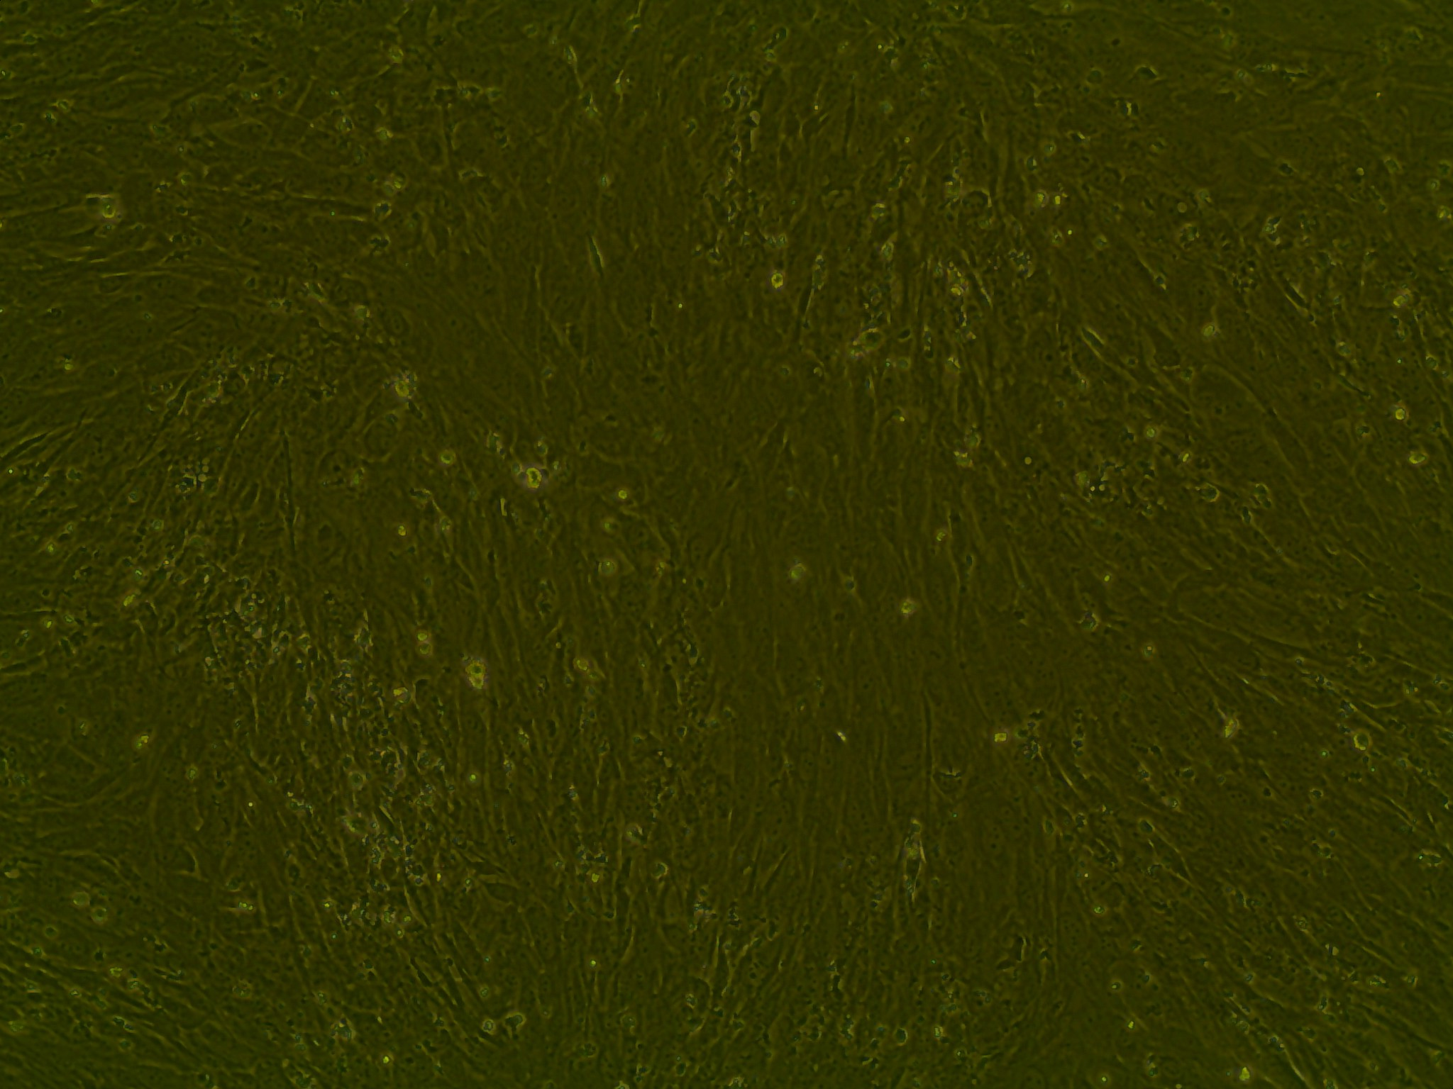
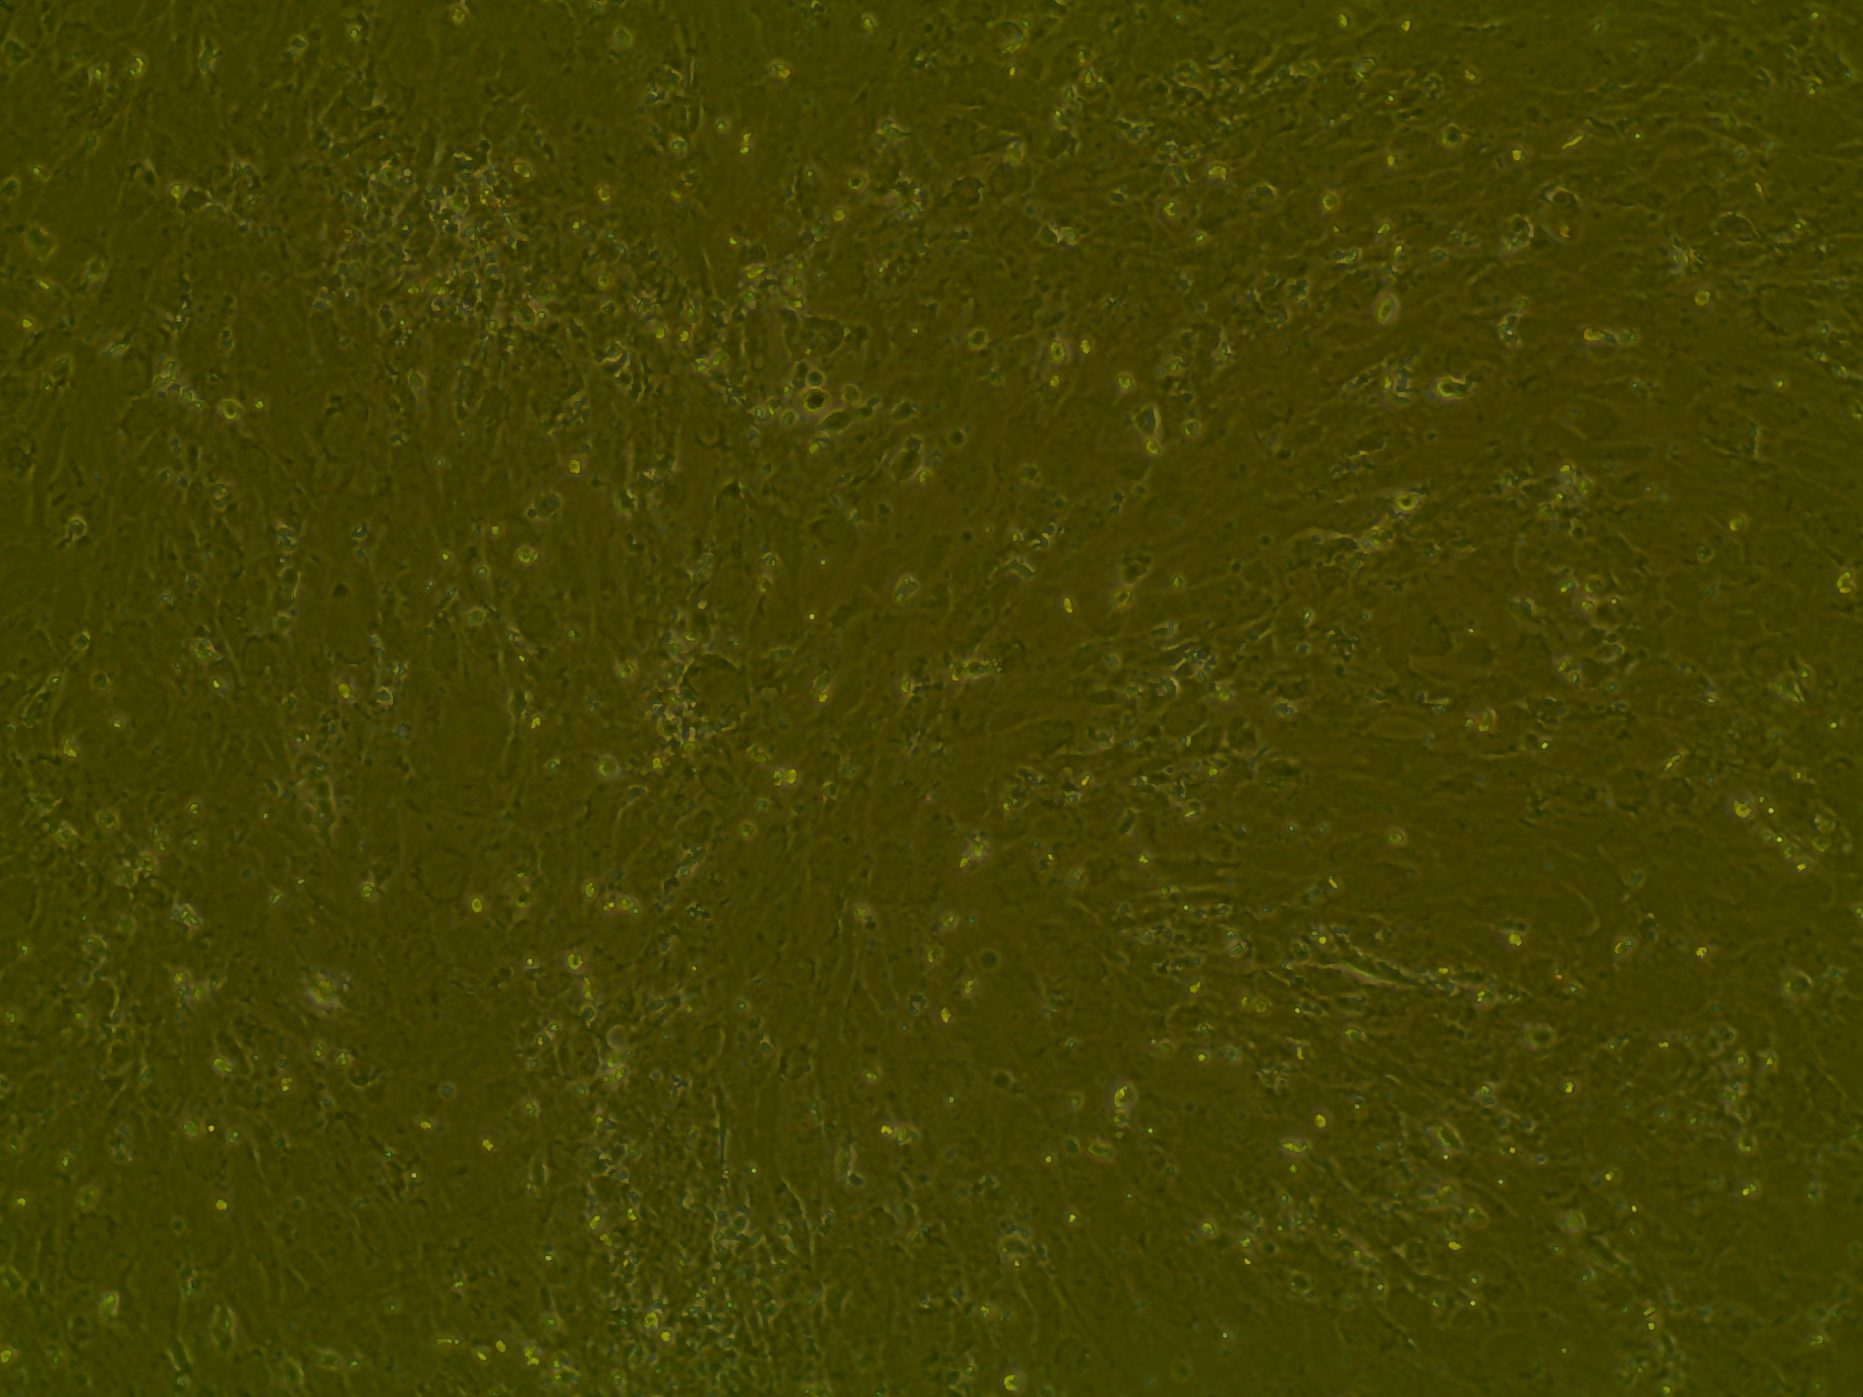
Differentiation: Day 4
Control
10 uM ALA
4x
10x

Slide 9
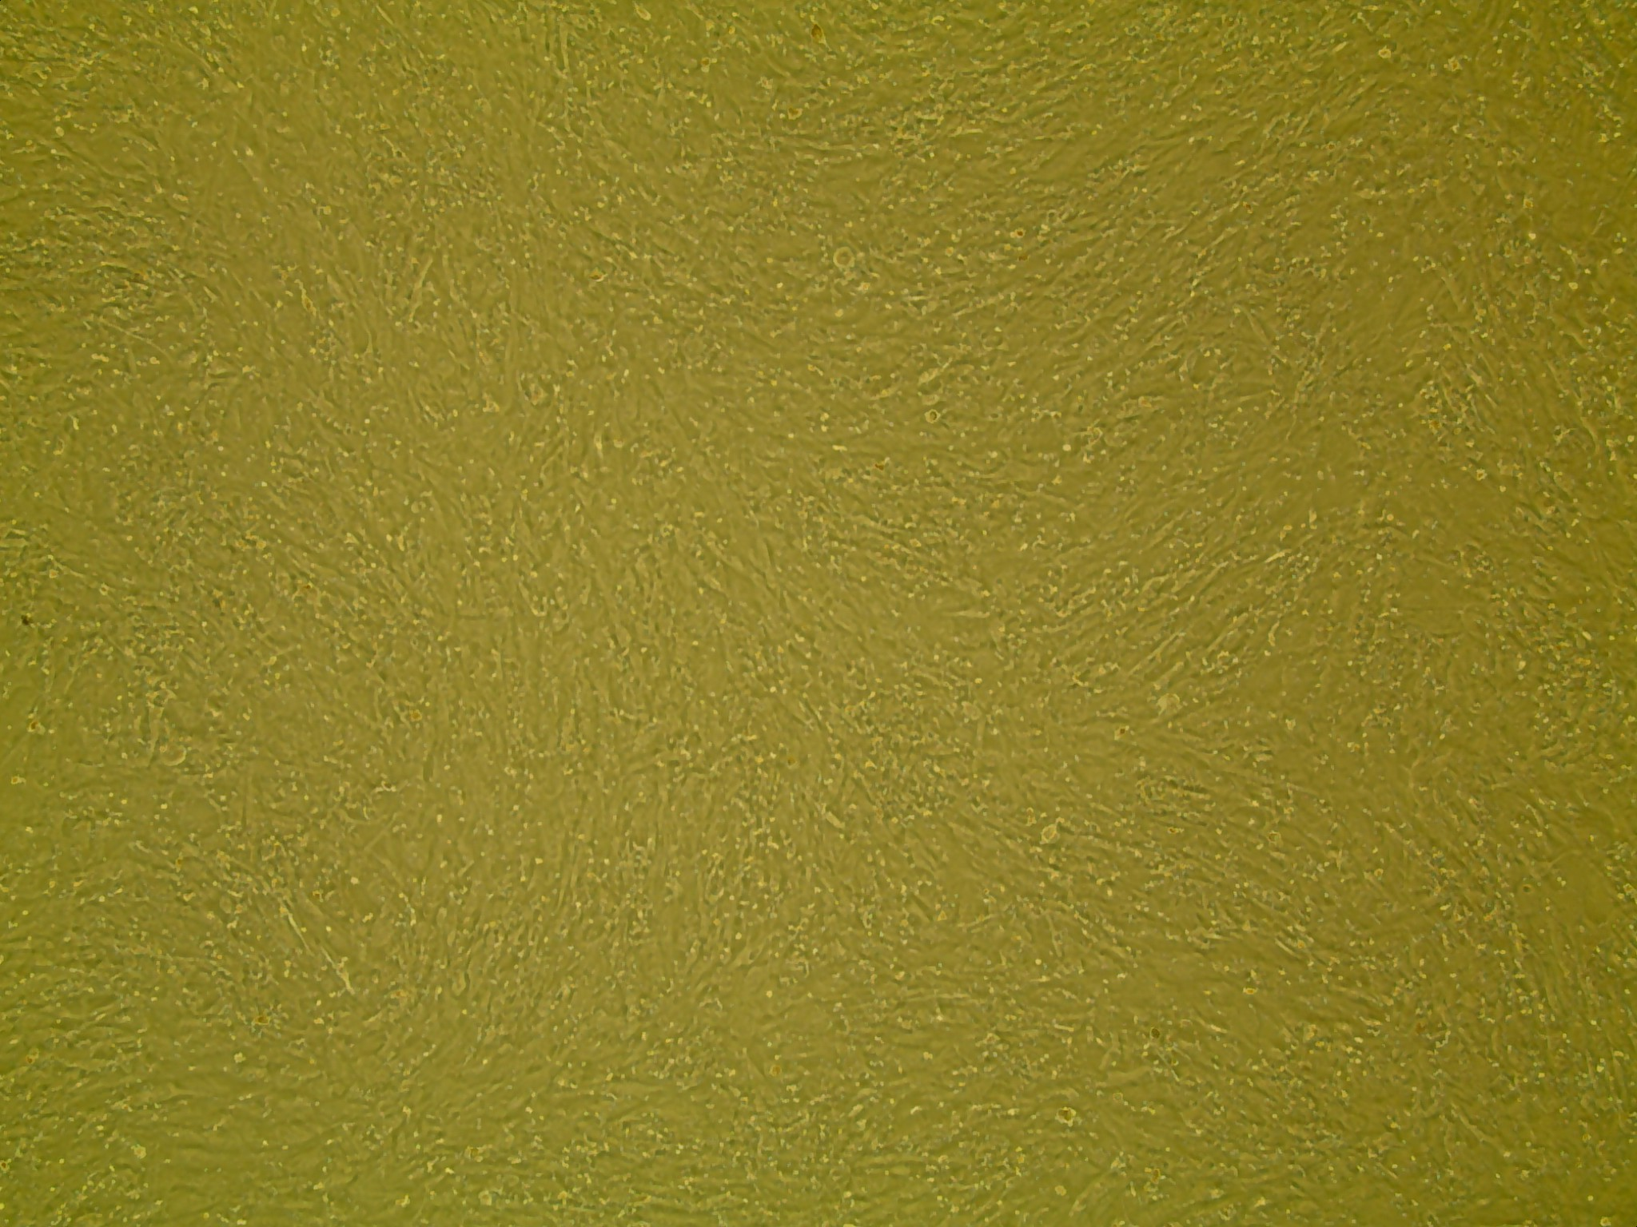
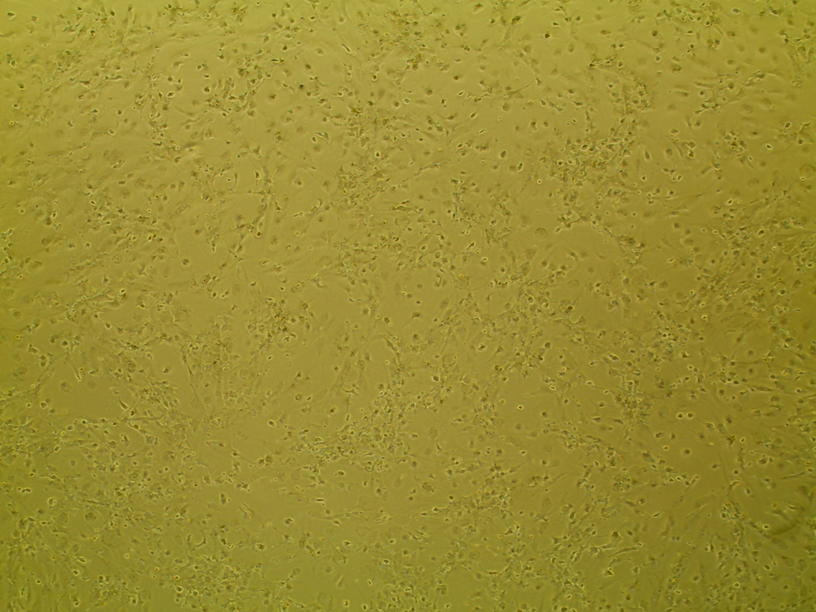
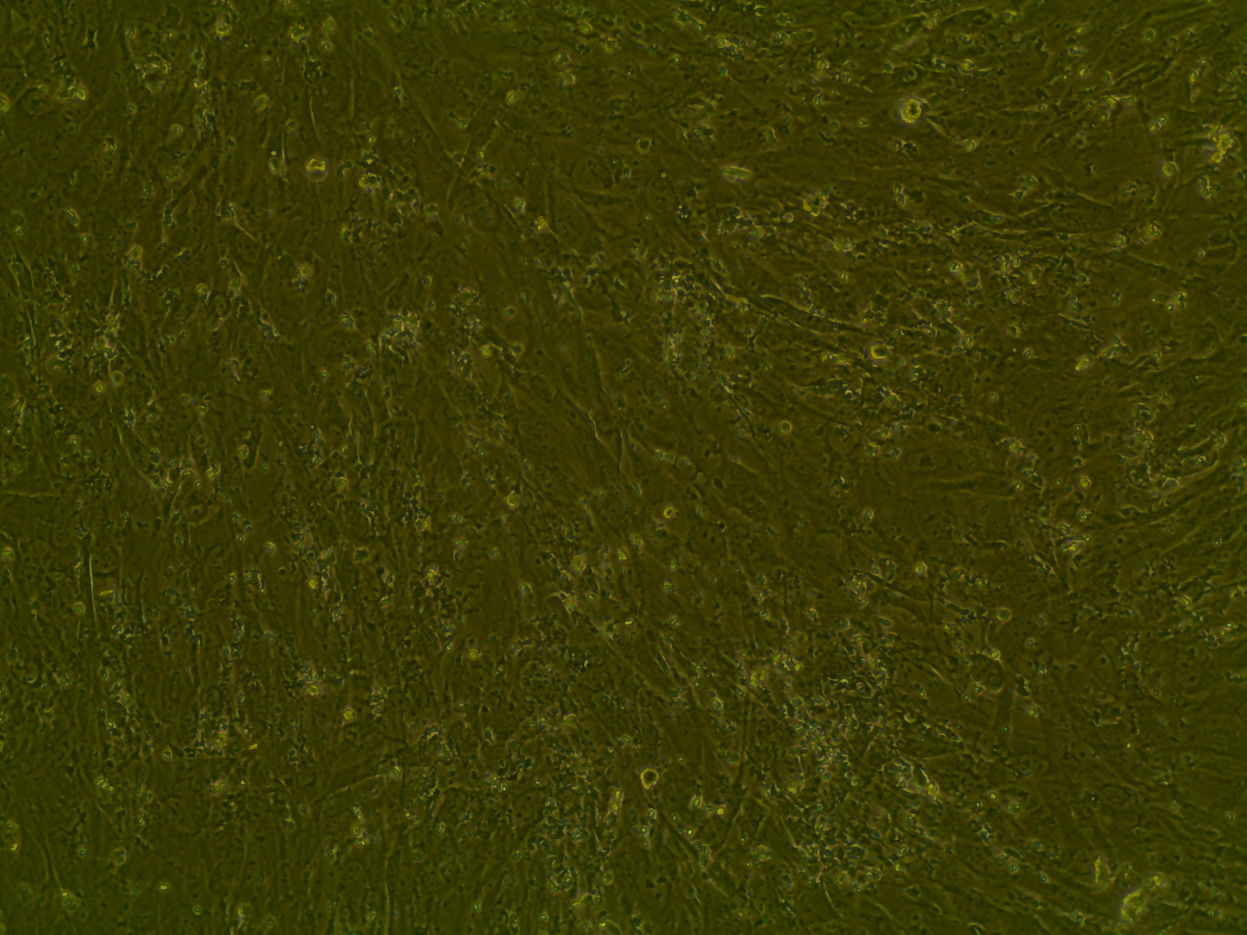
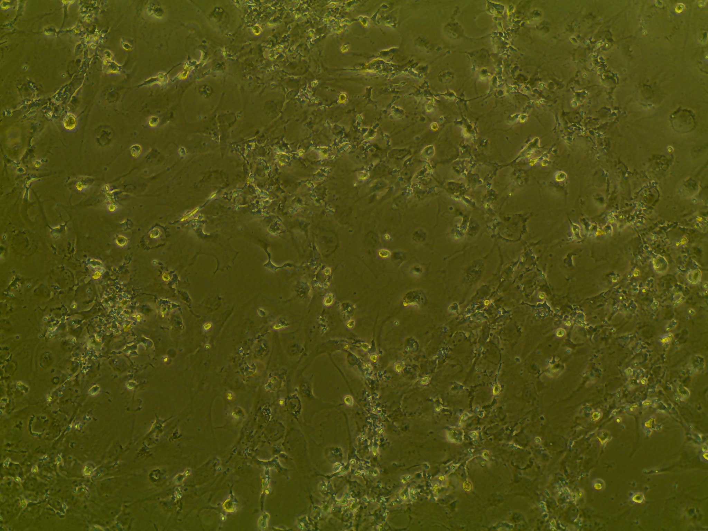
Differentiation: Day 10
Control
10 uM ALA
4x
10x

Slide 10
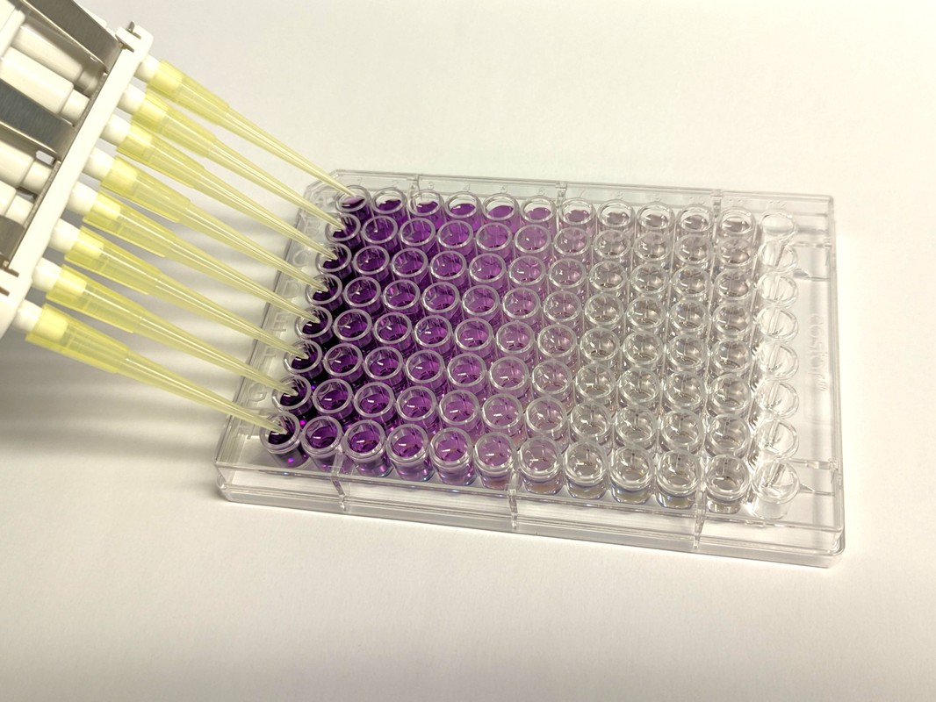
BCA Protein Quantification Assay
Lysed Cells
Measures the total protein concentration in a solution
Protein amino acid and peptide bonds react to ions in alkaline solution
Color changes to purple and is measured

Slide 11
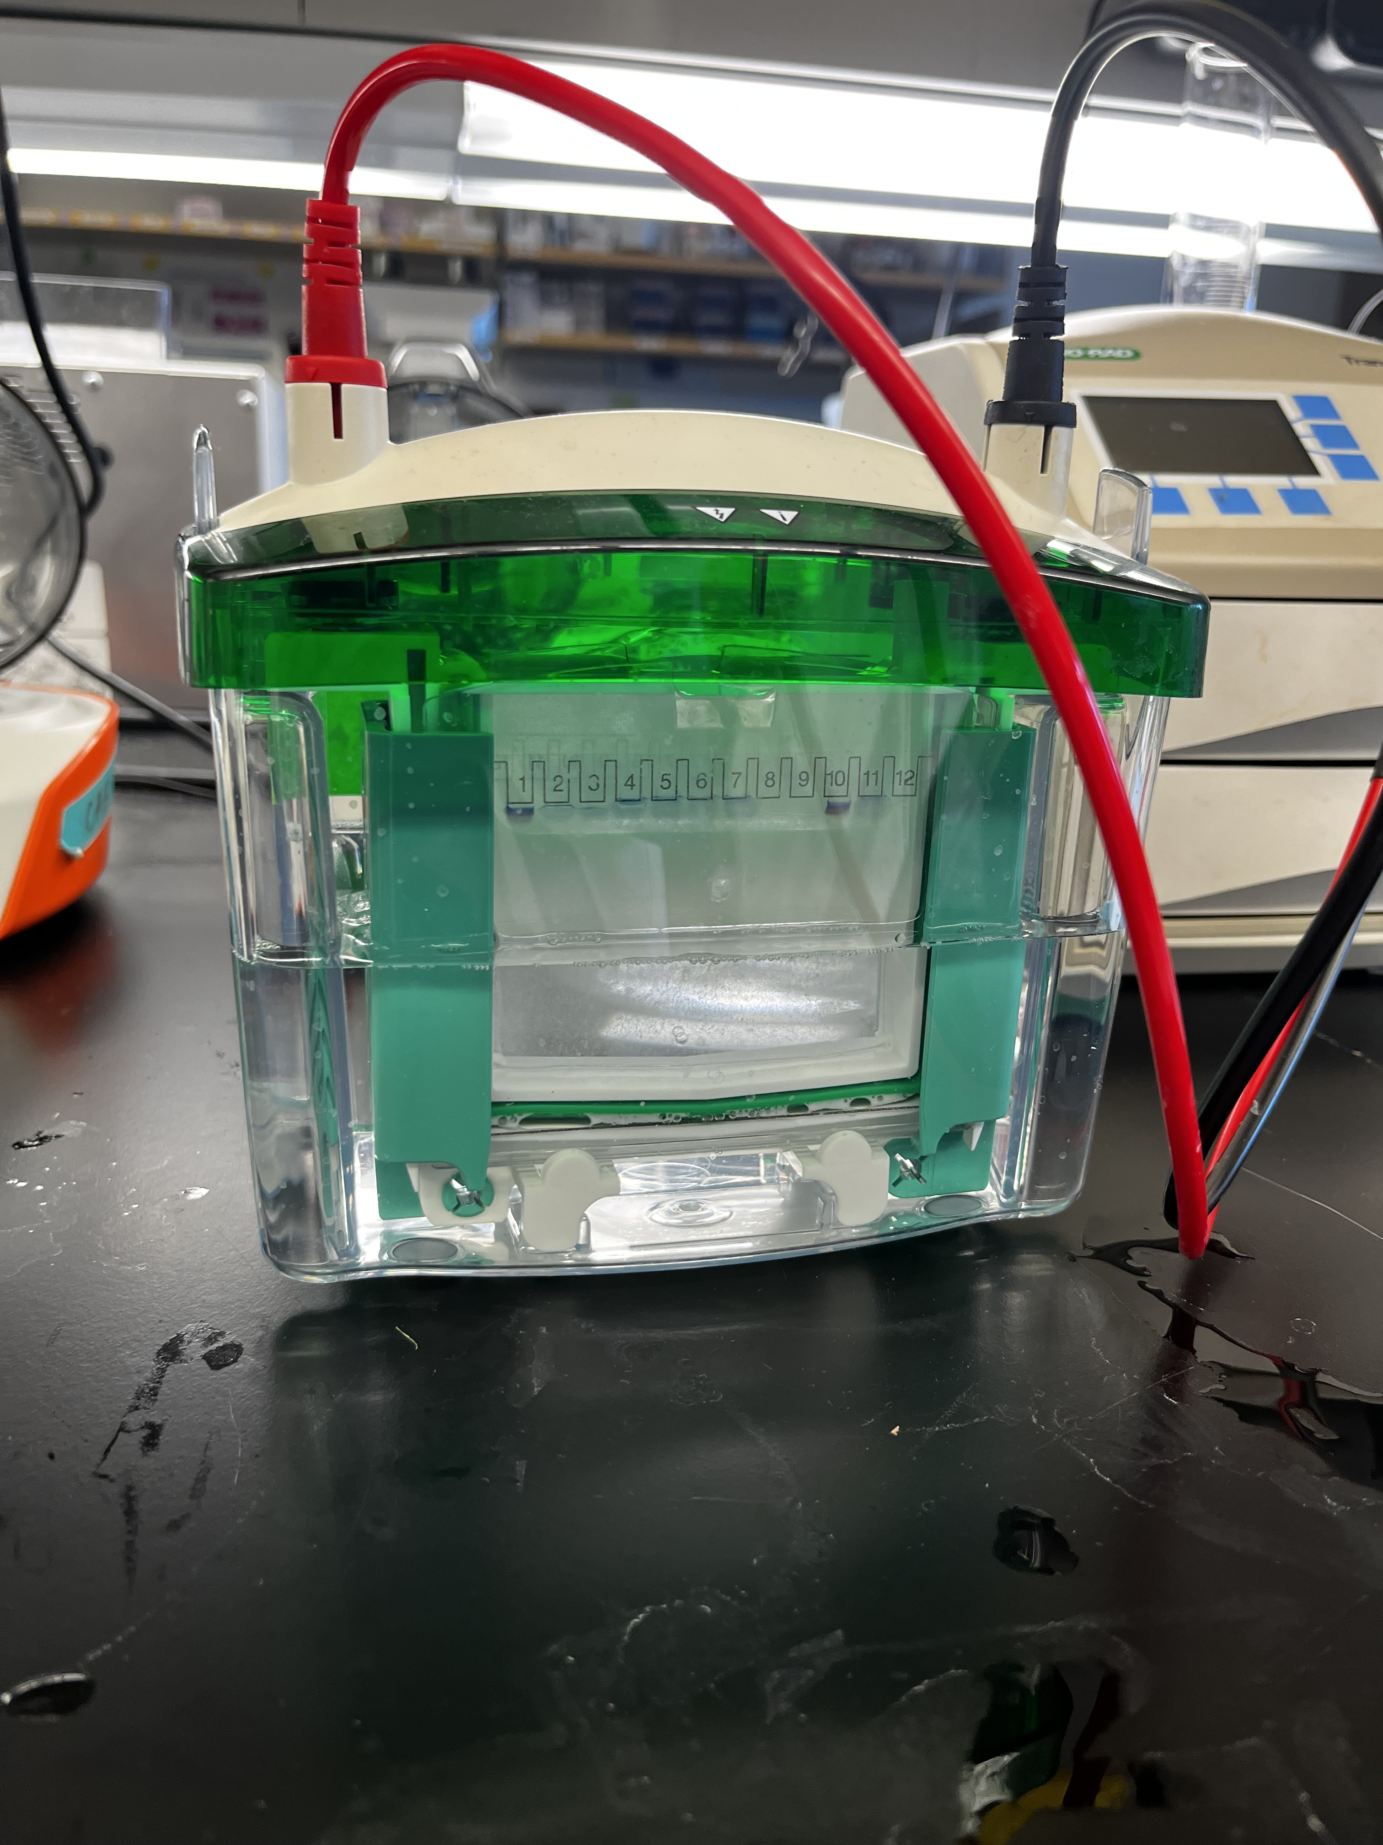
Western Blot
Loaded protein
SDS-PAGE (Sodium Dodecyl Sulfate–Polyacrylamide Gel Electrophoresis)
Separates proteins based on molecular weight
Probed for RUNX2 and SP7
Beta-Actin probed as a house keeping control

Slide 12
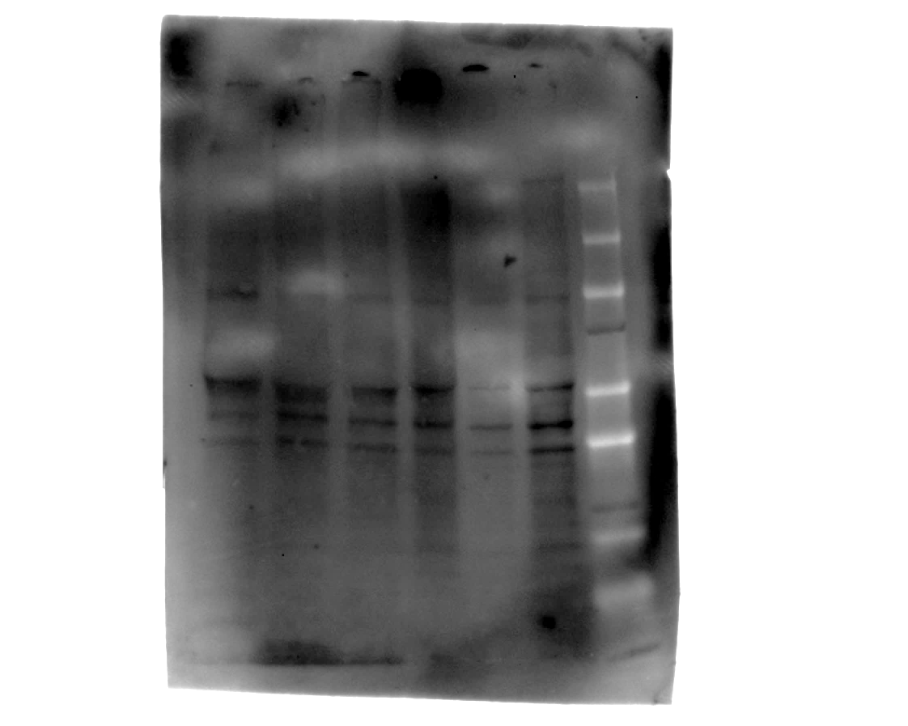
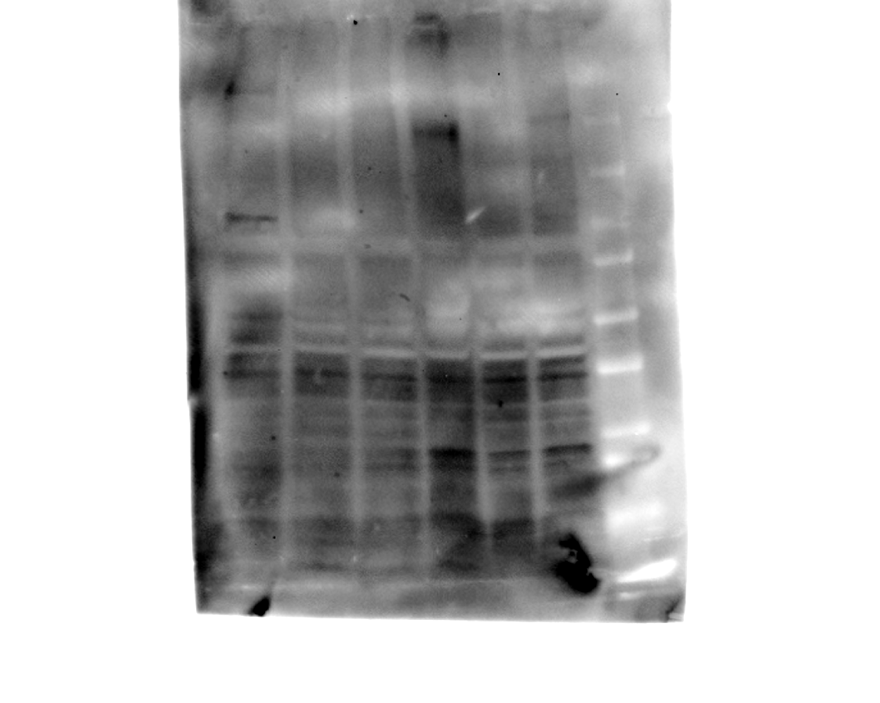
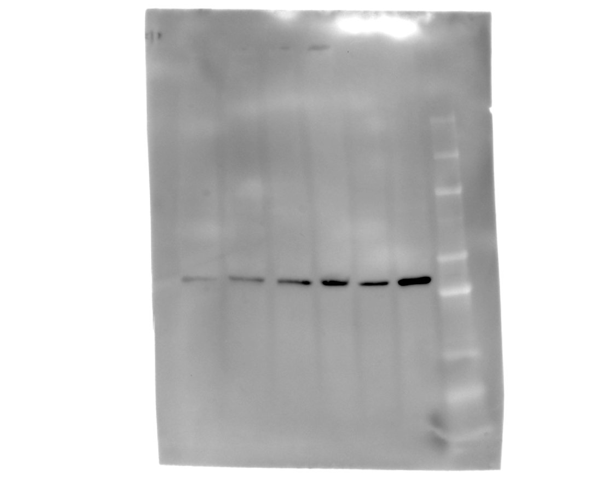
Results
RUNX2: 55 kDa
SP7: 45 kDa
Actin: 42 kDa
C1-C3
A1-A3
C1-C3
A1-A3
C1-C3
A1-A3
250
150
100
75
50
37
25
20
15
10
C1-C3: Control
A1-A3: ALA Treatment
Our results suggest that 10um ALA treatment does not alter the expression of RUNX2 and SP7 during osteoblast differentiation

Slide 13
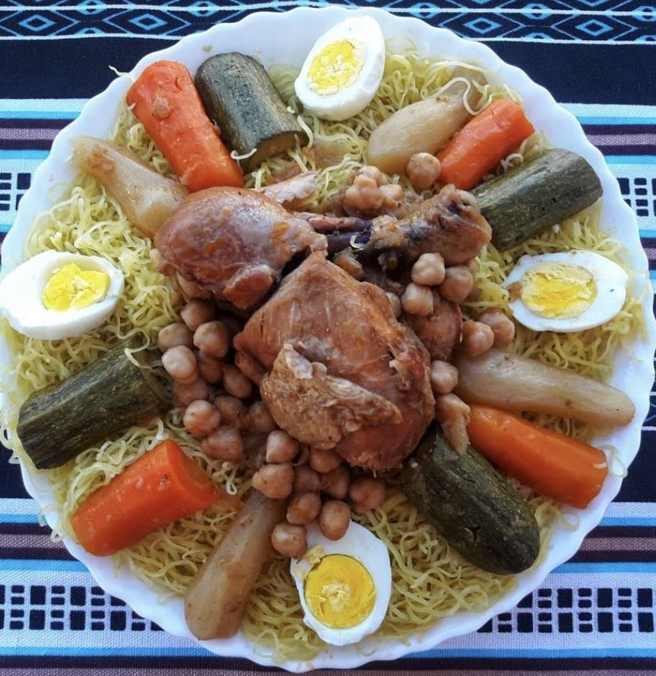

Culture Exchange: Food
India: Telangana Bagara Rice with Chicken
Algeria: Rishta

Slide 14
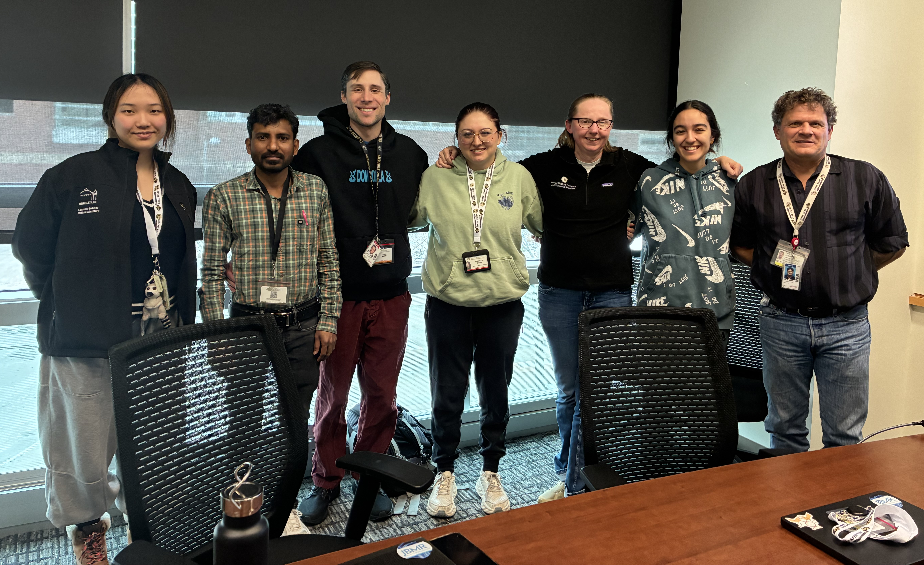
Thank You!
Cheryl Ackert-Bicknell’s Lab
Professor Dr. Cheryl L. Ackert-Bicknell, PhD
Dr. Reed A. Ayers, PhD
Dr. Rajashekar Donaka, PhD
Dr. Eric Marty, MD
Gabrielle N. Dudek, BS
Ella Yichi Chen, BS
ISCORE
Liz Evans
Dr. Cristina Cenciarelli

Slide 15
Resources
Anatomy and physiology I. Bone Formation and Development | Anatomy and Physiology I. (n.d.). https://courses.lumenlearning.com/suny-ap1/chapter/bone-formation-and-development/.
Bone Remodeling | Bone Growth, bone resorption, Bone Formation | Britannica. (n.d.). https://www.britannica.com/science/bone-remodeling.
Differentiation of primary human osteoblasts. (n.d.). https://www.sigmaaldrich.com/US/en/technical-documents/technical-article/cell-culture-and-cell-culture-analysis/mammalian-cell-culture/osteoblast-differentiation.
Dr. Harris, S. A., Enger, R. J., Riggs, L. B., & Spelsberg, T. C. (1995). Development and characterization of a conditionally immortalized human fetal osteoblastic cell line. Journal of Bone and Mineral Research, 10(2), 178–186. https://doi.org/10.1002/jbmr.5650100203.
Harris K, Zagar CA, Lawrence KV. Osteoporosis: Common Questions and Answers. Am Fam Physician. 2023 Mar;107(3):238-246. PMID: 36920813.
Komori, T. (2024). Regulation of skeletal development and maintenance by runx2 and SP7. International Journal of Molecular Sciences, 25(18), 10102. https://doi.org/10.3390/ijms251810102.

