Slide 1
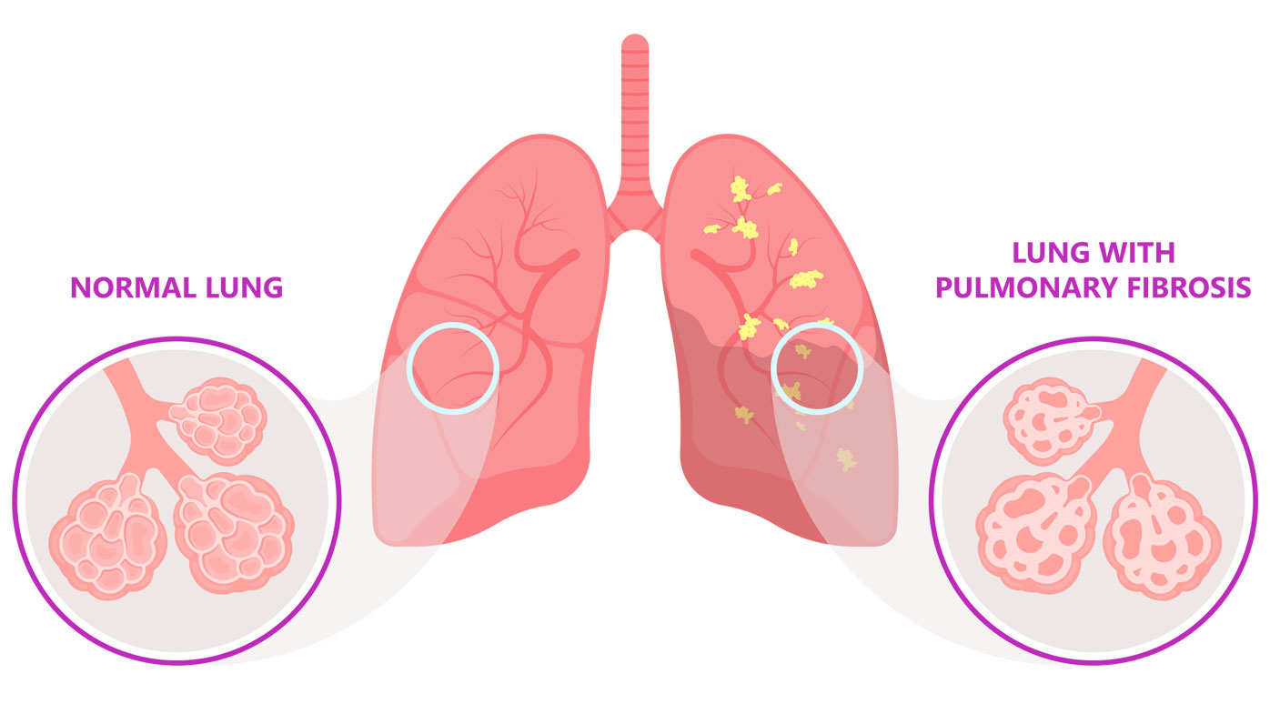
Decoding Pulmonary Fibrosis: Pathogenic Mechanisms And Experimental Modeling .
Student :Osama Khaled Mohammad Abu Jame (Undergraduate student)
Scholar: Kushal Kandhari (PhD)
Program: ISCORE
Semester: Fall 2025
Department: Pediatric
Notes:
Hello everyone, my name is Osama Abu Jame. I’m a Public Health student at CU Denver, and this semester I worked with Dr. Kushal Kandhari through the ISCORE program. Our project focused on Idiopathic Pulmonary Fibrosis, or IPF. In this presentation, I’m going to share what IPF is, why it matters, and some of the lab techniques we used to study lung tissue.

Slide 2

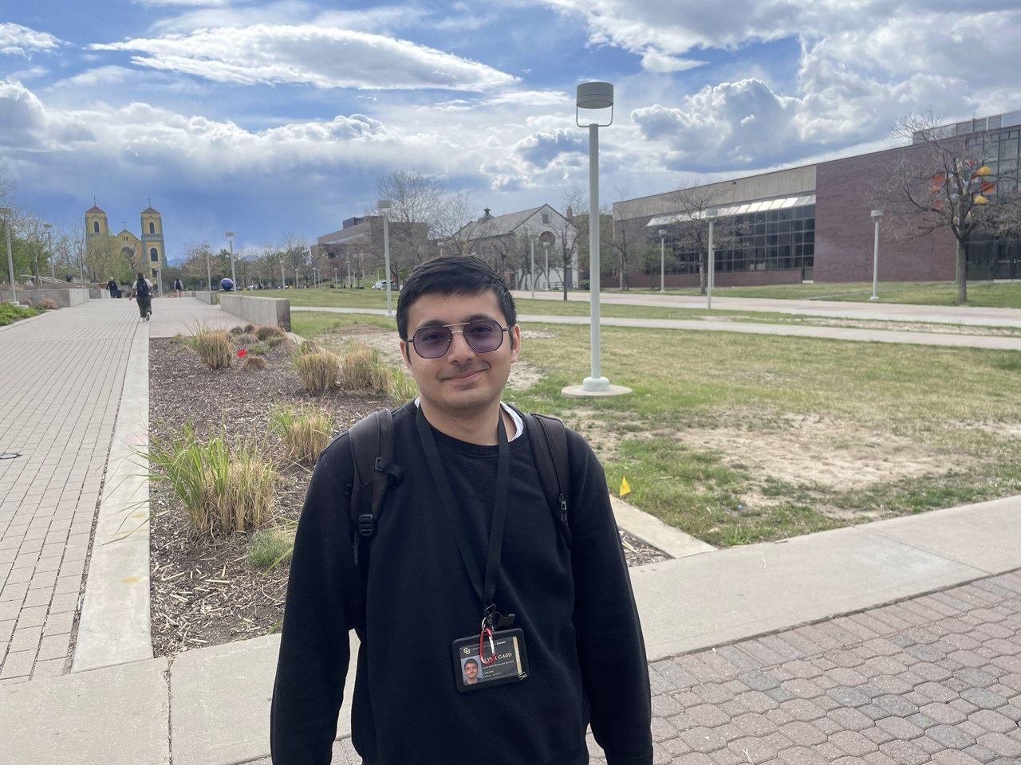
-Mentor :Kushal Kandhari PhD
-Worked with:
1-Chemical agent-induced toxicity
2-Cancer Biology
3-Idiopathic Pulmonary Fibrosis (IPF)
-Mentee: Osama Abu Jame (Undergraduate student)
-CU Denver Undergraduate Student Class of 2026.
-Major : Public health with minor in Biophysics.
-Working on attending medical school.
Notes:
My mentor, Dr. Kushal, works on several research topics like chemical toxicity, cancer biology, and pulmonary fibrosis. As his student, I was able to learn how researchers study lung diseases at the cellular level. I got to observe different lung cell types and understand how fibrosis develops. This experience helped me see what real lab work looks like and how it connects to patient health.

Slide 3
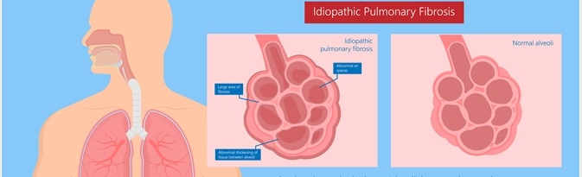
Idiopathic Pulmonary Fibrosis (IPF)
Definition :(IPF) is a chronic, progressive lung disease where scar tissue (fibrosis) forms in the lungs without a known cause (idiopathic).
This scarring makes the lung tissue thick and stiff, making it hard for oxygen to pass into the bloodstream.
Symptoms: include shortness of breath, dry cough, fatigue, and clubbing of fingers.
Notes:
Idiopathic Pulmonary Fibrosis is a long-term lung disease where scar tissue slowly builds up in the lungs. We don’t know exactly what causes it—that’s why it’s called “idiopathic.” As the lungs get stiffer, breathing becomes harder and oxygen can’t move into the blood as well. People with IPF often have shortness of breath, a dry cough, and feel tired all the time. There is no cure, which is why studying it is so important.
This visual always sticks with me: The earliest damage occurs in the alveoli — tiny, delicate air sacs where oxygen enters the bloodstream. As fibrosis develops, these fragile structures become stiff. It’s like trying to blow up a balloon that’s made out of leather — the lung loses its stretchiness. The scarring often shows up in the lower and outer zones of the lungs, replacing what should be light, functional tissue with heavy, inflexible scar tissue.

Slide 4
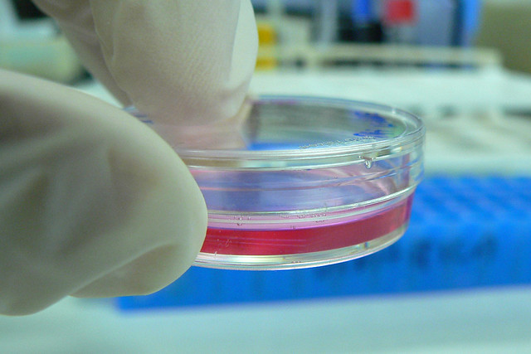
Cell Culture:
Definition: is the process of growing cells under controlled laboratory conditions.
Uses: Used in medical, genetic, and pharmaceutical research.
Areas :Enables study of cell growth, differentiation, and response to drugs or environmental changes.
Notes:
Cell culture is basically growing cells in the lab under controlled conditions. It lets scientists study how cells behave, how they respond to treatments, and how diseases affect them. Before testing anything on animals or humans, researchers usually start with cell culture because it’s a safer and more controlled way to understand what’s going on.

Slide 5
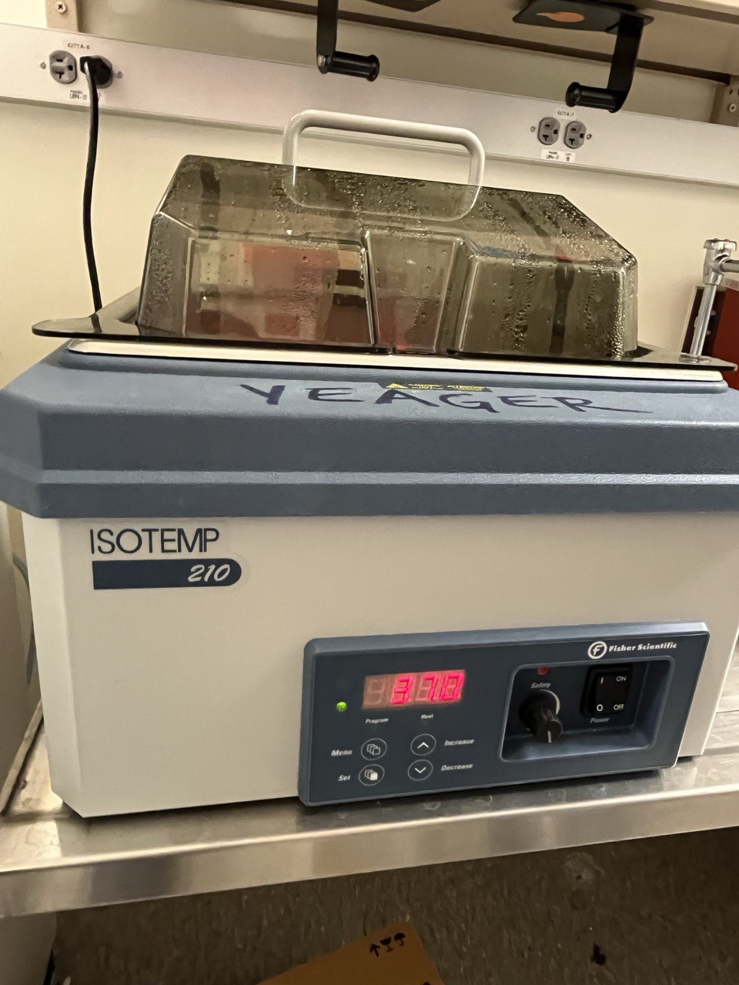
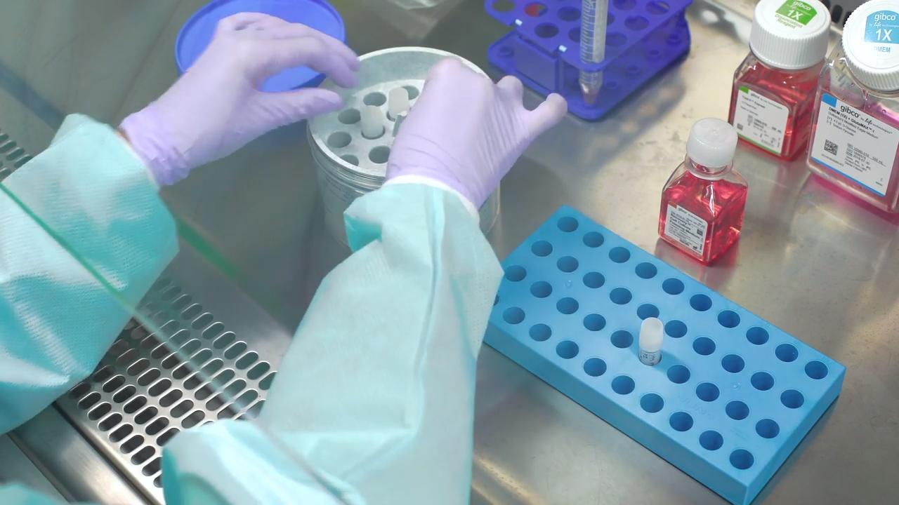
Procedure of Culture Cells:
A- Cryopreservation
B- Cell Line Revival
C- Observation
D- Cell Maintenance and Subculture
Notes:
The cell culture process has a few main steps. First, cryopreservation, which is storing cells at very low temperatures. Then we bring the cells back, which is called cell revival. After that, we watch them closely to make sure they’re healthy. Finally, we move them into fresh media, so they keep growing, which is called subculturing. I was able to learn these steps during the project.

Slide 6
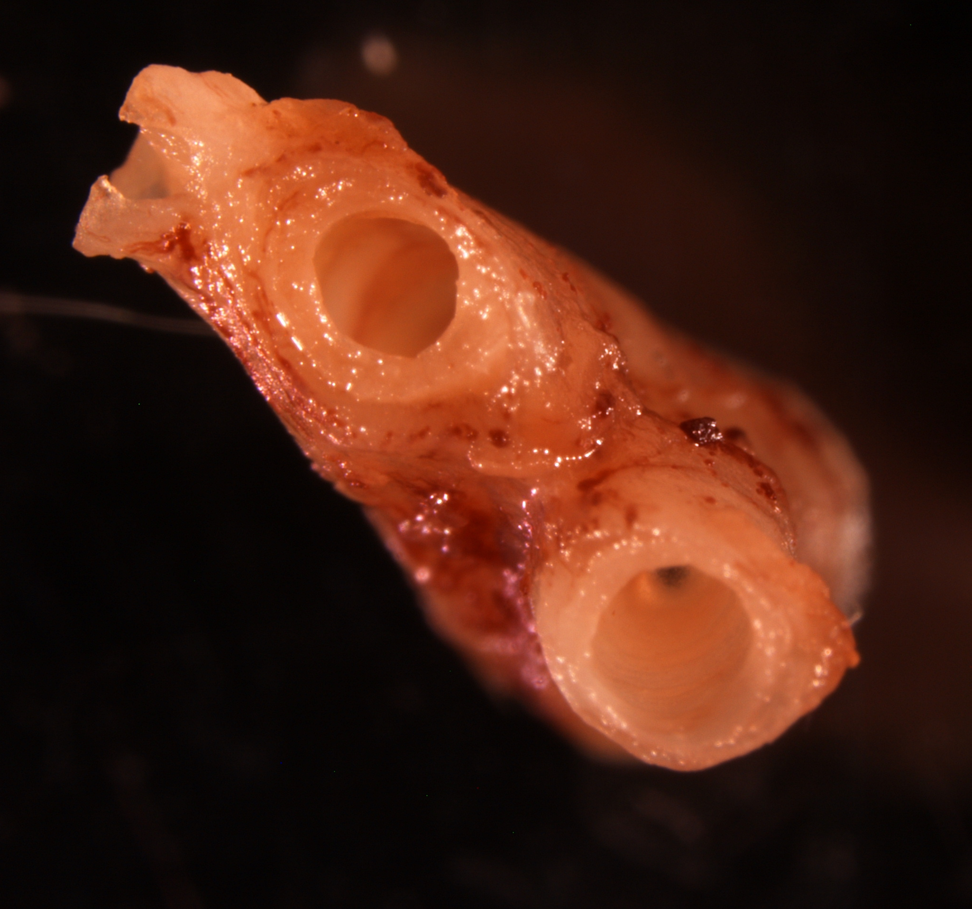
Human Bronchi
We observed human bronchi under the advance microscope under 4x to better understand of cell culture.
Notes:
Dr.Kushal took this image in the lab . This is a really image . One thing I did was look at human bronchi under an advanced microscope at 4x. Seeing the structure of the airways up close helped me understand how delicate the lungs are. It also made it easier to picture how fibrosis changes the tissue and makes breathing harder for patients.

Slide 7
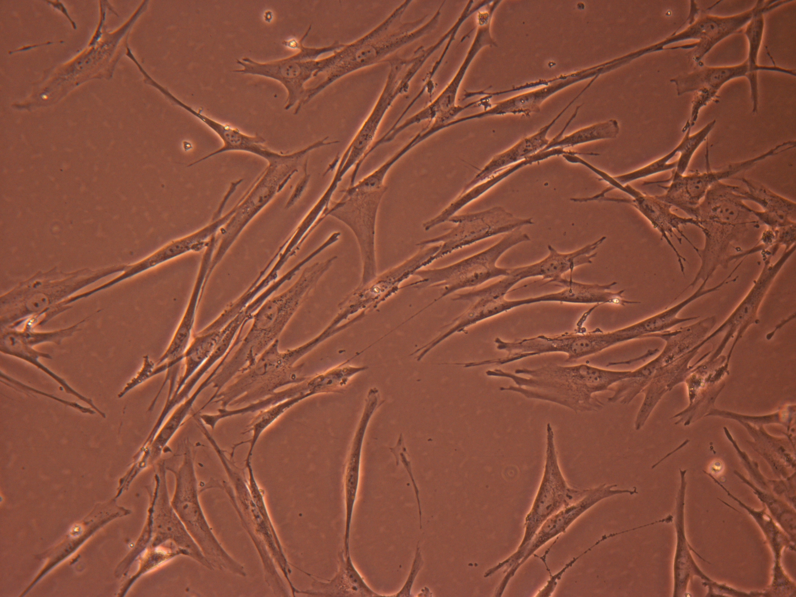
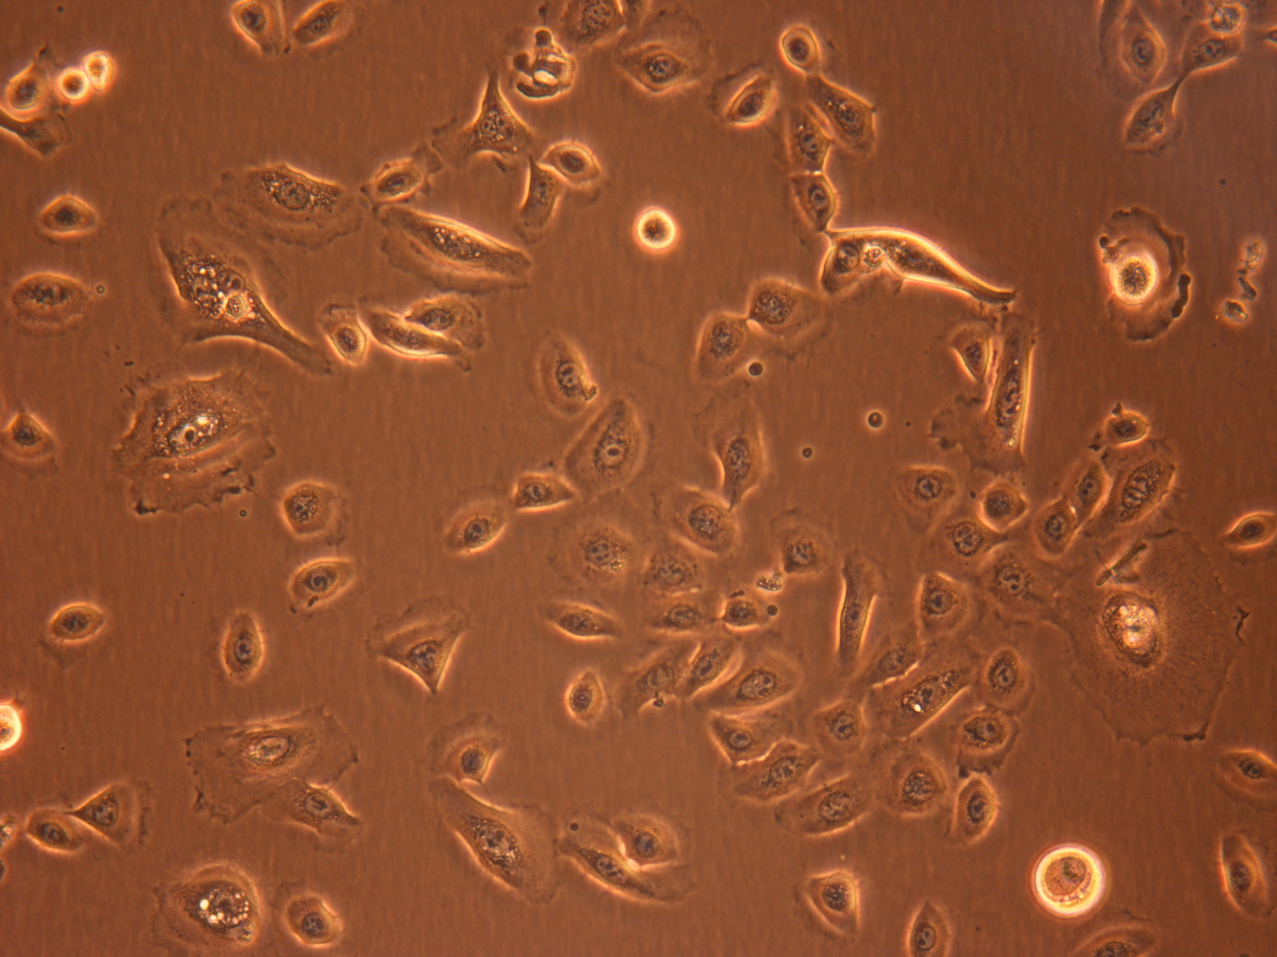
Human Bronchial Epithelial Cells
Human Lungs Fibroblasts
Notes:
These cells were obtained by chopping lung tissue very finely and we kept the chopped tissue in the culture media for over 1 month. After 8 days, We got these epithelial cells with good confluence. We observed the morphology under microscope. Lung fibroblasts are the structural cells that support the structure of the lung and also responsible for collagen production . These are the main types of cells that are altered during pulmonary fibrosis .
Lung fibroblasts are the structural cells that support the structure of the lung and also responsible for collagen production . These are the main types of cells that are altered during pulmonary fibrosis .

Slide 8
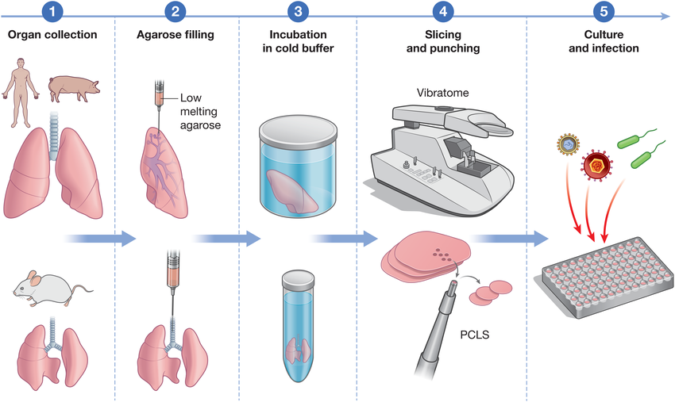
Precision-Cut Lung Slices (PCLS):
Definition: Thin, uniform slices of lung tissue used .
Purpose: Preserve lung architecture and cell diversity to study physiology, toxicology, and drug effects.
Preparation:
Inflate lung with agarose solution for structure support.
Slice tissue using a precision tissue slicer (e.g., vibratome).
Maintain slices in nutrient-rich medium for short-term culture.
Notes:
Precision-Cut Lung Slices, or PCLS, are thin slices of lung tissue that keep the natural lung structure intact. To make them, the lungs are first filled with agarose so they hold their shape, and then a machine cuts them into even slices. These slices are very useful because they allow us to study lung cells in their real environment and test how they react to different conditions or treatments.
Cell culture only focus on one type of cell at time . While Pcls work with most of the cells . Now imagine holding a thin slice of real human lung — so thin that light passes through it, yet it still behaves like true lung tissue. That’s PCLS: Precision-Cut Lung Slices. They preserve: • The structure • The cell diversity • The natural lung environment It’s like having a mini functional lung in the lab. With PCLS, scientists can: • Examine inflammation • Study fibrosis • Test how drugs affect real lung tissue • Observe respiratory behaviors outside the body PCLS fills the gap between simple cell cultures and full animal models. It’s one of our closest windows into human lung function.

Slide 9
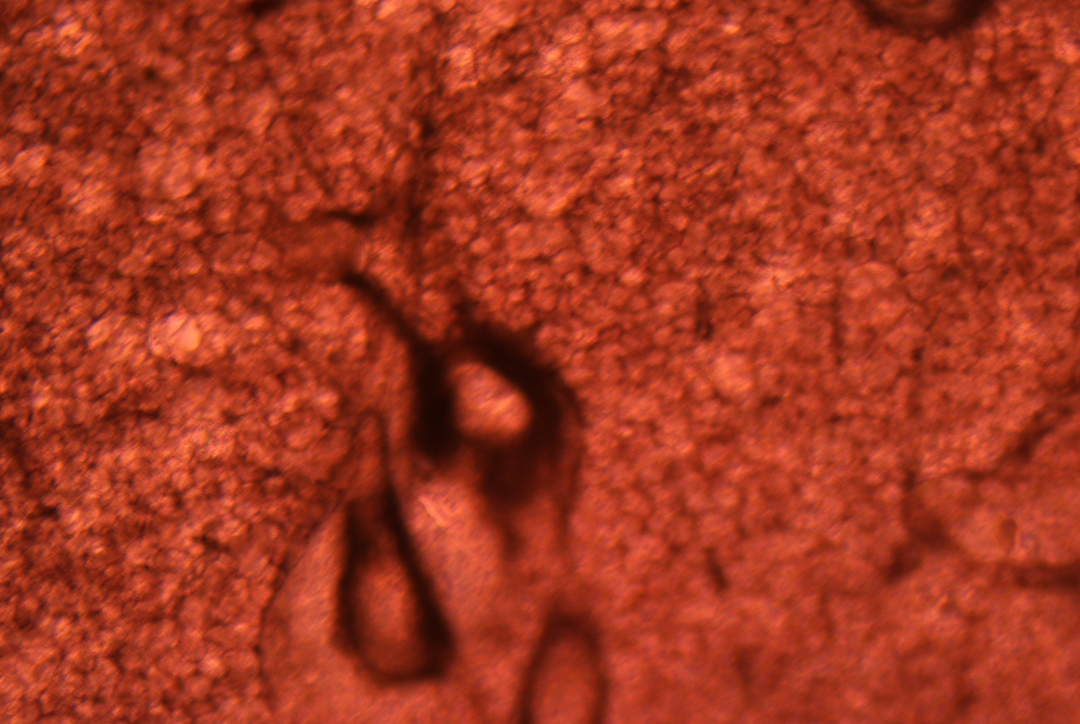
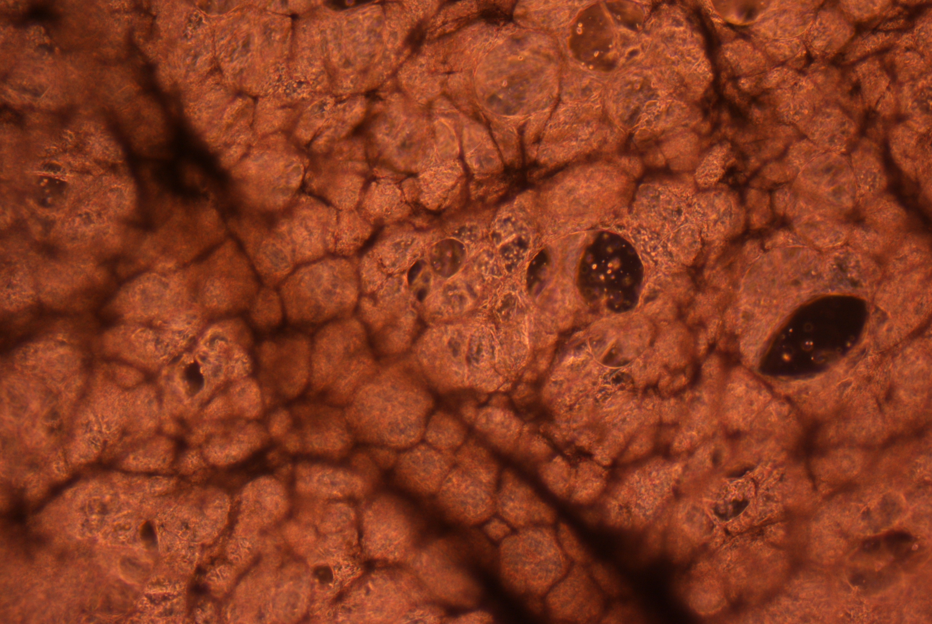
Human PCLs VS Rat PCLs

Slide 10

Culture Diversity:
•I brings cultural traditions from Jordan shaped by Arab, Islamic, and Bedouin heritage.
• Dr. Kushal shares India’s rich cultural diversity, including languages, religions, and regional customs.
• Both exchange perspectives on traditions, values, and daily experiences from their home countries.
• This cultural exchange strengthens their collaboration through mutual respect and global understanding.
Notes:
Another highlight of the ISCORE program was the cultural exchange. I shared pieces of Jordan, my home — from Petra to traditional Bedouin culture. In return, I learned about India’s traditions, foods, and clothing. It was a reminder that science isn’t isolated — it’s a global effort shaped by diverse perspectives.

Slide 11
Special Thank you to Dr. Cenciarelli, Liz, and Dr. Kushal for this great opportunity.
Notes:
This project helped me learn so much about lung research and made me even more motivated to continue my path toward medical school. I’m very grateful to Dr. Cenciarelli, Liz, and Dr. Kushal for giving me this opportunity and supporting me throughout the semester. Thank you all for listening.

