Slide 1



Targeting Mitochondrial Respiration to Overcome Therapy Resistance in Acute Myeloid Leukemia (AML)
Aditya Singh Jaiswar
Dr. Felipe Valenca Pereira
Dr. Mercedes Rincon
Dr. Rincon's Lab
Analyzing the effects of drugs targeting mitochondria on the viability of AML cells

Slide 2
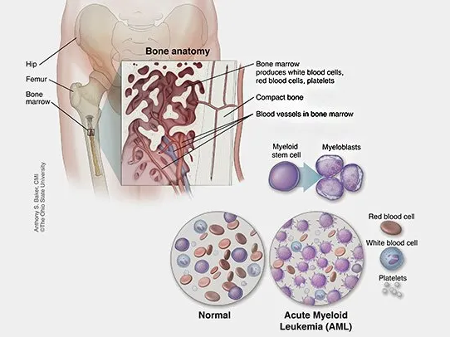
Introduction
Acute Myeloid Leukemia (AML): Most common adult acute leukemia where immature white blood cells (myeloblasts) rapidly grow while decreasing the count of healthy red blood cells
Frontline treatment for AML is currently Chemotherapy which is ineffective as nearly 75-80% of the adults will either not respond to therapy or relapse after the initial therapy
Notes:
Leukemia- broad category of blood cancers, AML- specific blood cancer w/ an increased number of white blood cells and a decreased healthy red blood cells count; acute refers to the speed of immature white blood cells growing; differs with CLL (chronic lymphatic leukemia) which has very slow growth of immature white blood cells
AML leads to low platelet counts in the body allowing easy bruising on the patients of AML

Slide 3
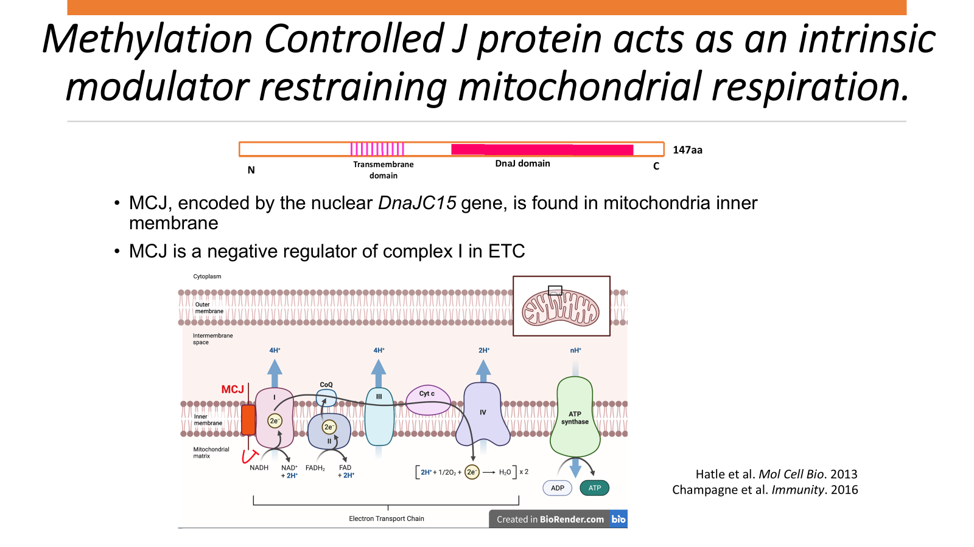
Notes:
Localized in mitochondria inner membrane; interacts with complex 1 of ETC inhibiting it and decreasing ATP production w/ cellular respiration serving as “brakes” of complex 1 Methylation control J protein

Slide 4
Hypothesis and Objective
A loss of MCJ expression correlates with the resistance to chemotherapy experienced by several AML patients. The integration of MCJ mimetics will restore MCJ function and augment the effectiveness of the chemotherapeutic drugs, such as Venetoclax thereby reducing associated resistance
Analyze the effects of the respective drugs (Venetoclax & MCJ Peptide) on the viability of treated MOLM 13 and MOL 14 cells over 24 hours and 48 hours.

Slide 5
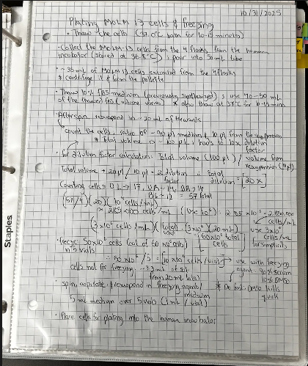
Methods
Cell culture techniques:
1) Thawing cell lines from N2, 2) cultivating the cells in the appropriate culture flasks 3) Preparing cell culture medium and freezing medium.
MOLM 13 & 14 cells were both cultured, with MOLM 14 cells being used for the viability experiment.
Drug treating the cells: Venetoclax & MitoX30 peptide
Notes:
Used different flaks as such cells grow with the help of suspension rather than typical adhesion that may take place in the same test tubes

Slide 6
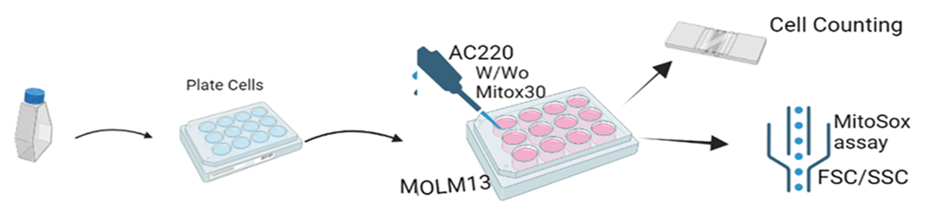
Experimental model:
Venetoclax
MOLM14
Notes:
Used MOLM14 not MOLM 13 & did not do MitoSox assay; drugs used were also different with Venetoclax as the major drug rather than AC220 & plated 500 microliters of solution in each of the 24 wells

Slide 7
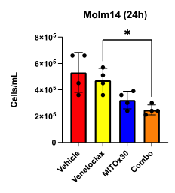
Results
Venetoclax: Venetoclax treated MOLM14 cells exhibited a lower numbers, on average, of cells present in the culture wells
The combination of Venetoclax with the MCJ peptide (Mitox30) significantly decreases the cell viability.
Figure 2. Results of MOLM 14 cell count with the respective drugs after 24 hours.
Notes:
Venetoclax binds to BCL 2 protein and inhibits it; induces apoptosis by releasing other proteins triggering pore formation in mitochondria

Slide 8
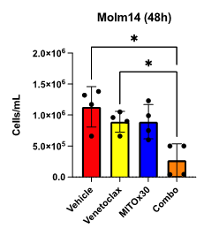
Results
Combo of MCJ Peptide & Venetoclax consistently had less cells (over a period of 24 & 48 hours) as compared to the MCJ peptide and Venetoclax alone.
Figure 3. Results of MOLM 14 cell count with the respective drugs after 48 hours​ , demonstrating a decrease in the number of cells per well.

Slide 9
Cultural exchange
The individuals within the lab share diverse ethnicities/backgrounds including Brazilian with Dr. Felipe, Spanish with Dr. Rincon, and Chinese and American with Qian Fang, Dr. Maureen Hoen, and Fahima
A difference in education is also present with some of the countries employing retention techniques including rote while other countries prioritizing critical thinking over memory retention
Very different!

Slide 10
Thank You!
Special thank you to: Dr. Mercedes Rincon, Dr. Felipe Pereira, Qian Fang, Dr. Maureen Hoen, and Dr. Cristina Cenciarelli for making this a very memorable experience!

