Slide 1
Understanding Vital Signaling Pathways and Mechanisms in Idiopathic Pulmonary Fibrosis (IPF)
SCORE 2025
Department of Pediatrics | Pulmonary and Sleep Medicine
Fall 2024
Slideshow and Data by Stephanie White and Eli
Mentor: Kushal Kandhari
Postdoctoral Fellow | Ph.D.

Slide 2
Mentor: Kushal Kandhari PhD
1) Chemical agent-induced toxicity.
2) Cancer Biology.
3.) Development of a comprehensive understanding of the vital signaling pathways and mechanisms in Idiopathic Pulmonary Fibrosis (IPF)

Slide 3
Kushal Kandhari PhD: Areas of Interest
1) Chemical agent-induced toxicity.
2) Cancer Biology.
3.) Development of a comprehensive understanding of the vital signaling pathways and mechanisms in Idiopathic Pulmonary Fibrosis (IPF)
Current Interest:
Understanding Idiopathic Pulmonary Fibrosis mechanisms and exploring links between chronic lung diseases and lung cancer

Slide 4
Mentees

Slide 5
Mentee: Stephanie White
Undergraduate Research Assistant interested in Biology and Biochemistry.
Junior at University of Colorado Denver
Pre-Med Student

Slide 6
Mentee: Eli
Undergraduate Research Assistant interested in Biology and Leadership
Junior at University of Colorado Denver
Pre-med student

Slide 7
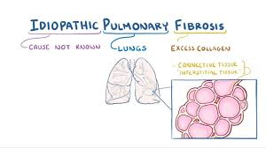
Background-What Idiopathic Pulmonary Fibrosis?
Idiopathic Pulmonary Fibrosis -Disease that causes scarring (fibrosis) of the lungs.
Idiopathic
-Idiopathic means that there is no clear cause.
*There is currently no cure
Figure One. Breakdown of Name.

Slide 8
Background-Overexpression of Collagen Peptides
-Overproduction of collagen and other ECM components leads to the development of pulmonary fibrosis.
What's Needed
-A way to inhibit over expression.
Figure Two. Comparison between IPF lungs and Normal Lungs.

Slide 9
Background-Why is This Important?
Stages of IPF:
Stage 1: Recently Diagnosed.
Stage 2: Needing Oxygen with Activity.
Stage 3: Needing Oxygen 24 Hours a Day.
Stage 4: Advanced Oxygen Needs.
*Not a formal staging system, but what progression may look like
Leading for a need of a Lung transplant
Figure Four. Xray of IPF.
Citation: National Jewish Hospital

Slide 10
Work in the Lab

Slide 11
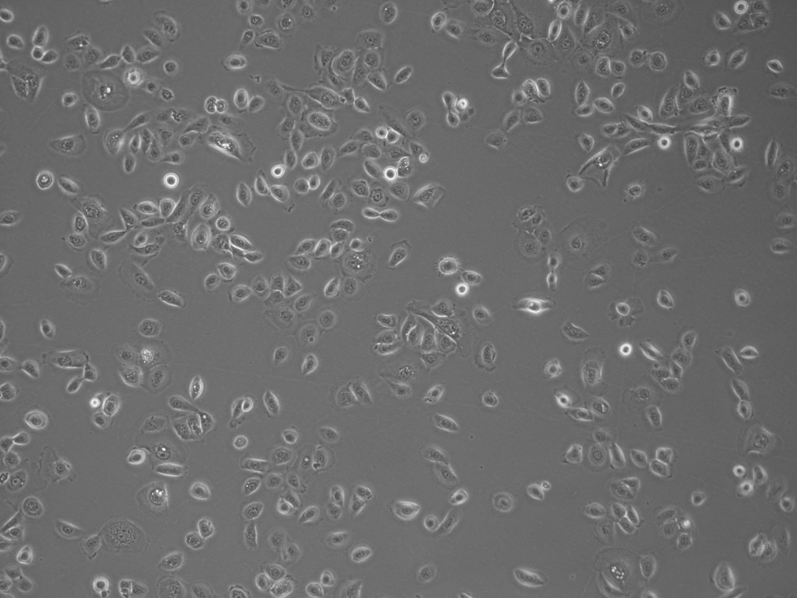
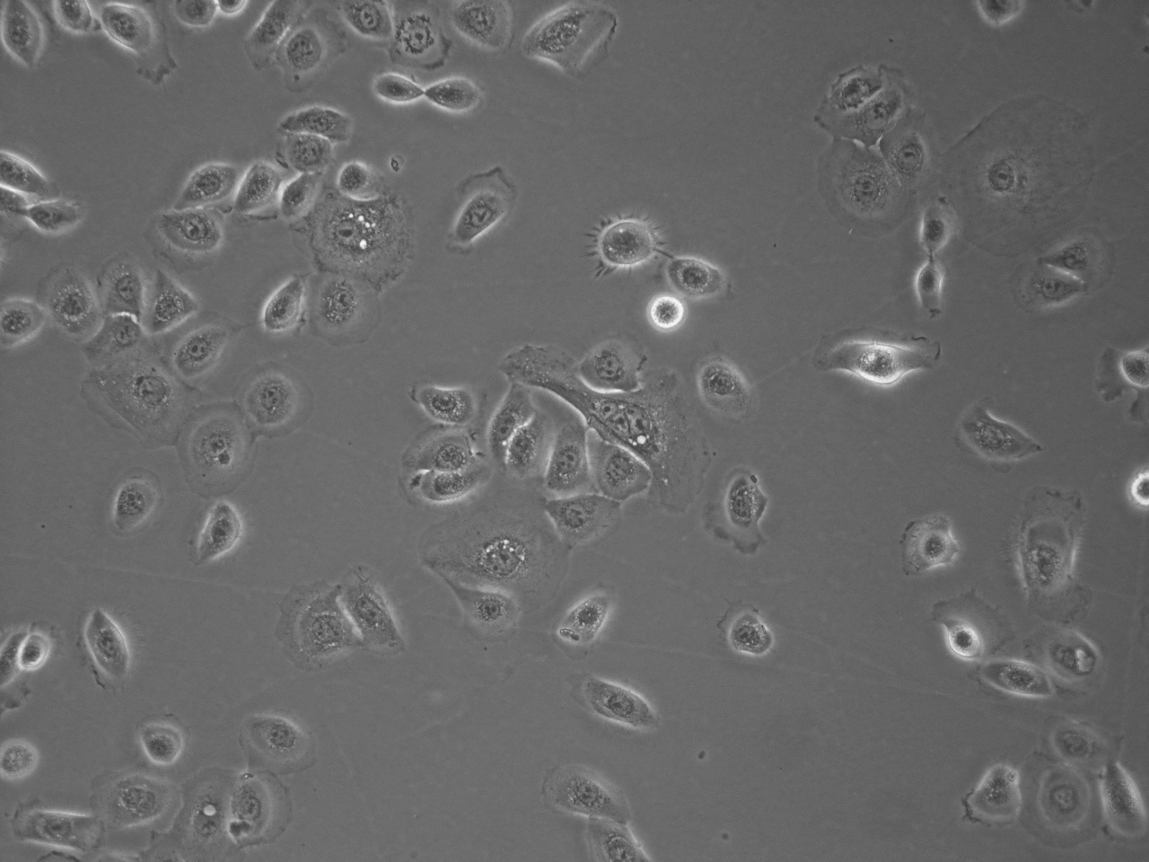
Cell Culture
Cells when surgically or enzymatically removed from an organism and placed in suitable culture environment will attach and grow are called as primary culture.
Primary cells have a finite life span
Cell lines have limited life span, they passage several times before they become senescent
Choice of media depends on the type of cell being cultured
For our work we used BEGM media from Lonza
Media is supplemented with antibiotics and different growth factors to support lung epithelial cell growth.
We also learned how to cryopreserve the cells in liquid nitrogen using DMSO as cryopreservant.
10X
20X
Figure Eight: Primary Human Bronchial Epithelial Cells (phBECs).

Slide 12
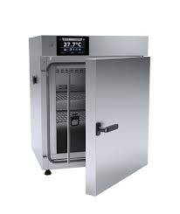
Cell Culture Important Information Learned
That 70% Ethanol is used instead of 100% to provide enough time to react with pathogens and disinfect the surfaces.
The incubator is at 5% Carbon Dioxide and 95% humidity to replicate the conditions of the human body.
That 37°C is normal human body temperature ideal for growth.
That trypsin can not be left in cells long because it stresses them.
We observed human bronchial epithelial cell isolation from human lung received from National Jewish Health
Figure Eight. Incubator Used In lab.

Slide 13
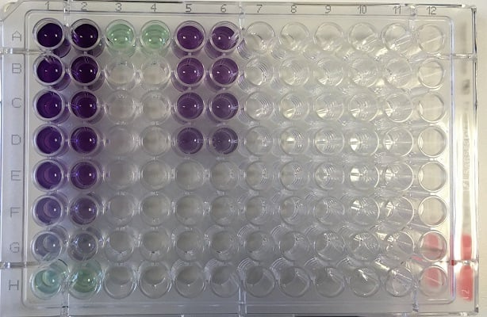
Protein Estimation using DC Assay
We also performed protein estimation in cell lysate samples to determine the amount of protein.
The DC Protein Assay is a colorimetric assay that measures protein concentration in a solution. It uses a reaction between a protein, an alkaline copper tartrate solution, and a Folin reagent to produce a blue product. The darker the blue, the more protein is present.

Slide 14
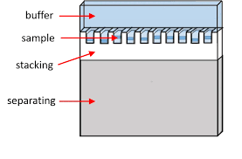
SDS PAGE and western blot
Sodium Dodecyl Sulfate-Polyacrylamide gel Electrophoresis (SDS-PAGE), is a technique widely used in biochemistry, forensics, genetics and molecular biology to separate and identify proteins according to their molecular weight.
This method separates proteins based primarily on their molecular weights.
After gel running, the proteins are transferred to a sheet of special blotting paper called nitrocellulose.
The proteins retain the same pattern of separation they had on the gel.
Figure Nine. SDS PAGE Diagram.

Slide 15
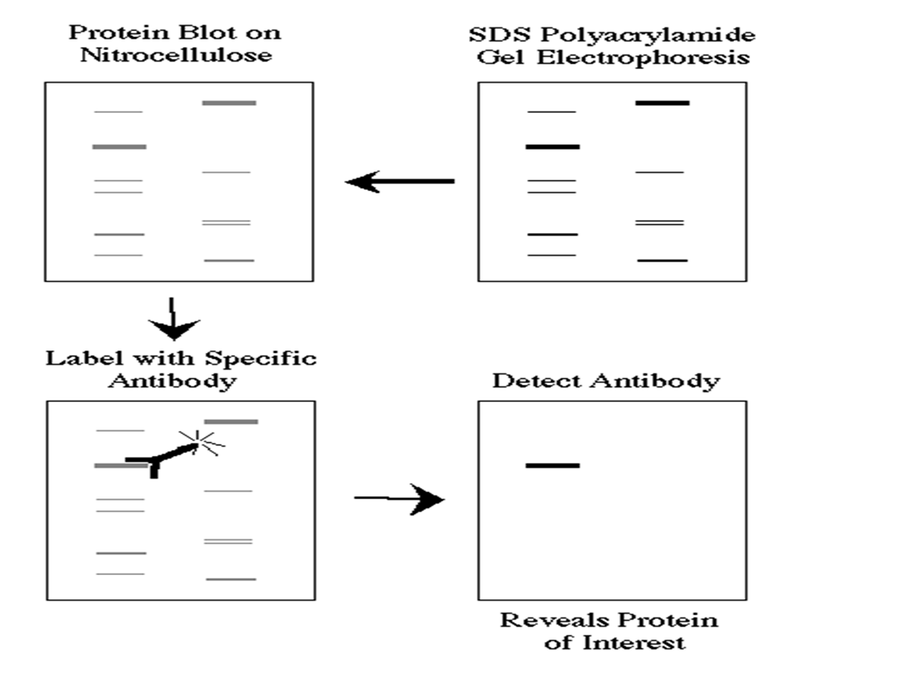
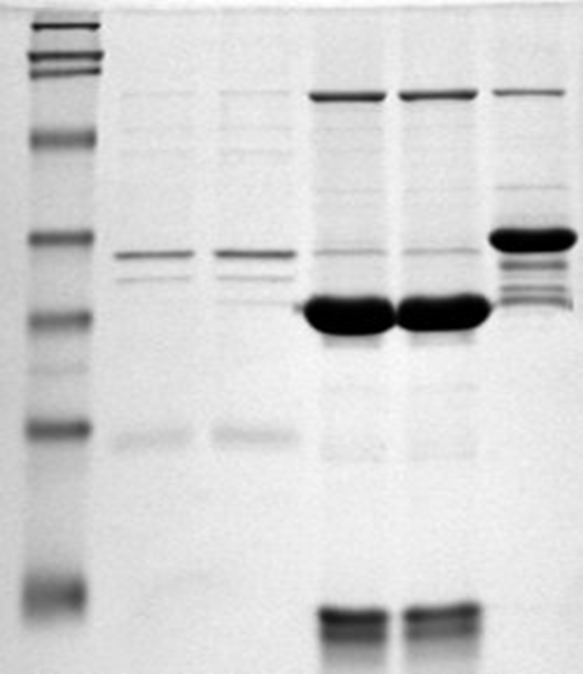
The blot is incubated with a generic protein (such as milk proteins) to bind to any remaining sticky places on the nitrocellulose.
An antibody is then added to the solution which is able to bind to its specific protein.
The antibody has an enzyme (e.g. horseradish peroxidase) or dye attached to it which cannot be seen at this time.
The location of the antibody is revealed by incubating it with a colorless substrate that the attached enzyme converts to a colored product that can be seen and photographed.
Example of final image captured by detection machine

Slide 16
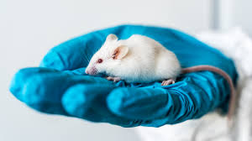
Introduction to Working with Lab Mice
We Got to Learn by Observing:
-Proper protocol on harvesting lungs.
-Proper handling.
-Getting vital signs to monitor them.
Overall got introduced to what working with rats and mice can look like
Figure Ten. Lab Mouse

Slide 17
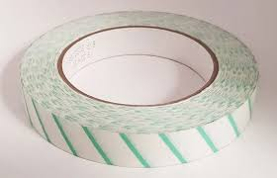
Autoclave Sterilization
What is it?
Kills harmful bacteria through high heat and pressure.
*Prevents contamination
-Proper safety and technique taught through sterilizing some equipment.
Figure Eleven. Autoclave Tape

Slide 18
Lab Goals:
Current:
Discover what proteins are being affected
Are the levels of said protein rising or falling
Discover what pathway is being affected by said proteins
Be the first to publish findings
Future:
Find a possible solution for determined pathway malfunction
Demonstrate enough evidence to support theory
Human testing

Slide 19
Learning outside the lab

Slide 20
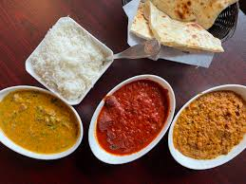
Important Cultural Exchange
Through lunches and coffee breaks we shared our experiences with:
-How we grew up.
-Our core values.
-How our cultures see certain things.
-What we would change about the world and the political climate.
-Got to share our cultures dishes.

Slide 21
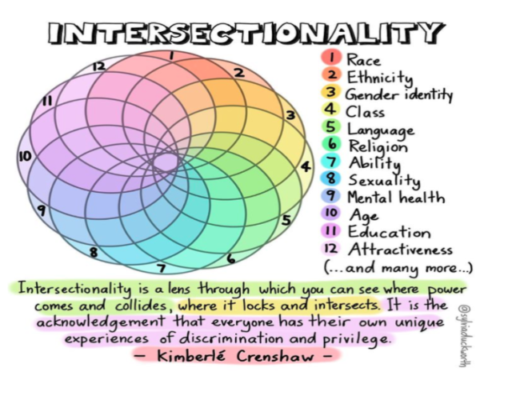
Common Ground:
New takeaways:
Interest in movies (Marvel was a big one)
Hiking
Interest in research and science
College experience
Gender Identity
Struggles of being an immigrant
Differences in american familial tendencies and asian ones
Many things about American research and how the majority of researchers are immigrants in part because schooling in America is so expensive

Slide 22
Thank You!

