Slide 1
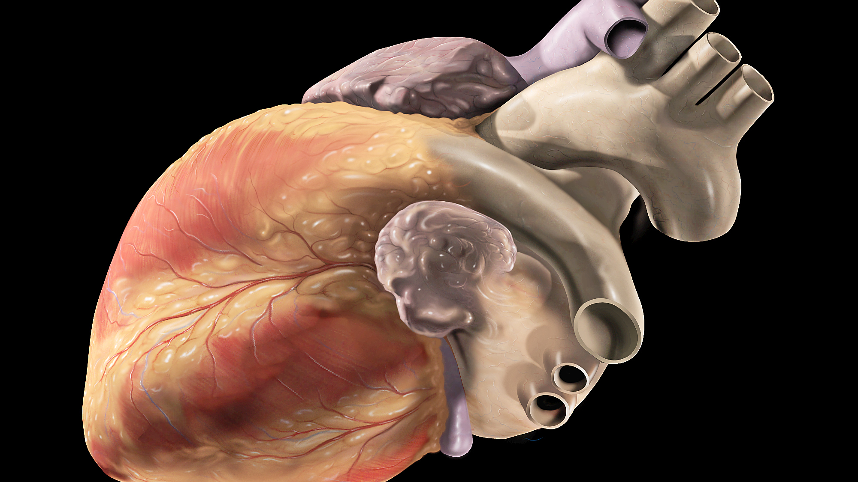
Transcriptional and Cellular Diversity of the Human Heart
(Tucker et al. 2020)
Tsenaat Hadgu

Slide 2
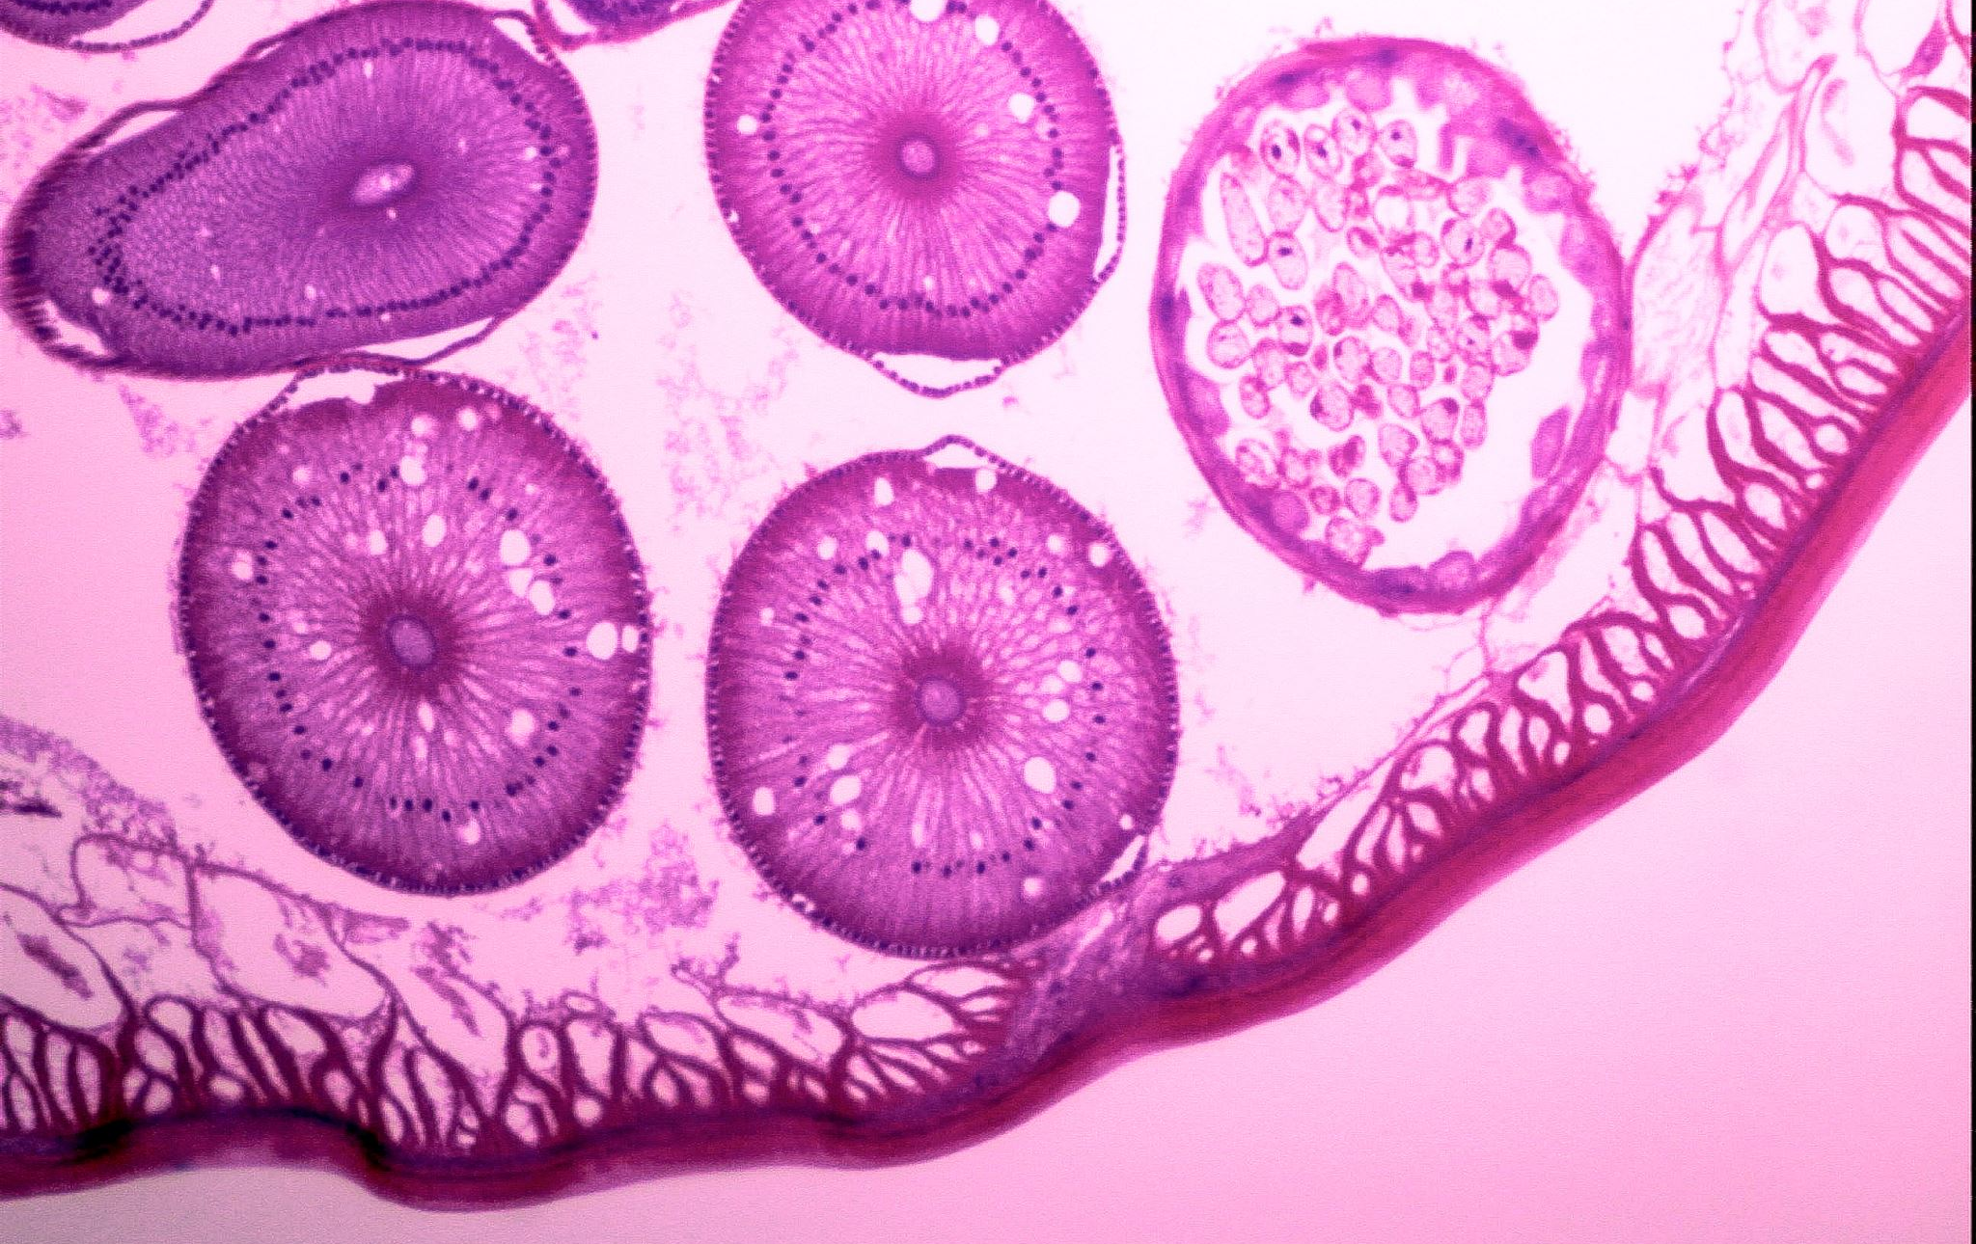
Aim
To understand the cellular and transcriptional diversity of the non-failing human heart, researchers conducted single-nucleus RNA sequencing (snRNA-seq) on samples from seven human donors with no history of heart disease.
The study used a large-scale snRNA-seq analysis of ~280,000 nuclei from the four chambers of the human heart (Tucker et al. 2020).

Slide 3
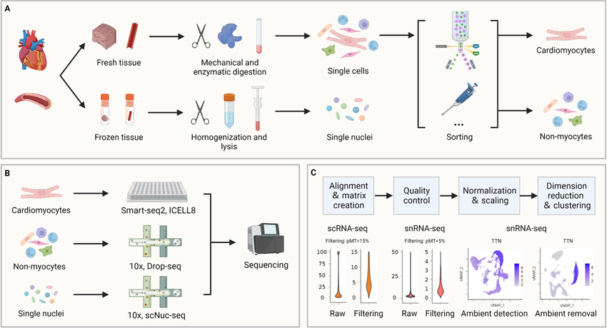
Single nucleus RNA sequencing (snRNA-seq) analyses gene expression in cells that are difficult to isolate, such as those from archived tissues. Traditional methods only provide a bulk overview of gene expression in a tissue sample, masking the crucial differences between individual cell types.
Applied to the heart, snRNA-seq provides an unprecedented view of the cellular diversity and the unique roles different cell types play in heart function (Tucker et al. 2020). This knowledge is critical to understanding both normal heart physiology and the development of heart disease.

Slide 4
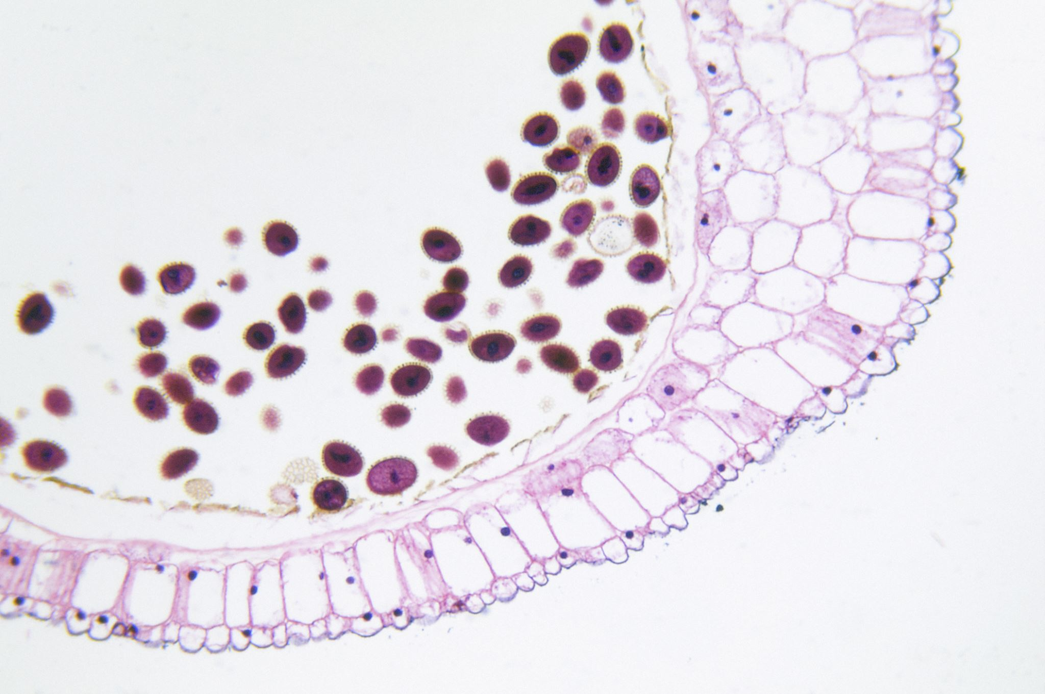
nine major cell types in the human heart (Tucker et al. 2020):
Cardiomyocytes: The muscle cells responsible for contraction.
Fibroblasts: Cells involved in maintaining the structural integrity of the heart.
Endothelial cells: Cells lining blood vessels and the heart chambers.
Pericytes: Cells supporting small blood vessels.
Vascular smooth muscle cells: Cells supporting larger blood vessels.
Macrophages: Immune cells involved in tissue repair and defense.
Lymphocytes: Immune cells involved in targeted immune responses.
Adipocytes: Fat cells, mainly found in the epicardial fat surrounding the heart.
Neuronal cells: Cells of the intrinsic cardiac nervous system.
Notes:
This study identified nine major cell types in the human heart, and over 20 cell subtypes

Slide 5
Findings (Tucker et al. 2020)
Chamber-specific differences in gene expression
The study identified differences in the atrial and ventricular cells: where atrial cardiomyocytes showed higher expression of genes involved in electrical conduction and hormone production, while ventricular cardiomyocytes showed higher expression of genes related to contractile function, largely found in the right ventricle. Lymphocytes were also found in the left ventricle (possibly due to stress)
Sex-differences
Males: NEB, which encodes the sarcomeric structural protein nebulin, is expressed at higher levels in the left ventricle of male hearts.
Females: ZNF827, located near a locus associated with coronary artery disease, is expressed more in female hearts, particularly in the right atrium.
These findings are relevant in understanding the sex differences in heart disease susceptibility.
Notes:
While the study was somewhat limited in power to detect sex-specific differences due to sample size, it did identify a small number of genes with differential expression between male and female hearts

Slide 6
Significance
Resource for future cardiovascular research: The identification of specific cell types and their unique gene expression profiles enhances our understanding of cardiac function, disease mechanisms, and potential therapeutic targets.
By moving beyond the traditional focus on cardiomyocytes, this study illuminates the importance of other cell types in maintaining cardiac health and contributing to disease pathogenesis.
Cardiovascular disease continues to be the leading cause of death among women in the United States, accounting for ~1 of every 3 female deaths¹
Notes:
This comprehensive analysis of the human heart transcriptome provides a valuable resource for future cardiovascular research

Slide 7
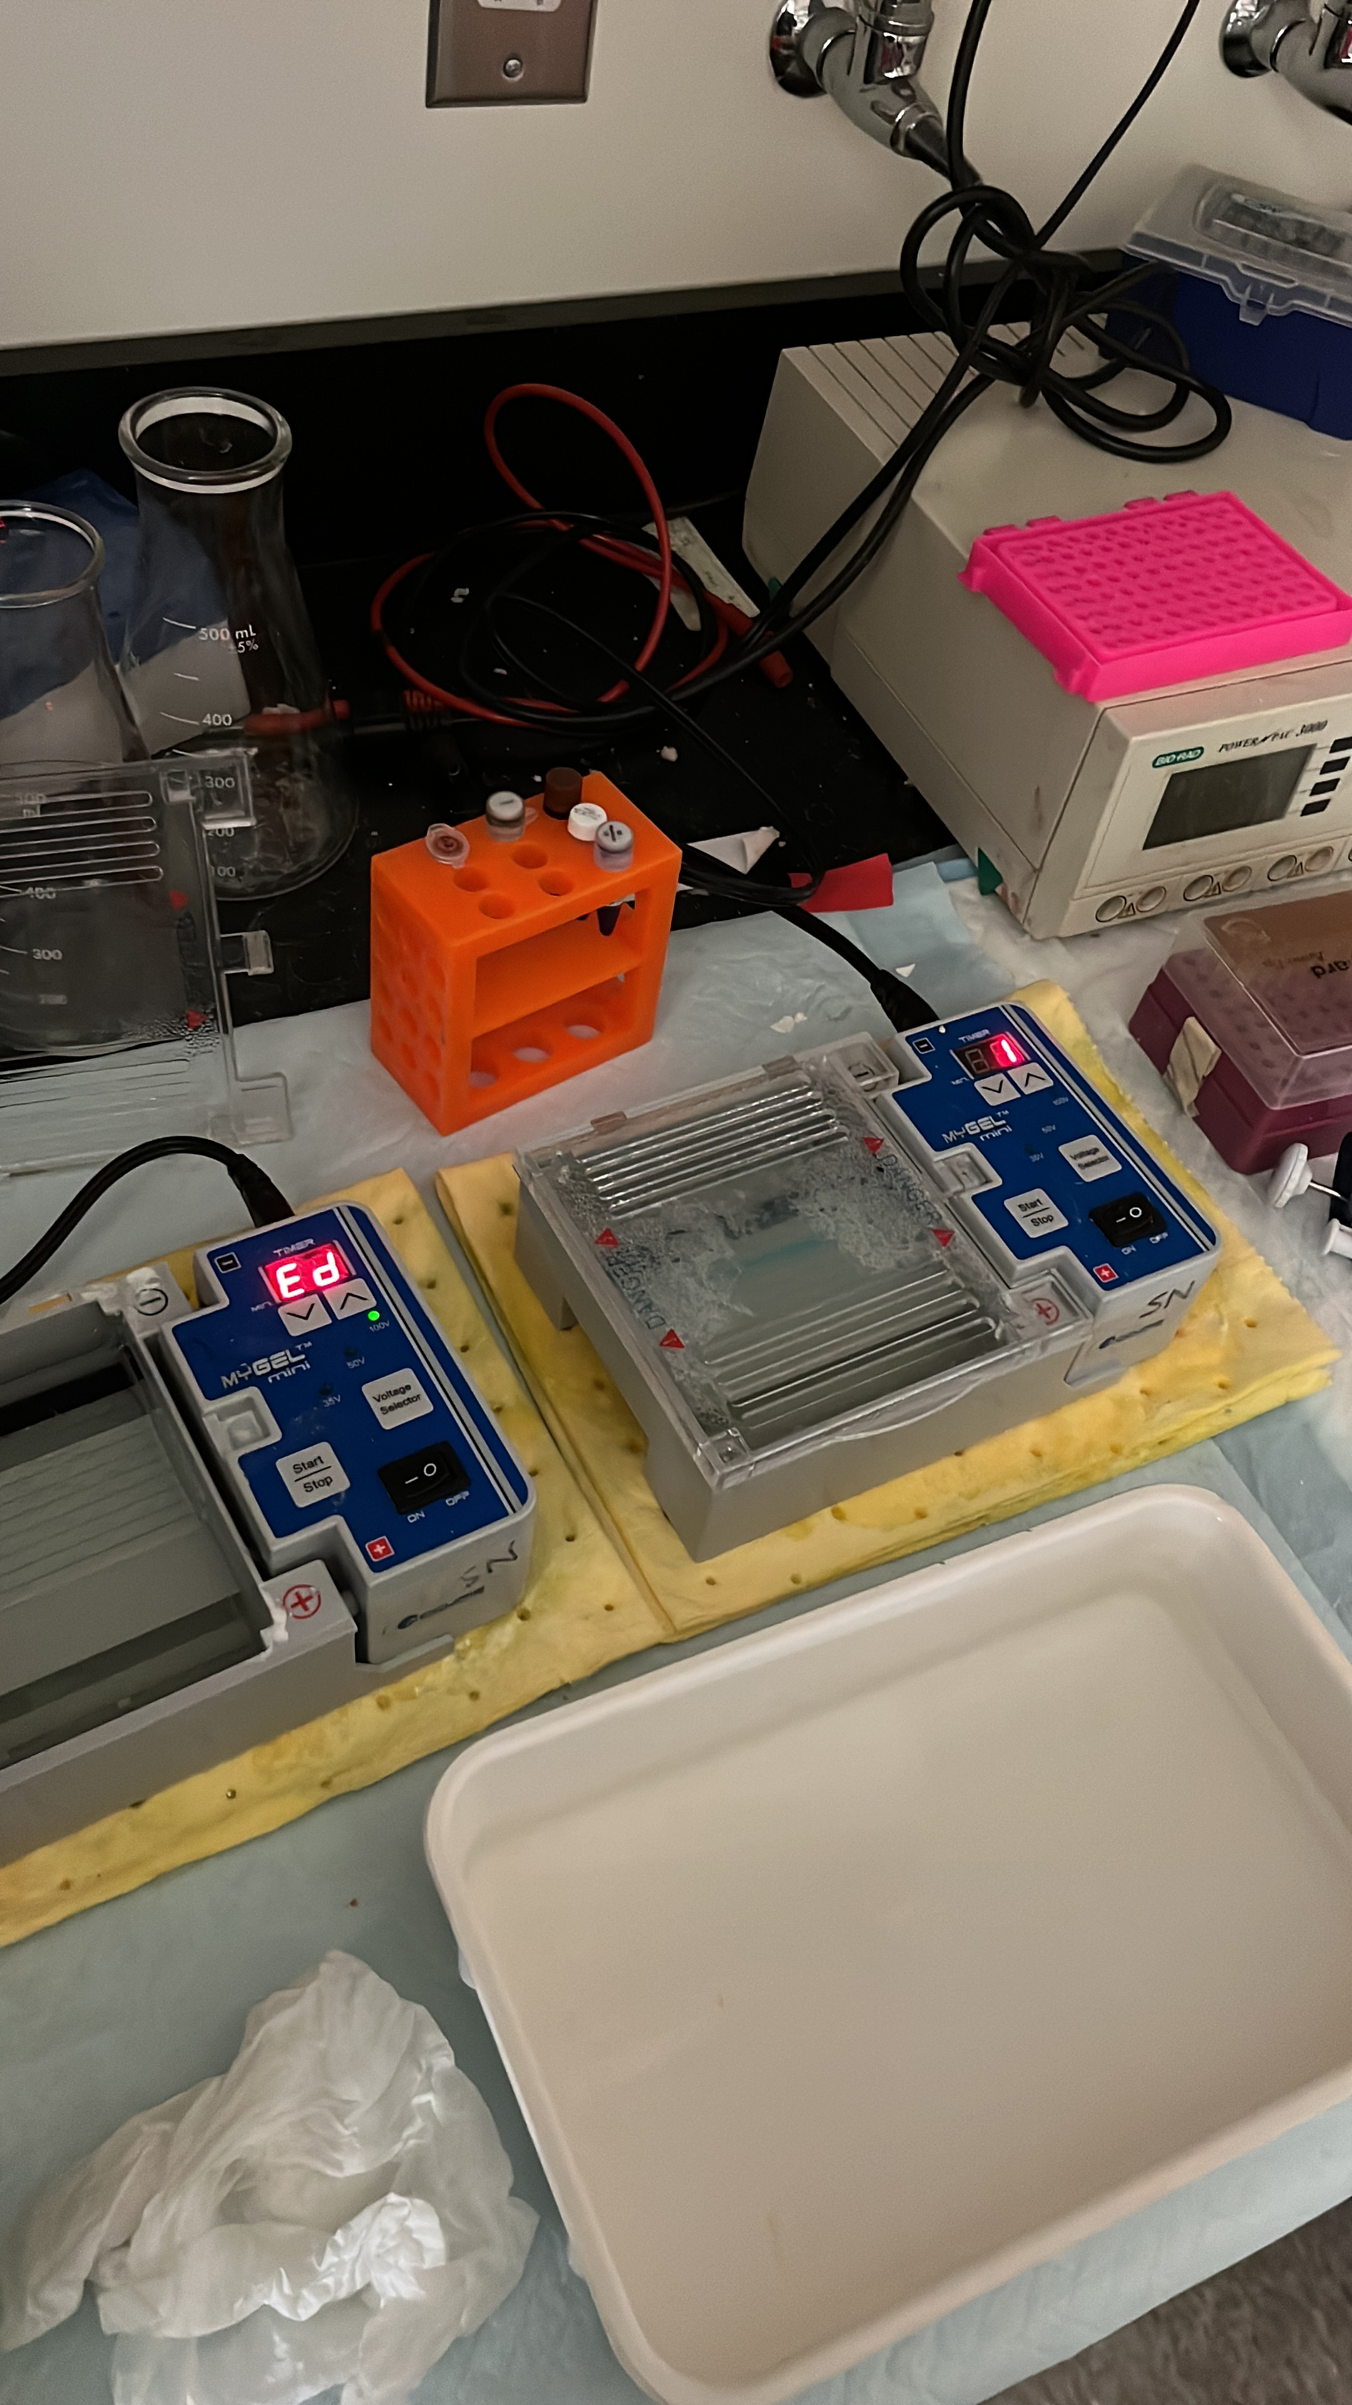
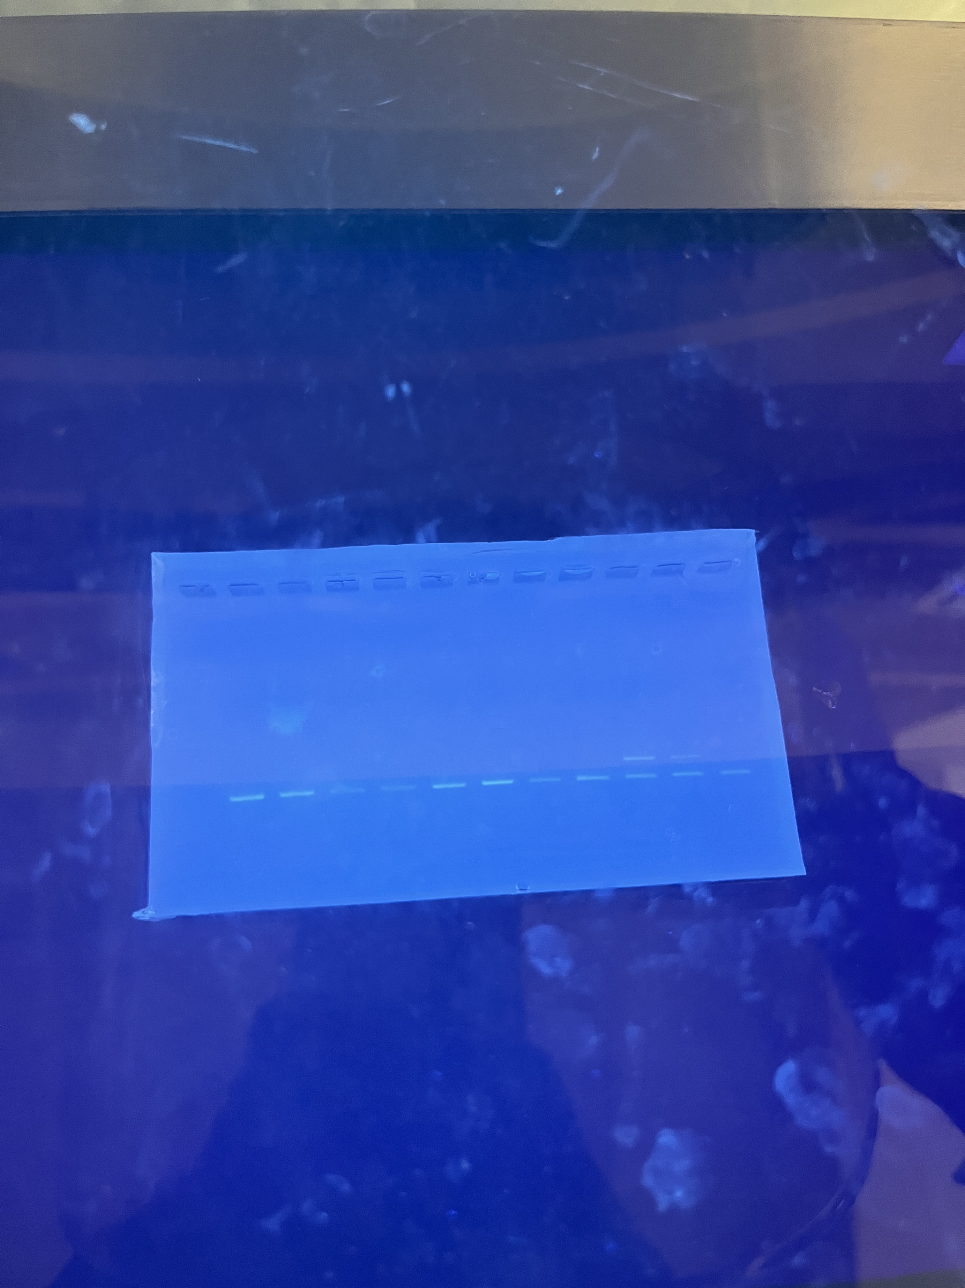
Cultural Exchange and Skills
Growth mindset- I learned to embrace challenges as opportunities for growth, motivating me to keep trying and refining my approach.
Celebration of achievements.
Notes:
This comprehensive analysis of the human heart transcriptome provides a valuable resource for future cardiovascular research

Slide 8
Acknowledgements
I would like to express my sincere gratitude to the ISCORE Coordinators, Dr. Cristina Cenciarelli, Elizabeth Evans, and the Chen Lab for their invaluable support and mentorship throughout this research journey. Your guidance and encouragement have been instrumental in my growth, and I truly appreciate the opportunity to learn from you.
Notes:
This comprehensive analysis of the human heart transcriptome provides a valuable resource for future cardiovascular research

Slide 9
References
(1)
Garcia, M.; Mulvagh, S. L.; Bairey Merz, C. N.; Buring, J. E.; Manson, J. E. Cardiovascular Disease in Women. Circulation Research 2016, 118 (8), 1273–1293.
(2)
Tucker, N. R.; Chaffin, M.; Fleming, S. J.; Hall, A. W.; Parsons, V. A.; Bedi, K. C.; Amer-Denis Akkad; Herndon, C. N.; Arduini, A.; Irinna Papangeli; Roselli, C.; François Aguet; Choi, S. H.; Ardlie, K. G.; Mehrtash Babadi; Margulies, K. B.; Stegmann, C. M.; Ellinor, P. T. Transcriptional and Cellular Diversity of the Human Heart. Circulation 2020, 142 (5), 466– 482.

