Slide 1
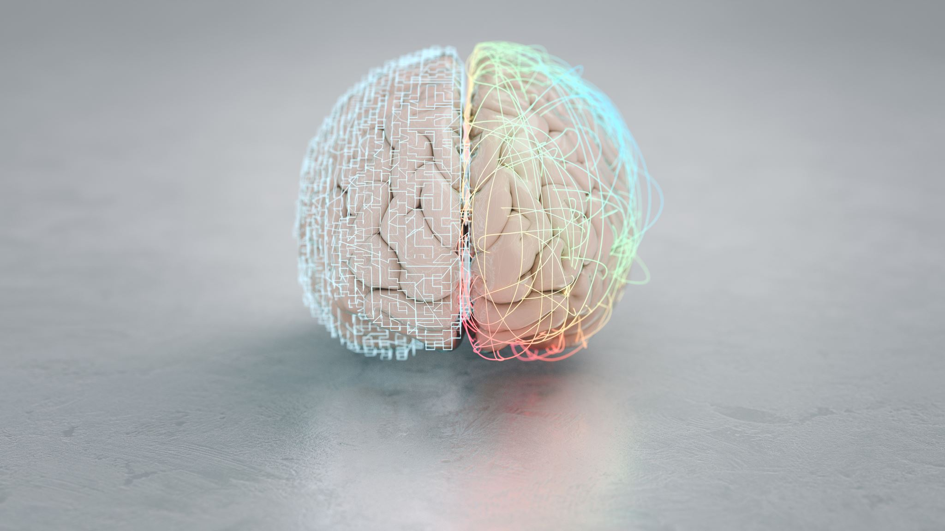
Exploring the Impact of APOE4 on Dopamine Neuron Survival in Parkinson's Disease
Mentor: Ece Bayram, MD, PhD
Student: Alexandra Gonzalez, undergraduate student
Notes:
Progressive Brain Diseases, a Study. ----> Possible alternative title?

Slide 2
Focus
Understanding sex, gender, ethnicity, and race in Parkinsonian Diseases.
Growing soft skills and analytical skills
Communication
Presentation
Scientific Writing
Learn R
Familiarize with ChatGPT
Notes:
Parkinsonian Diseases are brain diseases that impact movement control and lead to various other symptoms that impact one’s daily life.
A lot of preexisting research comes from educated, white, cisgender, straight males so focusing on individuals who don’t fit this criteria allows for a stronger understanding on the experiences of other communities with Parkinsonian diseases.

Slide 3
Parkinsonian Diseases
Parkinsonism: Clinical profile including (1) bradykinesia and (2) tremor and/or rigidity
Parkinson's disease: Most common cause of parkinsonism with dopaminergic neuron loss and Lewy bodies in the brain
Lewy body Disease: Based on the identification of Lewy bodies in the postmortem examination
Notes:
Lewy Body Dementia is an umbrella term for the diagnosis of PD dementia or DLB. Clinical diagnostic criteria for Parkinson’s disease (PD) dementia and dementia with Lewy bodies (DLB).
[Read the first 3 bullet points]
LBD and PD are both progressive conditions that cause movement and cognitive issues but they different in the order in which symptoms appear and the progression of the disease

Slide 4
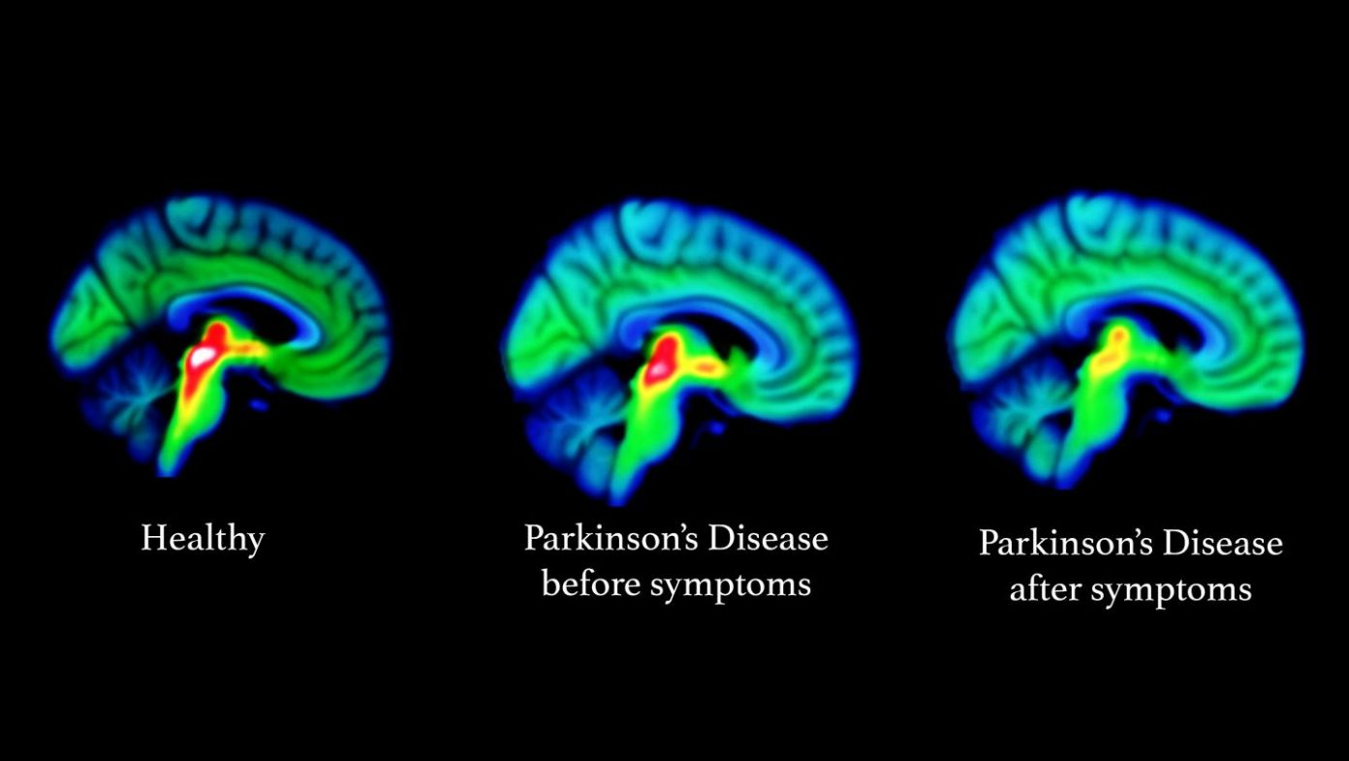
Notes:
After learning about Dr. Bayram's work and reading articles to gain more knowledge on those diseases. We each developed a research question from what we had read. My question, which I will share in a little, was focused on Parkinson’s disease so I will provide some information on what I learned throughout articles and our weekly meetings.

Slide 5
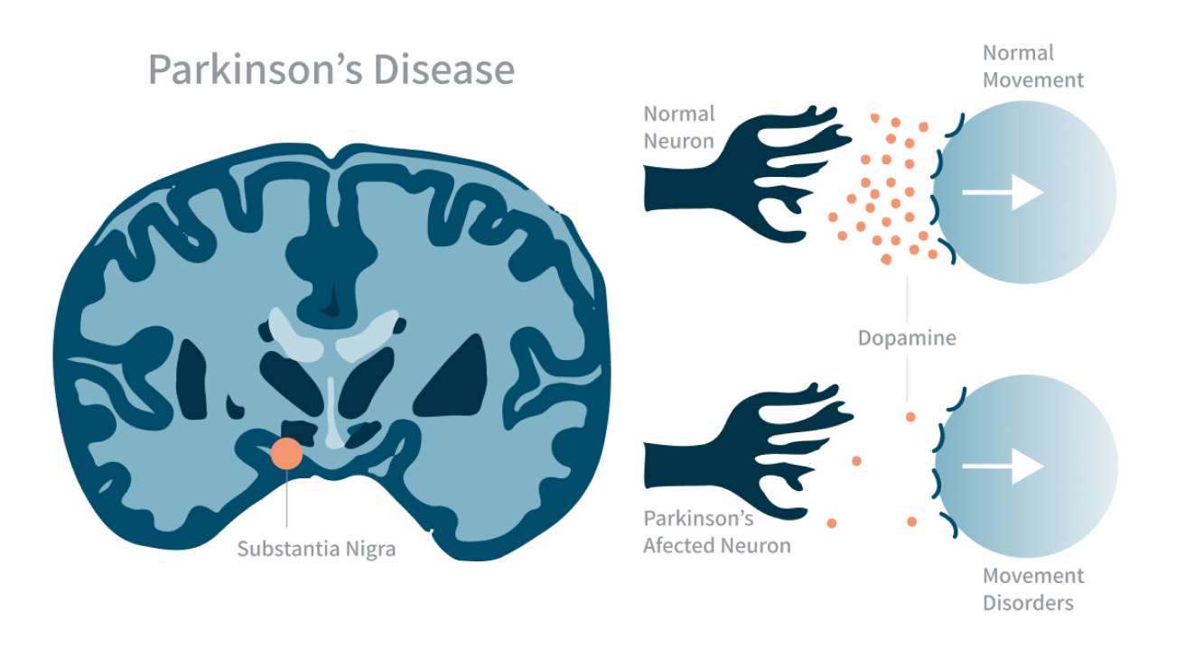
Background Info
Parkinson’s disease (PD) is a progressive neurodegenerative disorder that affects movement
-PD is the progressive loss of dopaminergic neurons in the substantia nigra. Dopamine influences motivation, movement, mental health, sleep, attention, and much more.
Motor symptoms include tremors, slowness, and muscle stiffness. Nonmotor symptoms include depression, cognitive decline, and sleep disturbances.
Notes:
The basal ganglia, which can be seen in the picture as the substantia nigra is part of it, is a brain region that’s heavily impacted by loss of dopamine. Dopamine influences many aspects of the body like motivation, movement, mental health, sleep, attention, and many more.
Because PD primarily affects the basal ganglia causing a significant depletion of dopamine, leading to motor symptoms like tremors, slowness, and muscle stiffness and nonmotor symptoms like depression, cognitive decline, and sleep disturbances.
-It’s important to note that PD can be present long before motor symptoms appear with early signs such as loss of smell, constipation, and mood changes. Early detection is important as early interventions have been shown to significantly slow down symptom progression.

Slide 6
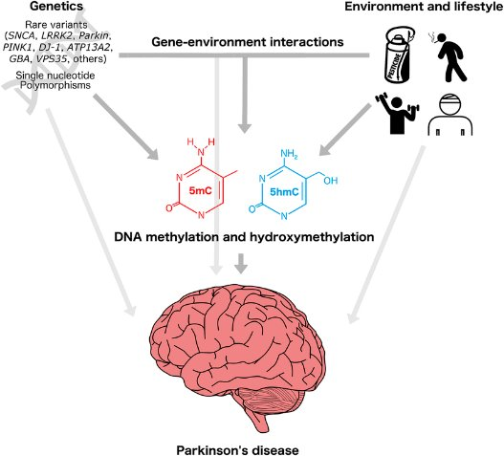
More on PD….
Genetic factors do play a role as mutations in genes occur, however, they often interact with other factors such as environment. Understanding the etiology of this disease involves looking into how all factors interplay.
Genetic factors: only about 3-5% of cases. Mutations on the LRRK-2 gene are most common.
Environmental factors: MPTP neurotoxin shows an increased prevalence of PD. Exposure to heavy metals and pesticides also an have an increased prevalence.
Notes:
Causes and Risk factors of PD include:
Genetic factors: Only about 3-5% of cases. Most common mutations are found in the LRRK-2 gene
Environmental factors such as MPTP which is a neurotoxin have been shown to increase the prevalence of PD. Exposure to heavy metals and pesticides also shows an increased prevalence.
Human genotypes are independently unique, and individuals exposed to the same environmental factors may be affected differently. An example of this interaction is individuals with a genetic predisposition may develop PD after prolonged exposure to pesticides. However, other individuals without genetic predispositions and with some exposure to pesticides may not develop PD, or they may develop PD much later.
Understanding these connection and to what extent the variables influence each other takes time. However, because PD is progressive, time is something patients with PD usually don’t have, and they want to decrease symptom progression as early as possible. So, developing other habits such as an active lifestyle provides the ability to maintain a relatively normal lifestyle as they continue doing daily living activities for a longer time.

Slide 7
Methods & Objective:
How does APOE4 linked to Parkinson’s disease influence the survival of dopamine-producing neurons?
National Alzheimer’s Coordinating Center (NACC) data for visits between September 2005– August 2019
294 females and 490 males with Parkinson’s disease, and available APOE4 count and nigral loss data
Statistical analysis using linear regression to assess relationship between nigral loss and APOE4
Adjusted for age at death
Notes:
The statistical analysis for this study was conducted using R. A linear regression analysis was conducted to examine the association between APOE4, which was an ordinal variable, and nigral loss, which was a continuous variable, while adjusting for age death, which was a continuous covariate. An ANOVA test was performed to examine whether age at death differs significantly based on APOE4 status, treating age at death as the dependent variable and APOE4 status as the independent variable.
APOE4 associated with a higher risk of developing dementia, so those with this allele have a higher likelihood of expericing cognitive decline and dementia like symtopms

Slide 8
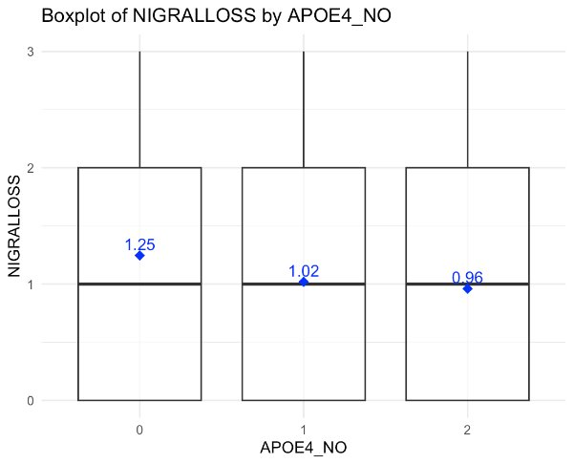
Results
Plot shows associations between Nigral loss and the presence of APOE4 alleles (0,1,2).
Non-significant minimal decrease in nigral loss as APOE4 status increases.
Notes:
Analyzing this data, we can conclude that these differences are due to random variations rather than an actual relationships between the APOEe4 status and nigral loss.

Slide 9
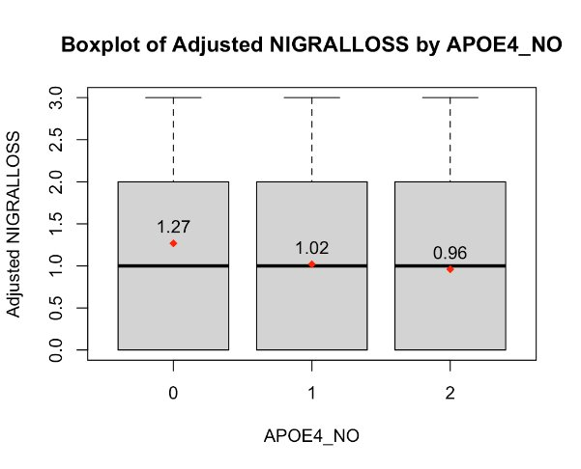
…Results
Plot shows association between Nigral loss and the presence of APOE4 alleles (0,1,2), adjusted for age at death.
Non-significant minimal decrease in nigral loss as APOE4 status increases.
Notes:
Due to overlapping interquartiles, this suggests the differences are not statistically significant. Thus, APOEe4 presence does not have a significant effect on nigral loss when accounting for age death.

Slide 10
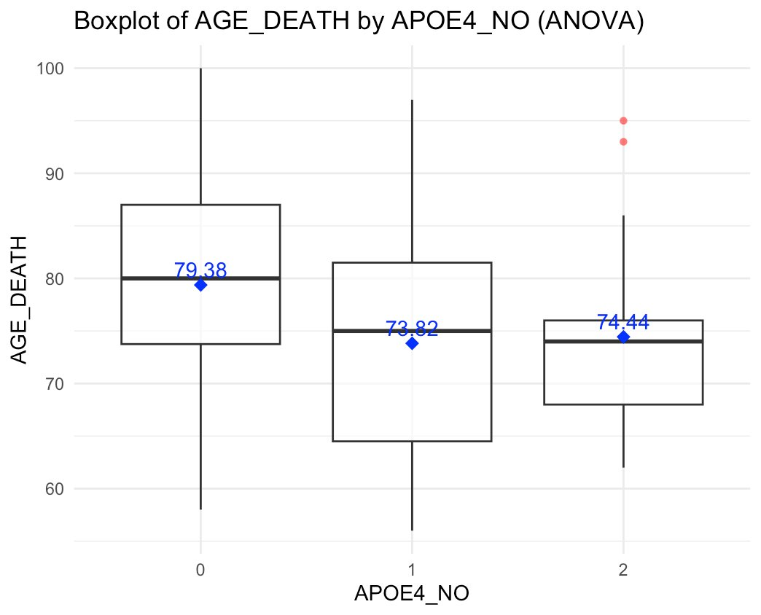
…Results
No association between APOE4 and age at death.
Notes:
We cannot fully rule out the influence of APOEe4 on age death because it can be that the presence of 1 allele causes significant disruption, leading to excessive neurodegeneration and causing early mortality but the presence of 2 alleles activates protective mechanisms that reduce the disruption on the system.

Slide 11
Findings concluded
Neither APOEe4 (p=.22) nor age death (p=.64) were significant predictors of nigral loss, suggesting insufficient data supporting a relationship between these variables.
More research is needed to explore these variables and their relationship, this would allow for a better understanding on the variable's influence on nigral loss.​
Notes:
[after the right text box]
There were no significant statistical associations between APOEe4, age at death, and nigral loss.

Slide 12
Cultural Exchange
Through my time with Ece, I learned about her culture and her educational journey which was very interesting and helpful.
Learned about her hometown, Adana, in Turkey, and how it’s known for its kebabs, among other foods and traditions of her culture.
We talked about our cultures and traditions. I also learned about her journey in learning Spanish.

Slide 13
Thank you!
A sincere thank you to Dr. Bayram for guiding me through those weeks and patiently answering all my questions! I am also deeply grateful to Dr. Cristina Cenciarelli and Elizabeth Evans for fostering a program that provides mentorship and invaluable learning opportunities for students and scholars.

