Slide 1
Data analysis and presentation preparation on
Parkinson’s Disease and Lewy Body Dementias
Hayden Lee Barrett
With mentor Dr. Ece Bayram

Slide 2
Mentor and Mentee
Hayden Lee Barrett
Dr. Ece Bayram
Thats me!
Mentor!

Slide 3
Cultural Exchange
Dr. Ece!
Ece is from Turkey and did much of her education there.
She is a queer rights activist which plays a role in the research she is doing now
Alexandra and Jatciry!
Both Alexandra and Jatciry are from Mexico, but still have different experiences here and there!
Through talking about their culture, a few connections between Mexican, Turkish, and American cultures were made between us
and Me!
I’ve grown up in the states my entire life, so learning about other cultures so personally has been great for me!
As a queer person, it is also great to see how queer activism is in different parts of the world

Slide 4
Lewy Bodies
Lewy Bodies are abnormal clusters of proteins in the brain that are associated with two known conditions:
Lewy Body Dementia and
Parkinson’s Disease
Both of which are neurological diseases with no known remedy.

Slide 5
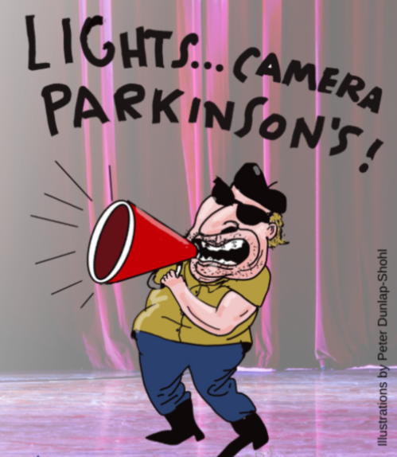
Parkinson’s Disease
Parkinson’s what the main focus of what I was doing.
Parkinson’s is a neurodegenerative disease associated with decreased motor function.
Common symptoms include a drop in mental health, pain, and most commonly, slowness.

Slide 6
What I did
Presentation and Learning
A large part of our time was not only learning about Lewy Body Dementia and Parkinson’s, but also presentation creation,
Translation
A lot of communicating what we know about complicated subjects like Parkinson’s is being able to translate that knowledge to more common terms.
Data Analysis
We used programs like R Studio and databases like Fox Insights to understand different aspects of Parkinson’s

Slide 7
Personal Research
Choosing a Subject
Analyzing Data
I chose to look more into environmental factors associated with Parkinson’s Disease. The database I used defined four different types of chemicals.
Using Fox Insights, a database using survey results collected from people with Parkinson’s, I was able to use R Studio to sort and analyze the data presented.
Results and presentation
I found that industrial chemicals and pesticides are most associated with the development of Parkinson’s.

Slide 8
Thank you!

