Slide 1
MCJ AML Project
Mercedes Rincon - Professor, Dept of Immunology and Microbiology University of Colorado Denver
Dom Lee - Student

Slide 2
Introduction to MCJ AML
Acute Myeloid Leukemia (AML) - a cancer of blood and bone marrow
Most common adult acute Leukemia
20% of childhood Leukemias
Methylation-controlled J protein (MCJ) - protein that acts as an endogenous brake of the mitochondria respiration
Loss of MCJ expression correlates to chemoresistance

Slide 3
MCJ AML cont.
Current therapy
Venetoclax - a targeted therapy that selectively inhibits the BCL-2 protein

Slide 4
MCJ AML cont.
Immunologic Evasion
Chemotherapy Resistance
Targeted Therapy Resistance
Resistance Mechanisms of AML
Metabolic reprogramming in leukemic cells is marked by elevated mitochondrial metabolic activity

Slide 5
MCJ AML cont.
MITOx30 and other mimetics
Mimic the function of Methylation-controlled J protein
Restore metabolic homeostasis
Induce of apoptosis

Slide 6
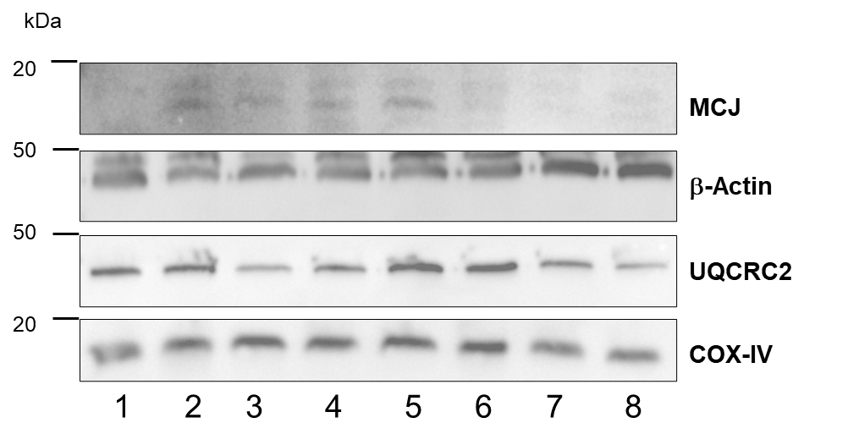
Contribution
Expression of MCJ in AML primary cells seen in Western blot protein expression
Notes:
MCJ expression B-Actin control
UQCRC2 & Cox-IV mitochondria specific

Slide 7
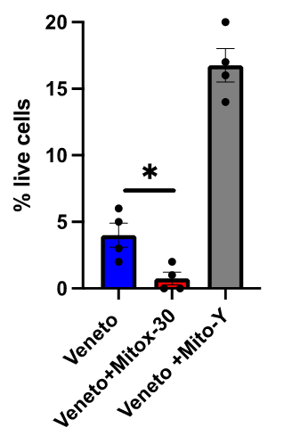
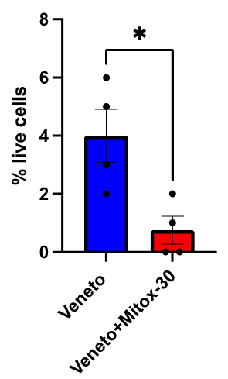
Contribution Cont.
Cell counts
MITOx30
Venetoclax
Variant
Notes:
Variant has change in amino acid

Slide 8
Culture
People in lab of different ethnicities and backgrounds
Brazilian
Chinese
Chinese American
American
People in different career fields/work fields
Hospitality/Service Industry (Me)
Research (Everyone else)

Slide 9
A special thanks
Cristina Cenciarelli
Mercedes Rincon
Felipe Pereira
Rest of Mercedes’ lab group

Slide 10
Thank you!

