Slide 1
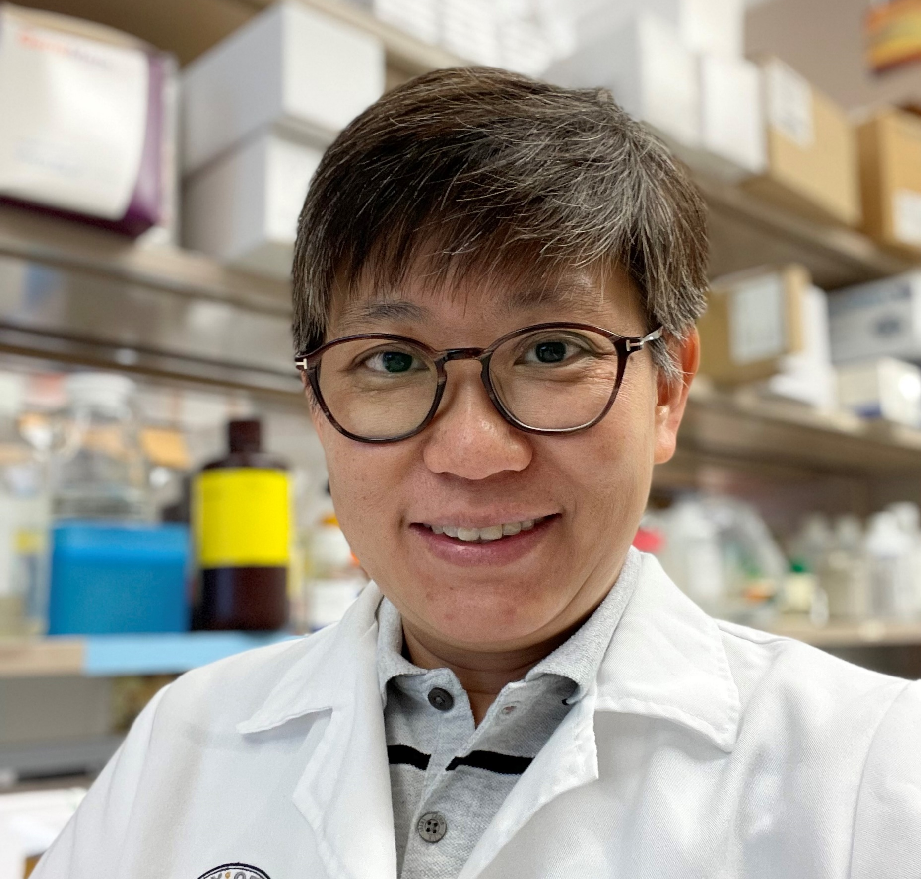
Experimental investigation of Filamin C deficiency on sarcomere stability and focal adhesion kinase in induced pluripotent stem cell-derived cardiomyocytes
PIC
Dr. Suet Nee Chen
PIC
Parveen Udawala
(Gao et al., 2024)

Slide 2
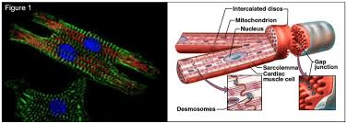
PHYSIOLOGY OF THE MYOCARDIUM
Cardiomyocytes (cardiac muscle cells)
involuntary
Sarcolemma
Plasma membrane – contains voltage gated CA channels
Intercalated discs – responsible for synchronous control
Connect fibers
Contain gap junctions & Desmosomes
Cardiac desmosomes
Anchor cardiac muscle fibers together
Important in maintaining structural integrity
Sarcomere
Functional unit of cardiomyocyte
Consists of thick (myosin) and thin (actin) filaments
(Bader et al., 2022)
Filamin C (FLNC)
Anchors the cytoskeleton to the z-discs
Important for:
Proper contractility
Structural integrity
Notes:
Cardiomyocytes are cardiac muscle cells under involuntary control. Each one contains a nucleus surrounded by a membrane called the sarcolemma which contains special voltage gated calcium channels. The sarcolemma is a plasma membrane that encompasses the nucleus of each cardiomyocytes. Cardiac muscle cells communicate with each other through gap junction and desmosomes that are contained within intercalated discs. Cardiac desmosomes help maintain structural integrity by anchoring cardiac muscle fibers together. Sarcomeres are the functional unit of cardiomyocytes and consist of both thick and thin filaments. Interactions between myosin and actin cause muscle movement. For this presentation, we are going to focus on Filamin C which is an actin binding crosslinking protein that anchor the cytoskeleton to the z-discs. FLNC is important in maintaining the structural integrity of cardiomyocytes.

Slide 3
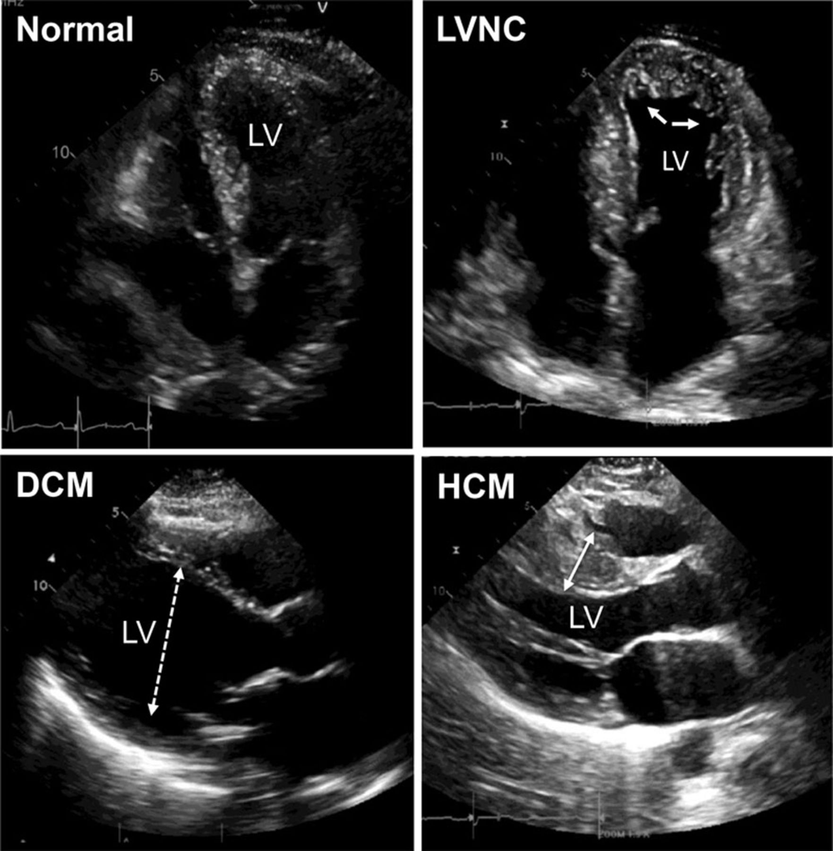
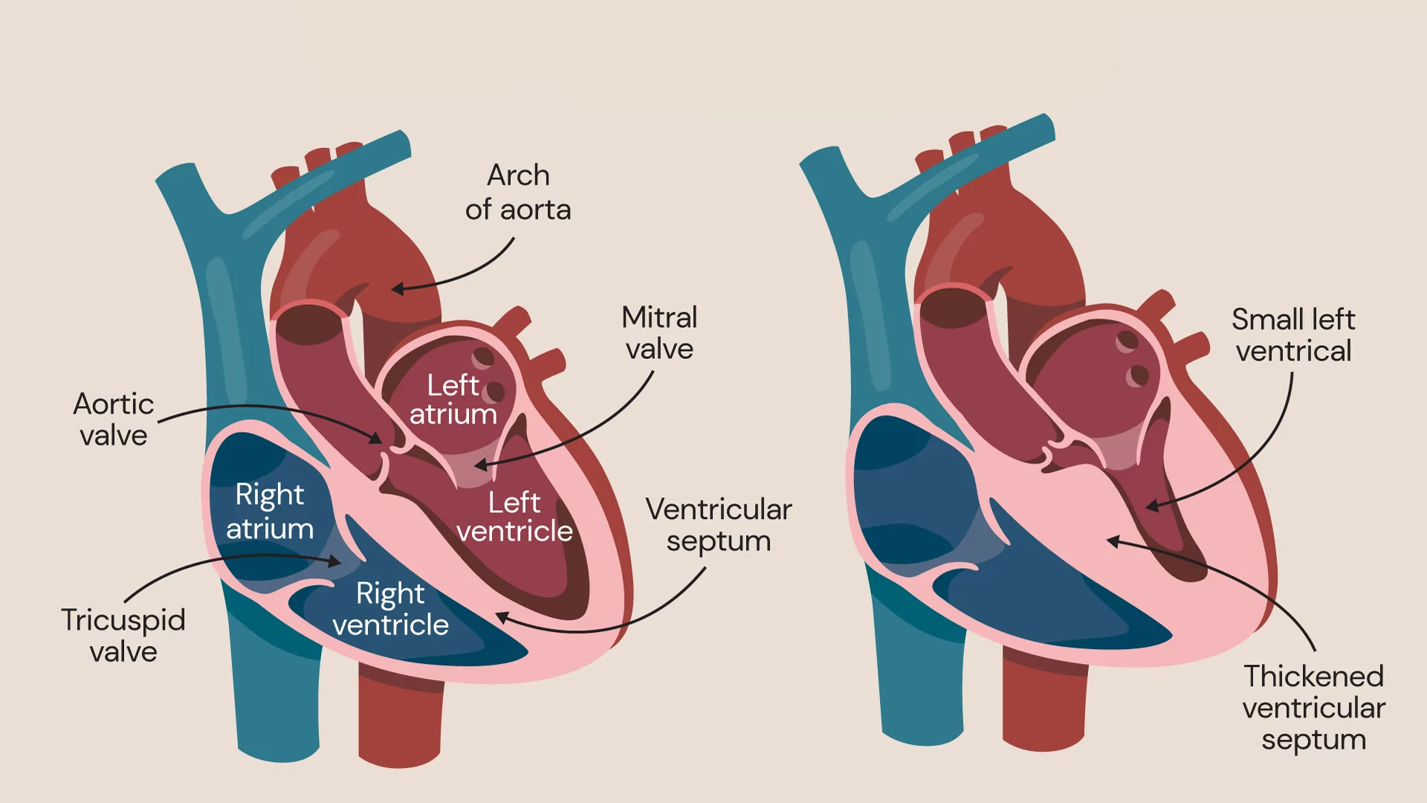
CARDIOMYOPATHY (CM)
Impacts the myocardium of the heart
Irregular contraction of myocardium can lead to:
Heart failure (Mechanical dysfunction)
Arrhythmias (Electrical dysfunction)
Asymptomatic, sudden death
(McNally & Mestroni, 2017)
(Pantaziz 2024)
Notes:
Cardiomyopathy is a medical condition that specifically impacts the myocardium of the heart. This condition can cause scar tissue to develop causing the heart to stiffen, expand or thicken. Irregular contraction of the heart due to these changes can lead to heart failure and arrhythmias. Cardiomyopathy can lead to sudden death possible at any age and often times, patients are asymptomatic

Slide 4
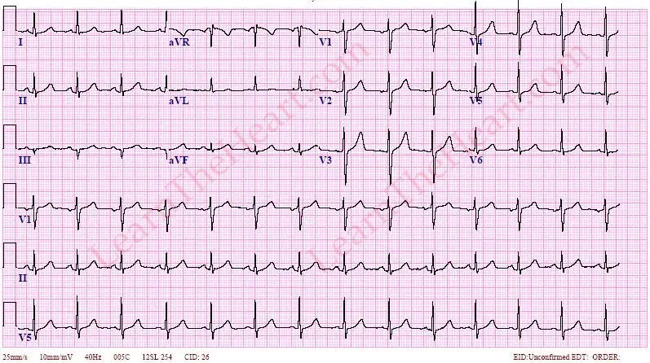
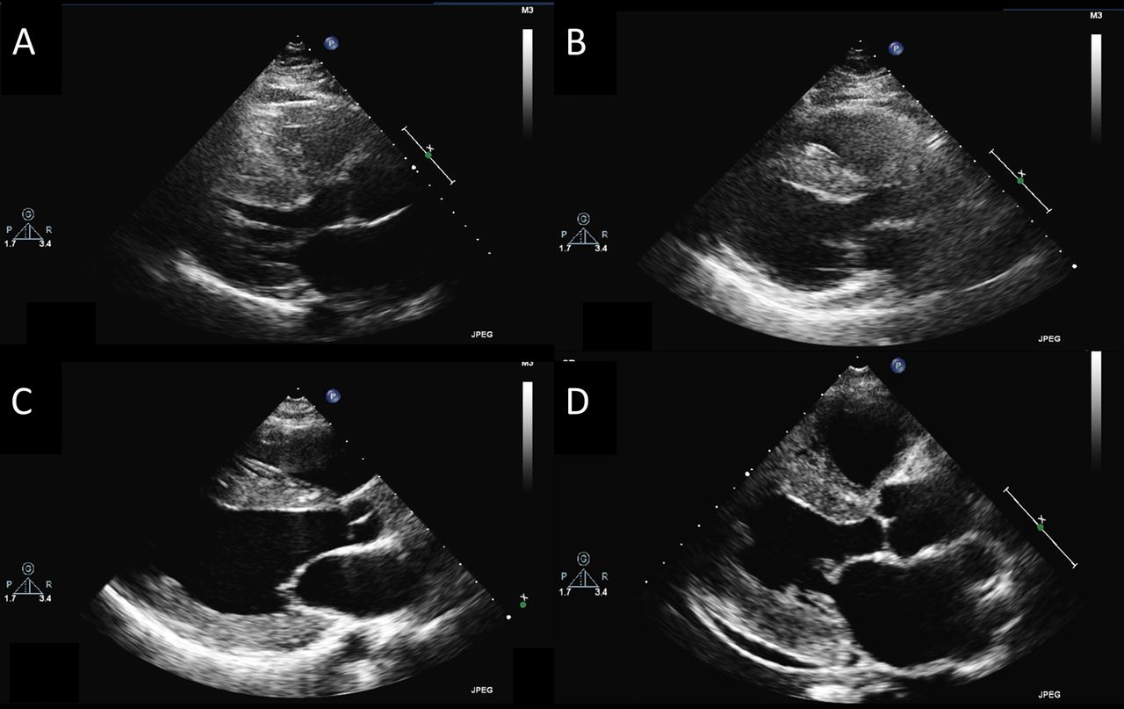
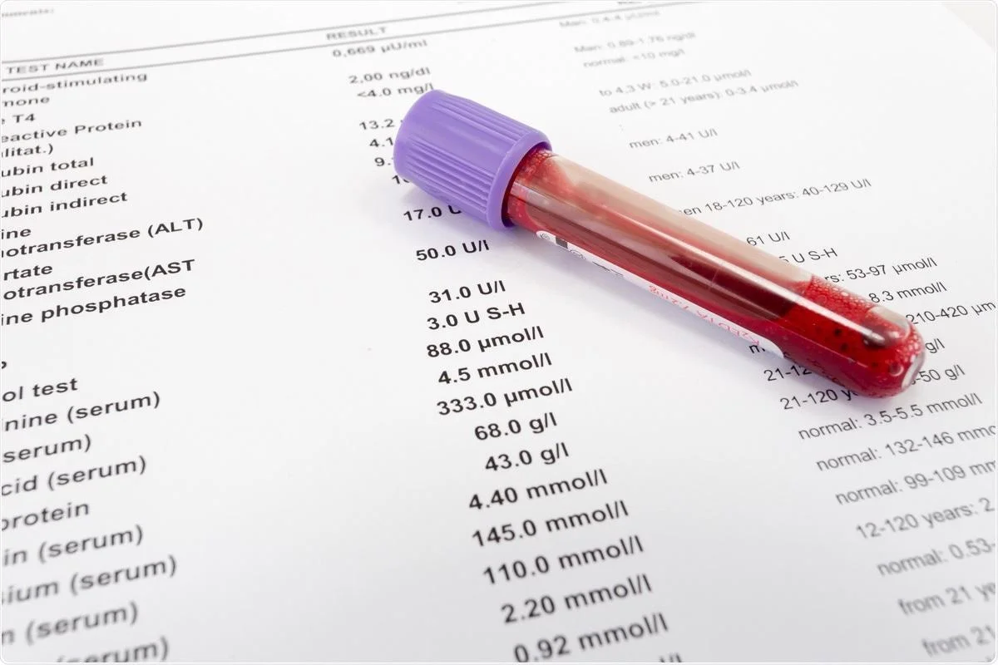
INHERITED CARDIOMYOPATHY
Diagnostic mechanisms:
ECG/EKG
Record heart’s electrical rhythm
ECHO
Rate & rhythm, chamber size, indications of hypertrophy, right ventricular function, left ventricular systolic function and ejection fraction, left ventricular diastolic function, congenital and pericardial abnormalities
Labs
Troponin, Creatinine Kinase (CK), Brain Natriuretic Peptide (BNP)
Notes:
There are several methods to diagnose cardiomyopathy. We can use EKGs to record the heart’s electrical rhythm which is indicative of depolarizations that lead to contraction of the myocardium. We can also use an ECHO to observe things like chamber size, systolic function, ejection fractions and other abnormalities. Additionally, we can use labs for specific cardiac biomarkers such as troponin, creatinine kinase and BNP which are all released in response to damage in the myocardium.

Slide 5
Unclassified Cardiomyopathies
Takotsubo CM – Stress induced CM
Brought on by wall motion abnormalities due to extreme stress
Ischemic CM (ICM)
Form of DCM related to coronary artery disease (CAD)
CM caused by myocardial damage due to cardiac ischemia
Lack of blood flow to cardiomyocytes leads to cell death
Dilated Cardiomyopathy (DCM)
Dilation and impaired contraction of one or both ventricles
Decreased systolic contraction
Arrhythmogenic Right Ventricular Cardiomyopathy (ARVCM)
Myocardium gets replaced with fibro-fatty tissue
Ventricular tachycardia & sudden death
TRUNCATED FLNC
Hypertrophic Cardiomyopathy (HCM)
Autosomal dominant disease
thickening of left ventricle
Abnormal heart contraction
Sarcomeric protein mutation
Restrictive Cardiomyopathy (RCM)
Impaired ventricular filing due to non dilated ventricles
Non dilated, non hypertrophied ventricles with bilateral enlargement secondary to increased arterial pressures
NON - TRUNCATED FLNC
(LeWine, 2023) & (Gao et al.,2024)
Notes:
There are 5 categories of cardiomyopathy. Dilated cardiomyopathy is the dilation and impaired contraction of one or both ventricles leading to decreased systolic contraction. Arrhythmogenic right ventricular cardiomyopathy is caused by the myocardium getting replaced by fibro-fatty tissue leading to the increased risk for ventricular tachycardia and sudden death. Both DCM and ARVCM are linked to truncated filamin C. Additionally, we have hypertrophic cardiomyopathy which is an autosomal dominant disease leading to thickening of the left ventricle walls. This leads to abnormal heart contraction caused by sarcomeric gene mutations which can cause diastolic dysfunction, mitral regurgitation and myocardial ischemia. Restrictive cardiomyopathy is when we have impaired ventricular filling due to non dilated ventricles and finally we have unclassified cardiomyopathies. Takotsubo cardiomyopathy is linked to stress caused abnormalities within the heart whereas ischemic cardiomyopathy is linked to myocardial damage caused by coronary artery disease.

Slide 6
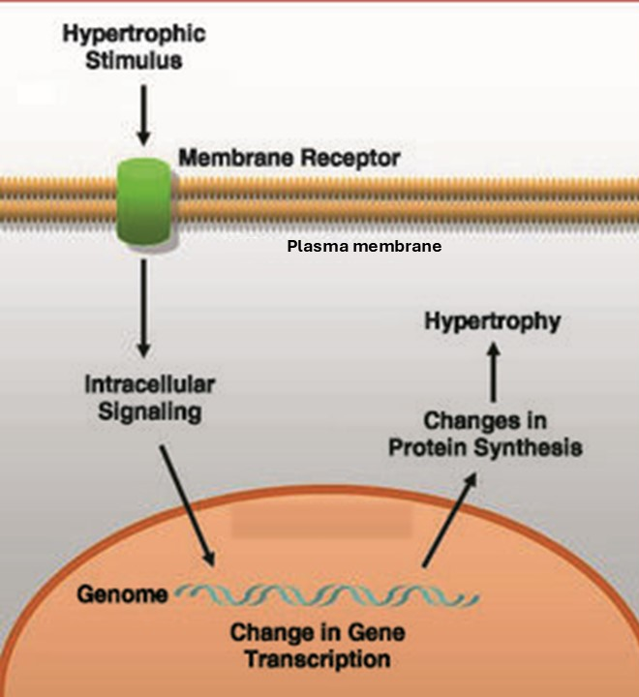
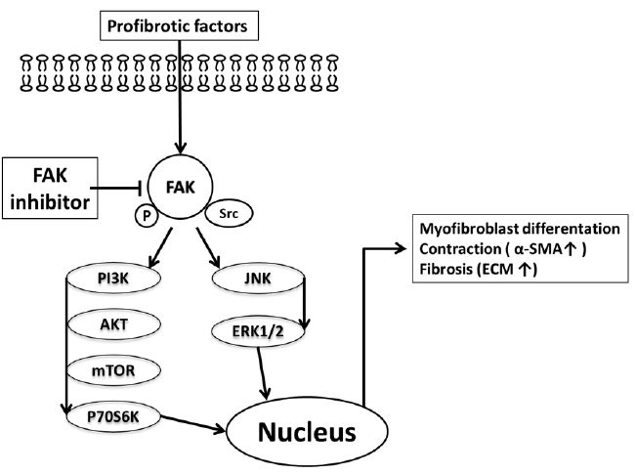
FAK SIGNALING
(Carreño et al., 2006)
Focal Adhesion Kinase (FAK)
Cytoplasmic tyrosinase kinase
Localized to focal adhesions (FA)
Connect the cell to the extracellular matrix
Important mediator of fibrosis
Important for signal transduction within FA complex
Cardiomyocytes undergo mechanical stress at FA sites
cardiac hypertrophy (stretch)
Interacts with several different cell signaling pathways
WNT/Beta-catenin signaling pathway
MAPK cascade
Changes in cell growth and survival
Impaired cardiac function and maladaptive hypertrophy brough on by excessive cardiac mechanical stress
(Fan et al., 2015)
Notes:
One cellular pathway to note for this project is the Focal adhesion kinase pathway. FAK is a cytoplasmic tyrosinase kinase that is localized to focal adhesions (FA). These help connect the cell to the extracellular matrix which allow the cell to integrate external mechanical signals. The FAK pathway is activated when cardiomyocytes undergo mechanical stress at these focal adhesion sites which causes the development of cardiac hypertrophy or stretch in response to increased workload. This pathway is downstream from several different cell signaling pathways which allows for it to influences changes in gene expression related to cell growth and survival. Excessive cardiac mechanical stress can lead to maladaptive hypertrophy and overall impaired cardiac function due to possible overactivation of the FAK pathway.

Slide 7
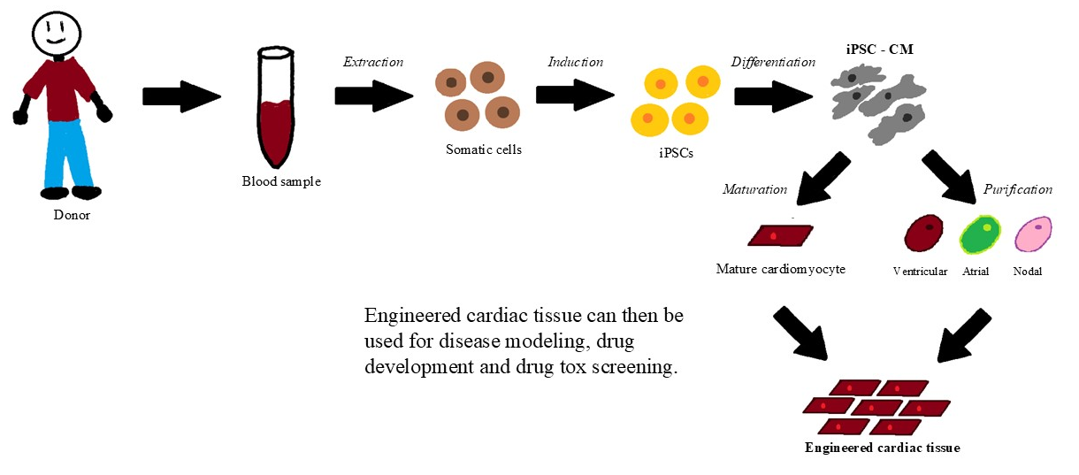
METHODS:
Induced pluripotent stem cells (iPSCs)
genetically reprogramed adult cells into an embryo-like state
Introduce genes into differentiated cells
Differentiate iPSCs into specific cells
Differentiate iPSCs from patients with CM into iPSC-CM
Major advantage:
Inv-vitro model with genetic background of patient with FLNC mutation
(Li et al., 2020)
CRISPR/Cas9 system
insertion/deletion – Creates FLNC knockout (KO) mice
Important in deriving FLNC-deficient hiPSC
PCR
Gene amplification and quantification of FLNC gene
Additional methods used for data analysis:
Immunofluorescence (IF), fast Fourier Transformation (FFT), spectrophotometry, electrophoresis
(Gao et al., 2024)
Notes:
For this project, we used iPSCs which stands for induced pluripotent stem cells. These are stem cells created by genetically reprogramming adult cells into an embryo-like state which allows us to introduce specific genes into these cells. This allows us to differentiate these iPSCs into any kind of cell in the body. So we can take iPSCs from patients with cardiomyopathy and differentiate them into iPSC cardiomyocytes. A major advantage of this is that these cells allow us to develop an in-vitro model that contains the genetic background of the patients with the FLNC mutation. Additionally we used the CRISPR/Cas9 system which allowed us to use guide RNA to target specific sequences within the FLNC exon. We used this to insert and delete genes to create FLNC knockout mice. Polymerase Chain reaction (PCR) was used for gene amplification and quantification of the FLNC gene. Additional methods used were immunofluorescence, fastfourier transformation, spectrophotometry and electrophoresis.

Slide 8
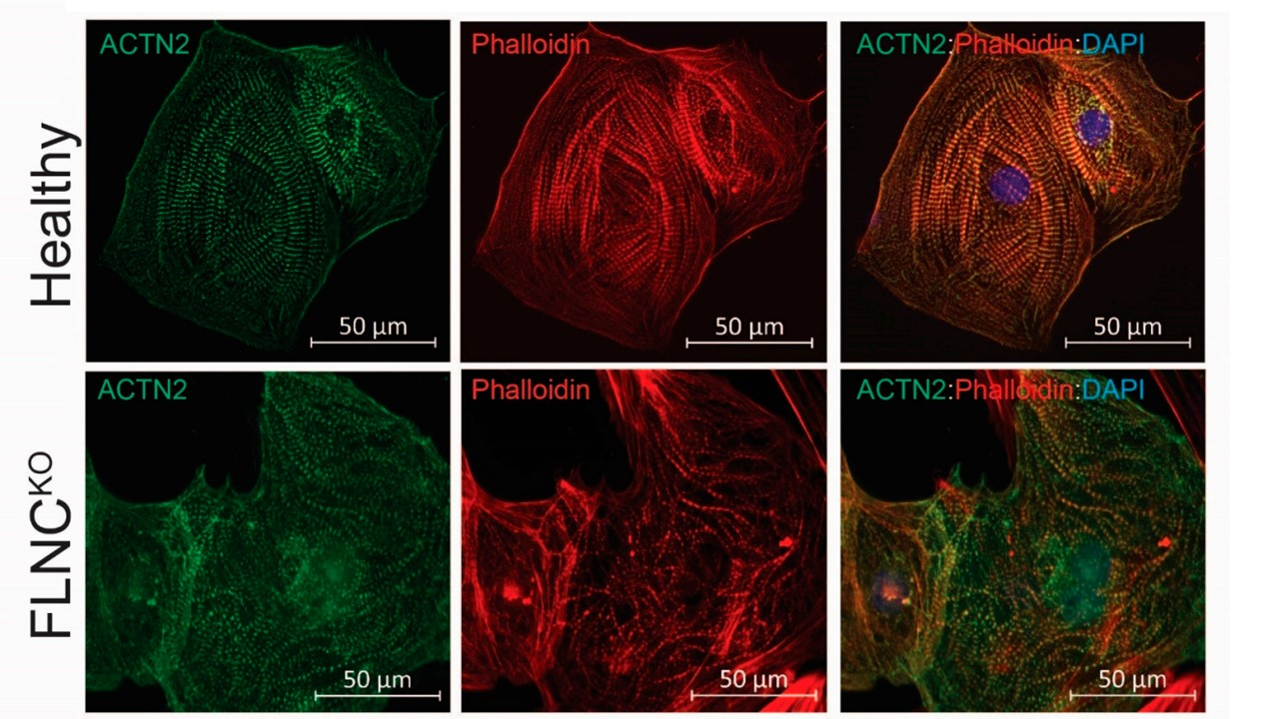
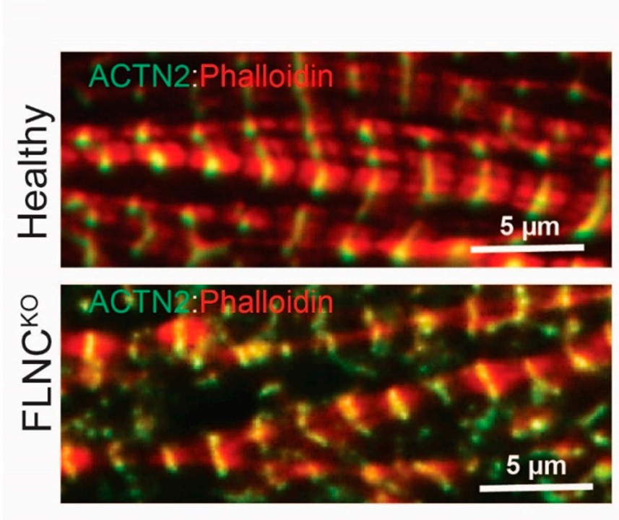
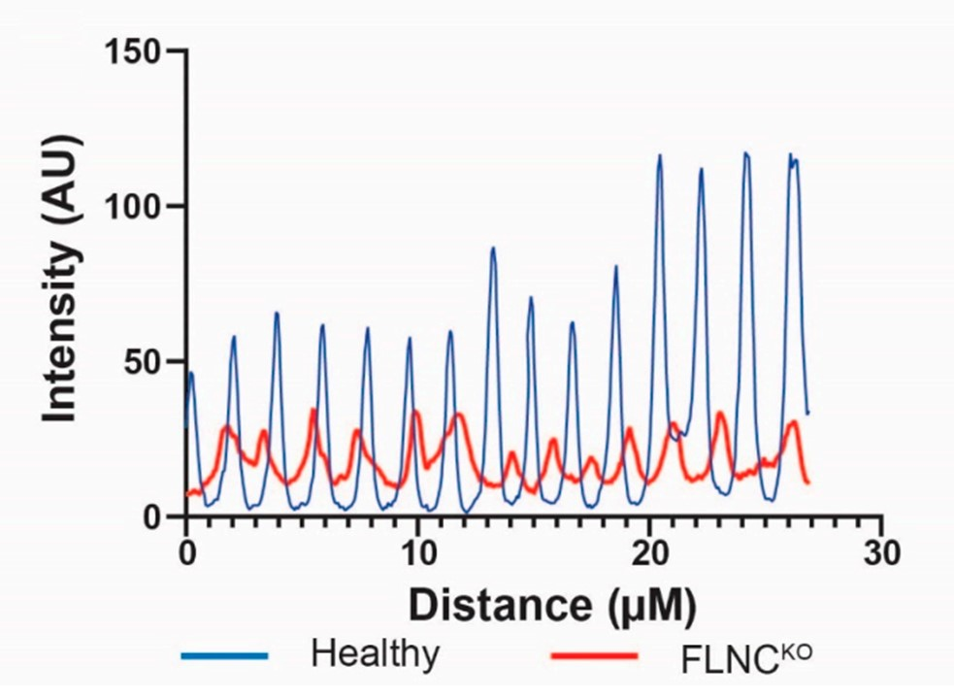
RESULTS:
Loss of actin-actinin crosslinking hinders filament formation in hiIPSC-CM (KO)
(Gao et al., 2024)
IF results:
Abnormal sarcomere structure
actin cytoskeleton dysregulation
Decreased crosslinking of thin filaments visualized by disrupted spatial distribution of F-Actin and ACTN2
Breaking and disarrangement of protein interactions in Z-discs
(ACTIN2 – Z-disc protein)
Healthy
Z-lines are dense, ordered, defined sarcomere boundaries
FLNC KO
Z-lines are thinner, broken, disarrayed sarcomeres
Notes:
We found that overall loss of actin-actinin crosslinking hindered filament formation in knockout mice. Immunofluorescence revealed abnormal sarcomere structure indicative of actin cytoskeleton dysregulation. Decreased crosslinking of thin filaments was visualized by disrupted spatial distribution of F-actin and ACTN2, a Z-disc protein. This revealed breaking and disarrangement of protein interactions in the z-discs of knockout mice.
Additionally, we noted knockout mice to have thinner, broken and disarrayed sarcomeres compared to healthy z-lines which are dense, ordered and show defined sarcomere boundaries.
Decreased concentration and irregular spacing of ACTN2
Wider sarcomere length

Slide 9
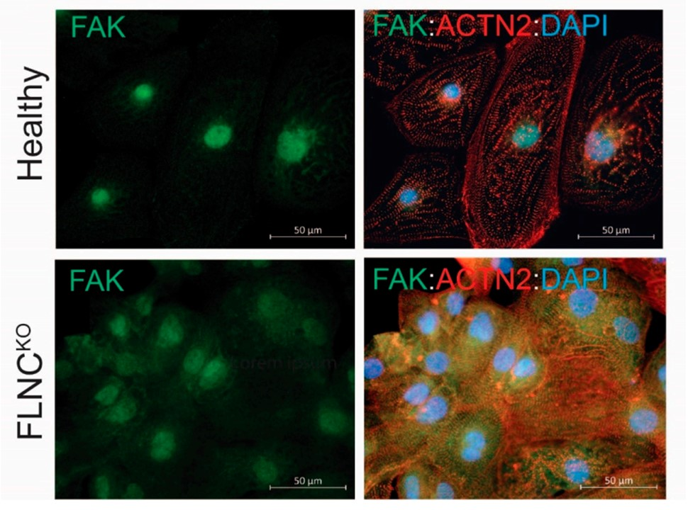
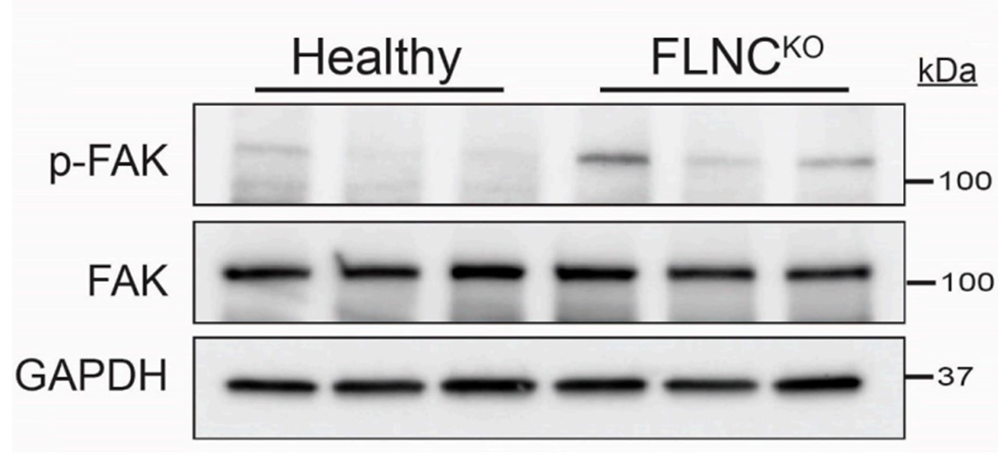
RESULTS:
Structural impairment caused by activation of FAK signaling in hiIPSC-CM (KO)
(Gao et al., 2024)
Upregulation of FAK signaling pathway
Downregulation of genes involved in crosslinking of contractile fibers and actin cytoskeleton
Indicates dysregulation of formation of sarcomere and intercalated discs
Activation of FAK signaling in FLNC KO
Increased expression of p-FAK and cytosolic FAK
Indications of structural impairment
Decreased intercalated disc proteins and sarcomeric genes
FLNC deficiency causing dysregulation of the transcription of calcium handling genes
Significant calcium handling abnormalities
Lower mRNA levels of SERCA (calcium handling gene)
Slower reuptake of calcium in the SR
Extended peak time of calcium
Notes:
We also found structural impairments caused by activation of FAK signaling in knockout mice. RNA sequencing revealed an overall upregulation of the FAK signaling pathway and a downregulation of genes involved in the crosslinking of contractile fibers and the actin cytoskeleton. This shows dysregulation of the formation of sarcomeres and intercalated discs. We also observed activation of FAK signaling in FLNC knockout mice through the increased expression of PFAK and cytosolic FAK. Additionally, we found indications of structural impairment through decreased intercalated disc proteins and sarcomeric genes. Finally, the dysregulation of transcription of calcium handling genes was caused by a deficiency in FLNC. This was evidently seen by calcium handling abnormalities and so we're reuptake of calcium in the sarcoplasmic reticulum.

Slide 10
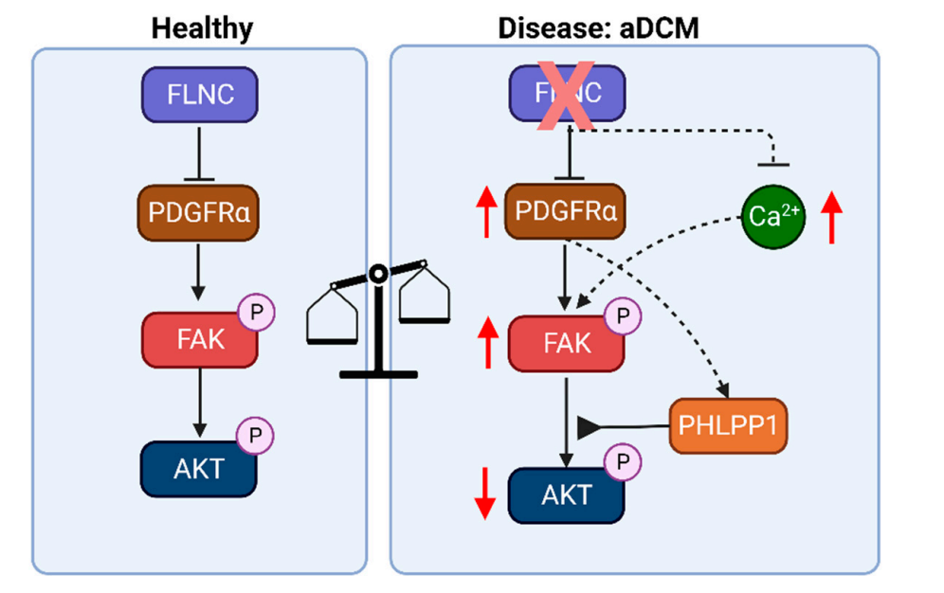
IMPLICATIONS
(Gao et al., 2024)
FLNC is important in maintaining the structural integrity of z-discs within cardiomyocytes
FLNC deficiency
dysregulation of the assembly of thin filaments
Impaired contraction in hiPSC – CM FLNC KO
Disarray of sarcomeres
Activation yet dysregulation of FAK pathway
sarcomeric/cytosolic deficits
defects in calcium regulation
FAK activation is significant in cardiomyopathy
Increase in cytosolic calcium causing phosphorylation of Fak
caused by disrupted thin filament formation
Dysregulation in calcium homeostasis
Dysfunction in excitation – contraction of cardiomyocytes
Sarcomere structure impairments affect calcium sensitivity of thin filaments
Future research
Specific mechanisms of FLNC involvement in myocardiocytes
Specific mechanism of FAK pathway in CM
Notes:
Overall we found that FLNC is important in maintaining the structural integrity of Z disks within cardiomyocytes. Loss of efficiency leads to overall dysregulation of the assembly of thin filaments which was visualized in a decrease in expression of thin filament genes impaired contraction in knockout mice and disarrayed sarcomeres. Finally we found that cardiomyopathy leads to activation yet dysregulation of the FK pathway possibly caused by sarcomeric slash cytosolic deficits as well as deficits in calcium regulation. We noted that AFAIK activation plays a significant role in cardiomyopathy in that dysfunctional assembly of FA is caused by an increase in cytosolic calcium which causes autophosphorylation of the FK pathway. In that FK activation is possibly caused by disrupted thin filament formation. Additionally we noted at this regulation in calcium homeostasis which leads to dysfunction and excitation slash contraction of cardiomyocytes. It's possible that sarcomere structure impairments affect calcium sensitivity of thin filaments which helps explain abnormalities in calcium handling gene expression. Future research can focus on the specific mechanisms of FLNC involvement in myocardial sites as well as the specific mechanism of the FAK pathway in cardiomyopathy.

Slide 11
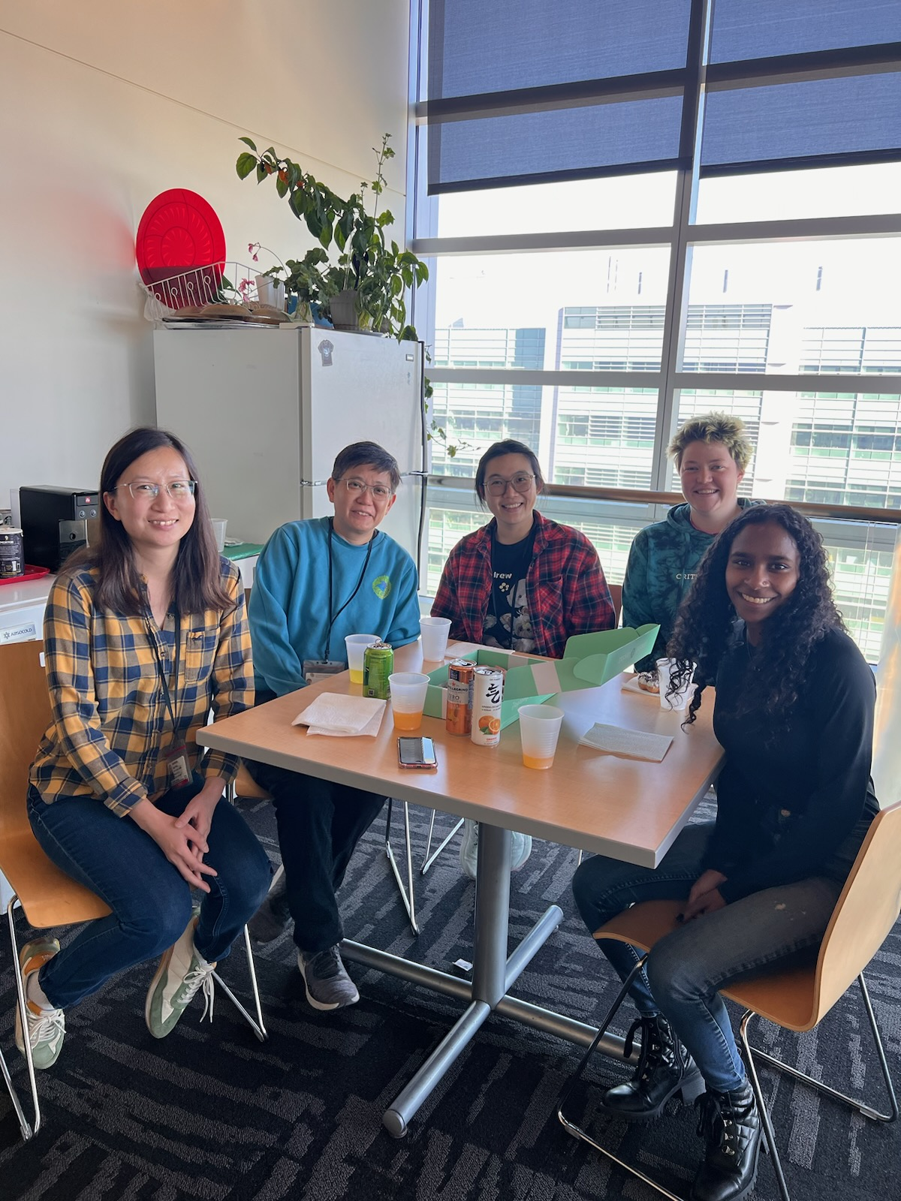
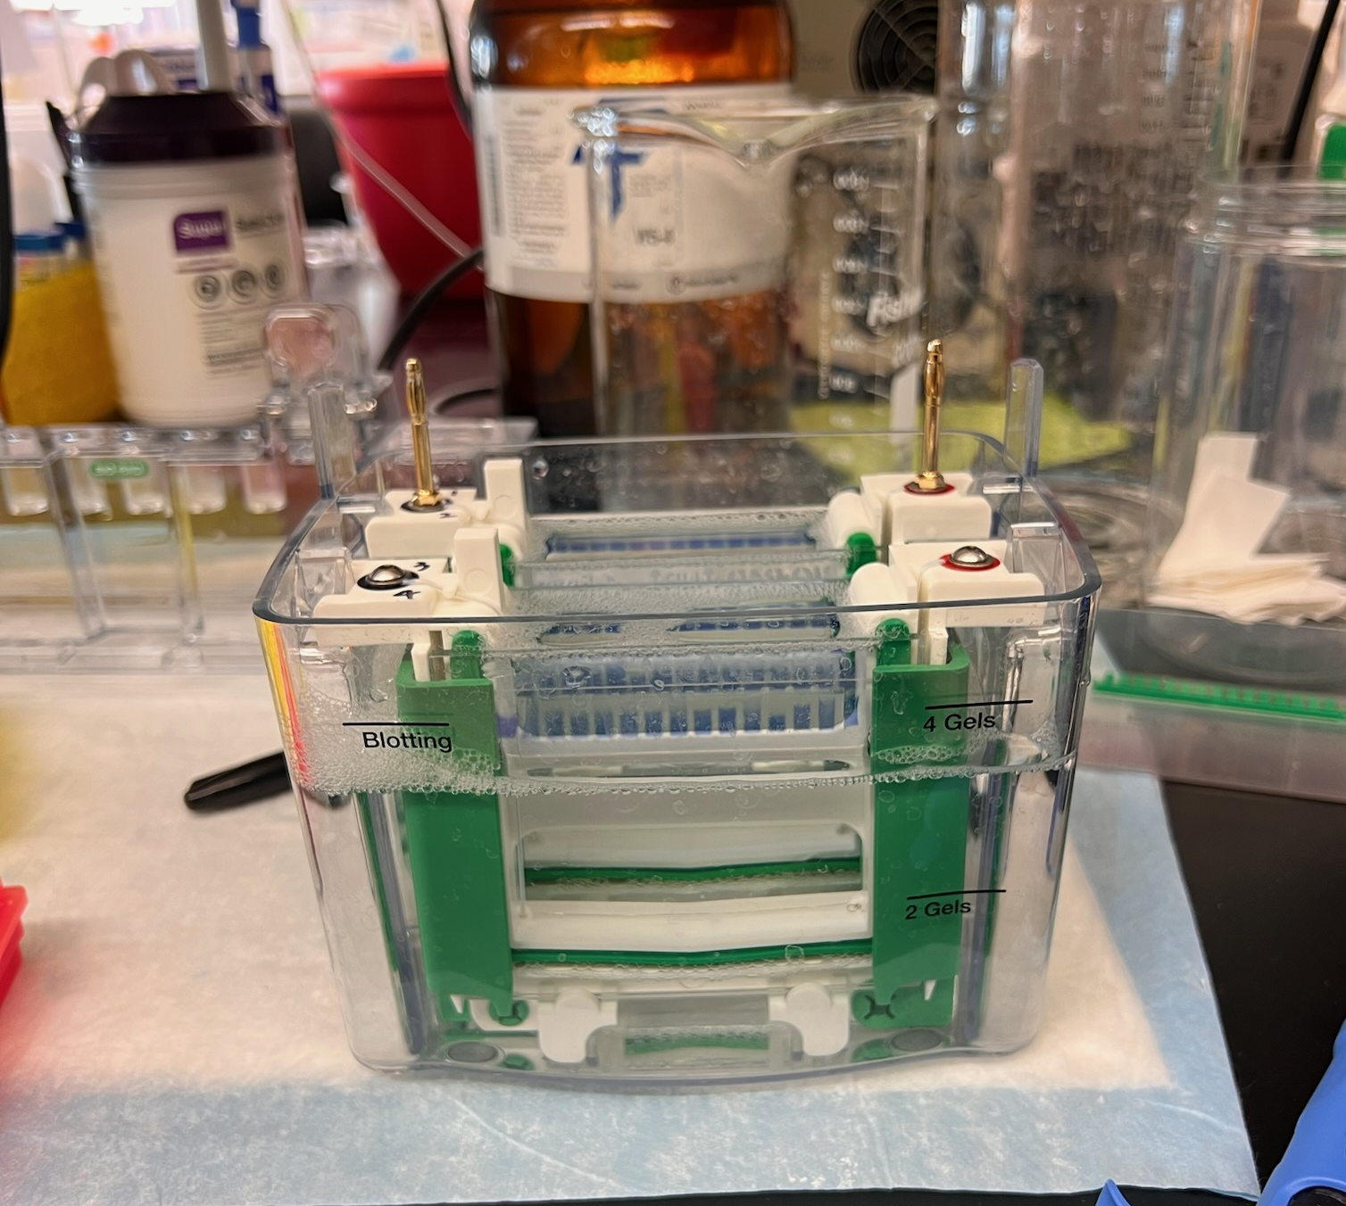
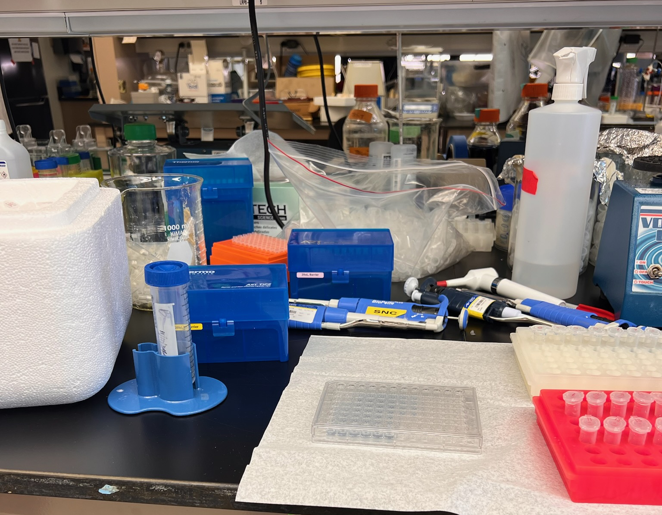
CULTURAL EXCHANGE AND INTERPERSONAL COMMUNICATION
Clear, honest, open communication
Science in multiple languages
Its okay to ask for clarification
Notes:
One of the major lessons I learned throughout the course of this program was how to be more mindful with my communication and how to communicate clearly. Working in research requires us to communicate constantly and its important to convey information accurately. Working with researchers from around the world, it makes us need to slow down and be mindful of how we communicate to others. Tone, infliction, and the use of slang are big factors when it comes to communicating because they can be different within different languages. This means its important to have an open mind because having a conversation involves two people.
As someone who speaks multiple languages, it still blew my mind hearing scientific talk in another language. I think that often times we forget that research comes from all corners of the world and this makes us a little less cognizant about the way we communicate about science. This was something I struggled with during this program. I learned that its okay to ask for clarification and to ask for further explanation.
Overall, I learned so much more than just science. I also learned how to communicate more openly, and effectively and opening my mind to multiple forms of discourse helped me integrate myself as a team member rather than someone on the outside looking in.

Slide 12
I want to give special thanks to the ISCORE program for this wonderful opportunity. Thank you to Dr. Cristina Cenciarelli and Elizabeth Evans for their consideration and assistance throughout the program
Thanks to Dr. Suet Nee Chen and Lingaonan He for letting me shadow their research and for hands on experience in the lab.
And additional thanks to Dr. Raffaella Lombardi for her collaboration and for allowing me shadow her research as well
Final thanks to everyone for this unforgettable experience and thank you all for your time!
Notes:
Before I conclude my presentation, I want to give thanks to the iSCORE program for this wonderful opportunity. Thank you to Dr. Cristina and Liz Evans for their consideration and assistance throughout the program. Thank you to Dr. Chen and Nan for their guidance and for letting me shadow their research. Additional thank to Dr. Lombardi for her collaboration and for letting me shadow part of her research as well. Final thanks to everyone for this unforgettable experience and thank you all for your time!

Slide 13
REFERENCES
Bader, F., Bendahmane, M., Saad, M., & Talhouk, R. (2022). Microscopic tridomain model of electrical activity in the heart with dynamical gap junctions. part 1–modeling and well-posedness. Acta Applicandae Mathematicae, 179(1), 11.
Pantaziz, A. (2024, June 20). Hypertrophic cardiomyopathy. Guy’s and St Thomas’ Specialist Care. https://guysandstthomasspecialistcare.co.uk/conditions/hypertrophic-cardiomyopathy/
McNally, E. M., & Mestroni, L. (2017). Dilated cardiomyopathy: genetic determinants and mechanisms. Circulation research, 121(7), 731-748.
LeWine, H. E. (2023, January 20). Cardiomyopathy. Harvard Health. https://www.health.harvard.edu/a_to_z/cardiomyopathy-a-to-z
Carreño, J. E., Apablaza, F., Ocaranza, M. P., & Jalil, J. E. (2006). Cardiac hypertrophy: molecular and cellular events. Revista Española de Cardiología (English Edition), 59(5), 473-486.
Fan, G. P., Wang, W., Zhao, H., Cai, L., Zhang, P. D., Yang, Z. H., ... & Wang, X. (2015). Pharmacological inhibition of focal adhesion kinase attenuates cardiac fibrosis in mice cardiac fibroblast and post-myocardial-infarction models. Cellular Physiology and Biochemistry, 37(2), 515-526.
Li, J., Hua, Y., Miyagawa, S., Zhang, J., Li, L., Liu, L., & Sawa, Y. (2020). hiPSC-derived cardiac tissue for disease modeling and drug discovery. International journal of molecular sciences, 21(23), 8893.
Gao, S., He, L., Lam, C. K., Taylor, M. R., Mestroni, L., Lombardi, R., & Chen, S. N. (2024). Filamin C Deficiency Impairs Sarcomere Stability and Activates Focal Adhesion Kinase through PDGFRA Signaling in Induced Pluripotent Stem Cell-Derived Cardiomyocytes. Cells, 13(3), 278.
Notes:
Here are all my references ☺

