Slide 1






Exploring The Connection Between Post Partum Depression and Telomere Length: Insights Into Preventive Approaches
Student: Taliyah TUBSS
Mentor: Dr. Vesile KOÇAK

Slide 2


GROUP MEMBERS
Vesile KOÇAK
Taliyah TUBBS

Slide 3


INTRODUCTION
  Postpartum depression (PPD) is characterized by depressive mood and inability to derive pleasure from daily activities within the first four weeks after childbirth.
  PPD affects up to 17.2% of mothers globally.
  Telomeres are protective caps on chromosomes that shorten with stress and aging.
  Stressful life events are linked to shorter telomere length (TL) and various negative health outcomes

Slide 4

AIM
To provide a summary and interpretation of the relationship between postpartum depression in mothers and telomere length in newborns, to deepen and synthesize the understanding of mental health problems of mothers and effects.

Slide 5

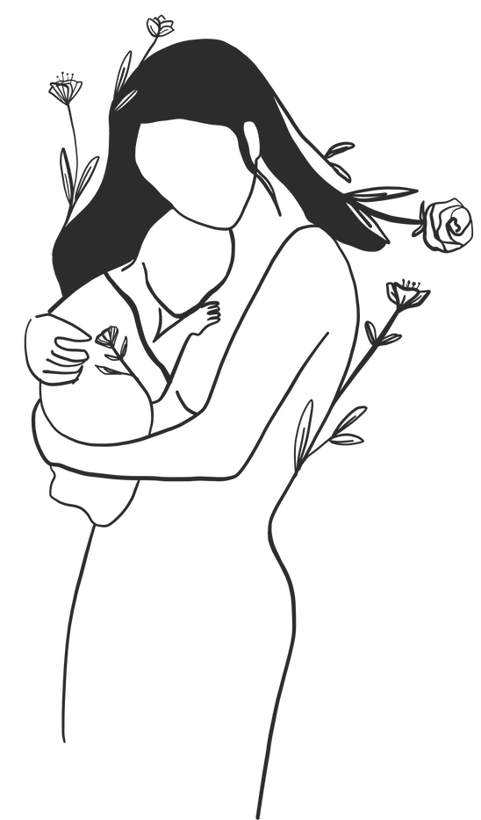
PROJECT GOALS
  To develop knowledge on how to protect infant health by preventing maternal depression by understanding the relationship between PPD and TL.
  To emphasize the importance of the subject by synthesizing the information in the literature

Slide 6
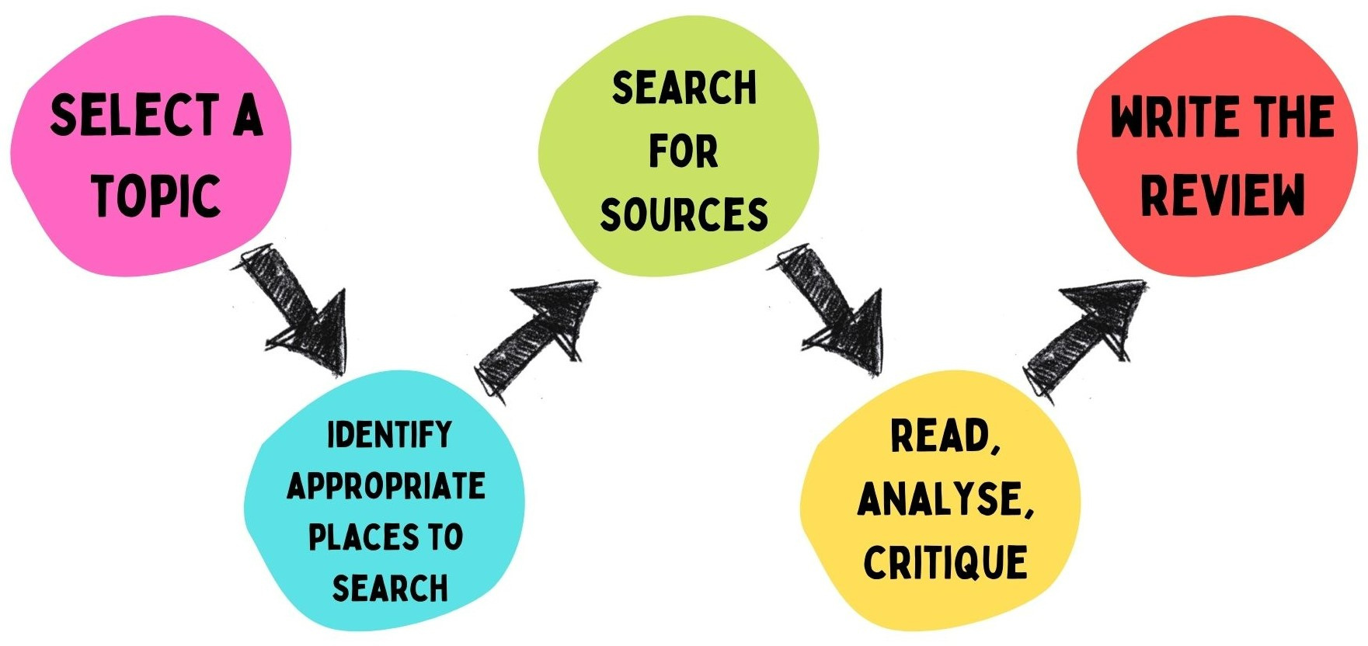
PROCESS

Slide 7

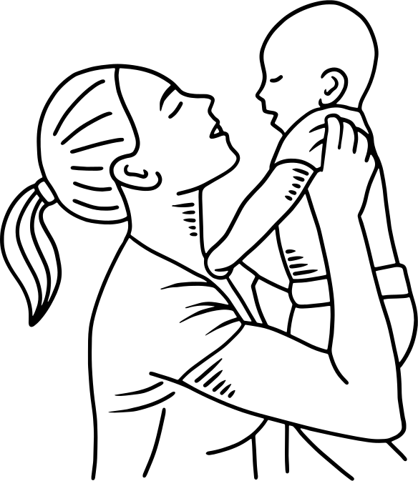
RESULT I
Prenatal and Postnatal Factors Influencing Telomere Length (TL) include:
1.Maternal tobacco use
2. Sleep disorders
3. Health conditions (e.g., hypertension, gestational diabetes)
4. Nutrition
5. Stress, Anxiety, and Depression

Slide 8
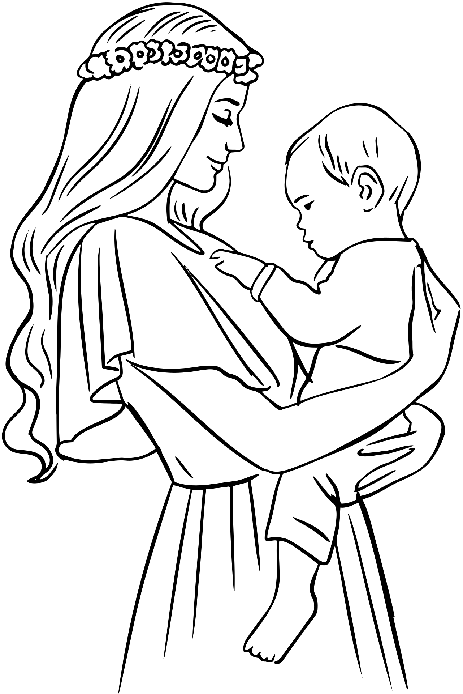
RESULT II
  Children who experience maternal depression are more likely to have significantly shorter telomeres, putting them at greater risk for both physical and psychological health issues.
  Awareness-based programs, such as yoga and meditation, alongside promoting healthy lifestyle behaviors, show promise in mitigating the negative effects of stress and depression on TL

Slide 9

CONCLUSION
Health inequalities appear to begin in the earliest months of life.
Therefore, more effective maternal mental health interventions are essential to prevent health inequalities across the lifespan.
Maternal resilience can protect against the harmful effects of prenatal stress on TL, suggesting that strong psychological resilience in mothers may positively influence their child’s telomere biology.
Improving maternal mental health and well-being during pregnancy is essential for both mother and child.

Slide 10

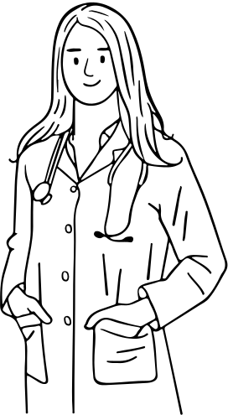
RECOMMENDATION
  Early identification and assessment of pregnant women experiencing stress and depression
  Provide appropriate interventions and health monitoring for both mothers and infants.
  Incorporate biological markers, such as TL, into the study of PPD.
  Longitudinal and follow-up studies should also be conducted to explore the long-term impacts of maternal mental health on child development.

Slide 11

CULTURAL EXCHANGE
Cultural differences
1. Healthcare/health insurance
2. Prenatal and postpartum periods.
3. Education
4. Nursing workplace

Slide 12
THANK YOU
A special thanks to Dr. Cristina Cenciarelli, and Elizabeth Evans, MSS, for bringing us together and creating an environment that mixes learning with fun.

Slide 13


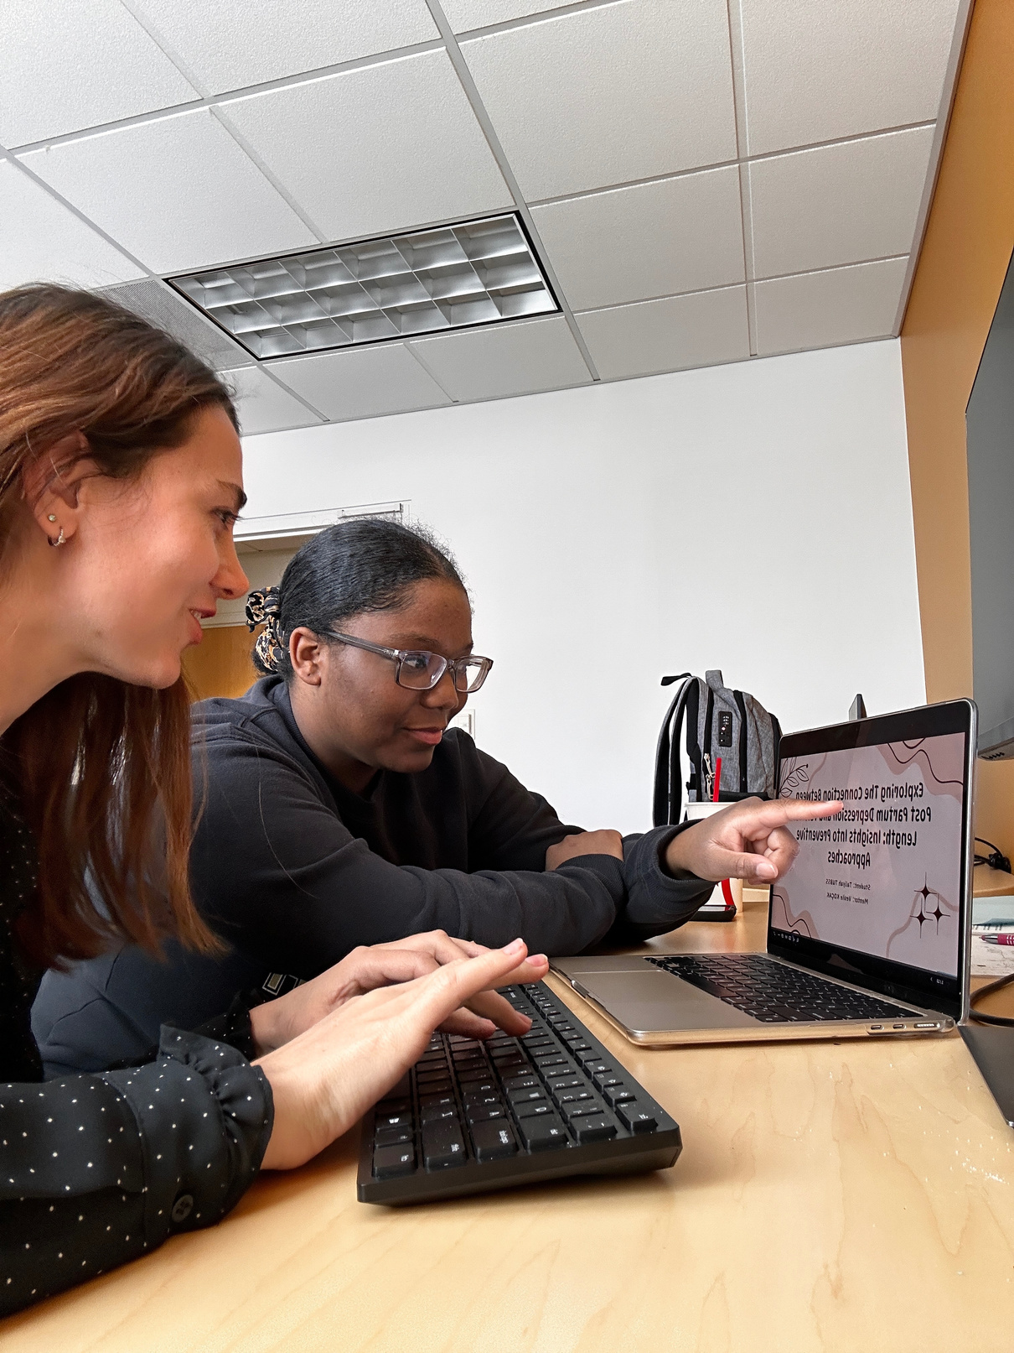
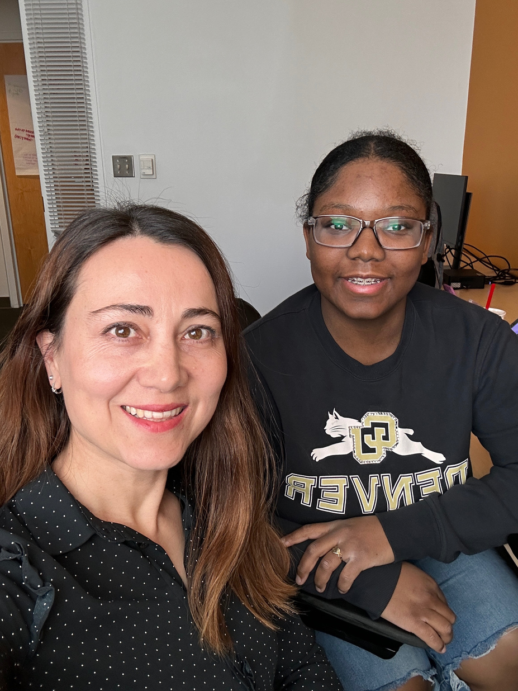

Slide 14
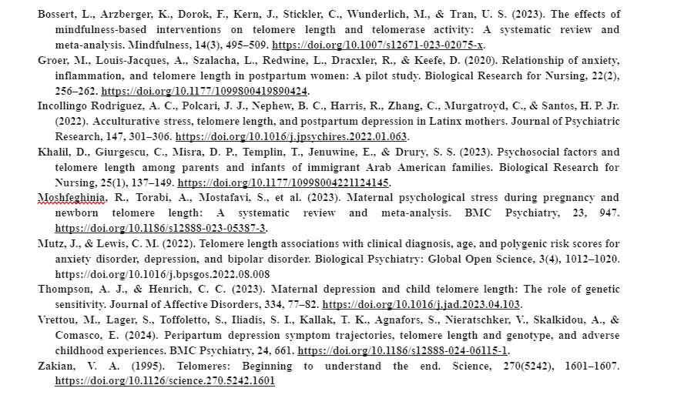

REFERENCES
Notes:
hey hey yeh y

