Slide 1
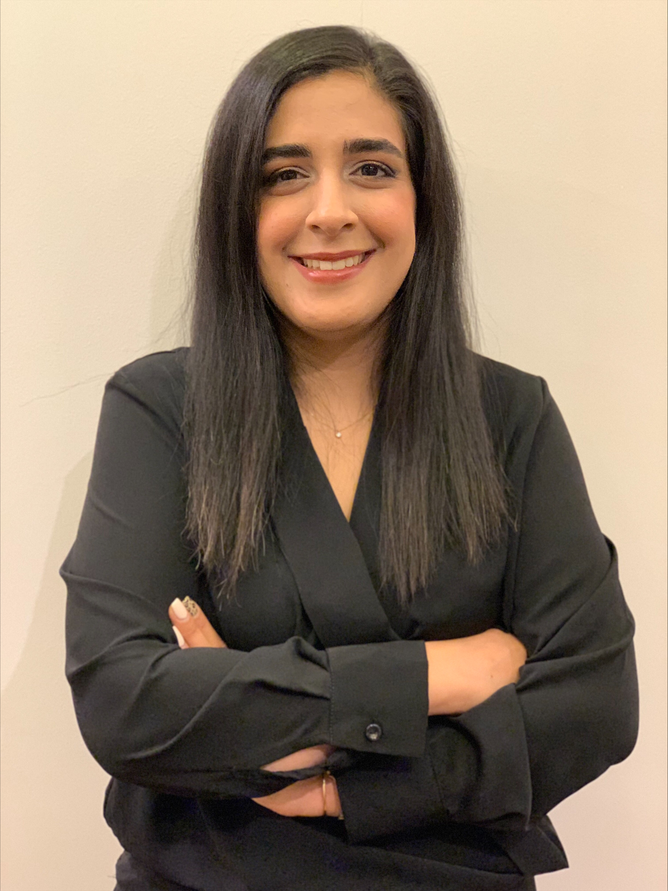
Endocrinology and Type II Diabetes Research
Undergraduate Student Elizabeth Markova & Researcher Marjan Rezaei

Slide 2
Endocrinology and Type II Diabetes Study (SIB Trial)
Approximately 38 million American have diabetes and approximately 90-95% of those people have Type II diabetes.
Diabetes has been seen mostly in adults over the age of 45, but has recently been more and more seen in teenagers, children, and young adults
Type II Diabetes is different from Type I, Type I occurs when the pancreas does not produce insulin or makes very little insulin, a person may develop Type II
Type II diabetes is caused by multiple factors including: inactivity, gestational diabetes, age, weight, genetics, being overweight, family history, and polycystic ovary syndrome.
Type II diabetes may cause heart disease, stroke, high blood pressure, narrowing blood vessels, foot problems, eye problems/loss of eyesight, and kidney disease.

Slide 3
Endocrinology and Type II Diabetes Study (SIB Trial)
The SIB Research Trial focuses on intestinal permeability in diabetes and metabolic disorders in humans.
Increased intestinal permeability is reported to cause obesity, metabolic syndrome and non- alcoholic fatty liver disease.
Impaired intestinal function has been seen to increase to antigens that can trigger autoimmune destruction of beta cells
The goal of the SIB Trial is to see what possible interventions/medications can improve the intestinal barrier integrity may decrease chronic inflammation and risk for diabetes and its complications, including cardiovascular disease.
The SIB trial uses a receptor agonist and a placebo to see the effects that both may have on the intestinal barrier in regards to intestinal permeability, chronic inflammation, and cardiovascular disease in Type II Diabetes

Slide 4
My Contribution/Understanding (SIB Trial)
Coming in I had very little knowledge about the research process and basic knowledge of Type II diabetes
Through this opportunity I learned about the different phases of research/approval of medication. Before a trial begins, an idea of a new medication is given, it is then tested on animals for side effects, possible outcomes, and to observe how the medication functions.
The phases of the trial include:
Phase 1: The medication is tested on a small population of healthy people to test for side effects, how the medication gets out of the body, what the medication does, and how the medication functions
Phase 2: The medication is tested/given to a small population of patients who have the disease the medication is meant to treat, the side effects and functions of the medication are observed.
Phase 3: The medication is tested on a larger population of patients for side effects and function, it is then sent to be approved by the FDA.
Phase 4: The medication is approved and is put on the market, large populations of patients are examined to observe the impact/influence of the medication and how it affects patients. The medication is compared to previous medications used to observe the effect.

Slide 5
My Contribution/Understanding (SIB Trial)
I also have a better understanding of the consent process and how important consent is to a research trial and the importance of protecting patient’s information and rights.
Through a pharmacy student, I learned about the history of diabetes medication and the different types of diabetes medications that exist.
I learned what intestinal permeability is and how it affects those who have it and how it may affect those with Type II diabetes
I learned more about how diabetes affect the body and the different organs that are affected
I had the opportunity of shadowing Marjan on a SIB trial, where i learned about the process of the trial and how the patient visits are carried out
I got to see the process of recruiting patients for the study and what is looked for when recruiting patients.

Slide 6
Cultural Exchange that Occurred
During the experience I had the opportunity of getting to know my researcher, Marjan.
It was such a pleasure working with Marjan and getting to know more about her culture and experiences.
Marjan told me about how college in her country is very much different from college in America. It was very interesting to learn more about her college experience as I am a college student myself.
Marjan and I also exchanged stories about our college experiences and I got to share stories about my Eastern European family
It was a great experience and allowed for me to see into other cultures and to get to know Marjan and many other amazing people

Slide 7
Thank You To Everyone!
I would like to begin by thanking Marjan for taking me in and for being my researcher. Marjan has been a great mentor and has taught me a lot about the Type II diabetes studies and gave me the opportunity to shadow her and give me a further insight on trials. I would also like to thank her for everything she has taught me and for creating an amazing and welcoming space for me to learn.
I would like to thank Cristina and Elizabeth for organizing this opportunity and for helping me through this process as it has been a new experience for me. It was such a pleasure working with them and I would like to thank them for the opportunity they provided me with.
I would like to thank everyone in the Endocrinology and Type II Diabetes Unit for being very welcoming and for always helping out/sharing their knowledge with me to help me learn more.

Slide 8
Thank You!

