Slide 1
Methylation-Controlled J Protein and Cell Migration
Ana Gijon Van Linden
ISCORE – Fall 2023
Notes:
Introduction to MCJ protein, mitochondria, scheme of immune cells → methods → CD8 cells and tumor → flow before and after purification

Slide 2
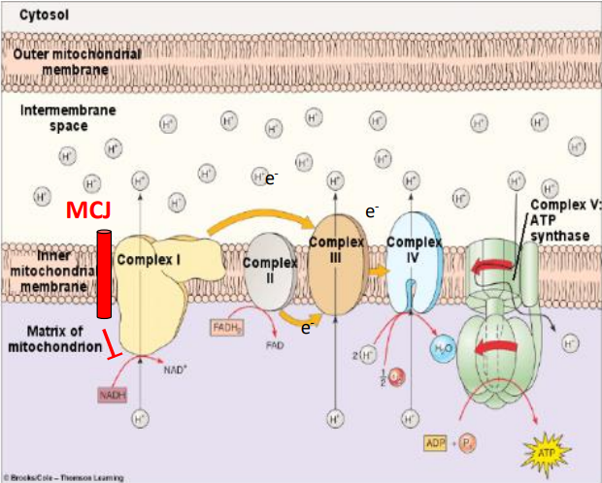
Introduction to MCJ
MCJ is a membrane-bound protein that associates with Complex I in the ETC
MCJ activity results in inhibition of Complex I and lessened cell respiration
Loss of MCJ expression results in Complex I activity and higher ATP production.

Slide 3
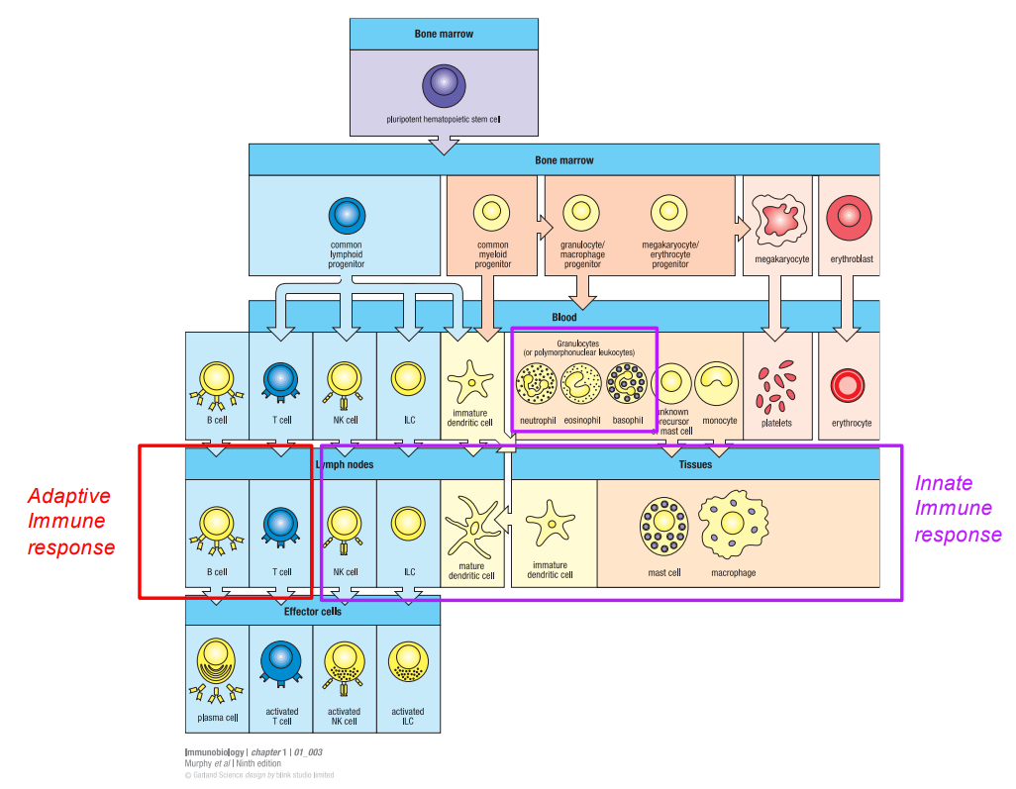
CD8+ T-Cells
T-cells are immune cells essential for adaptive immunity
Different types of T-cells exhibit different glycoproteins, carrying out different roles.
CD8+ T-cells are cytotoxic (killing) cells
Attack infected cells and tumor cells
Release perforin and cytokines such as IFN-γ, TNF, and IL-4

Slide 4
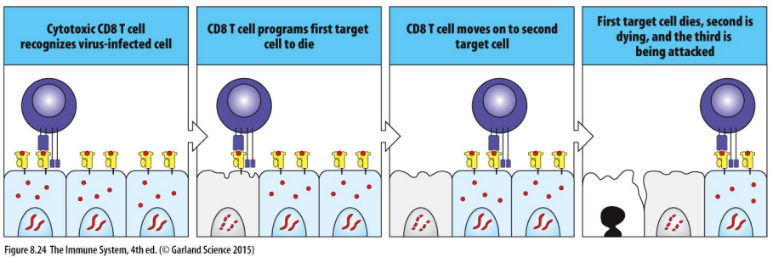
MCJ and CD8+ T-Cells
How does eliminating MCJ in CD8 T-cells increase their killing activity?
Removing ETC inhibitors greatly increases ATP production
ATP is required for secretion and motility
Effectively fighting tumors relies on infiltration of affected tissues

Slide 5
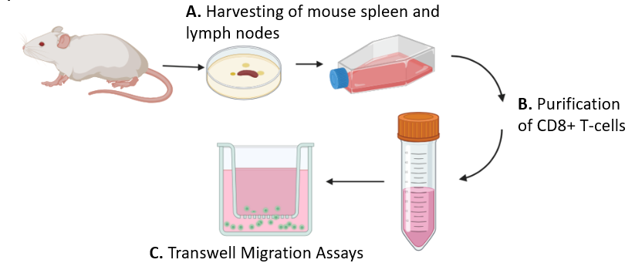
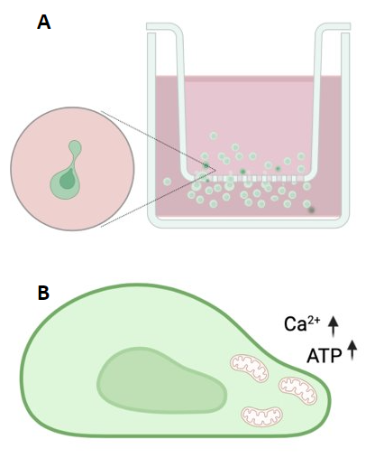
Techniques
Purification of CD8+ T-cells from mouse lymph nodes and spleen
Activation of CD8 cells using α-CD3 and α-CD28
Flow cytometry
Immunostaining
Migration assays

Slide 6
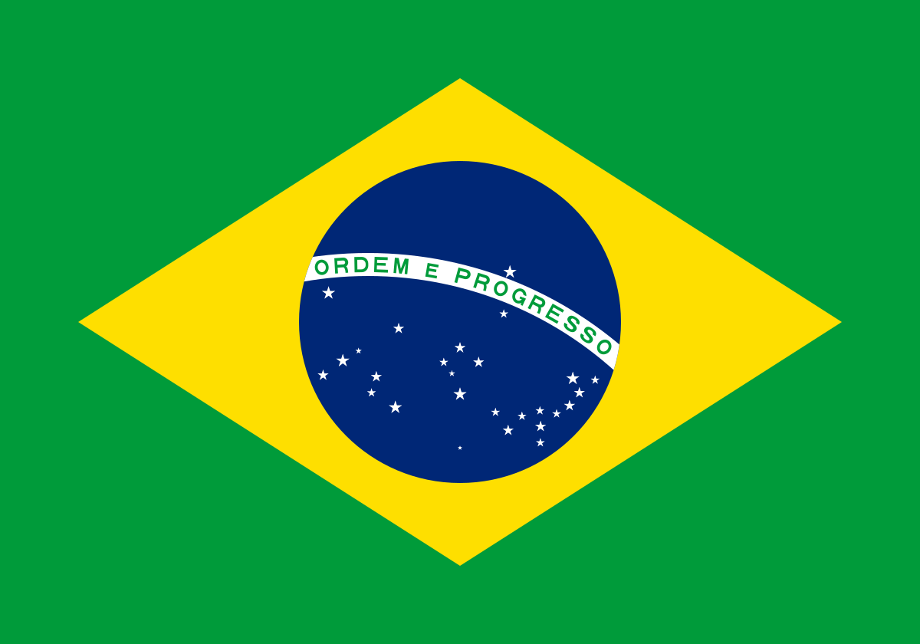
Cultural Takeaways
Although Portuguese and Spanish are mutually intelligible in writing, spoken words can be tricky
Some foods are shared, but not as many as I was expecting
Public transportation here is much worse
We talked a lot about family and a little bit about differences in support and independence between the U.S. and our native countries

Slide 7
Special Thanks
Dr. Mercedes Rincon, for letting me into her lab
Qian and Ashley, for explaining things with great patience and letting me observe some of their research
Fahima, for guiding me through cell purification and helping with this presentation
All other members of Rincon lab (and other labs), for helping me make sense of everything
Dr. Felipe Valenca Pereira, for being an amazing and patient mentor

