Slide 1
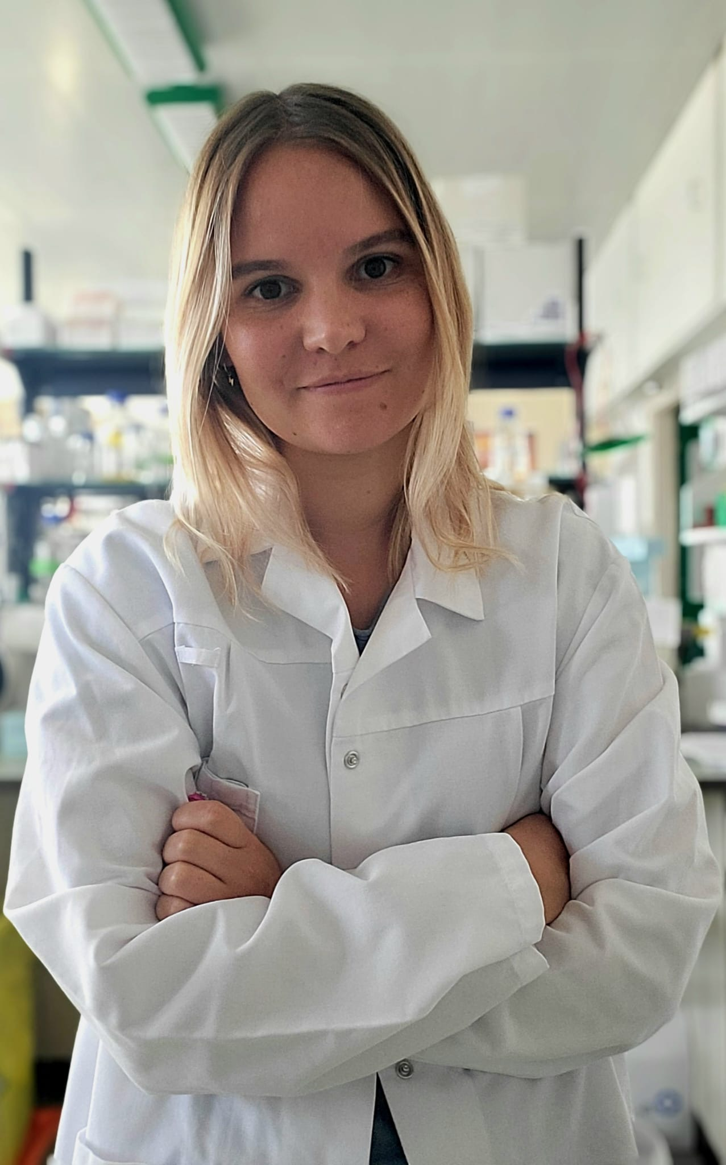
15-PGDH Inhibition in Human Cardiac Fibroblasts Mckinsey lab
Student: Sharall Ashini Virginia Withanage
Scholar: Julia Bertazzo
Scholar: Marion Delaunay

Slide 2
Project introduction
15-PGDH Project
Genotyping
histology

Slide 3
Project introduction
15-PGDH Inhibition in Human Cardiac Fibroblasts
We are now expanding the understanding and effects of Eicosanoid degradation inhibition in the context of heart disease.
In the heart, the increase of eicosanoids have shown to be beneficial.
Prostaglandin E2 is one of the eicosanoids that can be elevated because of 15-PGDH degradation.
Notes:
.

Slide 4
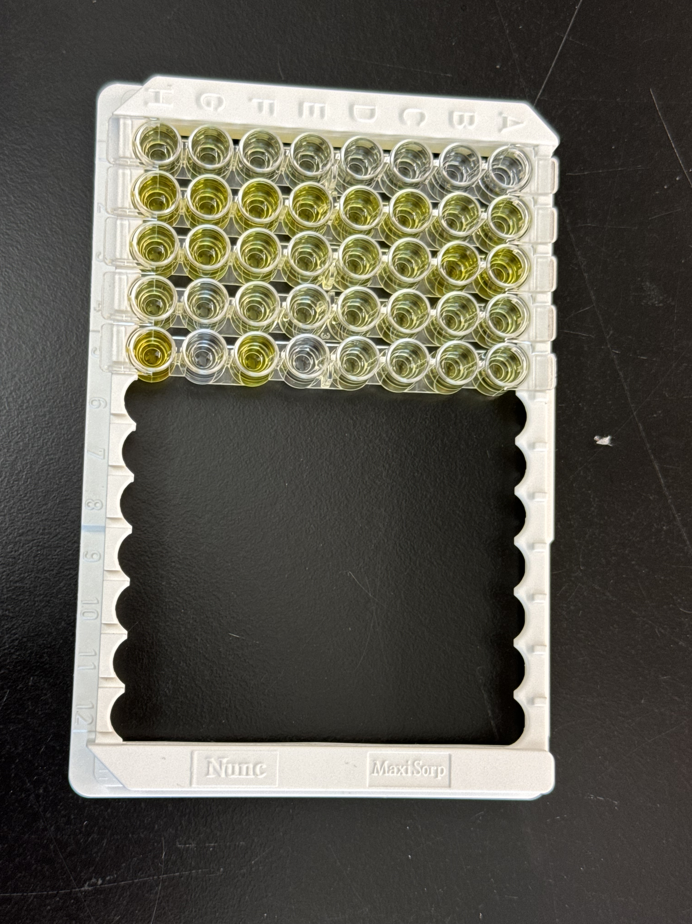
Techniques
Enzyme linked immunosorbent assay (ELISA)
An ELISA is a lab test used to detect and measure substances like proteins, antibodies etc in a sample.
The ELISA carried out measured the amount of prostaglandin in the sample.
Prostaglandin is a type of eicosanoid, which are small molecules of fat.
How was this carried out?
A plate containing a specific antibody that identifies prostaglandins was used.
The sample was then added. If the sample consisted of prostaglandins, it would then bind to the antibody.
A Prostaglandin E₂ AChE Tracer was added to detect and measure the levels of prostaglandin. This provides a color change, signifying the concentration of the prostaglandin based on the color intensity.

Slide 5
Techniques
Polymerase chain reaction (PCR) - Genotyping
PCR is a lab technique used to amplify a specific segment of DNA.
The Cre-LoxP system was used to modify the DNA particularly in manipulating genes by rearrangement, deletion or insertion.
LoxP sites are essentially short, specific fragments of DNA sequences that are used to surround DNA that we want to modify.
Cre is the enzyme used to recognize these LoxP sites and acts on the DNA we want to modify.

Slide 6
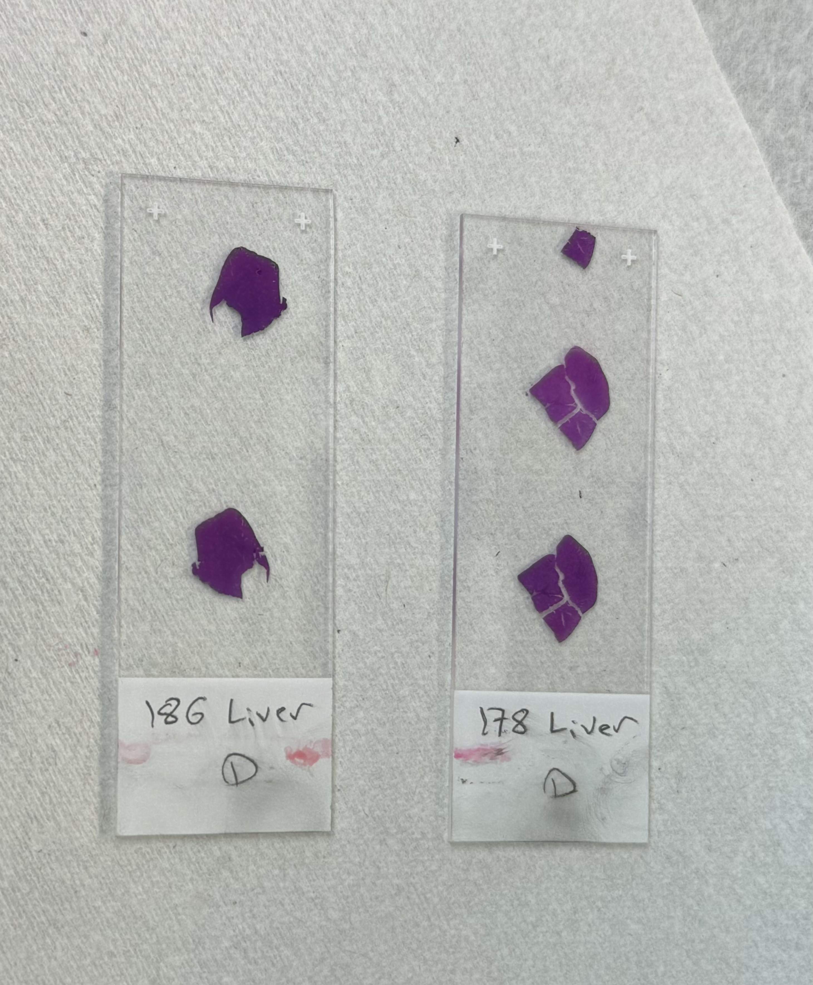
Techniques
Histology
Histology is the study of tissues under a microscope.
Staining using mouse liver samples
Histoclear II was used to dewax the paraffin from the tissue samples.
Two different dyes were used to stain the samples; Hematoxylin and Eosin (H&E)
Hematoxylin usually stains the nucleus of the cell in dark blue or purple.
Eosin stains the cytoplasm and some other parts of the tissue in pink.
This helps pathologists identify diseases like infections or cancer.

Slide 7
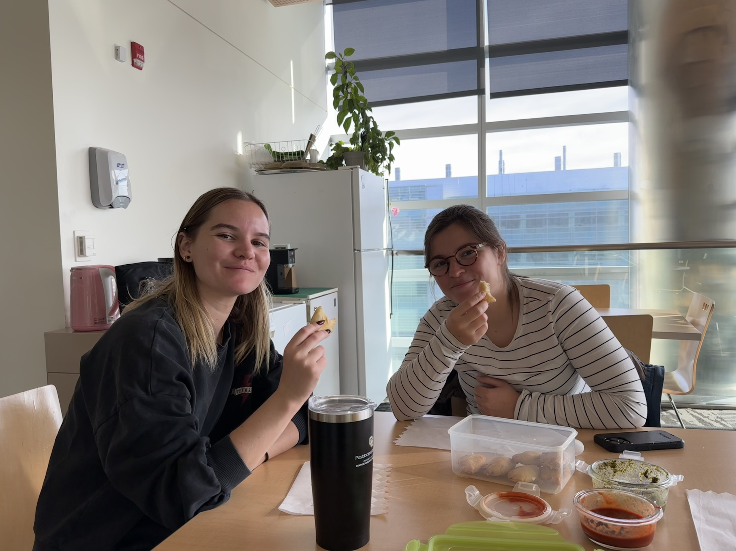
CULTURAL EXCHANGE
Food is easily one of the most vital aspects of cultural exchange.
As a Sri Lankan in Colorado, I’ve not come across any Sri Lankan restaurants or stores, so I took it upon myself to make an easy Sri Lankan short eat called Pattis.
Julia, Marion and I also discussed the different education systems.

Slide 8
THANK YOU
I would like to express my sincere thanks to Julia and Marion for their great mentorship and to the McKinsey Lab group for providing me with such a welcoming environment. I would also like to thank Dr. Cristina Cenciarelli and Liz Evans for this great opportunity and for leading me through this experience.

