Slide 1
Promoting Trainee Wellness and Mental Health
Dr. Sharon L. Milgram
Director, Office of Intramural Training & Education
National Institutes of Health
www.training.nih.gov
On Twitter @NIH_OITE

Slide 2
We Train Thresholders…
Who may be dealing with complicating contextual factors, beyond the normal stress of doing science
Financial strain, including food and housing insecurity
Extent of support network and/or family challenges
Membership in marginalized communities
1st generation college/graduate student
International status
Impact of past or recent trauma
[Chronic] illness, including emotional/mental health concerns
Culture/atmosphere of program/lab
News events, both nationally and internationally
Who are smart problem-solvers who have accomplished a lot in their (relatively) short educational careers

Slide 3
Three Overlapping Goals
To help trainees appreciate the link between stress management/wellness and school/career/life success
To help trainees work through acute stressors with minimal disruption of their academic and research progress
To better prepare ourselves to deal with more serious mental health concerns that impact some members of our community
Requires three things:
That we frame this as a wellness, not an illness, issue
substantial personal and culture change at all levels
Collaboration between PIs, trainees and institutional resource staff

Slide 4
Resilience
The ability to navigate difficult situations with intention and ease; the ability to adapt and grow through adversity
To be resilient we have to:
Find community and engage with peers and mentors
Be proactive and use resources to thrive
Find purpose day-to-day
Understand and acknowledge negative emotions
Have strategies for dealing with distorted self-talk and imposter fears
Develop our growth mindset
Practice holistic self-care
NOTE: A group is only as resilient as the individuals that make up that group and resilience starts at the top

Slide 5
Two Resilience Videos
https://www.pathlms.com/ashg/webinars/5264 (From ASHG webinar series)
https://videocast.nih.gov/summary.asp?Live=34801&bhcp=1 (from a workshop on resilience for NIH trainees)

Slide 6
To Make Wellness a Part of the Research Culture We Have To…
Decide - ourselves and as a community - that wellness is a priority for us, our research group and our community
Have and articulate a conceptual model/definition of “wellness”
Grounded in the view that “to do well, we have to be well”.
Identify multiple points where wellness information/ activities can be highlighted or integrated into research group, program and department activities
Develop comfort with using wellness language with trainees, faculty and staff

Slide 7
Holistic Health and Self-Care
Body
Mind
Heart
Spirit
Requires paying attention to physical, mental, emotional, and spiritual wellbeing.

Slide 8
Wellness Assessment - Body
Never 1…………..2…….…….3……….……4…....…..5 Always
I am getting enough sleep (7-9 hours)
I am eating balanced, nutritious meals
I avoid excessive use of caffeine
I avoid excessive use of alcohol and others drugs of abuse
I am getting regular exercise (at least 3 times a week)
I am getting regular health care for myself
I take care of myself when I am sick, need rest, or just need a break

Slide 9
Wellness Assessment - Mind
Never 1…………..2…….…….3……….……4…....…..5 Always
I avoid getting caught up in perfectionism
I focus on the present vs. rehashing the past or worrying about the future
I avoid negative or deceptive self-talk
I practice self-affirmations and positive self-talk
I avoid judging myself compared to others
I give myself time to explore and learn about new things
I am open to counseling as a tool to maintain and improve my health and wellbeing

Slide 10
Wellness Assessment - Heart
Never 1…………..2…….…….3……….……4…....…..5 Always
I’m in touch with and let myself feel all my emotions
I reach out to others for support when I need it
I communicate my needs and feelings directly and honestly
I make time to spend with my friends and ‘family’
I engage in activities that are fun and relaxing
I avoid extreme use of my phone as a coping tool/ avoidance strategy
I demonstrate compassion for myself and others

Slide 11
Wellness Assessment - Spirit
Never 1…………..2…….…….3……….……4…....…..5 Always
I feel connected to something that is bigger than me – however I define that
I seek out resources (practices, activities, people, places) that nurture me spiritually
I reflect on and invest in what is meaningful to me
I read writings or watch media that are inspirational to me
I think of and care about the lives of others who are different than me
I allow time to just be (human being vs. human doing)
I engage in activities that support my life’s purpose

Slide 12
So……
Where are you doing well? Where might you improve?
What about the wellness of your research group/program?

Slide 13
Stress
Physical, mental or emotional pressure or tension
DISTRESS is negative stress
Can be short- or long-term – feels unpleasant
Causes anxiety or concern and can lead to mental and physical problems
Perceived as outside of one’s coping abilities
Decreases performance
EUSTRESS is positive stress
Short-term, moderate – can feel exciting
Motivates, focuses energy
Perceived as within one’s coping abilities
Can improve performance

Slide 14
Fallout from Stress
Significant decline in school or work performance; impacts on individual progress and team science
Missing classes or work
Working excessively, but not smartly
Not dealing with critical responsibilities and deadlines
Unable to successfully navigate difficult conversations and group dynamics
Isolation and withdrawal

Slide 15
Common Signs of Distress (I)
Verbal
Directly talking about the issue
Raising an issue, but minimizing it
Denial of real problems, “It’s fine, I’m fine”
Excessive and unreasonable self-blame
Excessively rapid or abnormally slow speech
Incoherent speech
Respiratory and related changes
Hyperventilating, rapid breathing or breathlessness
Sweating or dizziness

Slide 16
Common Signs of Distress (II)
Changes in appearance
Hygiene, self-care
Weight gain or loss
Changes in energy level
Excessive fatigue or subdued
Manic restlessness or hyperenergetic
Emotional signs
Changes in affect, emotional presentation
Flooding with emotion
Extreme mood changes
Feelings of helplessness, hopelessness
Significant irritability

Slide 17
Common Signs of Distress (III)
Cognitive signs
Confused thinking
Difficulty concentrating
Excessive worrying, fears
Physical presentations
Somatic complaints
Sleeping or eating too little or too much
Self-medicating, such as with alcohol, drugs, electronics
Self-injury

Slide 18
Mental Illness
Cognitive, emotional, or behavioral problems that lead to significant impairment, distress, and/or an inability to cope with the ordinary demands of life
The severity of illness can vary from mild to moderate to severe and can change over time
Efforts to cope with the mental illness can lead to maladaptive behaviors
Individuals may have a dual diagnosis and suffer from more than one mental illness at a given time
Many people exhibit some symptoms without mental illness

Slide 19
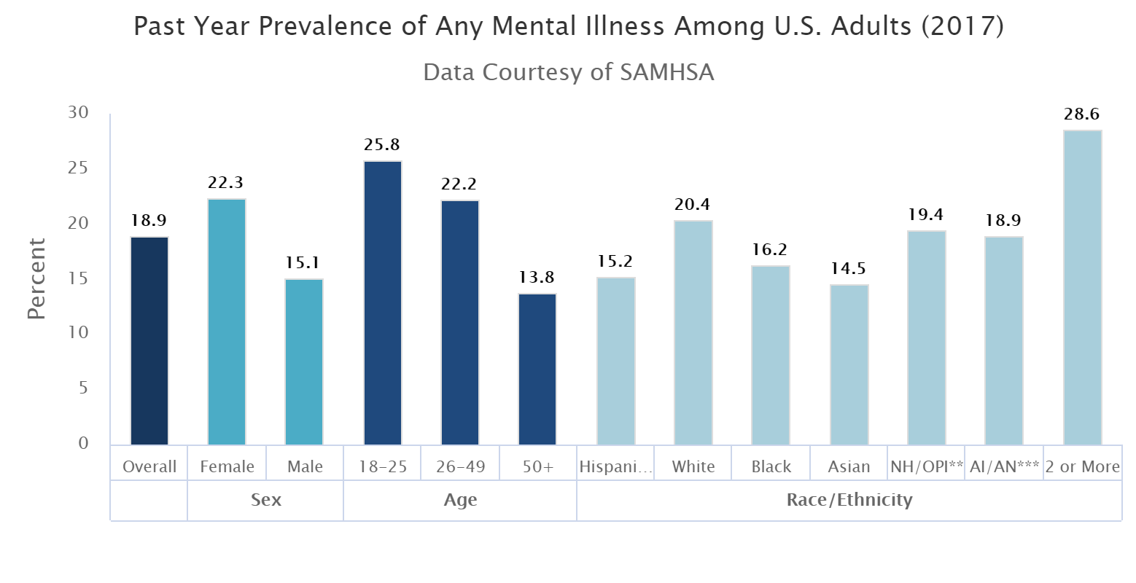
Any Mental Illness
Any mental illness (AMI) is defined as a mental, behavioral, or emotional disorder. AMI can vary in impact, ranging from no impairment to mild, moderate, and even severe impairment.

Slide 20
Anxiety
Persistent or extreme worries or fears that can be overwhelming and that impair normal functioning
The fear is disproportionate to the reality and the anxious person has difficulty having perspective
Anxiety can result in
Emotional distress
Physical symptoms
Cognitive distortions
Behavioral maladaptation

Slide 21
Types of Anxiety
Anxiety can be generalized or very specific in nature
Generalized Anxiety Disorder (GAD): excessive, recurring worry about life routines and situations including health, work, and social interactions
Phobias: intense fear of or aversion to specific objects or situations
Obsessive Compulsive Disorder: repetitive, unwanted, intrusive thoughts (obsessions) and irrational, excessive urges to do certain actions (compulsions) to stave off imagined harms
Panic Disorder: recurrent, unexpected and sudden periods of intense fear accompanied by physical and psychological symptoms
Social Anxiety Disorder: fear of social or performance situations

Slide 22
Depression
A common, serious mood disorder that can interfere in the ability to work, eat, sleep, socialize, or otherwise participate in one’s life
Episodic periods of a decrease in energy or happiness levels from typical or baseline
Negative thoughts and perspective on self and the world
Persistent feelings of sadness and worthlessness
A lack of desire to engage in formerly pleasurable activities often leading to withdrawal
Exhibiting helplessness or hopelessness

Slide 23
Types of Mood Disorders
,
Major Depressive Disorder: characterized by severe symptoms that affect how you feel, think, and handle daily activities
Bipolar Disorder: also known as manic-depressive illness, is a brain disorder that causes unusual shifts in mood, energy, activity levels, and the ability to carry out day-to-day tasks
Mania: characterized by high energy and activity levels and extreme elation
Dysthymia: a persistent, chronic form of depression, not as severe as major depressive disorder
Seasonal Affective Disorder: the onset of depression during the winter months
Postpartum Depression: full-blown major depression during pregnancy or after delivery

Slide 24
PIs and Program Staff Are Critical ’First Responders’
We need resources to respond and refer appropriately
We need to stay in our lane

Slide 25
First Principles
People have a universal human need too be seen, valued and heard for who they are
Our goal is to make our trainees feel seen, valued and heard - and that is no easy feat because one size does not fit all
This is further complicated by
the power differential between PIs and trainees/program directors
various contextual factors, individual personalities and identity issues
the fact that we need to get work done

Slide 26
Things I Try To Keep In Mind
Many problems can’t be solved; however, they can be respectfully acknowledged
“Whoever does the work, does the learning”
Means putting aside my tendency to want to tell them what to do
And two tips for getting a more complete story
Sitting in silence (or allowing them some time to cry without jumping in)
Asking ‘How’ and ‘What’ questions rather than ‘Why’ questions

Slide 27
Helpful Communication Strategies (I)
Show appreciation for their trust in you
“Thank you for sharing that”
Listen actively
Give your full attention and indicate that you are engaged
Reflect back what you heard to confirm understanding
Encourage sharing with open- vs. closed-ended questions
Keep the focus on them and where they are at at the moment
Do not jump into problem solving/fix-it mode too quickly (or at all)
Allow pauses and time for them to gather their thoughts
Encourage them to be a part of the solution
Do not immediately share a story as this discounts their experience
Acknowledge the difficult emotions that come up
Allow expressions of emotions without an immediate cut-off

Slide 28
Helpful Communication Strategies (II)
Acknowledge the difficulty or challenge
“That must have been really hard for you; I’m so sorry that happened.”
Express genuine interest
“Tell me about the career workshop you went to”
“How was that hike with your friends last Saturday?”
Express confidence in them
“I really think you can do this; you’ve handled hard things before.”
Encourage the use of resources
“Is there anything here at UC or in the community that might be helpful?”
Keep the door open
“Feel free to come back to talk again.”
“Let’s meet again next week, or sooner if you need to.”

Slide 29
Helpful Communication Strategies (III)
Use open and nonjudgmental language
Instead of “Oh, you shouldn’t feel ____.”, try “it is reasonable to feel ________ about the review and …..”
Instead of “Why in the world did you do that?” try ”Can you share your reasoning with me?”
Help trainees determine a better course of action
“What do you think would be a better way to handle this next time?
We all make mistakes; the key is to learn from them. What might you learn from this?”
Be honest and kind, especially when saying hard things
“I know this is hard to hear, but it’s important that we discuss what happened…..”

Slide 30
Know About Internal Resources
In the student’s program
In your Deans Office, Program Offices, etc.
Counseling Center/Student Health Center
Ombuds Office
Wellness and fitness resources
Student health insurance policy
Student affinity groups/interest groups
International office
Title IX office
Important – making a named referral and closing the loop is often the difference between great, good and not so good outcomes

Slide 31
Talking With Students
If they come to you
Thank them for sharing
Acknowledge the difficulty
Help them explore strategies and resources and/or refer to appropriate resources
Explicitly encourage the use of resources
Thank them sharing and set a time to follow up
Close the loop on any resources you referred them to
If you notice behavioral changes that concern you
Use SBI strategy to describe what you have noticed but do not interpret the behaviors you observed
Express your concern for them and their progress in your program; avoid threats and implied threats
Continue as outlined above

Slide 32
Common Barriers To Counseling
Stigma – broadly, in their family, community and in the scientific community
Time away from school/lab
Financial issues
Lack of understanding about counseling in general
Overwhelming to begin the process or a bad experience with counseling in the past
NOTE: PIs have influence on some of these barriers!

Slide 33
A Chance To Practice!
While talking with your student about their lack of progress in your group, the student shares that they recently had a falling-out with their parents over religion. They have not spoken to their parents for several months (they used to talk several times per week) and are angry and upset about what happened. Beyond that, they are concerned about finances since their parents have been helping them out with rent and car insurance payments. The student acknowledges that this stress is greatly impacting their ability to focus on coursework and lab.

Slide 34
PIs vs. Program Directors
Different boundaries, time commitments, responsibilities, and level of comfort discussing health/mental health concerns with their trainees
Best scenario is that the PI…
Listens, acknowledges the difficulty their trainee is facing, and expresses support
Explicitly encourages the use of resources and refers them to the appropriate staff in the program, or other resources in the University
Makes it clear that it is fine that they take time away from research responsibilities to resolve the issue or to attend to their health and well-being

Slide 35
YOU Can Make a Difference If You Know Your Role and Stay In Our Lane
An informed, aware and caring PI and/or program director who knows the signs of distress without over-interpreting them
Not a mental health counselor, social worker, parent, or friend
Someone who:
Listens well
Observes carefully
Helps trainees access resources
Talks directly with students about their health and well-being (while remembering appropriate boundaries)
Models good attitudes and behaviors
Seek advice from experts – early and often

Slide 36
We Are Role Models
Complete a self-care assessment and develop your own self-care plan; also, develop a research group plan
Read articles/blogs/books, and use apps, related to self-care
Attend trainings/workshops on stress management, personal wellness, resilience, mindfulness, etc.
Attend workshops focused on trainee career development and wellness needs; support your staff to do the same
Create a supportive circle of colleagues who focus on more than the science
Create and maintain good working relationships with institutional support staff and systems

Slide 37
Some Things You Can Do
Dedicate a lab meeting, or have a lab retreat, to talk about wellness and work – life boundaries
Attend a workshop together with your research group – here or at a national meeting
Plan a wellness event together with your research group (happy hour is NOT a wellness activity)
Support the development of institutional wellness resources for trainees and staff
Explore your career biases and do something about them
Help bring appropriate management and mentoring workshops to your campus and scientific community

Slide 38
QUESTIONS?

