Slide 1
Becoming a Resilient Learner
Dr. Sharon L. Milgram, Director NIH OITE
milgrams@od.nih.gov
www.training.nih.gov
On Twitter @NIH_OITE

Slide 2
The Stages of Learning
Enthusiastic
beginner
Disillusioned
learner
Cautious
performer
High
Achiever
Competence
Low/None
Some
Moderate
High
Confidence
High
Low
Variable
High
What do you do? What don’t you do?
Adapted from Ken Blanchard, Self Leadership and the One Minute Manager

Slide 3
What is Resilience?
The ability to:
adapt and grow through adversity
navigate difficult challenges with awareness, intention, and skill
find a constructive way forward during challenging time
A set of attitudes and behaviors that can be learned and developed through education, self-reflection, and practice
http://www.apa.org/helpcenter/road-resilience.aspx

Slide 4
Take-Aways
Resilience = People + Process
Those who are resilient prepare to be resilient
http://www.psychologytoday.com/blog/design-your-path/201305/10-traits-emotionally-resilient-people

Slide 5
To Be Resilient We Have To
Learn from previous experiences, both good and bad
Build strong positive relationships with peers and mentors
Be proactive and use resources to thrive
Mayo Clinic http://www.mayoclinic.org/tests-procedures/resilience-training/
in-depth/resilience/art-20046311?pg=2)

Slide 6
To Be Resilient We Have To
Learn from previous experiences, both good and bad
Build strong positive relationships with peers and mentors
Be proactive and use resources to thrive
Be thoughtful about how we approach setback and engage with our negative self-talk (our inner critic)
Mayo Clinic http://www.mayoclinic.org/tests-procedures/resilience-training/
in-depth/resilience/art-20046311?pg=2)

Slide 7
The ABCs
Activating event
Beliefs
Consequences
The stories we tell ourselves
http://www.mindtools.com/pages/article/abc.htm

Slide 8
Some Philosophy To Start
From the work Marshall Rosenberg and colleagues, Nonviolent Communication; www.cnvc.org

Slide 9
So……..
Do you talk like a jackal or a giraffe?
To yourself? To others?

Slide 10
The Stories We Tell Ourselves Are Often…
More negative than the situation warrants
Delivered in jackal language

Slide 11
Two Areas to Consider
Cognitive distortions…. leading to pessimistic attitudes and feelings of hopelessness
Imposter fears…… leading us to feel like we don’t belong
https://tinybuddha.com/blog/change-life-changing-stories-tell-yourself/

Slide 12
Cognitive Distortions/Automatic Negative Thoughts
Characteristic ways our mind convinces us of something that is really not true
Reinforce negative thinking/emotions and generally serve to keep us feeling bad about ourselves
Can lead us to feel very anxious and pessimistic about our situation
NOTE: Our brain has a built-in negativity bias

Slide 13
Some ANT Examples (and a vote)
All-or-nothing thinking: Our performance is either perfect or it is a complete failure
Catastrophizing: We exaggerate the implications of a set-back or mistake
Mind reading: We make assumptions about what someone else is thinking
Fortune telling: We predict the outcome of an event before it happens
Minimizing: We downplay the importance of our accomplishments or positive qualities
Over-generalization: We take one negative event and see other similar events through that failure
Emotional Reasoning: We assume our emotions are a true reflection of the way things are

Slide 14
Imposter Fears
The feeling of phoniness in people who believe that they are not intelligent, capable or creative despite evidence of high achievement

Slide 15
More on Imposter Fears
Four flavors:
Feeling like a fake
Attributing success to luck
Discounting your successes
Assuming you had to work hard and that the equivalent accomplishment was easy for everyone else
Causes:
Being a student
Being in an environment that feels foreign to you
Organizational culture and messaging
Messages from family and childhood
Stereotype threat
Working in a creative field
http://paulineroseclance.com/

Slide 16
Important Message
YOU ARE NOT ALONE! 70+% of individuals experience imposter fears at some point in their educational and work journey.

Slide 17
Impacts of Cognitive Distortions and Imposter Fears
In small doses and put into perspective?
They can make us use resources and work hard
Unchecked and unquestioned? We
experience chronic stress, potentially leading to poor performance
second guess ourselves (in class, on exams, in our research group)
hesitate to ask for help
don’t volunteer for assignments or apply for competitive positions
maintain a low profile in the group
engage in self-sabotaging behavior

Slide 18
Explore Your Self-Talk Now
Use journaling for self-reflection and discovery
Talk about them with mentors and peers
Really getting in the way? Find a counselor, explore why and learn skills for dealing with them

Slide 19
And Deal With Them In The Moment
When you hear them -- take a deep breath, pause and stretch
Acknowledge them and talk back using giraffe language
Appreciate that these “stories” are a part of the human experience, the student experience, and the life-long learner experience
Use your science voice to question them
Find inspiration…… from a positive affirmation, a phrase, an image that makes you feel strong

Slide 20
An Acronym To Help - HATS
Hear your negative self-talk/inner critic
Appreciate you have a choice
Talk back – giraffe language
Seek help and access resources

Slide 21
And Another Strategy
Appreciative Inquiry (AI): A tool for self, group and organizational change that focuses on starting with what is working and using that as a foundation for future development
What did go well? Why did it go well?
What have I learned since the last situation like this?
If I was not afraid, what would I do now?
If I did not have any constraints, what would I do now?
What are the opportunities for growth and learning in this situation?
David Cooperrider, 1980s

Slide 22
Most Important Take Home Message
To do well, we have to be well

Slide 23
Holistic Self-Care
All the things we do, and avoid doing, to care for our….
Body
Mind
Heart
Spirit

Slide 24
Wellness Assessment - Body
Never 1…………..2…….…….3……….……4…....…..5 Always
I am getting enough sleep (7-9 hours)
I am eating balanced, nutritious meals
I avoid excessive use of caffeine
I avoid excessive use of alcohol and others drugs of abuse
I am getting regular exercise (at least 3 times a week)
I am getting regular health care for myself
I take care of myself when I am sick, need rest, or just need a break

Slide 25
Wellness Assessment - Mind
Never 1…………..2…….…….3……….……4…....…..5 Always
I avoid getting caught up in perfectionism
I focus on the present vs. rehashing the past or worrying about the future
I avoid negative or deceptive self-talk
I practice self-affirmations and positive self-talk
I avoid judging myself compared to others
I give myself time to explore and learn about new things
I am open to counseling as a tool to maintain and improve my health and wellbeing

Slide 26
Wellness Assessment - Heart
Never 1…………..2…….…….3……….……4…....…..5 Always
I’m in touch with and let myself feel all my emotions
I reach out to others for support when I need it
I communicate my needs and feelings directly and honestly
I make time to spend with my friends and ‘family’
I engage in activities that are fun and relaxing
I avoid extreme use of my phone as a coping tool/ avoidance strategy
I demonstrate compassion for myself and others

Slide 27
Wellness Assessment - Spirit
Never 1…………..2…….…….3……….……4…....…..5 Always
I feel connected to something that is bigger than me – however I define that
I seek out resources (practices, activities, people, places) that nurture me spiritually
I reflect on and invest in what is meaningful to me
I read writings or watch media that are inspirational to me
I think of and care about the lives of others who are different than me
I allow time to just be (human being vs. human doing)
I engage in activities that support my life’s purpose

Slide 28
Food For Thought
What are you pleased about?
What might you like to work on?
Pick ONE new habit you would like to develop or one current habit you would like to soften/break… what will you do to make that happen?

Slide 29
Now Let’s Talk About the…..
Elephant(s) in the room

Slide 30
To Be Resilient We Have To
Learn from previous experiences, both good and bad
Build strong positive relationships with peers and mentors
Be proactive and use resources to thrive
Develop our growth mindset
Be thoughtful about how we approach setback and engage with our negative self-talk
Do things that bring happiness and meaning to our day, week, month….
Q for U – what brings happiness and meaning to your day, week, month?
Mayo Clinic http://www.mayoclinic.org/tests-procedures/resilience-training/
in-depth/resilience/art-20046311?pg=2)

Slide 31
The Wellness Collage
A way to identify and talk about things that bring happiness and meaning to our lives
KEY TAKE-AWAY: Never under-estimate the things in your life that bring you happiness

Slide 32
How About Your Wellness Collage?

Slide 33
Take Home Message
WHERE WE ARE
NOW
OUR OWN INTERNAL
LANDSCAPE
MENTORS & LEARNING COMMUNITIES
WHERE WE WANT TO GO

Slide 34
Powerful Tools for Change
Community
Journaling
Mindfulness and meditation
Counseling

Slide 35
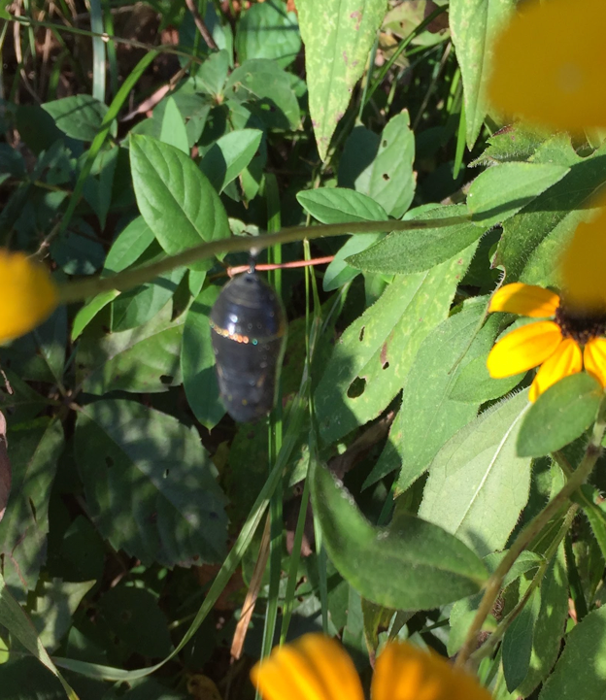
And My Parting Thought

Slide 36
Questions?

