Slide 1
COMIRB as Single IRB

Slide 2
Step #1
Contact COMIRB Director to discuss the proposal
Provide funding proposal
Identify sites
Describe activities taking place at relying sites
COMIRB strives to fulfill the single IRB role, but cannot in every case.

Slide 3
Options
If COMIRB cannot serve as sIRB:
An IRB from one of the other sites may be able to serve, probably with additional expense (they can charge but we cannot)
Budget for a private IRB

Slide 4
Budget
COMIRB is supported by indirect costs
Cannot charge an additional fee for COMIRB serving as sIRB
You can and should budget for additional administrative support the PI will need to manage the study and IRB paperwork for all sites
You may need to budget for monitoring visits to the other sites (e.g., contracting with CReST to tak on this function)

Slide 5
COMIRB Website
Forms:
Guidance: COMIRB as sIRB
Template sIRB Plan
sIRB PI Responsibilities

Slide 6
Smart IRB
What is Smart IRB?
Smart IRB is a network of institutional IRBs (564) who have agreed in principle to rely on one another
23 page reliance agreement

Slide 7
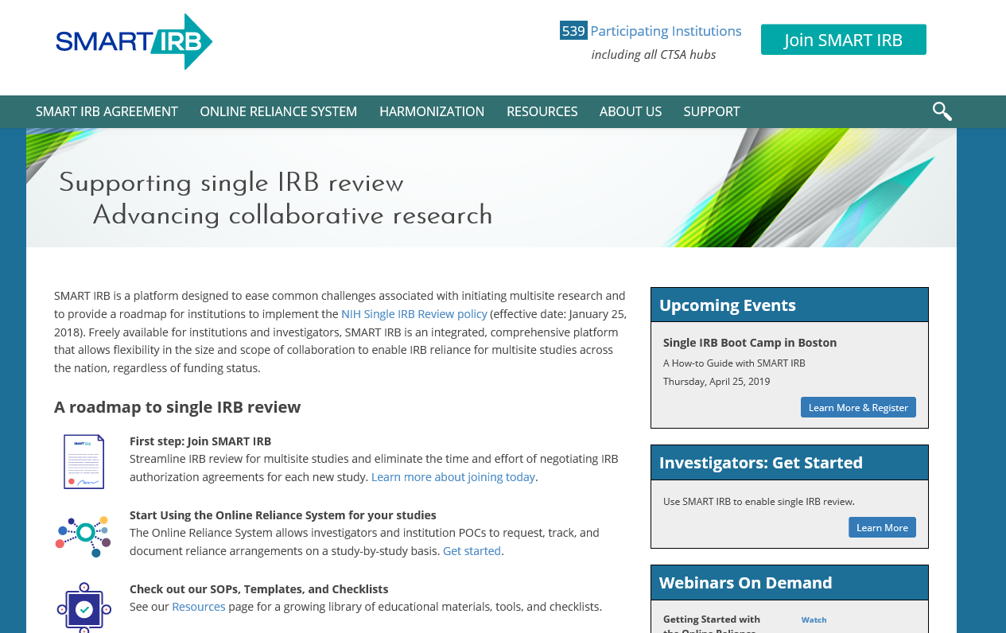
Participating Institutions
Notes:
There are 607 as of 8/8/19

