Slide 1
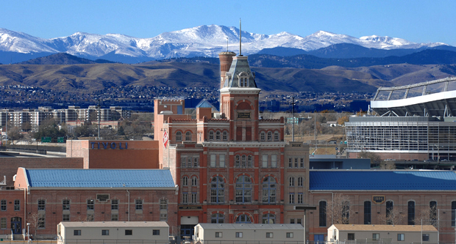
College Council
Winter Presentations
March 15th, 2024
Notes:
TITLE SLIDE:
Change background as needed; more images available at http://ucdenver.webdamdb.com
Change Title and Subtitle as needed
Date updates automatically

Slide 2
Introduction to College Council
The College Council committee is comprised of one representative from each college within CU Denver to serve as a direct liaison between the students of their respective programs to both the college administration and SGA.
Architecture and Planning– Michelle Favorite
Arts and Media – TaTiana Torres
Business – Kanimozhi Sivakumaran
Educational and Human Development – Maura Lorden
Engineering – Abigail Gebremariam
Liberal Arts and Sciences – N/A
Public Affairs – Jessica Valdez
Advisor – Kelsi Dew
Committee Projects
Success Looks Like Me! (or some form of a career panel)
Student Advisory Councils
Know your Student Rights Campaign
Review of 2030 maps for each of our colleges
AHEC Survey

Slide 4
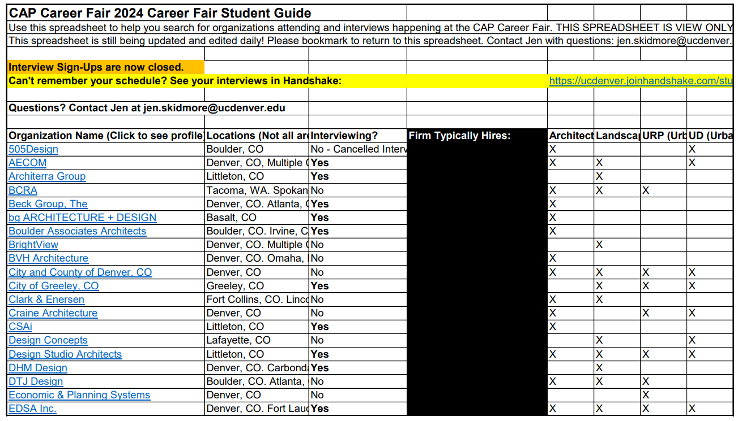
College of Architecture and Planning
Currently Exceling:
Lecture Series
Representation series
Online options & archive
Employer Spotlight
Career Fair
64 Firms presents
Job and internship interviews
Mentorship Program
Professional and Peer
1 hour per month
Portfolio Review & Workshop
Resume Review

Slide 5
CAP Goals
Immediate
Student Advisory
Contact Studio Reps.
Fill roles for 1st year and Transfer students
Address Budget Cuts in CAP
How smaller studios affect classes
Donor recognition
Fabrication Lab Fee
Overall
Create Resource List
Where to find and purchase supplies
Tool Borrowing System
Reduce the out-of-pocket cost for supplies
More recognition of other majors in CAP
Landscape Architecture
Interior Design
Urban Planning

Slide 6
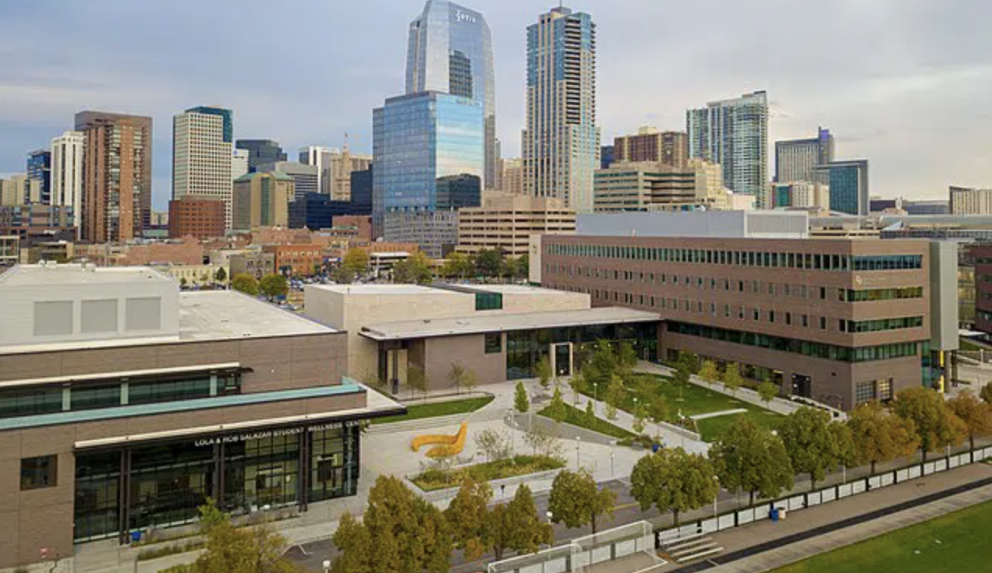
College of Arts & Media

Slide 7
College of Arts and Media
Where We Excell
Where We Can Improve
Nationally top ranked programs
Billboard's Top Business Schools, Best Film Schools in the US & Canada, Top Ranking Animation program, ect.
Honors and accolades among our faculty and staff
Grammy & Oscar nominees and winners
Priority on finding a successful career in the field after graduation
The majors are siloed, and don't encourage a lot of interdisciplinary practice within the classroom
Lack of intermingling between departments
CAM doesn't have a "unified vision", which makes it hard to market our strengths as a single unit
Fundraising has been a major concern for the college, especially with concerns of budget cuts

Slide 8
College of Arts and Media
Goals for the College
Have the Student Advisory Council play a major role with decisions affecting the college
Make sure each department is represented by at least one student
Keep open communication and start foundational work for our new dean, Lucinda Bliss
Create outlined steps for myself or whoever is elected for CAM rep in the fall
Sit down with each department chair to learn more about the different units
Keep working towards a CAM-centered career/internship fair

Slide 9
BUSINESS SCHOOL

Slide 10
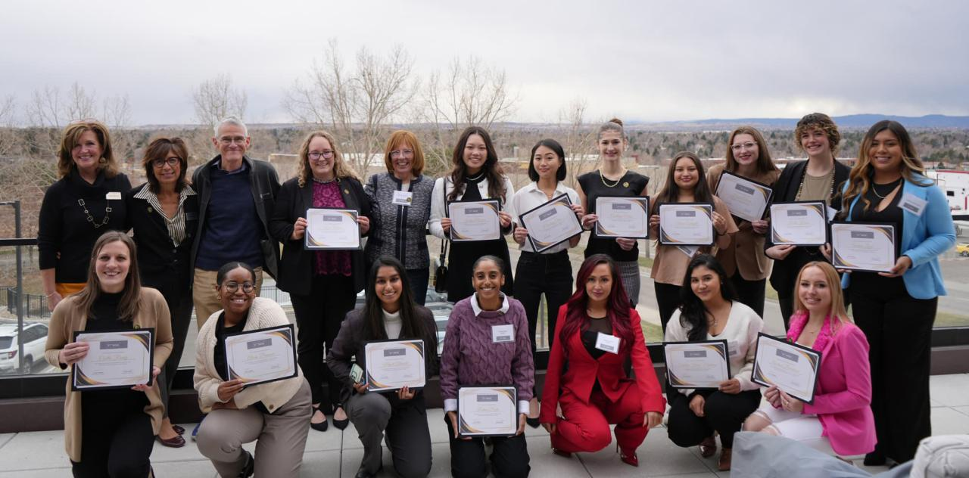
ACADEMIC YEAR GOALS
Building a community.
Increase the quantity and frequency of Advisory Council.
Organize more activities to appreciate students.
Building the Alumni Network members.
Collaborating with Dean's Cabin.

Slide 11
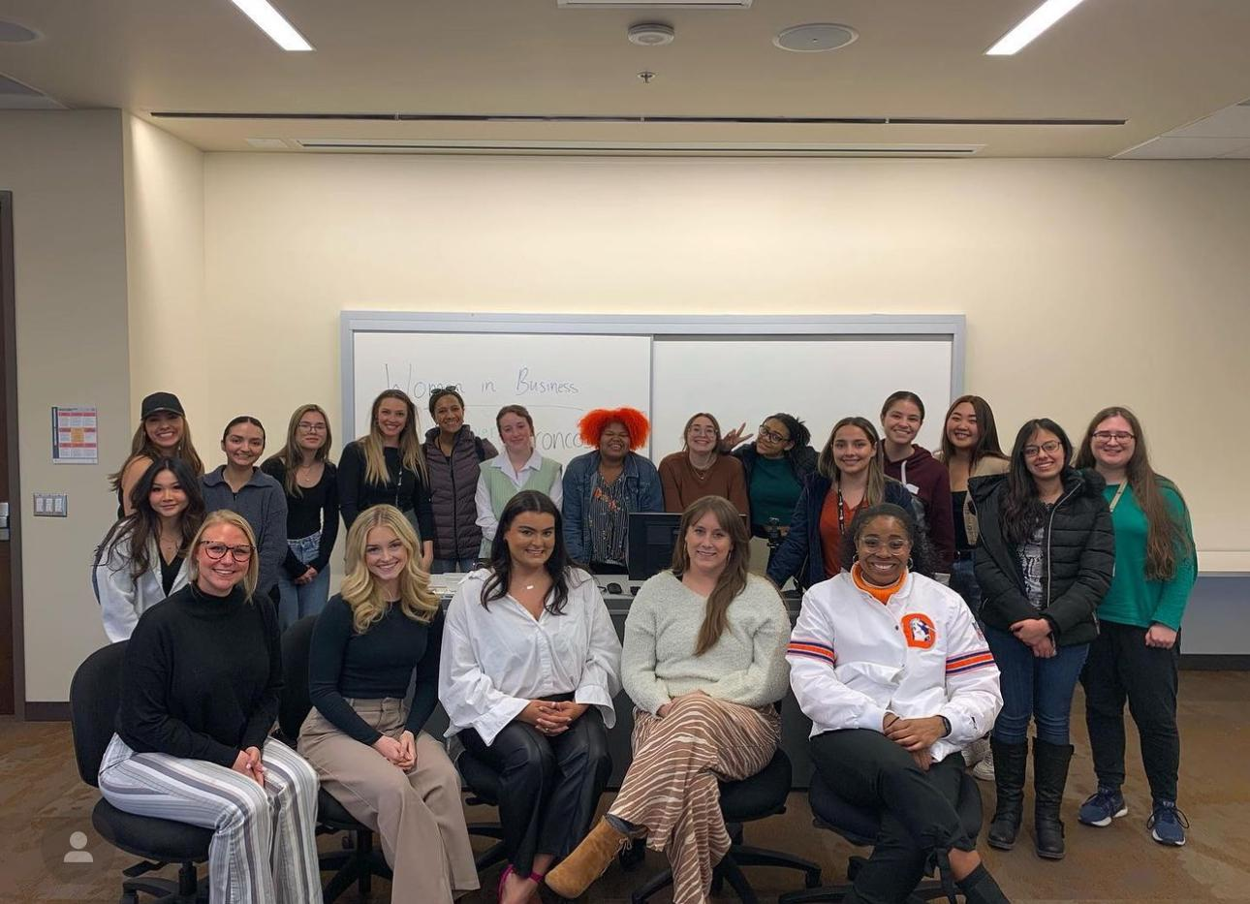
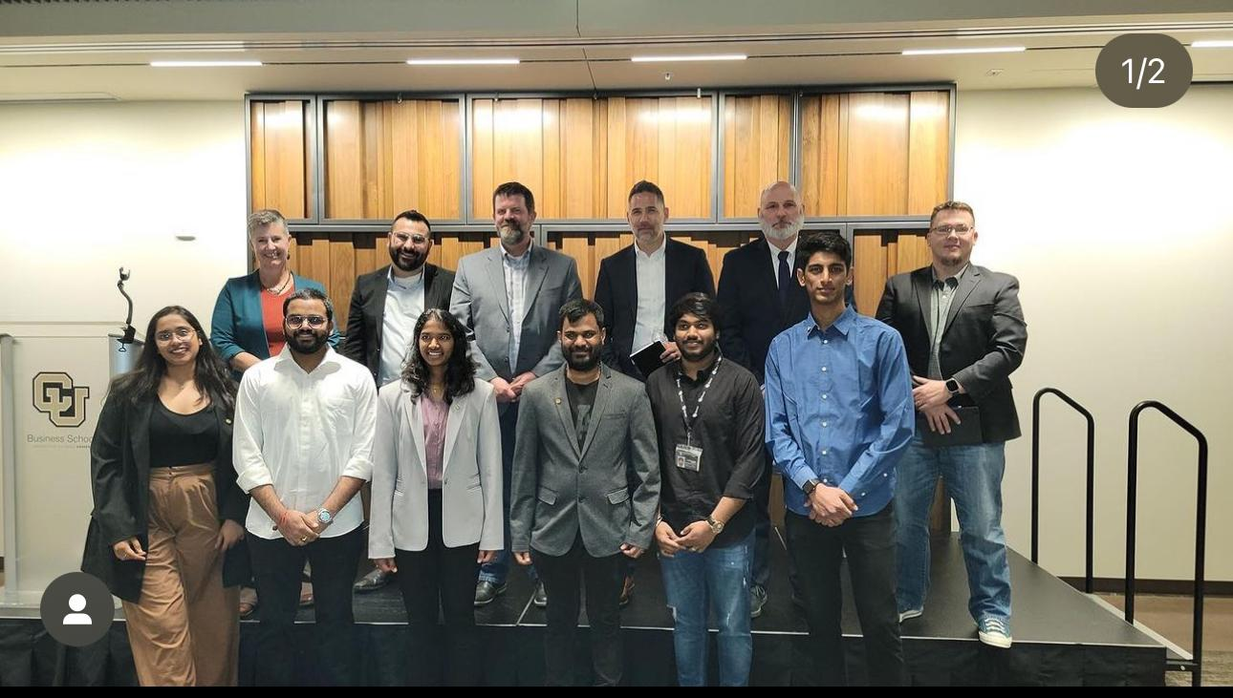
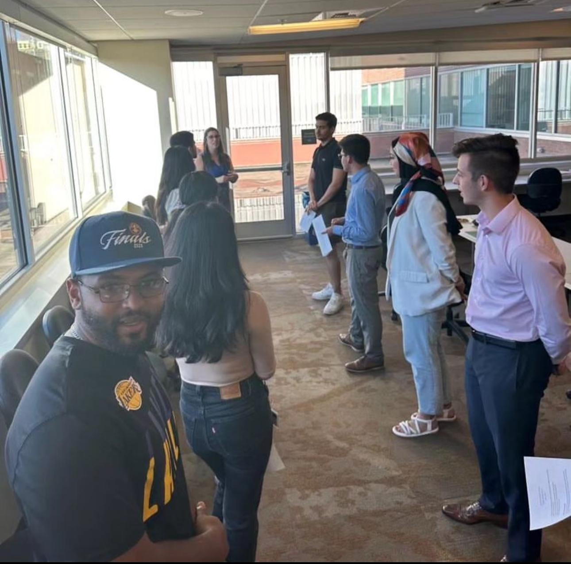
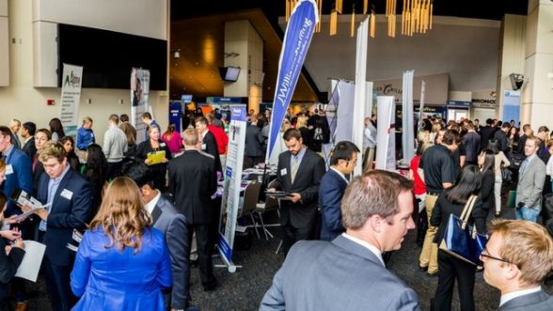
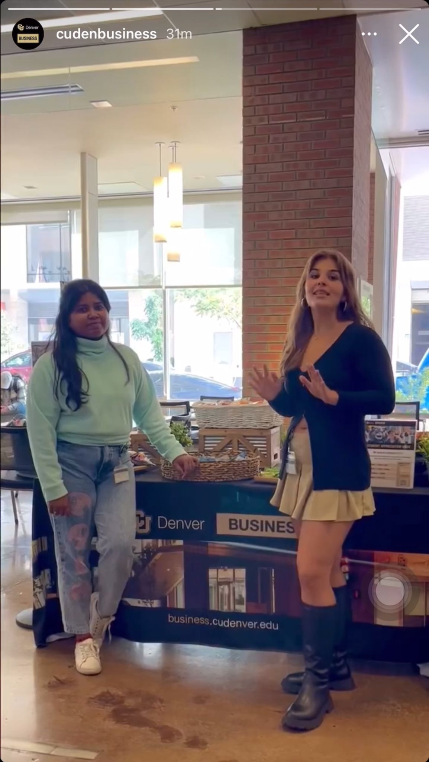
CLUBS & EVENTS

Slide 12
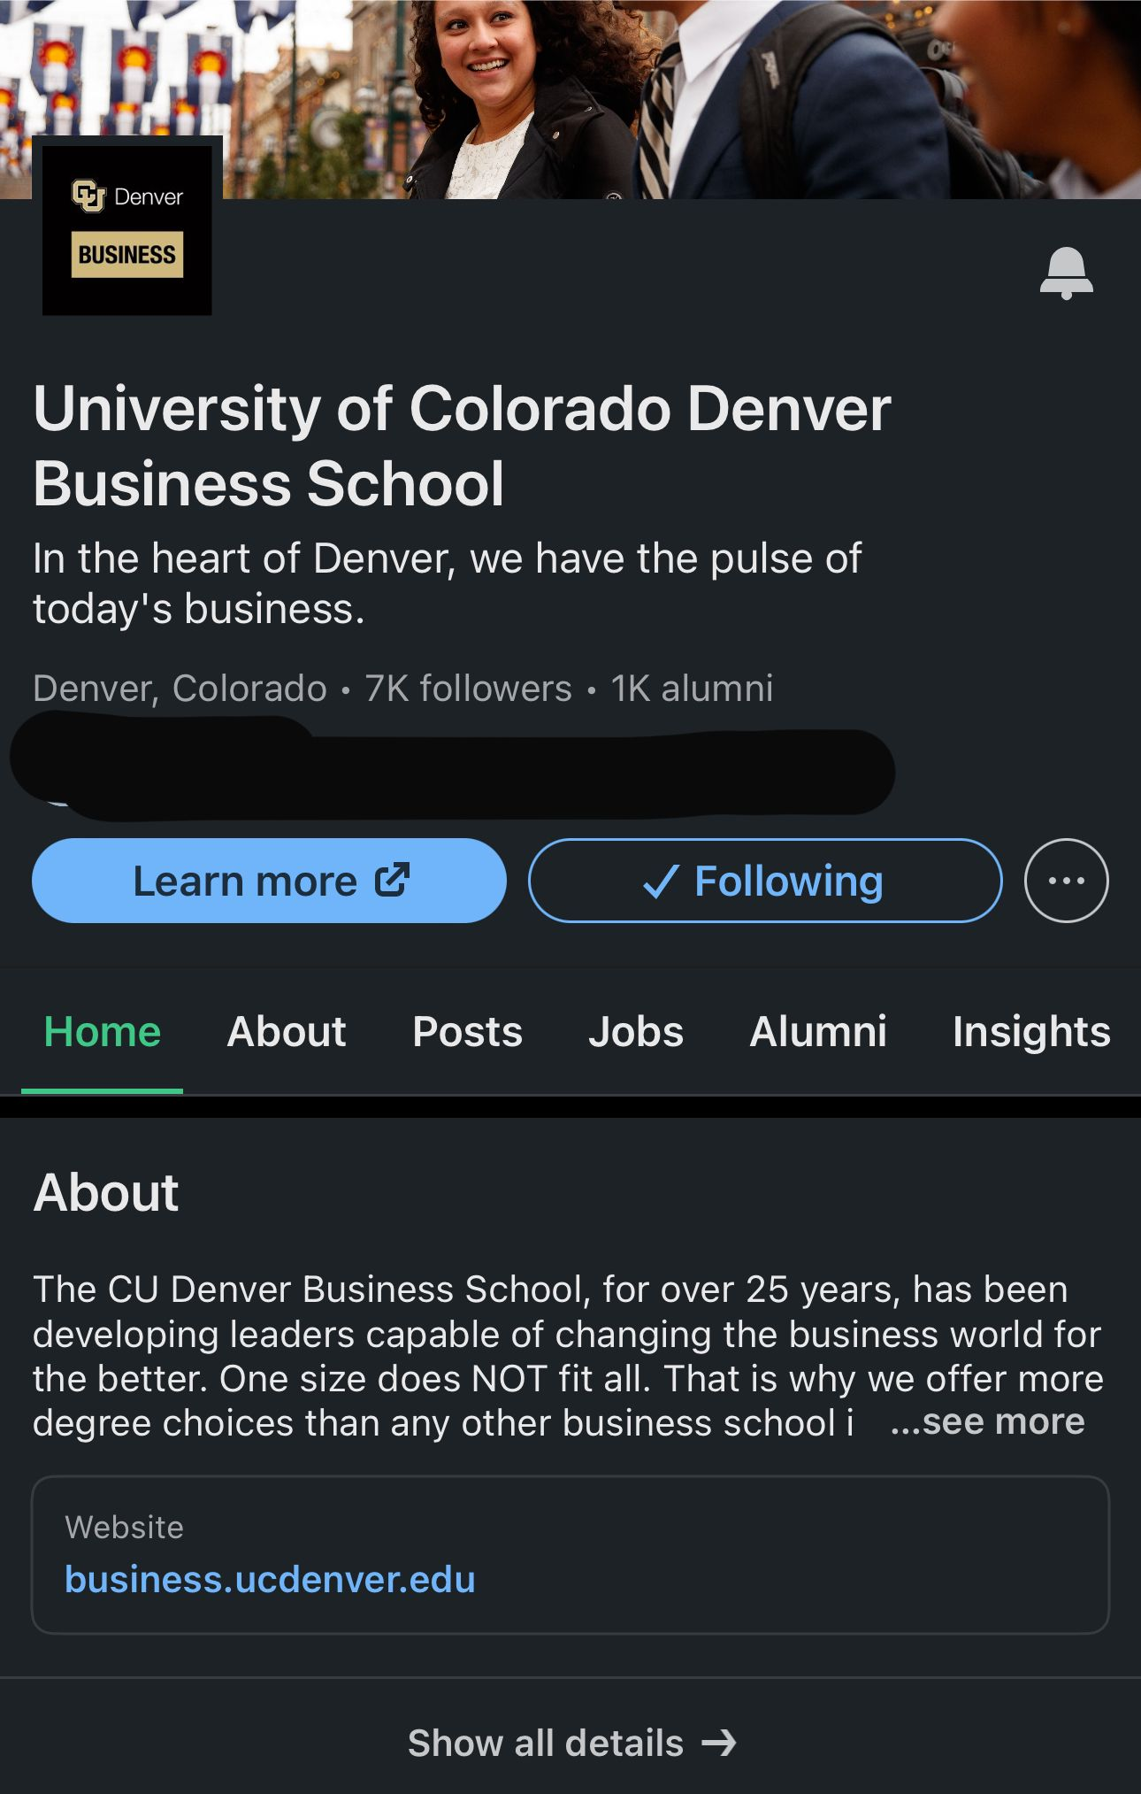
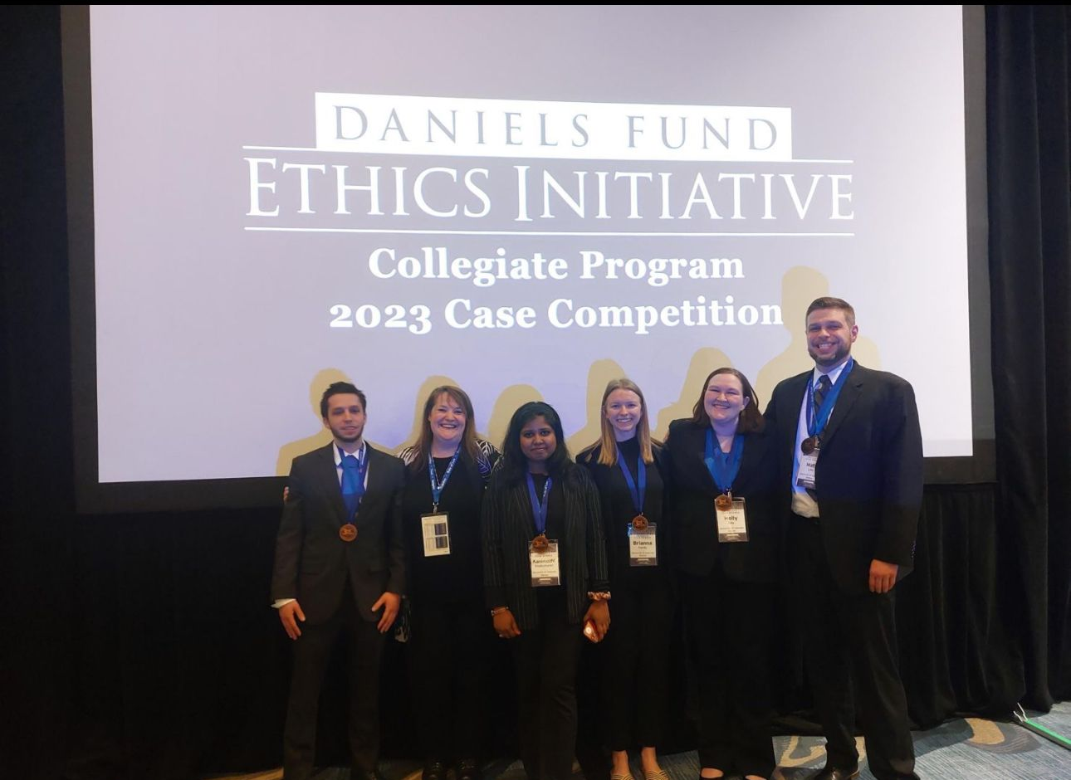
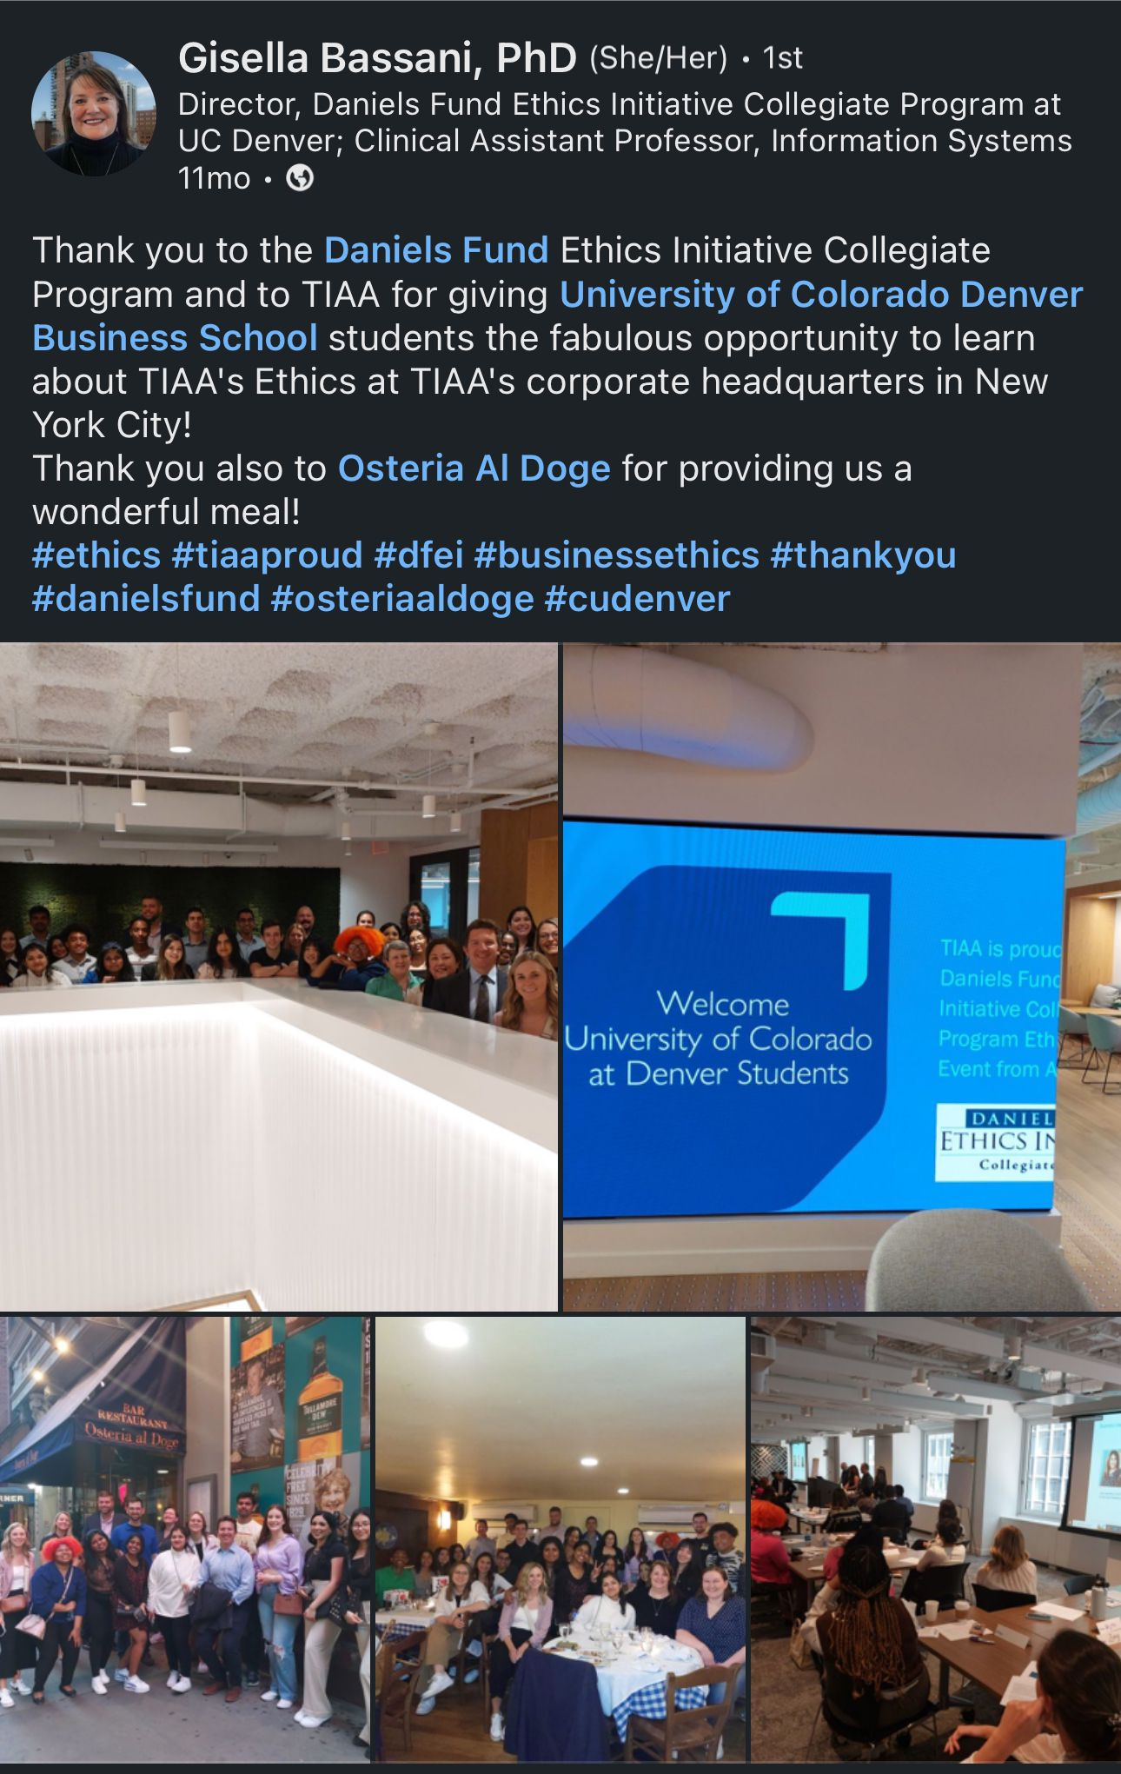
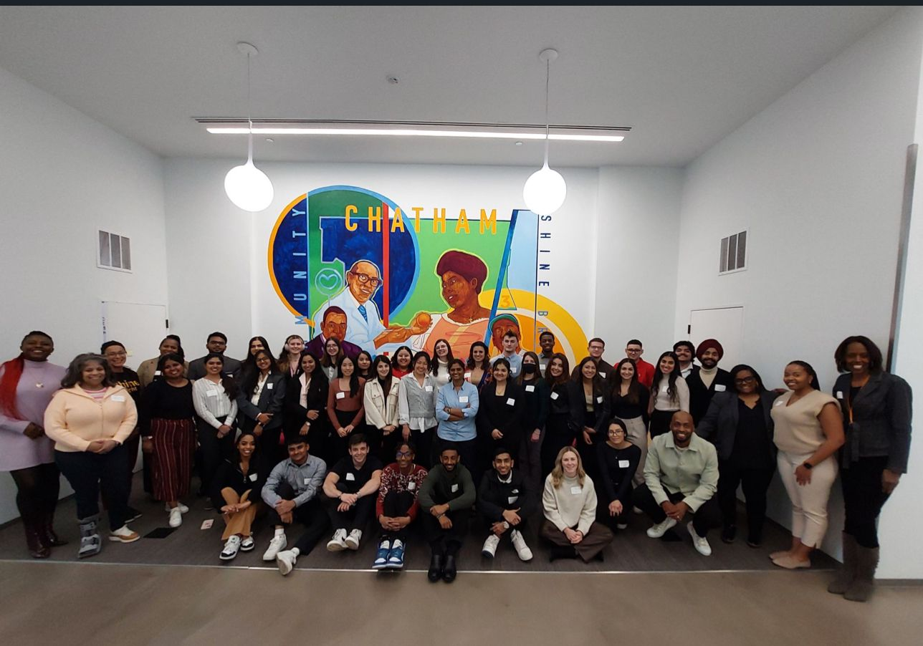
ONLINE PRESENCE / SITE VISITS/ COMPETITIONS

Slide 14
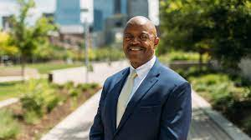
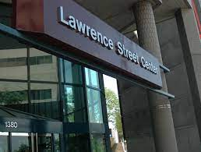
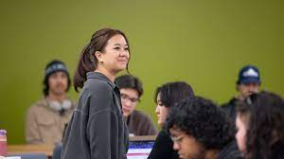
Education & Human Development
University of Colorado Denver
Current Standings
Current Goals
Positive student-professor connections
Strong pipeline of internships
Great "home base"
,,
Student Advisory Committee
Increase a sense of belonging
Advertise SEHD-related clubs
Host a lunch with the dean event
The ultimate goal is to increase student enrollment and retainment!
Notes:
CONTENT SLIDE (1-COLUMN)

Slide 15
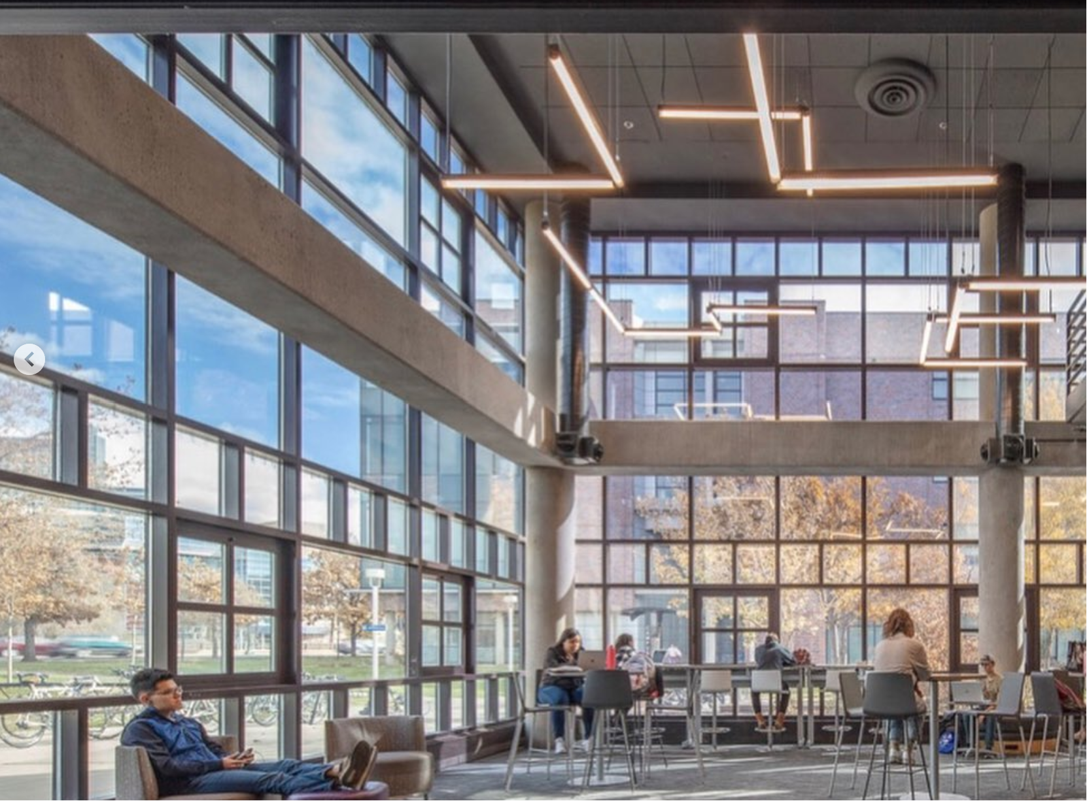

Slide 16
Needs Within CEDC
Dean's Student Advisory Council
More collaboration between departments and Students
Environment for Discussions and Educational Panel sessions
Extended lab hours(CEDC Computer Labs)
More Study Abroad Opportunities
Research & Independent Project building opportunities for Students

Slide 17
CEDC Goals
Short Term Goals
Long Term Goals
Organize CEDC Contact List
Updated Documents
Dean's Student Advisory Council
Engineering Week (Recurring Every Semester)

Slide 18
Progress for achieving goals
Meeting Summaries(Minutes included in documents)
Deans Student Advisory Council: Biweekly, Friday's (3:00-4:00)
Engineering Week:
Highlight each department's program, faculty , students, student organization
Recognize high achieving students, teaching Professor and Research Professor in each department
Overall highlight to be included in CU Denver News
Department Dates: Decision to be made soon
Monday-Friday:
One department per day.
CEDC Website and Social Media Feature for each day of the department
Friday:
The featured department hosts the Panel/Morning session
The Afternoon includes award ceremonies, Speech from Dean and overall featuring of CEDC

Slide 20
School of Public Affairs
College Needs/Concerns:
More in person programming
Community within the College
Networking opportunities
Professional opportunities and internships
Community service opportunities
Connection with the college community after they graduate
Opportunities for both Undergraduate and Master’s students to be involved
Loss of almost all our faculty of color, and overall retention
Questions about the work environment within SPA, treatment of faculty, and lack of transparency.

Slide 21
School of Public Affairs
Goals to address these needs:
Encouraging collaboration when appropriate between student orgs
Hosting a career panel
Creating an alumni network for the student orgs and inviting alumni to meetings/events
Connecting with students about what events they can/want to attend
Planning a SPA Day of Service
Hosting the first SAC meeting
Review of SPA financial data
Meeting with professors to talk about positive/
negative aspects of working in SPA

Slide 22
School of Public Affairs
Progress + Other goals:
APS and APP hosted their first joint meeting and opening meetings to each other’s members
Pizza with a Professor had multiple faculty members from both programs
A career panel is being planned for April
20+ students have signed up to be on a alumni newsletter
SPA Day of Service is planned for April
SAC meeting
Talking with students about how to accommodate their schedules

Slide 23
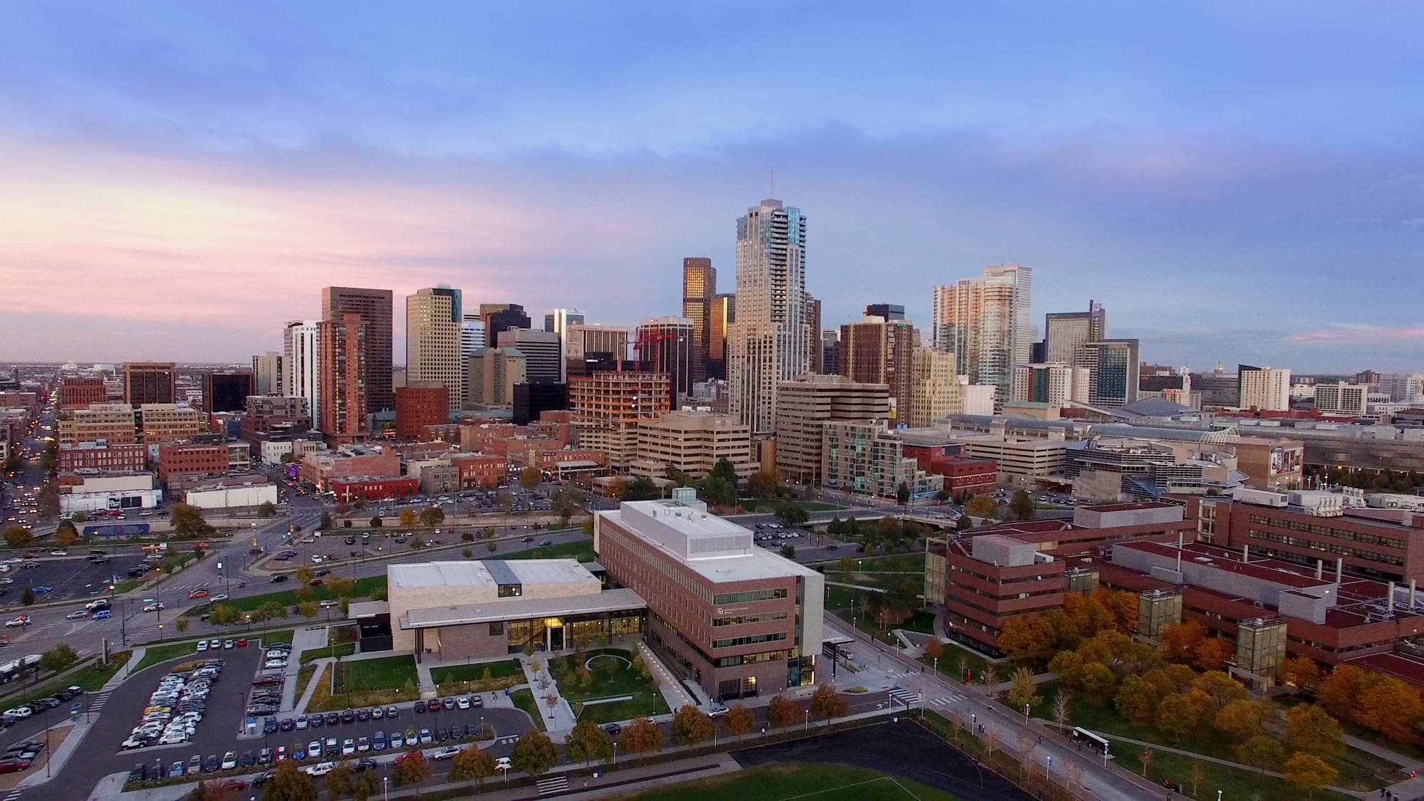
Thank you!
Questions?
Notes:
END SLIDE:
Change background as needed
Change Title and Subtitle as needed
More images available at http://ucdenver.webdamdb.com

